Slide 1
Architectural Barriers:
Creighton University Humanities Building
OTD 457: Phys Rehab III
Group VI: Christin Albright, Khadijah Lane, CJ Neubaum, Taylor See-Palar, Sky Williams, & Alexis Woodie

Slide 2
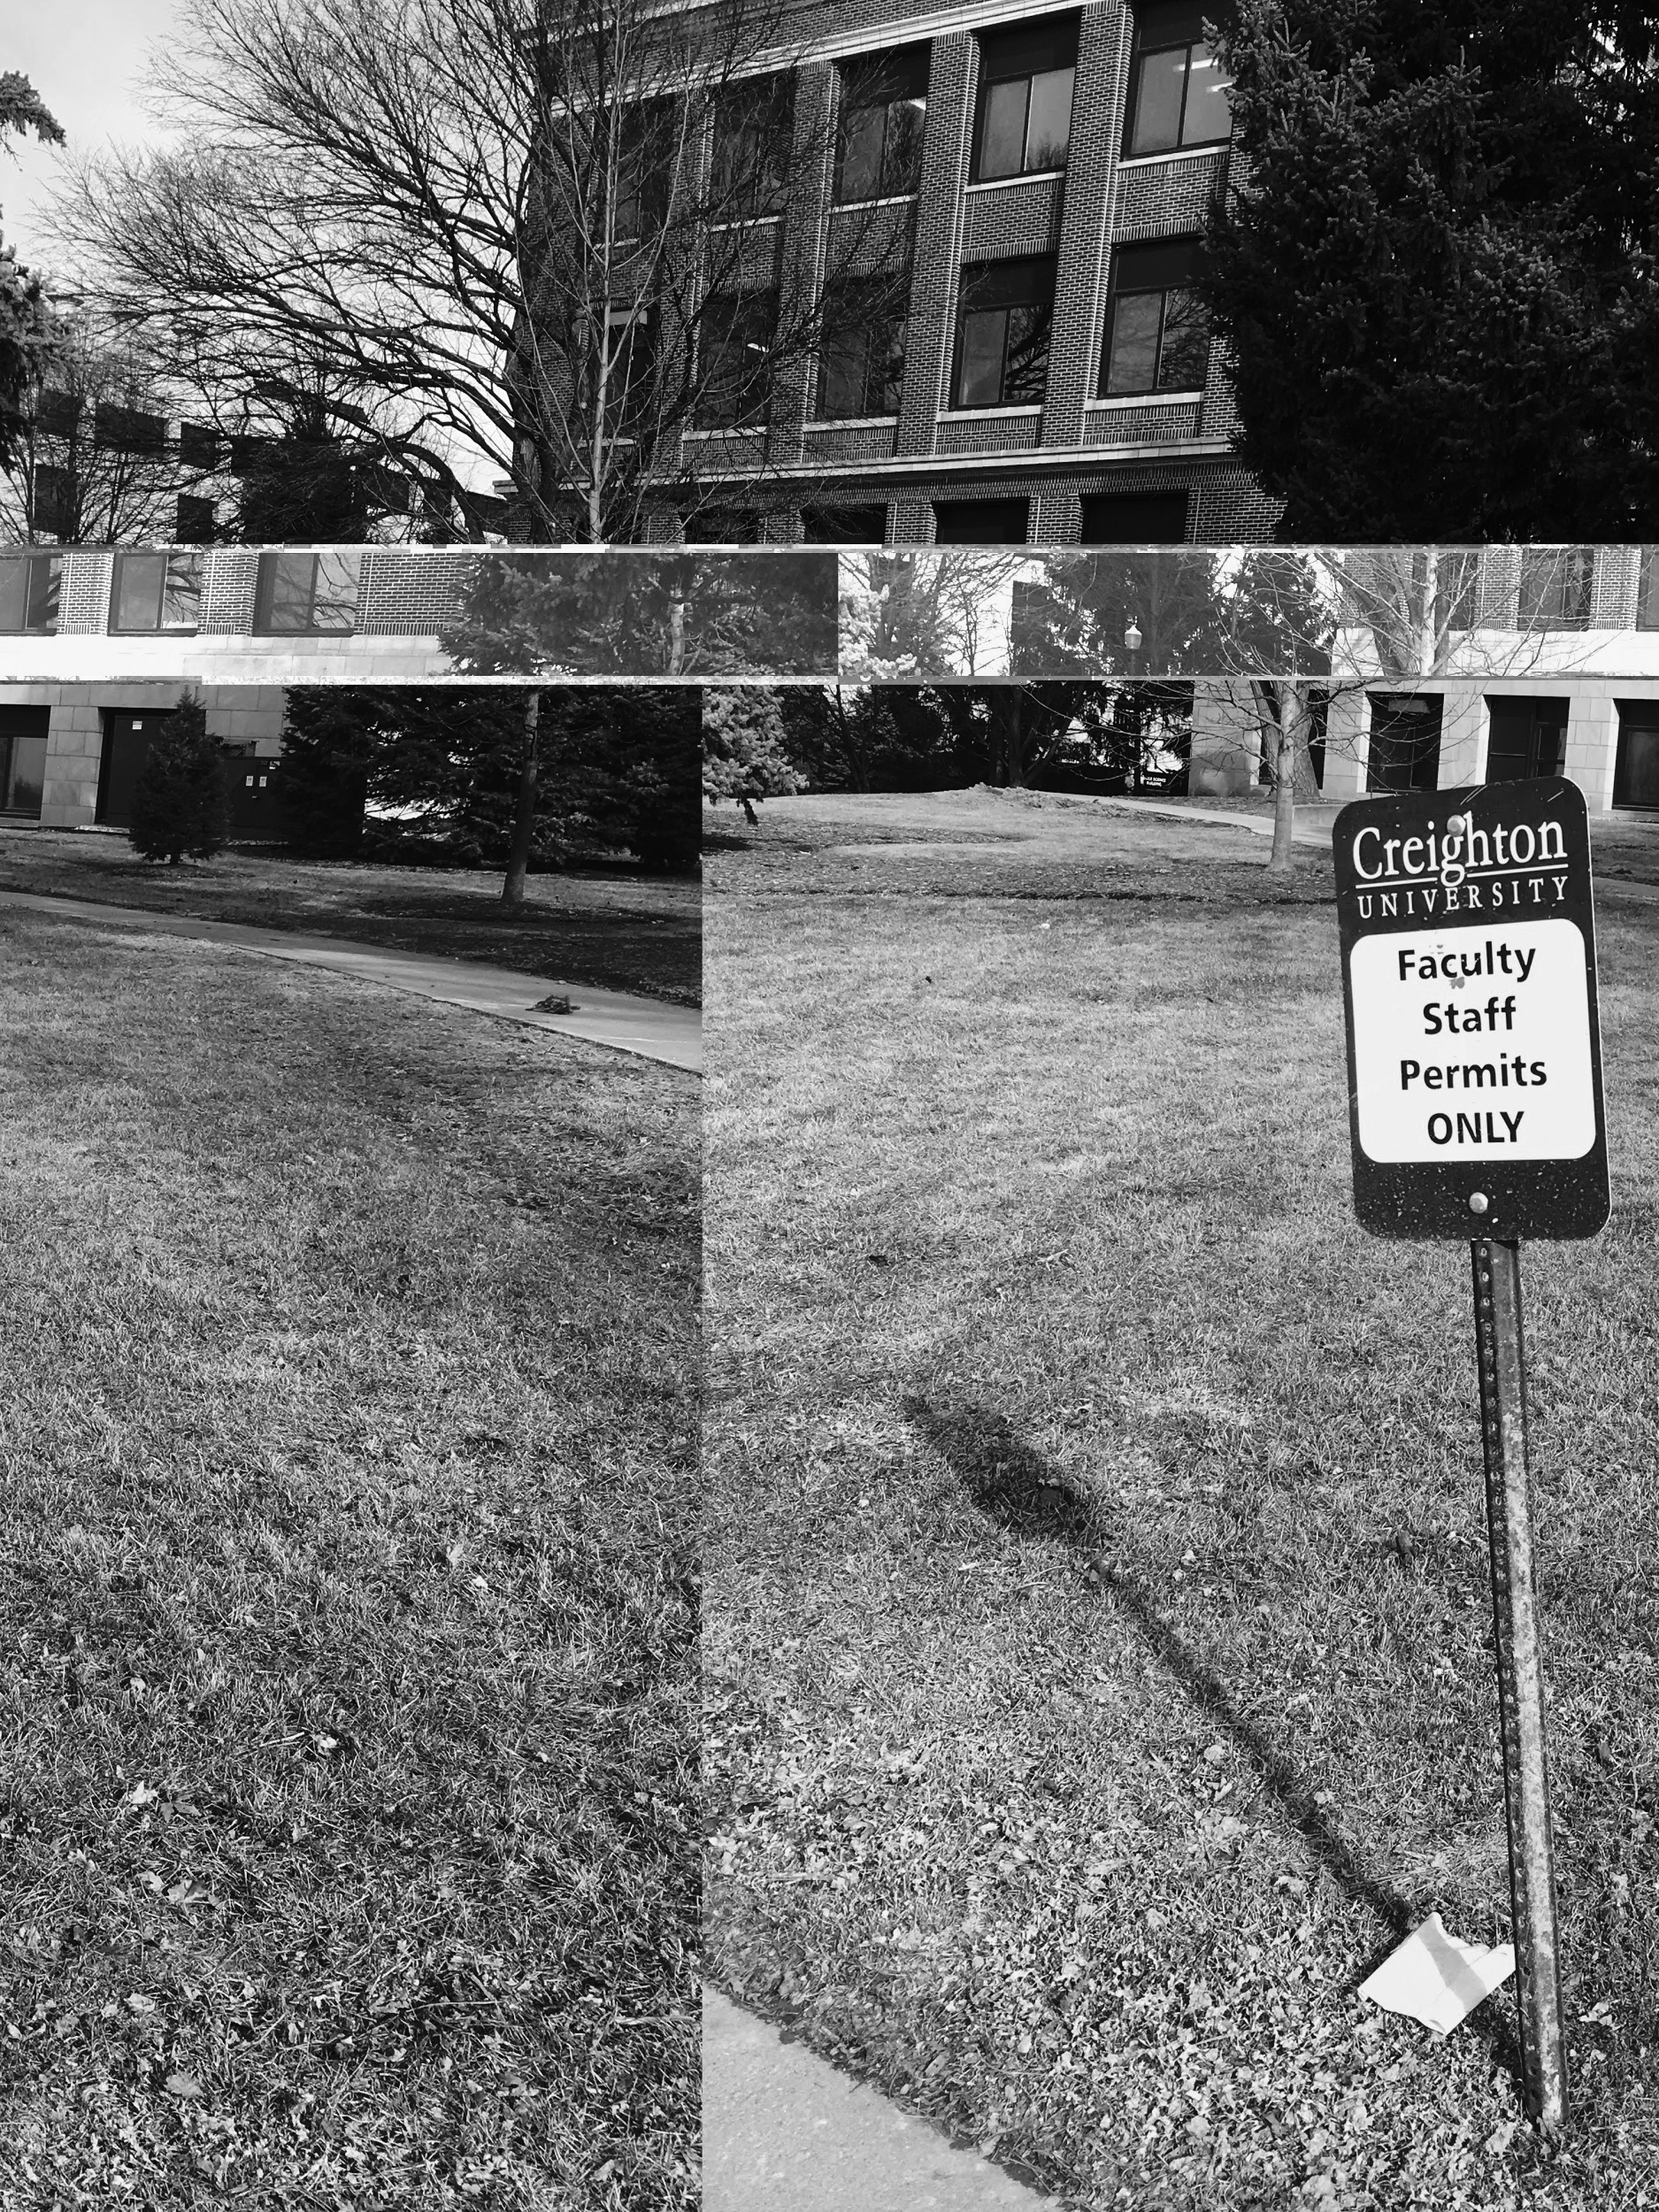
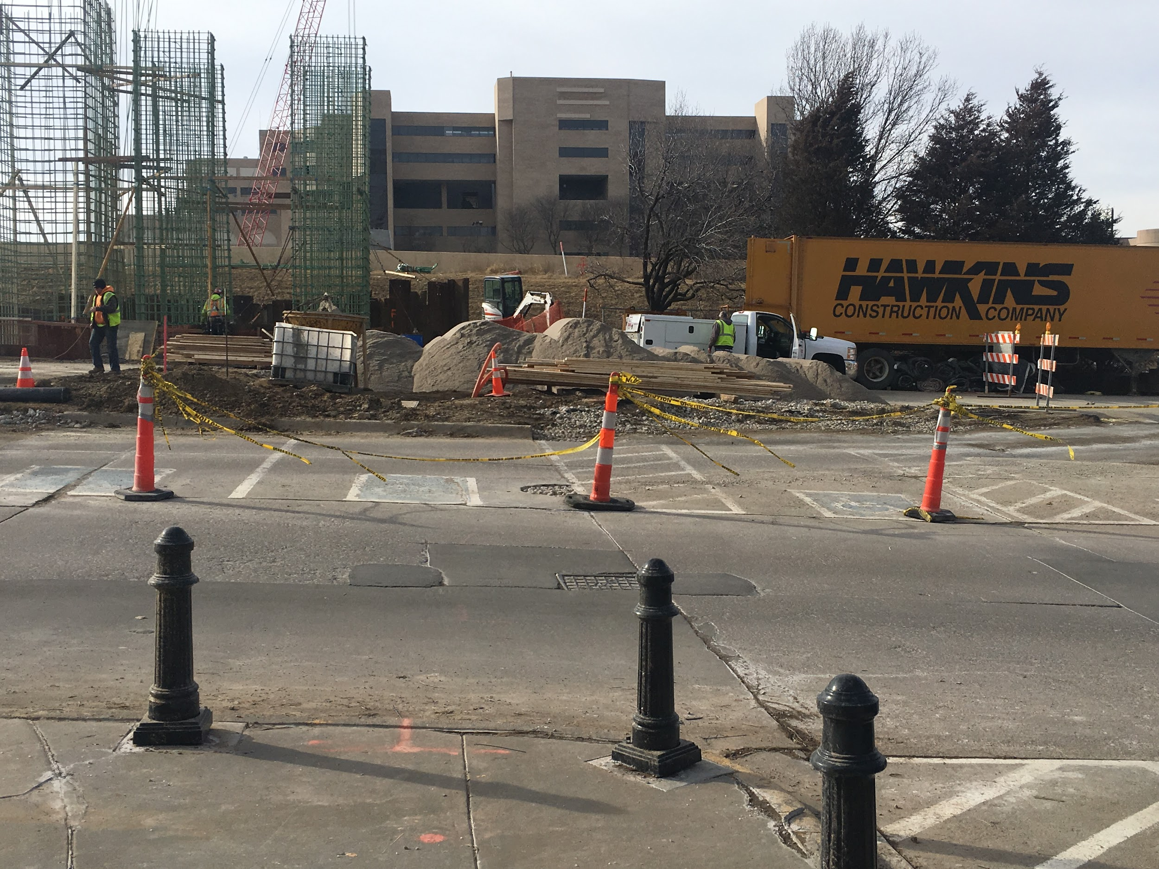
Off street parking and passenger loading
Parking spaces are not located closely to the building (faculty parking only, student parking was not close).
There are 26-50 total spaces, with 4 accessible spaces that were all blocked off by construction and 2 accessible spaces that were not blocked.
The width of the pathway was more than 36 inches wide.
There was no landscaping or rails on the sides of the path that narrowed it.

Slide 3
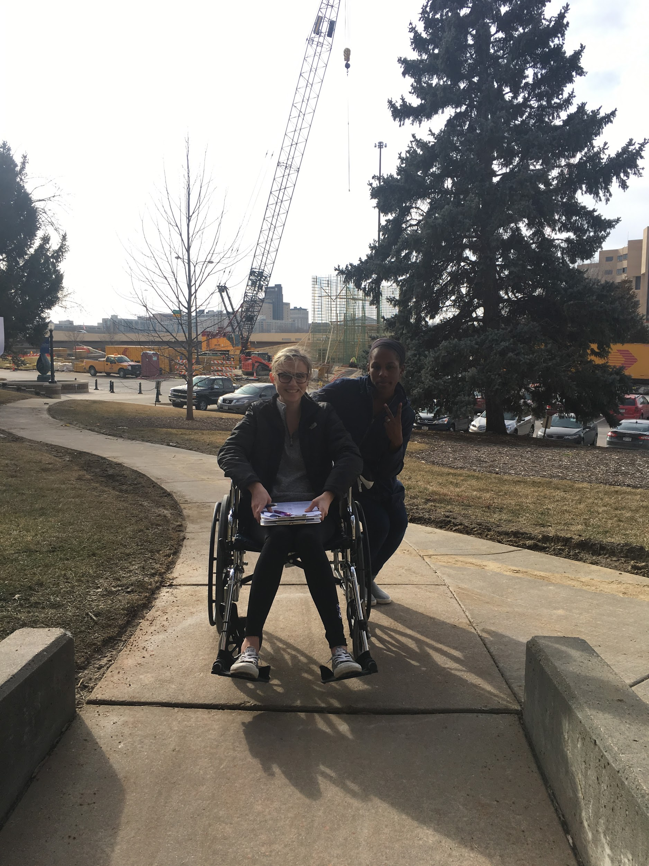
Approach to selected entrance
There were no signs indicating where inaccessible or accessible entrances to the building were. There was an accessible entrance on the side.
The distance from the parking area to the entrance of the facility was about 150 feet.
There is a loading zone/slope that leads to the entrance of the building.

Slide 4
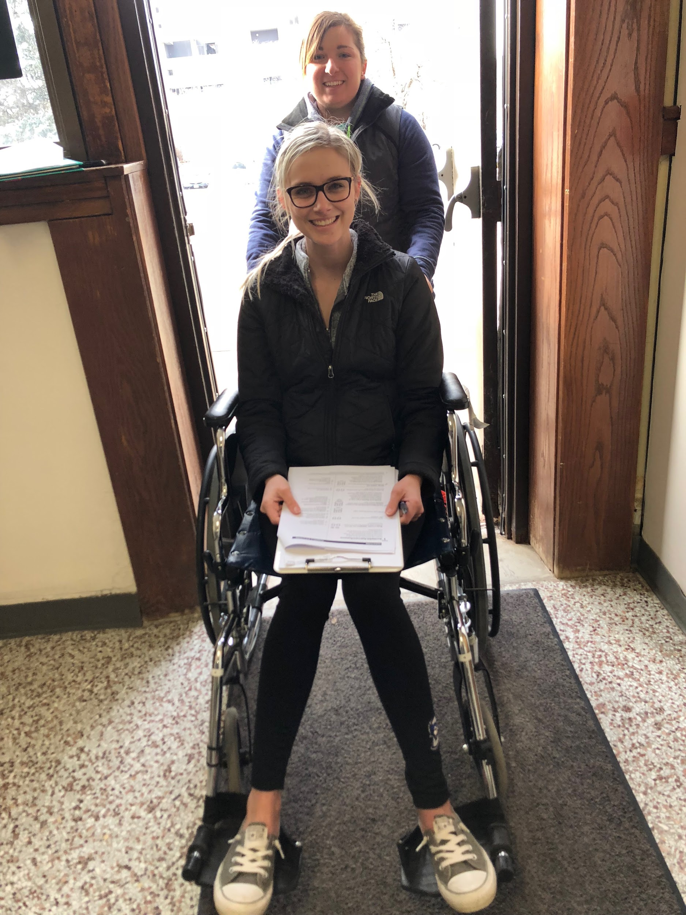
Entrance
There was not a non-slip surface near the door- the carpet was there but it was not secured to the ground and was easily moved.
The measurement of the open doorway from frame to frame was 36 inches.
The door was not a double door, but the wheelchair fit through the frame.
The door handle was 48 inches high, but not operable with a closed fist. There was a button that was reachable that opened the door automatically.

Slide 5
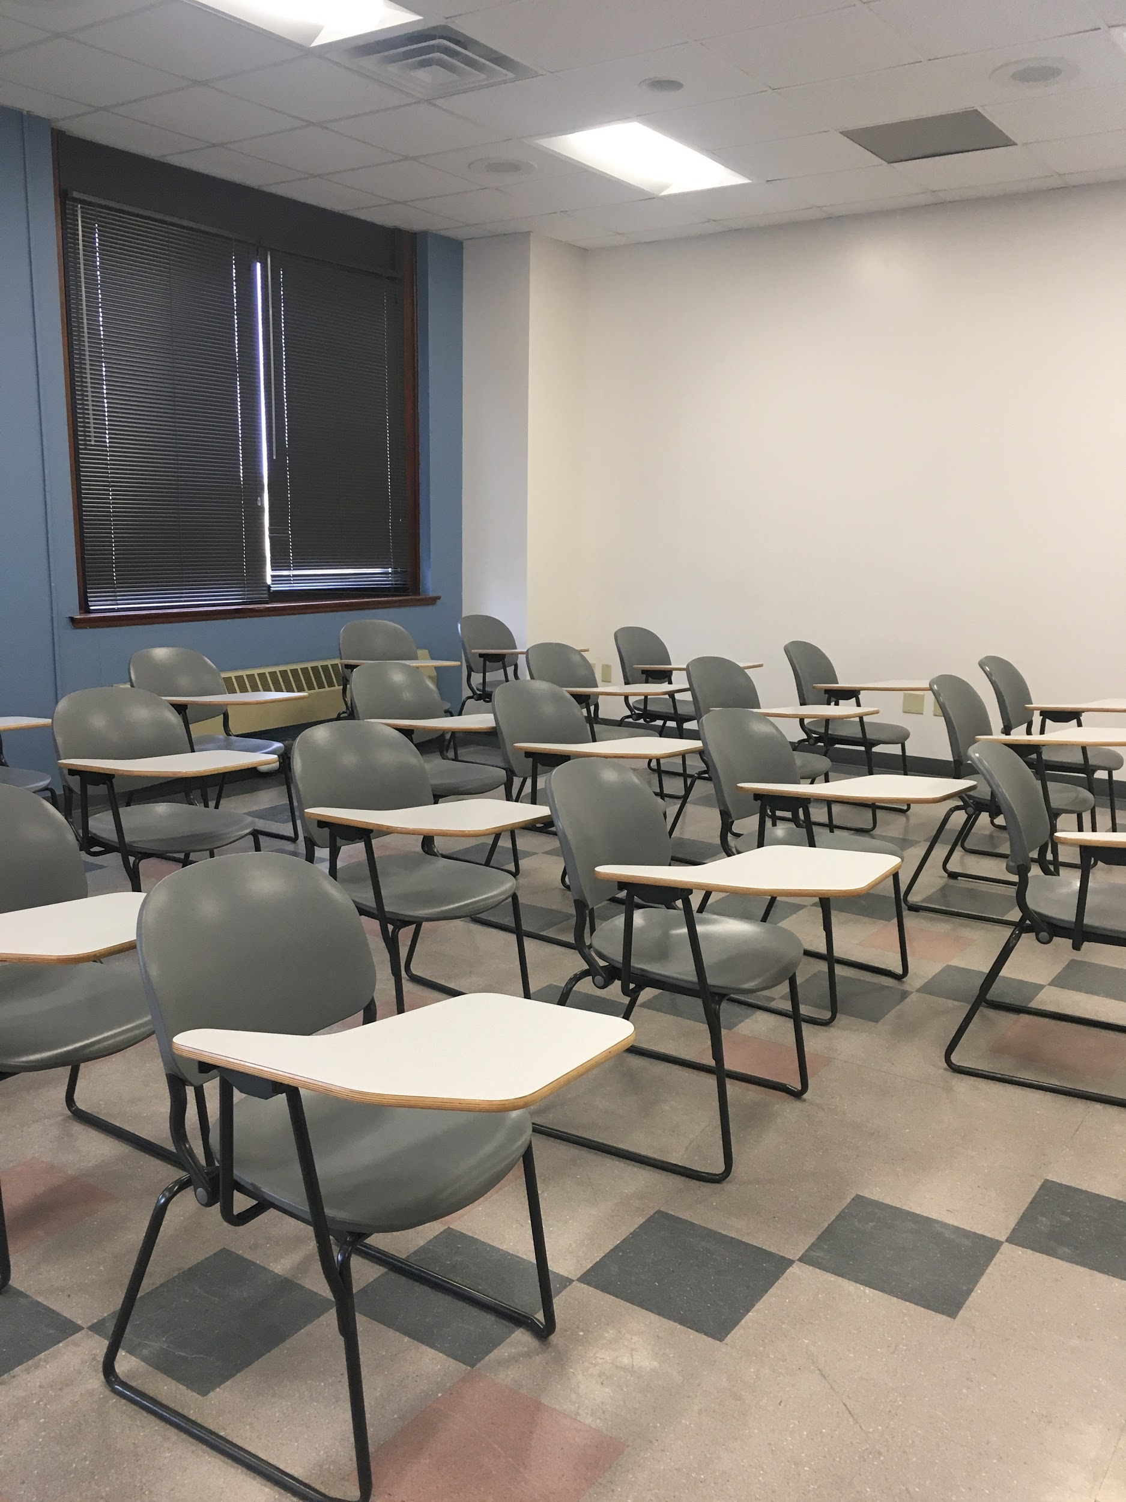
Access to essential areas
There is a five foot T-space for the wheelchair to turn around/ reverse direction.
Routes to public services (offices, etc.) are accessible, with a five foot T-space.
There were no eating areas, but toilets were available and accessible (barely).
Emergency exits were not easily accessible for a wheelchair.
Floor plan included on slide 11 (final slide).

Slide 6
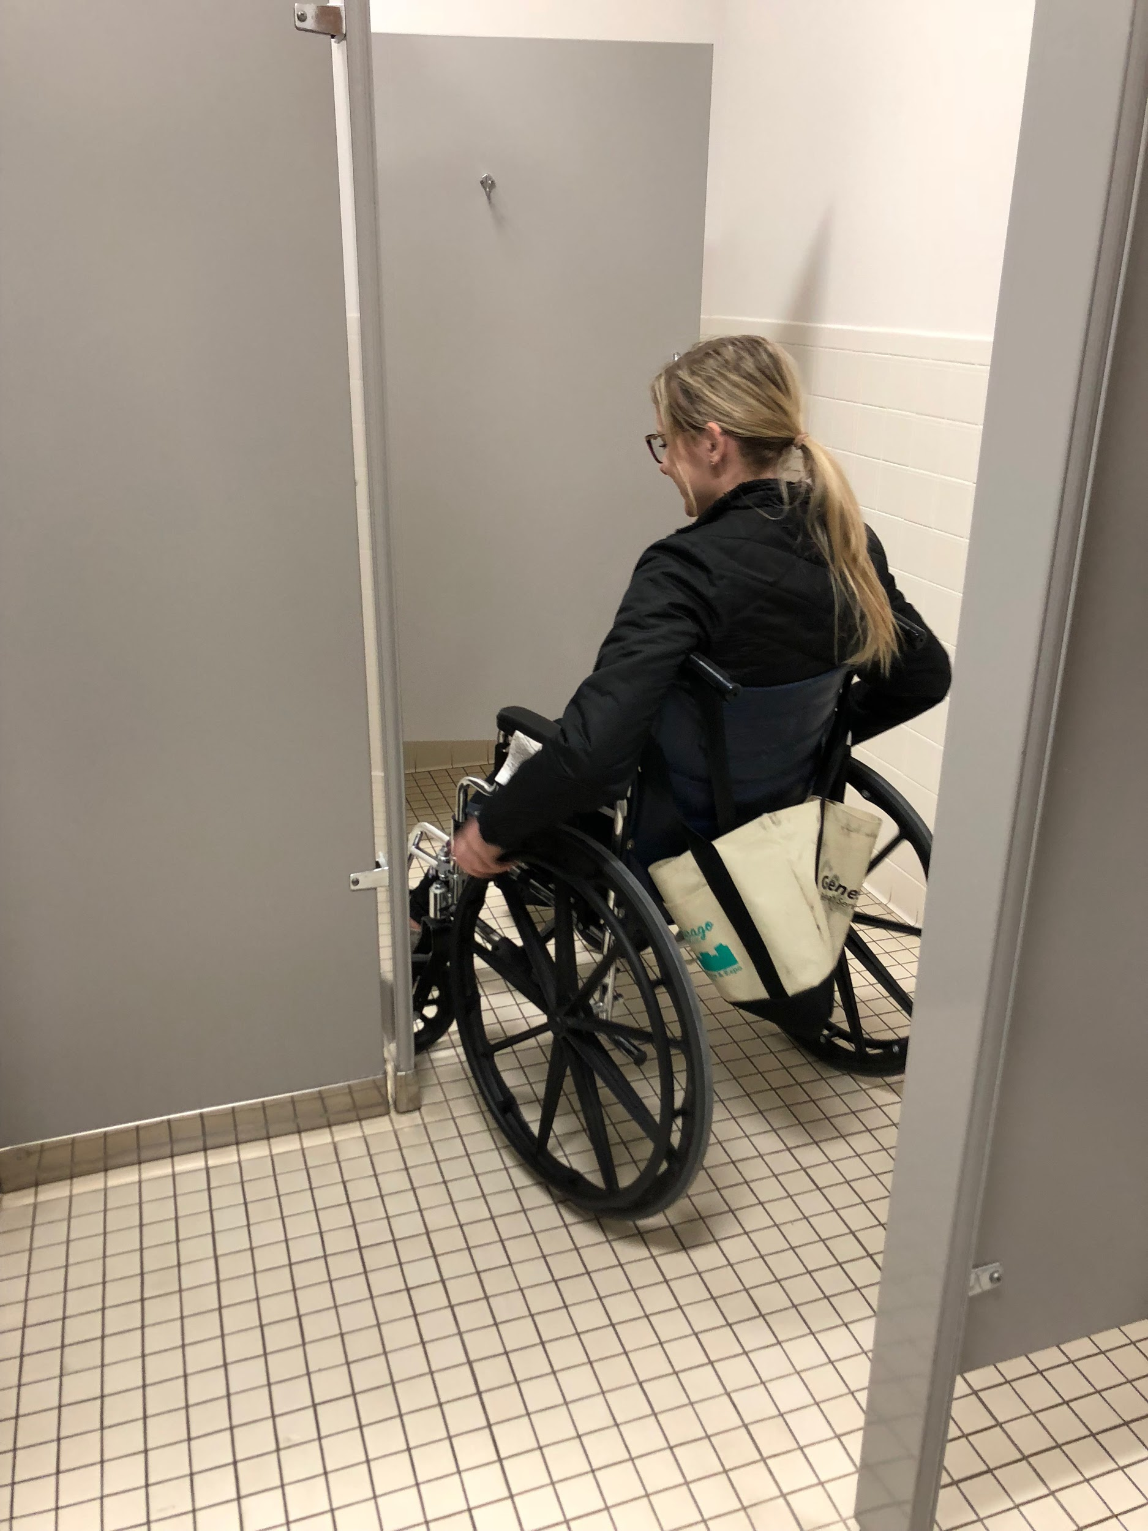
Public restrooms
Restroom was not marked as accessible on the outside
There was enough room to carefully navigate wheelchair (but barely!).
There was an unnecessary wall that made accessibility to the stall very difficult.
The toilet stall door was not accessible with a fist. The stall provided greater access than typical stalls once inside, but the door did not have at least a 5 feet by 5 feet clearance of the door swing (it was 4 feet by 5 feet).
There are grab bars behind the toilet and on the side wall nearest to the toilet.
There is a very small T-space to maneuver the wheelchair around.
The toilet height was 18.5 inches, the sink height was 34 inches with a 30 inch clearance underneath.
The faucet handles were one lever handles.
The paper towel dispenser height was 44 inches.

Slide 7
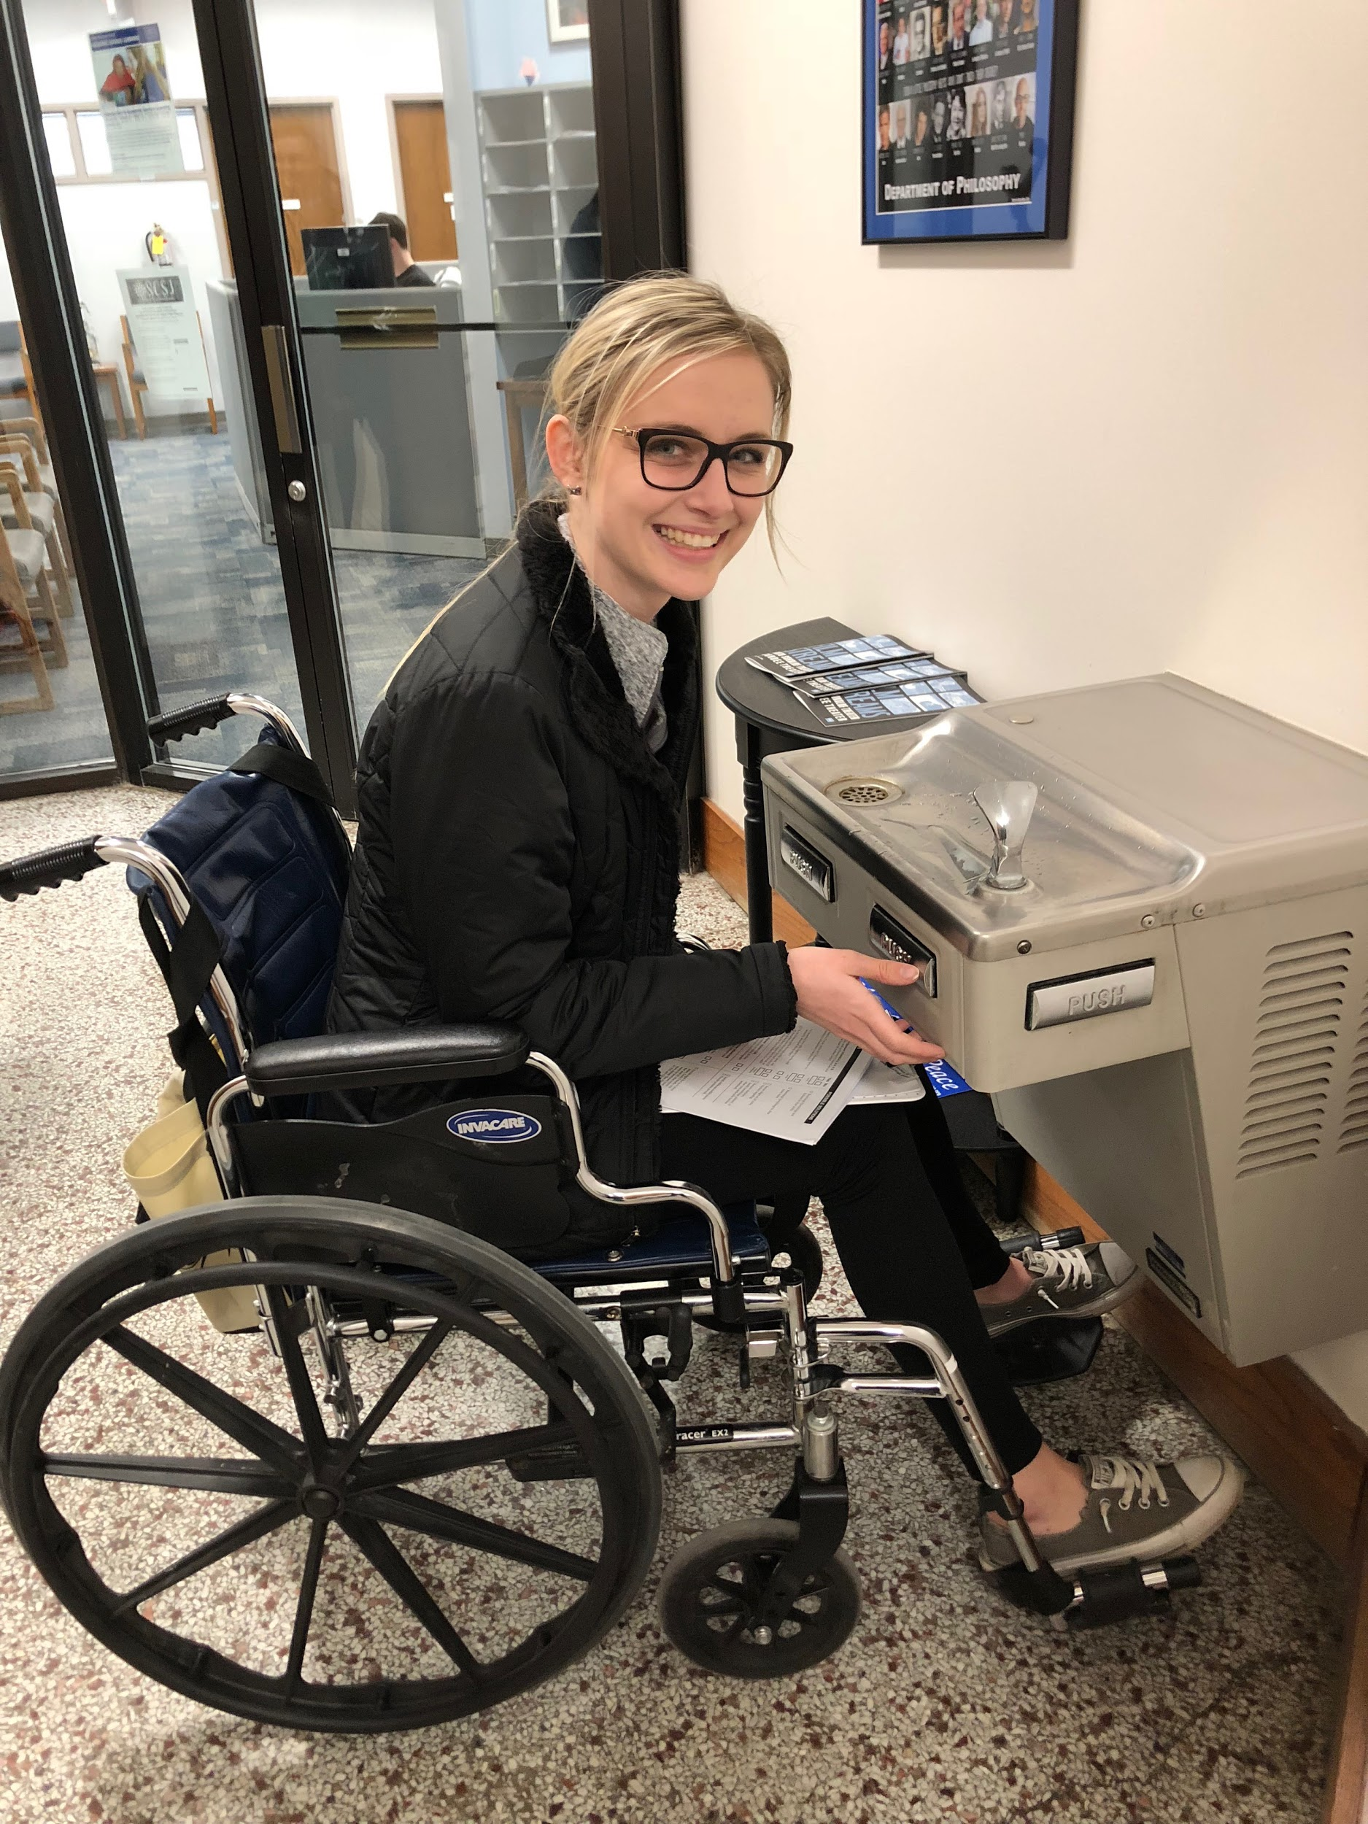
Public telephones and water fountains
There were no telephones
The spout is located more than 26 inches from the ground
The features on the water fountain are able to be used with a closed fist, and were located on the front and the side

Slide 8
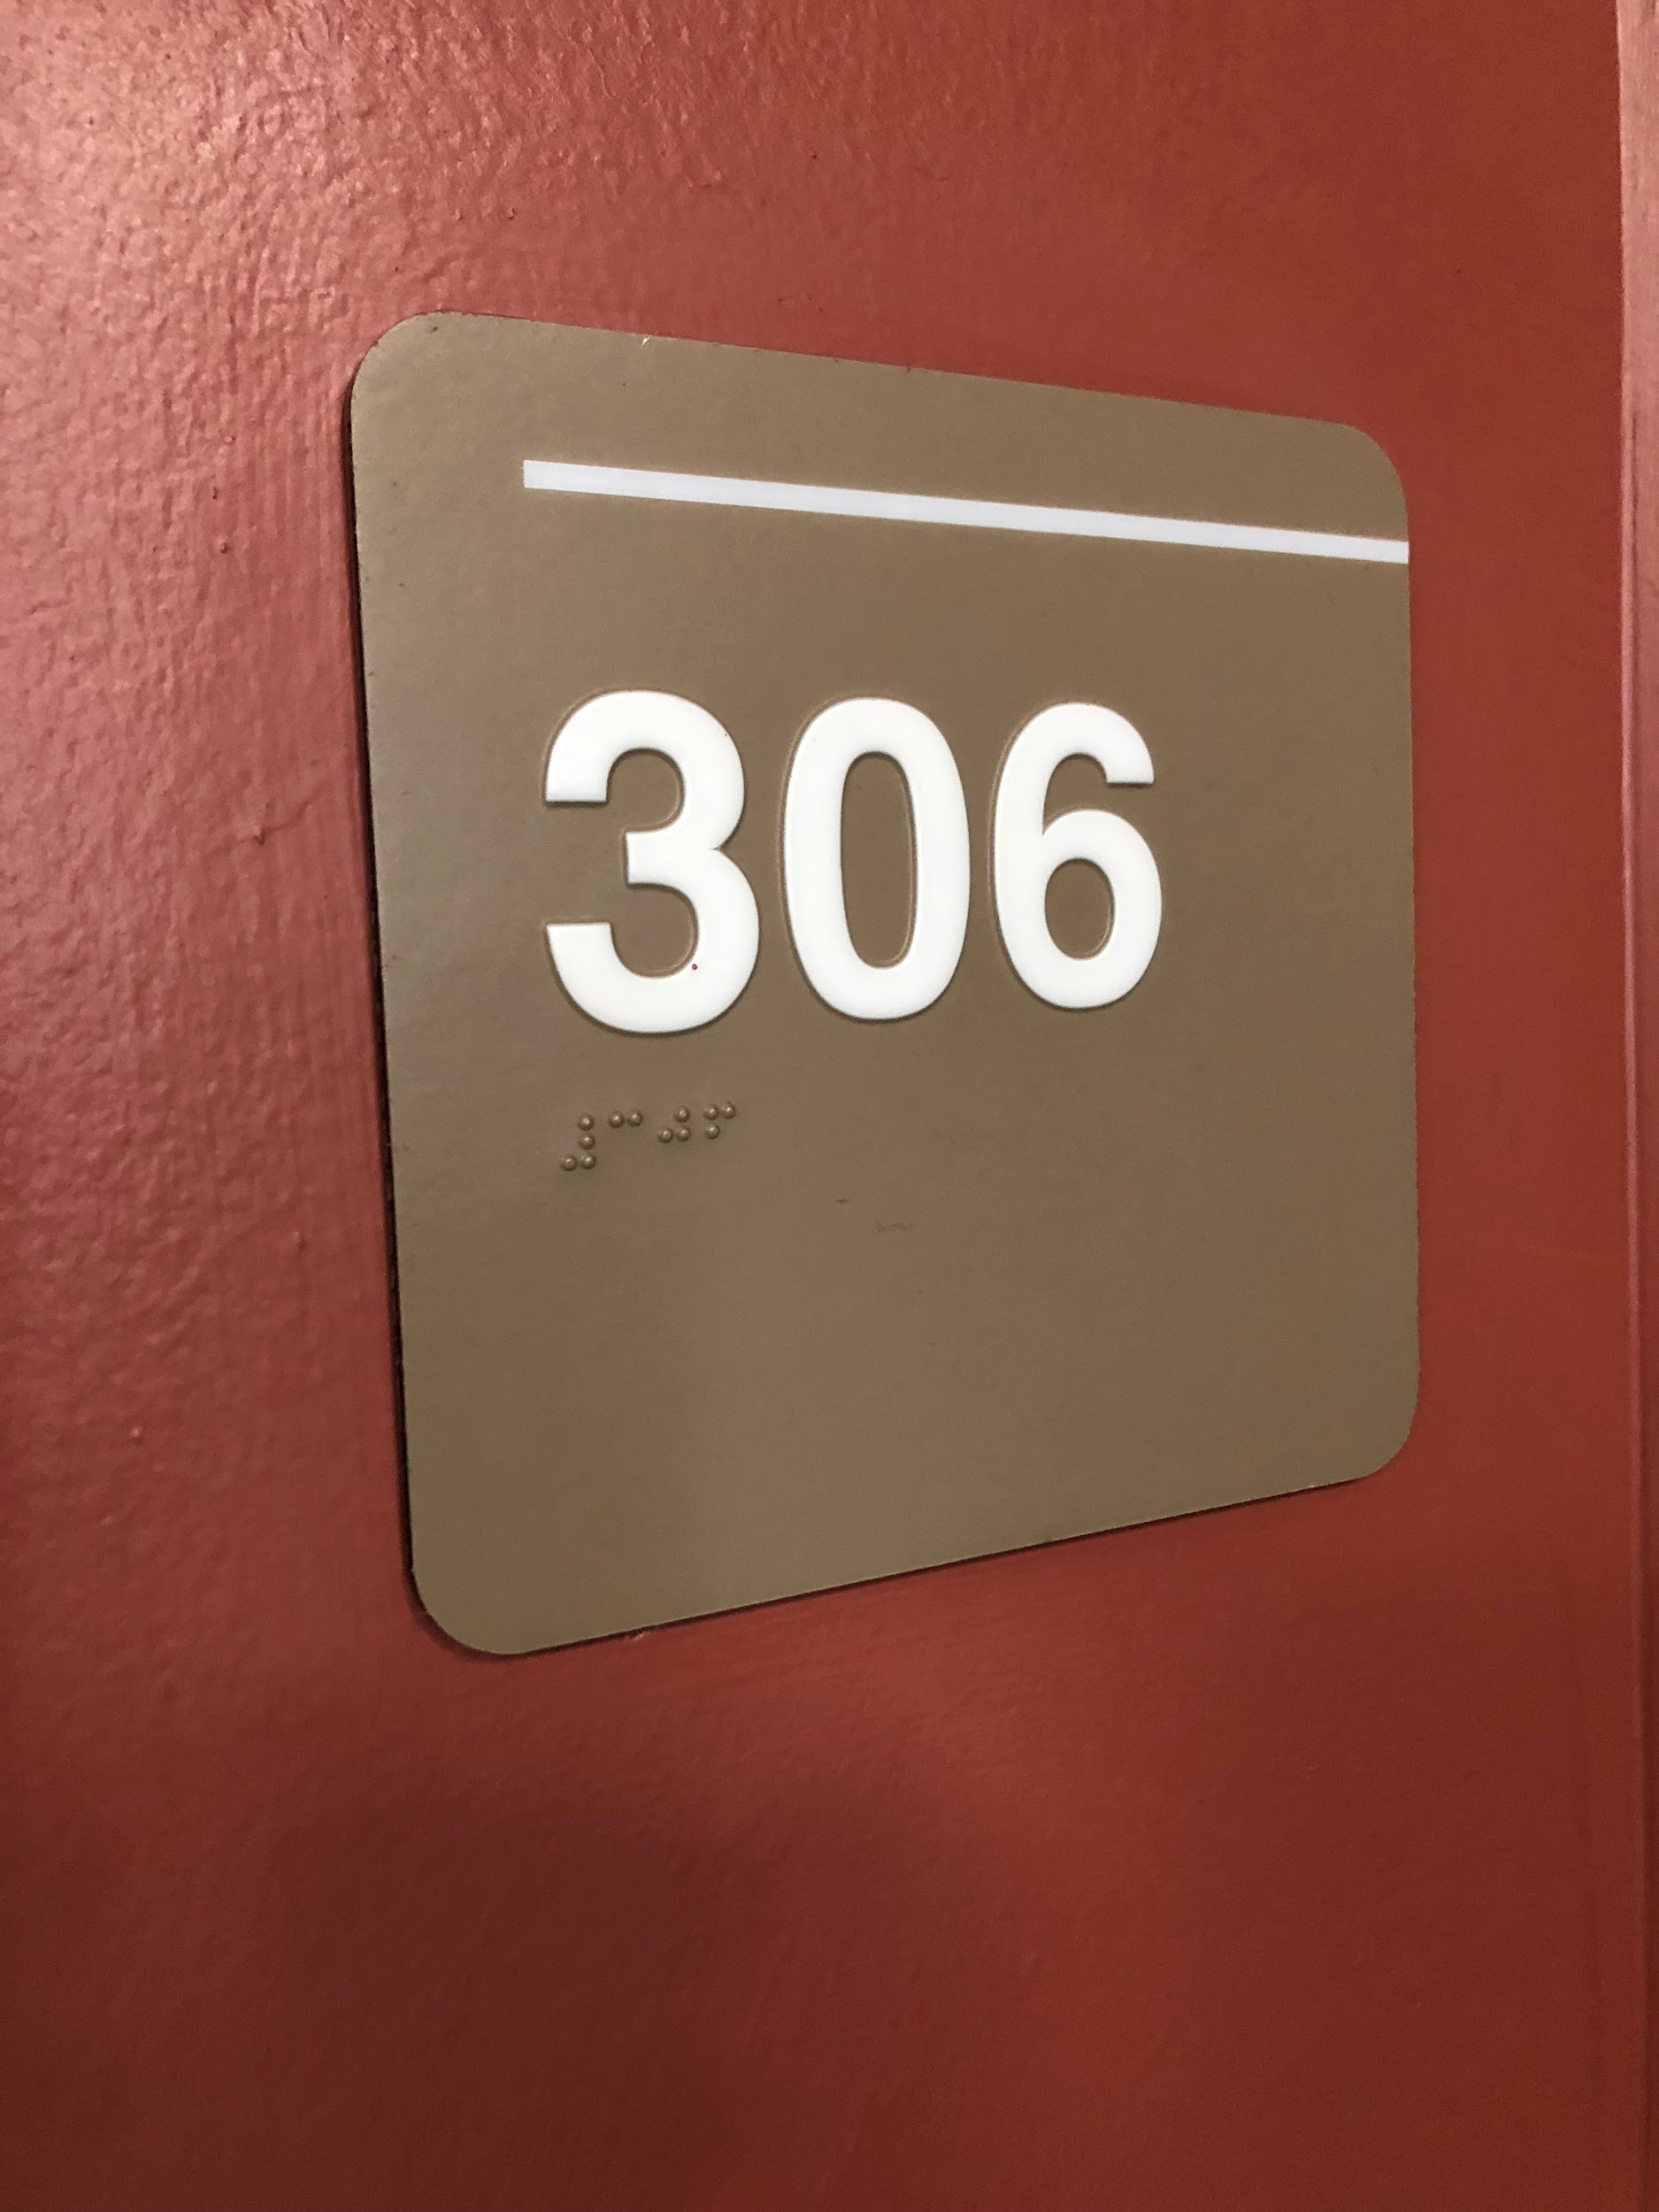
Access for the visually impaired
Braille signage is located under the raised numbers to label the classroom.
There are no voice activated assistance devices in the building.

Slide 9
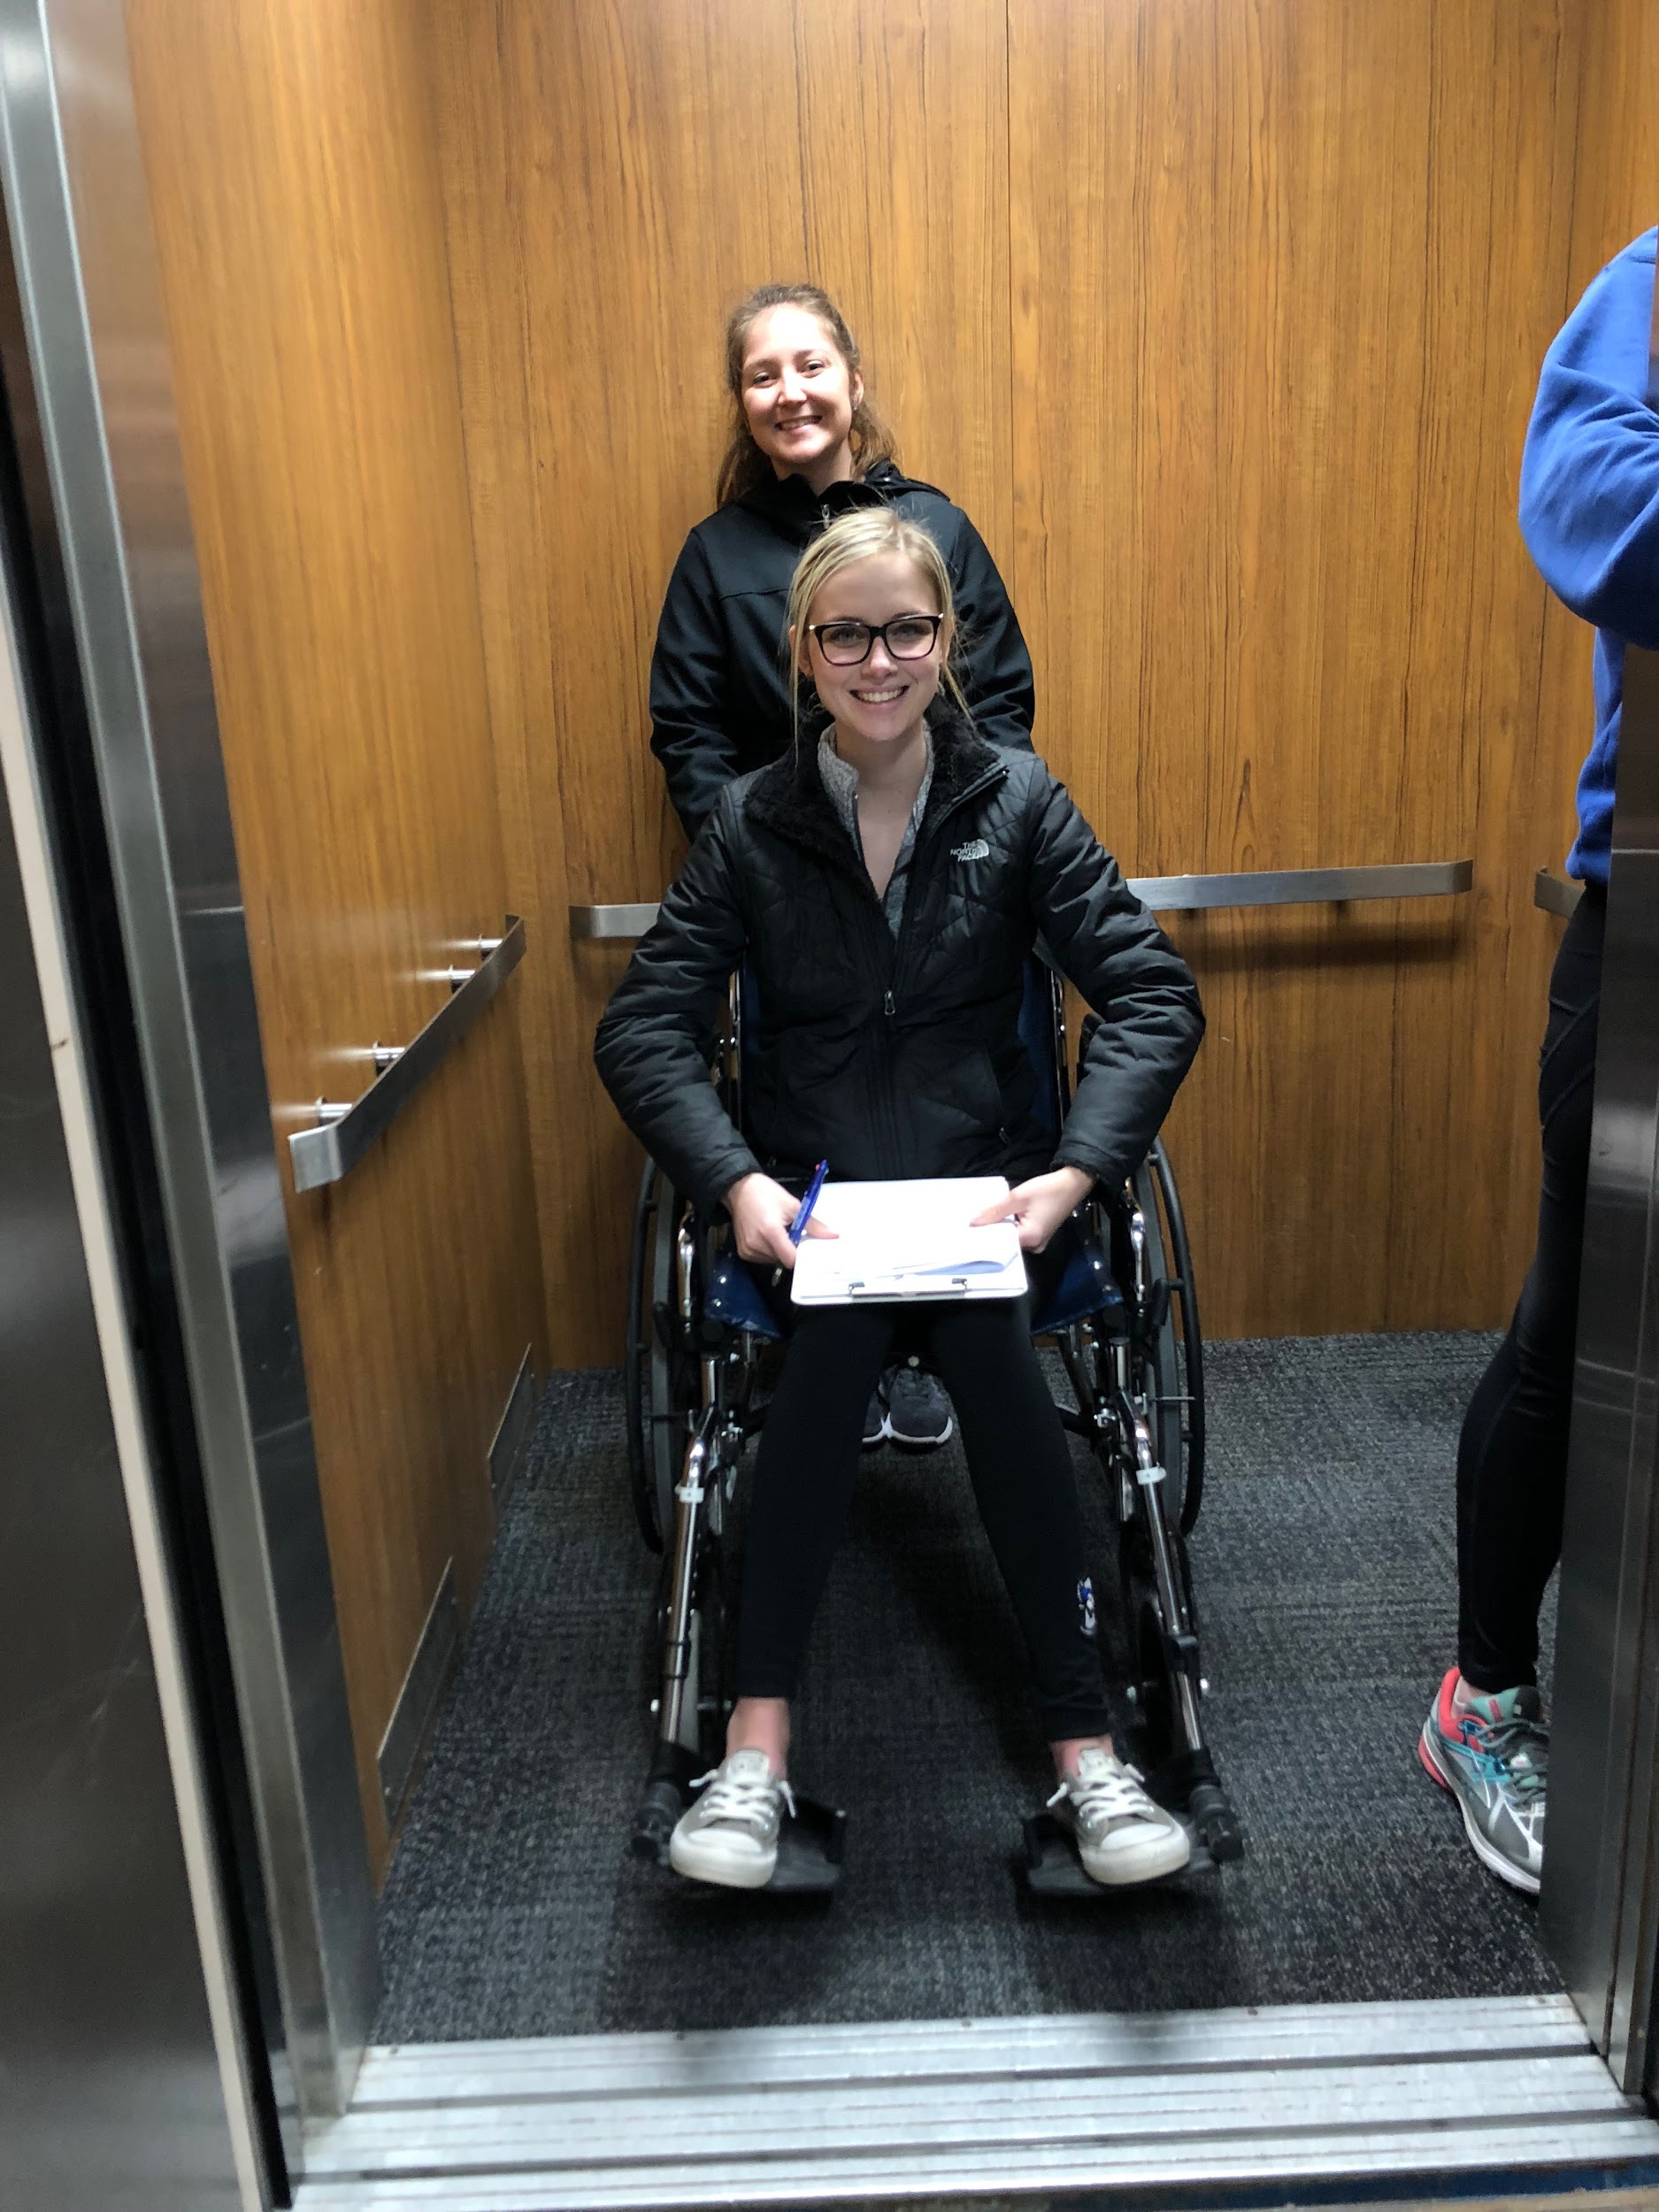
Assistance/physical aids available
Building includes elevator to access all floors of the building.
The elevator buttons are within reach (<42 inches in height) and the numbers are raised but do not include braille.
The stairs have grab bars along the sides but do not continue along the corners.
There are automatic buttons on the entrances of the buildings, but other doors inside the building are not accessible.

Slide 10
Recommendations
More railings for ramps
Possibly a lift where main offices are
More automatic powered door switches
Additional signs to navigate around building (where accessible restrooms are, where offices are, etc.)
Removing the unnecessary wall in bathroom

Slide 11
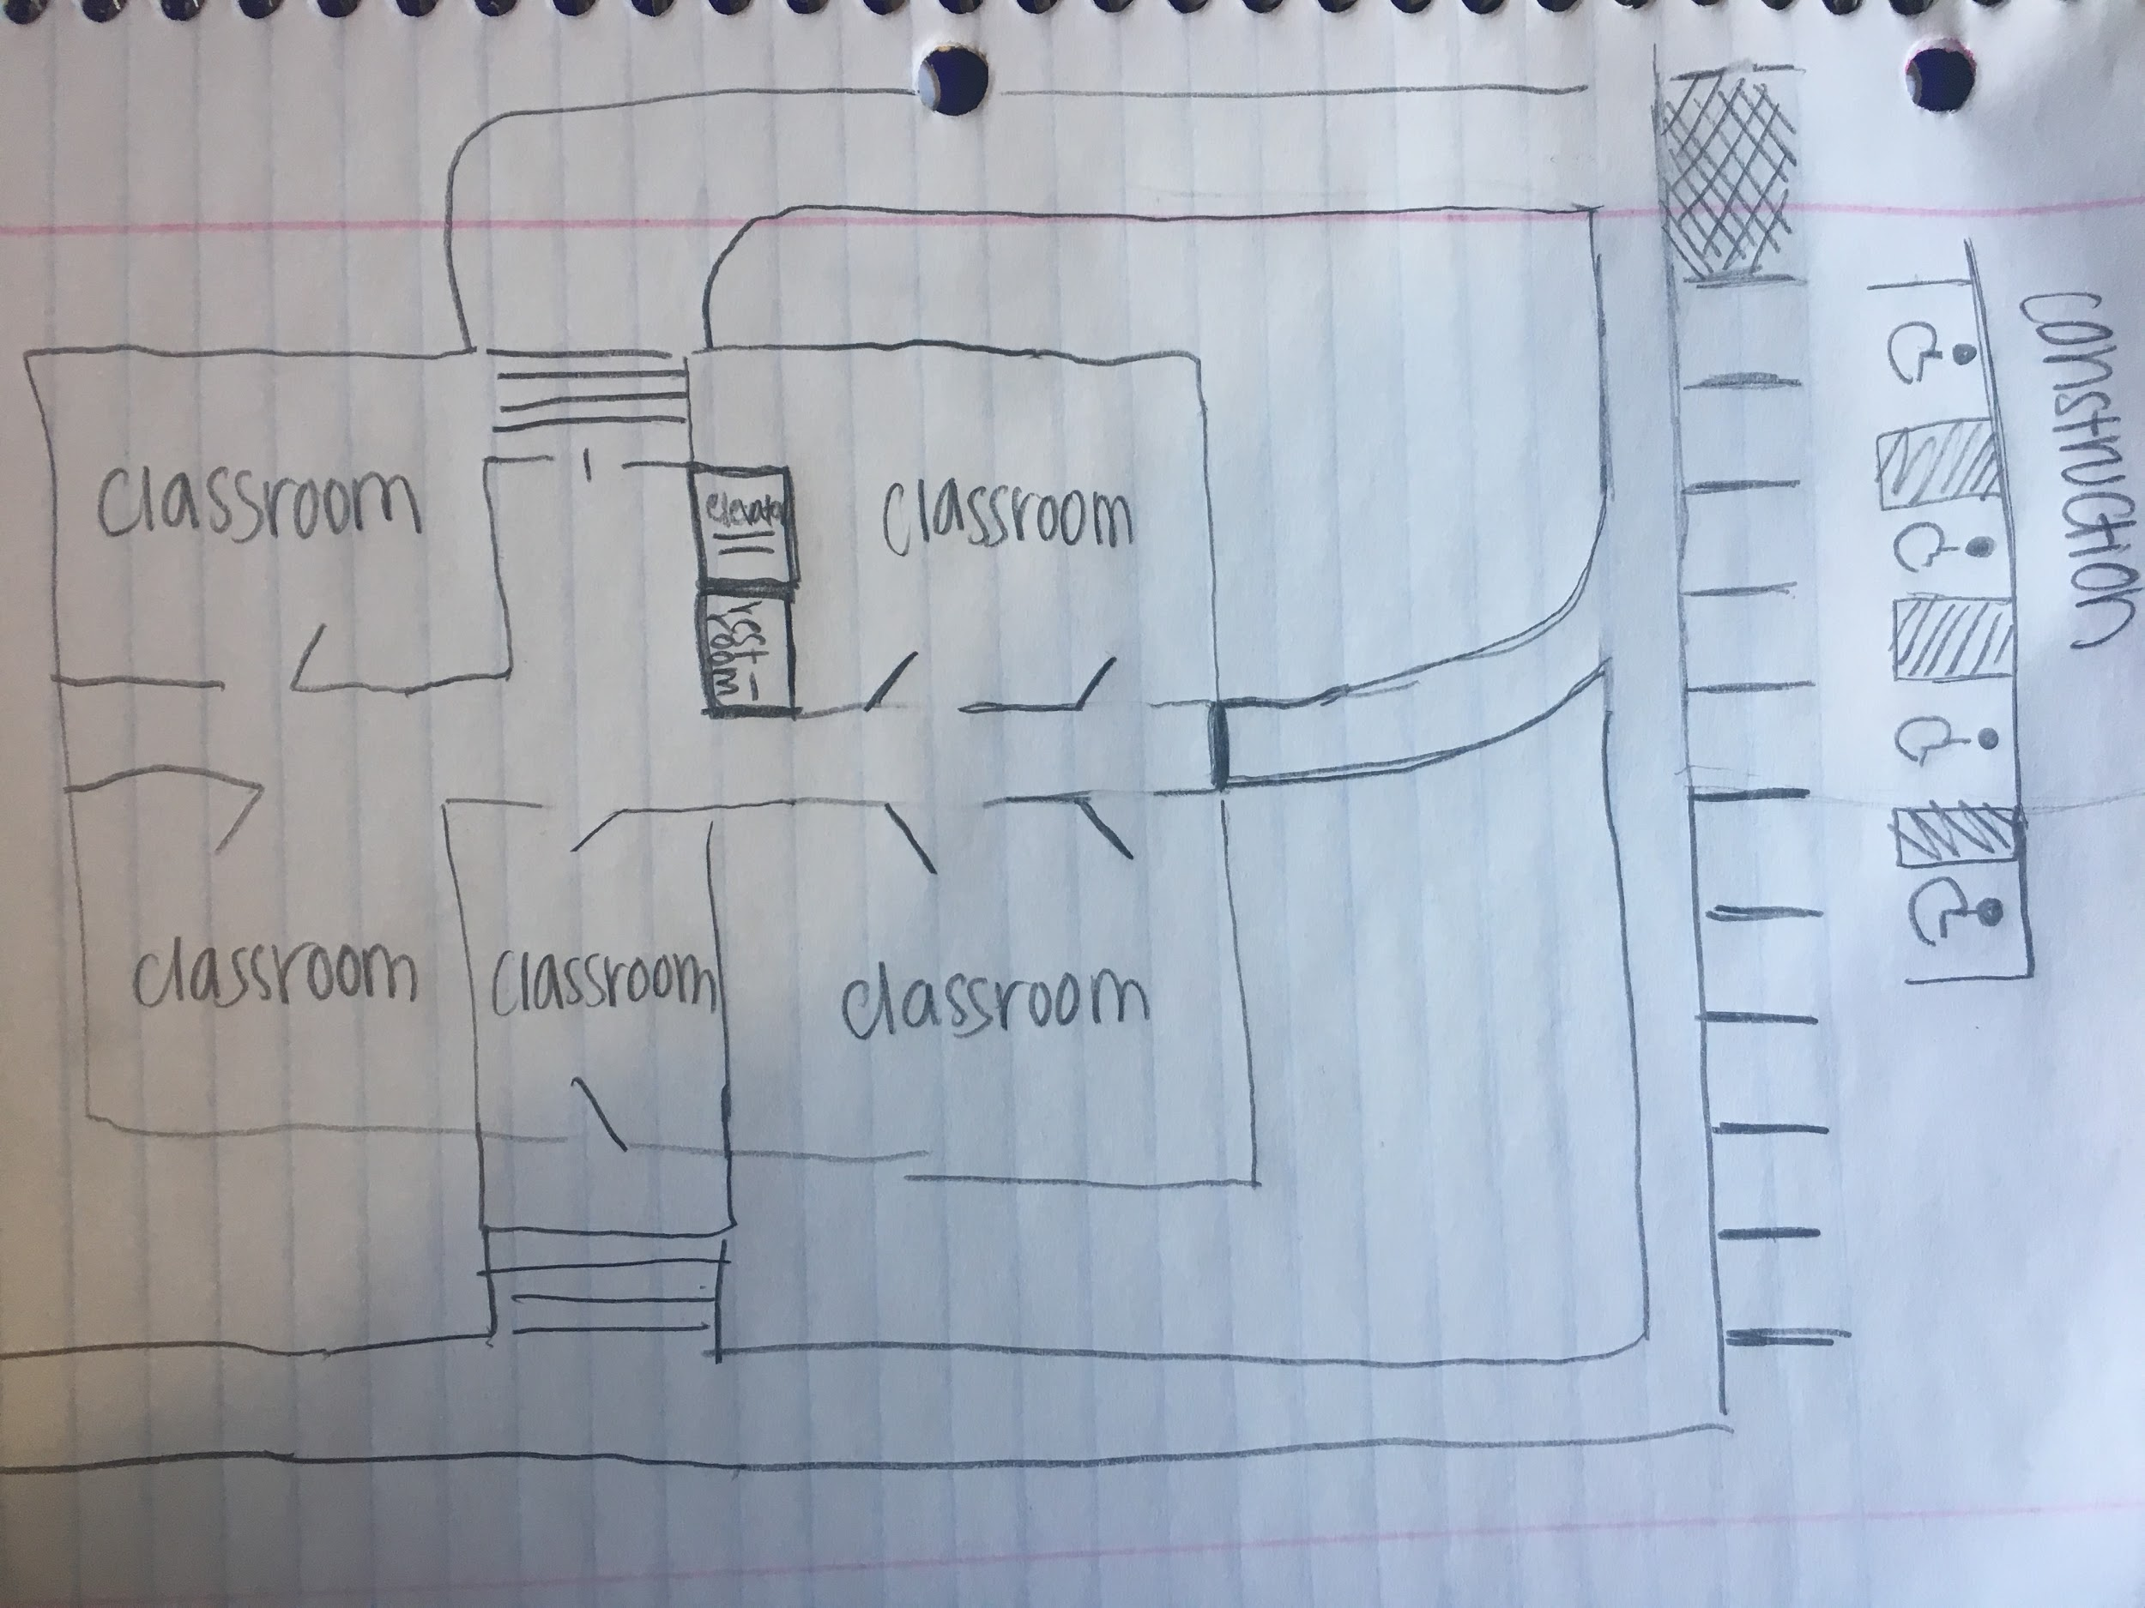
General floor plan

