Slide 1
Creighton University
OMB Uniform Guidance Implementation
Administrator Training
September 21, 2015

Slide 2
2

Slide 3
So what is this all about?
Why are we all here?
Creighton is a recipient of over $20 million in federal awards annually
The US Office of Management and Budget (OMB) issued broad revisions to its guidance for federal awards on December 26, 2013 effective December 26, 2014
2CFR Chapter I and II Parts 200, 215, 220, 225 and 230 Uniform Administrative Requirements, Cost Principles, and Audit Requirements for Federal Awards (UG)
UG streamlined and consolidated existing OMB documents and regulations into one document
3

Slide 4
Have you heard of the new Uniform Guidance?
Yes
No
Unsure

Slide 5
Question
5

Slide 6
Why update federal award guidance?
To streamline issued guidance and ease the administrative burden
To strengthen oversight over federal funds to reduce risks of waste, fraud and abuse
To focus grant policies on areas that emphasize the achievement of better grant outcomes at a lower cost
There has been a longstanding aim to increase the efficiency and the effectiveness of grant programs
In response to presidential directives
Bottom Line - We must first experience some pain and then hope for the promised relief
6

Slide 7
When is this effective?
Federal agencies must implement the requirements to be effective by December 26, 2014
Administrative requirements and cost principles will apply to new awards and to additional funding to existing awards made after December 26, 2014
The audit requirements are effective for fiscal years beginning after December 26, 2014 (i.e. FY 2016 for Creighton)
Existing federal awards will continue to be governed by the terms and conditions of the federal award
7

Slide 8
What are some of the major changes?
Emphasis on Internal Controls
Financial Monitoring – including Effort Reporting
Sub recipient Monitoring and Other Matters including Risk Assessment
Cost Principles
Equipment/Property
Procurement (emphasis on competition)- delayed until next fiscal year
8

Slide 9
What we’ve done so far…….
A core team managed the Uniform Guidance Implementation (UGI) Project (i.e. policy development and revisions)
Work Teams reviewed our policies and make changes as needed – Please stand if you worked on a team
Huron Consulting provided support and technical expertise and was on site January 15 – 16, 2015 to facilitate discussions and assist the work teams
Once teams came up with final policy revisions Huron and Dr. Murray approved them
Rolling info out now to you!
9

Slide 10
5 Areas to Discuss Today
Basics of Charges to a Sponsored Project
Financial Monitoring
Cost Transfers- Michon
Cost Sharing – Jerrod
Award Closeout – Amber
Award Monitoring – Mary
PARs- Amber and Amanda
Sub recipient Monitoring - Beth and Michon
Equipment – Michon
Travel - Amanda
10

Slide 11
Let’s Start with the Basics.
What Do I have to consider when I want to charge something to a sponsored project?
Allowable
Reasonable
Allocable
Consistently Treated
11

Slide 12
How Do I Know what is Allowable?
Costs must conform to
Any limitations or exclusions in the cost principles 2 CFR section 200.400
The award’s terms and conditions
University Policy
12

Slide 13
A partial listing of UNALLOWABLE costs
Entertainment costs
Tickets to a sporting event
Movies in a hotel room
Alcohol
Bad debts
Alumni Activities
Losses from other awards
13

Slide 14
In summary
Expenses charged to a sponsored project must benefit that project directly to be allowable.
14

Slide 15
How Do I Know What is Reasonable?
Prudent Person Test- What would a reasonable person do in a similar situation?
Necessary for the Project
Adhere to laws and regulations
Newspaper Test!!!
15

Slide 16
What does Allocable Mean?
Goods or services involved are charged in accordance with the relative benefits received
Costs that benefit more than one project and can be split based on benefit to each
For example, cost of a piece of machinery could be split based on time spent on each project)
Example of not allocable- lab coats
Absolutely NO shifting of costs from one project to another to cover cost overruns, avoid restrictions or for convenience!!!!
16

Slide 17
What does Consistent Treatment Mean?
“A cost may not be assigned to a Federal award as a direct cost if any other cost incurred for the same purpose in like circumstance has been allocated to a Federal Award as an indirect cost.”
Appendix I lists all of our account codes and whether this type of expense can be charged directly or is it to be covered by the indirect rate.
Each of you have a copy of Appendix I on your table that you can take with you today as a parting gift.
17

Slide 18
Is this allowable? Cost of a catered lunch for a PI and staff during busy research time
Yes
No

Slide 19
Answer- NO
Not allowable- government expects that people buy their own lunch.
It is allowed if you are out of town traveling for the purpose of the project
19

Slide 20
Is this allowable? Wine with dinner while out of town at a conference
Yes
No

Slide 21
Answer- NO
Alcohol is never allowed on a federal grant
21

Slide 22
Is this allowable? Cost of a computer that is essential and allocable but not solely dedicated to the project
Yes
No

Slide 23
Answer- YES
Under the new guidance if it is essential and allocable but not solely dedicated it can be charged- budget for it!
23

Slide 24
Is this allowable? Supplies purchased before the end date of the grant and received after the end date of the grant
Yes
No

Slide 25
Answer- NO
No, these supplies were not used within the dates of the project
These last minute purchases are red flags for audit!
25

Slide 26
Is this cost allowable? Cost of an extra night’s hotel due to a weather delay.
Yes
No

Slide 27
Answer- YES
It could not be helped, so it is allowable.
However, staying an extra day because you are in Florida and you want to spend a day at Disney World is not
27

Slide 28
Direct Vs Indirect Charges
Total Expenses charged to the grant =
Direct + Indirect
Direct Charges are charges that can be identified specifically with that sponsored project.
An Indirect charge is automatically posted by Banner to account 7890 each time a direct expense is charged.
The indirect calculation is based on the indirect rate stated in the contract. For Federal awards, this rate is 45.5%
28

Slide 29
Indirect Charges – An Example
If a lab supply is charged to a sponsored project for $100, Banner calculates $45.50 and charges this amount to the sponsored project under account 7890.
The total amount charged to the sponsor for this entire transaction will be $145.50.
29

Slide 30
Indirect Charges – What’s Covered by that 45.5%?
Administrative salaries – such as most administrators’ salaries, pre award, post award salaries and expenses
There are some exceptions - talk to Beth, Amber, Amanda or me for more info on when this may be allowed
General Office Supplies
Utilities
General maintenance and repairs
Interest
Academic Expenses
30

Slide 31
New – Direct Cost Justification Form
This form is necessary if you want to direct charge something that is normally covered by the indirects (updated unlike circumstance form)
A. For example, office supplies – Trio or large community survey where a big part of the project will be mailings
B. Fill out form at beginning of project so we know to expect these types of expenses
C. Explain what project is about and why you need to direct charge these expenses
D. Acct Services will approve
31

Slide 32
New Uniform Guidance-
2 CFR Part 200 et all
32

Slide 33
Financial Monitoring - Cost Transfers Michon
What are Cost Transfers?
Moving expenses on or off a sponsored project
This is an area of concern for auditors
“All Cost Transfers are effected only for appropriate purposes and are conducted in accordance with sponsor terms and conditions, federal regulations and Creighton’s polices.”
“Costs to any sponsored project account must be allowable and proportionately benefit the sponsored project being charged”
33

Slide 34
Financial Monitoring - Cost Transfers
Inappropriate practices
Shifting costs from one project to another to meet budget or funding deficiencies
Shifting costs from one project to another to avoid sponsor restrictions
Assigning costs to sponsored projects based on remaining balances
Example – Large equipment purchases
Late PAR changes
34

Slide 35
Financial Monitoring - Cost Transfers
Cost transfers must be done on the JV template with required documentation
Date of original charge (screen shot of transaction in Banner)
Description of charge being transferred
Why the cost is being transferred
If correcting an error – how did the error occur?
35

Slide 36
Financial Monitoring - Cost Transfers
Cost transfers should be processed within 90 days of the original occurrence
It is very important that you as administrators watch all expenses charged to projects!
Late costs transfers mean that you are not monitoring your award
New Form
36

Slide 37
Financial Monitoring - Cost Transfers
Cost Transfer/Salary Recertification Request Form
37

Slide 38
Financial Monitoring – Cost Sharing Jerrod
Cost Sharing means the portion of the total project costs that are not borne by the sponsor.
We should only propose cost share if REQUIRED by the sponsor.
Must be clearly stated on the proposal routing form and outlined in the budget
If not required by the sponsor, Dr. Murray must pre-approve
NSF not allowing it at all.
If we commit to it, admins must complete the cost sharing worksheet each quarter, which tracks the expenses Creighton is incurring for the project.
38

Slide 39
What is cost share?
Giving your money to a homeless person
The portion of a project that is paid for by Creighton
Moving expenses from one project to another via a journal entry

Slide 40
Answer- #2
2. The portion of a project that is not paid for by the sponsor. This means Creighton pays these expenses.
40

Slide 41
Financial Monitoring – Cost Sharing
Costs that qualify to be treated as direct costs on sponsored projects may be used to meet the cost sharing commitment
F&A expenses can not be used as cost share if the full F&A rate is provided (45.5%)
41

Slide 42
Financial Monitoring – Cost Sharing
Accounting Services will be working this fall on developing “Companion Accounts”.
We will track the cost share in these accounts. These accounts will make it very easy to track what cost share went to what project.
Currently, these expenses are included in GCF expenses. It is hard to identify what expenses are used for cost share
42

Slide 43
Financial Monitoring – Cost Sharing
COST SHARE WORKSHEET |  |  |  | FUND #
 |  |  |  |  |  |  |  |  | Updated by Accounting Services
Total committed cost share - Salary & Benefits |  | $ - |  |  |  |  |  |  | Updated by Dept Admins
Total committed cost share - Direct Expenses |  | $ -
Total committed cost share - Waived Indirects |  | $ -
Grand total committed cost share per the budget |  | $ -
Salary and Benefits
 |  |  |  |  |  | Waived Indirect % |  |  | Diff b/w 44.5% and OH on this grant
Name | Person No 1 |  |  |  |  | on Salaries
 | FUND | ORG | ACCT
 | Salary | Cost Share % | Cost Share Salary | Cost Share Benefits | Fringe Rate | Total Cost Share Salary & Benefits |  | Total Waived Indirects | Total Cost Share
July 2015 |  |  | $ - | $ - | 29.00% | $ - |  | $ - | $ -
August 2015 |  |  | $ - | $ - | 29.00% | $ - |  | $ - | $ -
September 2015 |  |  | $ - | $ - | 29.00% | $ - |  | $ - | $ -
October 2015 |  |  | $ - | $ - | 29.00% | $ - |  | $ - | $ -
November 2015 |  |  | $ - | $ - | 29.00% | $ - |  | $ - | $ -
December 2015 |  |  | $ - | $ - | 29.00% | $ - |  | $ - | $ -
January 2016 |  |  | $ - | $ - | 29.00% | $ - |  | $ - | $ -
February 2016 |  |  | $ - | $ - | 29.00% | $ - |  | $ - | $ -
March 2016 |  |  | $ - | $ - | 29.00% | $ - |  | $ - | $ -
April 2016 |  |  | $ - | $ - | 29.00% | $ - |  | $ - | $ -
May 2016 |  |  | $ - | $ - | 29.00% | $ - |  | $ - | $ -
June 2016 |  |  | $ - | $ - | 29.00% | $ - |  | $ - | $ -
Total | $ - |  | $ - | $ - |  | $ - |  | $ - | $ -
43

Slide 44
Financial Monitoring – Cost Sharing
Direct Expenses
 |  |  |  |  |  | Waived Indirect % |  | 0.0%
 |  |  |  |  |  | on Direct Expenses
Vendor Name | Banner Inv # |  | Fund | Org | Acct | Amount |  | Total Waived Indirects | Total Cost Share
ABC company | XXXXXXXX |  | XXXXXX | XXXXXX | XXXX | $ - |  | $ - | $ -
DEF company | XXXXXXXX |  | XXXXXX | XXXXXX | XXXX | $ - |  | $ - | $ -
 |  |  |  |  |  | $ - |  | $ - | $ -
 |  |  |  |  |  | $ - |  | $ - | $ -
 |  |  |  |  |  | $ - |  | $ - | $ -
 |  |  |  |  |  | $ - |  | $ - | $ -
 |  |  |  |  |  | $ - |  | $ - | $ -
 |  |  |  |  |  | $ - |  | $ - | $ -
TOTAL DIRECT EXPENSES |  |  |  |  |  | $ - |  | $ - | $ -
Waived Indirects on Direct Expenses only
 | Direct Expenses (no OH) |  | Total Waived Indirects |  |  | Waived Indirect % on Direct Expenses |  | 0.0%
July 2015 | $ - |  | $ -
August 2015 | $ - |  | $ -
September 2015 | $ - |  | $ -
October 2015 | $ - |  | $ - |  |  | ** If Waived Indirects are already calculated on the
November 2015 | $ - |  | $ - |  |  | salaries above in the Salary section, please omit
December 2015 | $ - |  | $ - |  |  | those expenses from the direct expense total entered
January 2016 | $ - |  | $ - |  |  | into this section.
February 2016 | $ - |  | $ -
March 2016 | $ - |  | $ -
April 2016 | $ - |  | $ - |  |  | ** If Waived Indirects are not calculated on the salaries
May 2016 | $ - |  | $ - |  |  | above in the Salary section, put 0% in that Waived
June 2016 | $ - |  | $ - |  |  | Indirects box, but put the Waived Indirects percentage
Total | $ - |  | $ - |  |  | in this box.
44

Slide 45
Financial Monitoring – Cost Sharing
In Kind Services
Student Name |  | Rate |  | Hours Worked |  | Amount |  |  | Total Cost Share
Student A |  | $ - |  |  |  | $ - |  |  | $ -
Student B |  | $ - |  |  |  | $ - |  |  | $ -
Student C |  | $ - |  |  |  | $ - |  |  | $ -
Student D |  | $ - |  |  |  | $ - |  |  | $ -
Student E |  | $ - |  |  |  | $ - |  |  | $ -
Student F |  | $ - |  |  |  | $ - |  |  | $ -
Student G |  | $ - |  |  |  | $ - |  |  | $ -
Student H |  | $ - |  |  |  | $ - |  |  | $ -
 |  |  |  |  |  | $ - |  |  | $ -
 | Total Salary |  | Total Cost Share Salary | Total Cost Share Benefits |  | Total Cost Share All Direct Expenses |  | Total Cost Share Waived Indirects | Total Cost Share
GRAND TOTAL ALL EXPENSES | $ - |  | $ - | $ - |  | $ - |  | $ - | $ -
45

Slide 46
Financial Monitoring – Award Closeout Amber
We are required by the Uniform Guidance to liquidate all obligations incurred and to close out all sponsored projects in Creighton’s financial and other systems within 90 calendar days after the end date of the grant.
What does this mean to you?
46

Slide 47
Financial Monitoring – Award Closeout
Accounting Services will initiate the closing process within 30 days prior to end date of the project.
All goods must be received before the end date of the project.
Reasonable effort must be made to ensure all invoices post to the project within 45 days after end date – this may mean making phone calls to subs
47

Slide 48
Financial Monitoring – Award Closeout
Accounting Services will prepare the Grant Reconciliation Worksheet.
This worksheet details the budget and how monies have been spent on the project.
Dept admin and PI have 7 days to review and approve and notify Accounting Services if any unposted expenses are still not recorded.
48

Slide 49
Financial Monitoring – Award Closeout
There are many risk factors associated with late award closeout.
Sponsors may withhold carryover funds, incremental funding or final payments until final reports or invoices are received
This could jeopardize future funding for the entire University
We don’t have a big problem with this, but we don’t want to!
49

Slide 50
GRANT RECONCILIATION WORKSHEET
 | PLEASE VERIFY AMOUNT GIVEN IN "TOTAL REPORTABLE EXPENDITURES"
 | AS WHAT WE SHOULD REPORT TO FUNDING AGENCY
FUND #: | 278999 |  |  |  | PI: | John Smith
ORG #: | 999999 |  |  |  | ADMIN: | Jane Doe
EXP DATE: | 9/29/15
FUND NAME: | Grant ABC
 |  |  |  |  |  | 44.5%
AWARDED: |  |  | DIRECT COST | EQUIPMENT | OTHER | INDIRECTS | TOTAL
As of: |  | FY14 | 12,249.13 | 0.00 | 0.00 | 5,450.87 | 17,700.00
 |  | FY15 | 2,986.16 | 0.00 | 0.00 | 1,328.84 | 4,315.00
 |  | FY16 | 244.98 | 0.00 | 0.00 | 109.02 | 354.00
Total Award: |  |  | 15,480.27 | 0.00 | 0.00 | 6,888.73 | 22,369.00
POSTED:
As of: |  | 6/30/2014 | 7,148.87 | 0.00 | 0.00 | 3,181.27 | 10,330.14
 |  | 6/30/2015 | 7,759.89 | 0.00 | 0.00 | 3,453.19 | 11,213.08
 |  | 8/31/2015 | 591.28 | 0.00 | 0.00 | 263.12 | 854.40
 |  |  | 0.00 | 0.00 | 0.00 | 0.00 | 0.00
Total Posted: |  |  | 15,500.04 | 0.00 | 0.00 | 6,897.58 | 22,397.62
LESS: Non-Applicable Expenditures
Date | Account | Document
7/31/2015 | 6010 | PAYM0815 | 15.67 | 0.00 | 0.00 | 6.97 | 22.64 | - John Doe
7/31/2015 | 6703 | PAYM0815 | 4.09 | 0.00 | 0.00 | 1.82 | 5.91 | - John Doe
Total Non-Applicable Expenditures: |  |  | 19.76 | 0.00 | 0.00 | 8.79 | 28.55
Revised Total |  |  | 15,480.28 | 0.00 | 0.00 | 6,888.79 | 22,369.07
Plus or Minus Overhead Adjustment
7890 @ | 44.5% |  | 0.00 | 0.00 | 0.00 | (0.07) | (0.07)
Total Reportable Expenditures: |  |  | 15,480.28 | 0.00 | 0.00 | 6,888.72 | 22,369.00
(Over) Under Budget |  |  | (0.01) | 0.00 | 0.00 | 0.01 | (0.00)
Open Encumbrances:
 |  |  | Please initiate paperwork to either cancel these purchase orders or
 |  |  | send a change order through to move it to another fund number.
Completed By: |  | Sally Smith |  | 280-9999 |  |  | Date

Slide 51
Financial Monitoring – Award Monitoring - Mary
It is a big part of our jobs as administrators to monitor our department’s awards.
At least monthly, review expenses charged to the project. If journal entries need to be made, do them right away
Quarterly we are recommending that you meet with your PI and review a new template
It doesn’t have to be this exact form , but this information should be covered in the meeting
51

Slide 54
Financial Monitoring – Effort Reporting
Amanda and Amber
Levels of effort proposed in any sponsored project application should be consistent with the actual effort each individual is expected to expend on the project.
Sponsors generally consider proposed effort in the grant proposal to be the commitment, if the proposal is awarded.
PI’s and other key personnel are responsible for ensuring that these commitments are met.
54

Slide 55
Financial Monitoring – Effort Reporting
If a new award increases an investigator’s committed effort to greater than 100% the investigator must coordinate with Sponsored Programs to revise the level of effort requested by communicating with the sponsor.
55

Slide 56
Financial Monitoring – Effort Reporting
Principal Investigators and other key personnel named in the award may not reduce their effort by more than 25% of the amount committed – or be disengaged from the project for more than three months without notifying and requesting approval from the sponsor.
Some awards may not allow any reductions in effort from the commitment.
56

Slide 57
Financial Monitoring – Effort Reporting
Principal Investigators and support staff must periodically (at least quarterly) review the status of dedicated effort against commitments.
When responsibilities change significantly, you must determine if a formal reductions is necessary and coordinate with Sponsored Programs to communicate with the sponsor.
57

Slide 58
Financial Monitoring – Effort Reporting
PARs are produced every payroll for any person who works on a governmentally sponsored project.
PARs should be completed by each employee and signed in ink.
If the employee is not able to sign, the PI can sign as along as the PI has suitable means to verify that the work was performed.
58

Slide 59
Financial Monitoring – Effort Reporting
If an employee is working on a federally sponsored project, but not being paid from that project, the admin will need to create a PAR for that person.
Work with Amber or Amanda if this happens.
59

Slide 60
Financial Monitoring – Effort Reporting
For hourly employees, total hours paid must equal total hours on the PAR
For monthly employees, the time should be shown in %s and needs to add up to 100%.
60

Slide 61
Financial Monitoring – Effort Reporting
We spend an inordinate amount of time chasing down PARs! With reduced staff, we just don’t have time for this.
New deadlines and acceleration of notices
61

Slide 62
Financial Monitoring – Effort Reporting
30 days after pay date, list will be sent to PI and Dept admin
60 days – list will be sent to dept chair
90 days- list will be sent to the dean and research compliance committee
120 days – salaries may be removed from the sponsored project and charged to your department - can not be moved back to project
62

Slide 63
Financial Monitoring – Effort Reporting
We hate to be so harsh, but after talking to Huron and Dr. Murray, we decided that this is a serious internal control problem and needs to be addressed.
63

Slide 64
Financial Monitoring – Effort Reporting
For any faculty member with Institutional Base Salary above the NIH salary cap ( currently $183,300), a NIH Cap Share Worksheet Template must be completed.
Not many people are at this rate, so we won’t go over that now, but if you have a faculty member who gets to that rate, work with Amber or Amanda
64

Slide 65
Financial Monitoring – Effort Reporting
For salaries paid on sponsored projects, during the summer months or other periods not included in the period for which their base salary is paid, salary can not exceed the base salary divided by the number of months for which it covers.
For example, if a faculty is paid $90,000 for 9 months ($10,000/month) you can’t pay him or her $12,000 per month in the summer.
65

Slide 66
Financial Monitoring – Effort Reporting
Just a reminder from before- Once a PAR has been certified, changes should rarely need to be made.
This is a very big audit risk and we have too many of these!
Must fill out the “Over 90 Days Cost Transfer & Effort Recertification Form”
Explain what happened and get it signed by appropriate people, including Dr. Murray.
If this happens, someone didn’t do their job!
Admins should not be signing PARs for recertification
66

Slide 67
Financial Monitoring – Effort Reporting
A consistent or excessive number of PAR re-certifications on a single award or by one department, may lead to financial compliance risk for Creighton.
This suggests a lack of proper award management and raises questions on accounting practices and internal controls
67

Slide 68
Financial Monitoring – Effort Reporting
Example of bad PAR problems for tables to work on together
68

Slide 69
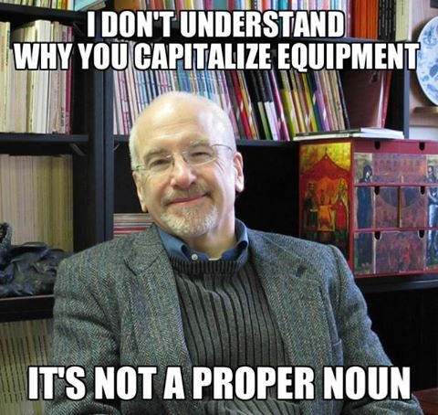
Financial Monitoring – Equipment
Michon
69

Slide 70
Financial Monitoring – Equipment
Michon
When we buy equipment (assets costing over $5000), there are some strings attached to that equipment
CU must use the equipment for the authorized purposes of the project until funding for that project ceases, or until the equipment is not longer needed for that project.
70

Slide 71
Financial Monitoring – Equipment
Michon
If we would like the equipment to be used on a project in addition to the project for which it was purchased – ok as long as it doesn’t interfere with that project
1st priority- projects funded by same agency
2nd priority – projects funded by other federal agencies
3rd priority – any other project
71

Slide 72
Financial Monitoring – Equipment
Departments are responsible for their equipment
PI is responsible for proper maintenance of the equipment
If you move or dispose of equipment, fill out the “Asset Disposal/Move Form” and send to Leisha
We do a physical inventory each year for all federally sponsored equipment- PLEASE help us
72

Slide 73
Financial Monitoring – Equipment
What if a PI is leaving and wants to take the equipment with him?
All equipment belongs to CU!
Any assets transferred from Creighton to another institution must be approved by sponsoring agency and dean of the school.
Let Accounting Services know, so we can dispose of the asset - Asset Disposal/Move Form
73

Slide 74
Financial Monitoring – Equipment
What if PI wants to sell a piece of equipment that was purchased on a federally sponsored project?
Can we keep the money??
If fair market value of $5,000 or less can be disposed or sold with no further obligation
If over $5000 need to ask agency
Percentage of the proceeds goes back to agency and we get $500 or 10% for our efforts
74

Slide 75
Travel - Amanda
The Fly America Act and Foreign Travel
The Fly America Act states that any foreign travel that is financed by federal funds must be booked on a U.S. Flag Carrier or Code Share Carrier regardless of cost or convenience.
75

Slide 76
Travel - Amanda
Code Share Flight
A code share carrier provides seats for another airline on it’s regularly scheduled flight.
Travelers may fly on a code share flight that is operated by a foreign carrier. However, the ticket MUST have the US Flag Carrier Code for the flight in addition to the foreign carrier code.
76

Slide 77
Travel - Amanda
Open Skies Agreement
Agreement with the EU
All airlines of the countries listed in the agreement can be substituted for US Flag Carriers on International flights including two points outside the US and also from and to the US from EU or any other foreign point.
77

Slide 78
Travel - Amanda
Open Skies Agreement
Agreements with Australia, Switzerland, and Japan
Travelers can use these airlines only if a point of origin/destination is either US or the country with which there is an agreement.
The exception is not allowed when a City Pair exists or if your travel is DOD funded
City Pair- fares available to US Govt personnel and not available to grantees.
78

Slide 79
Travel - Amanda
Other Exceptions?
Long Story Short…YES!
If you know you will have a PI that is traveling internationally please contact Amanda prior to making arrangements. This will ensure that the tickets purchased will be allowable costs on the federal award.
79

Slide 80
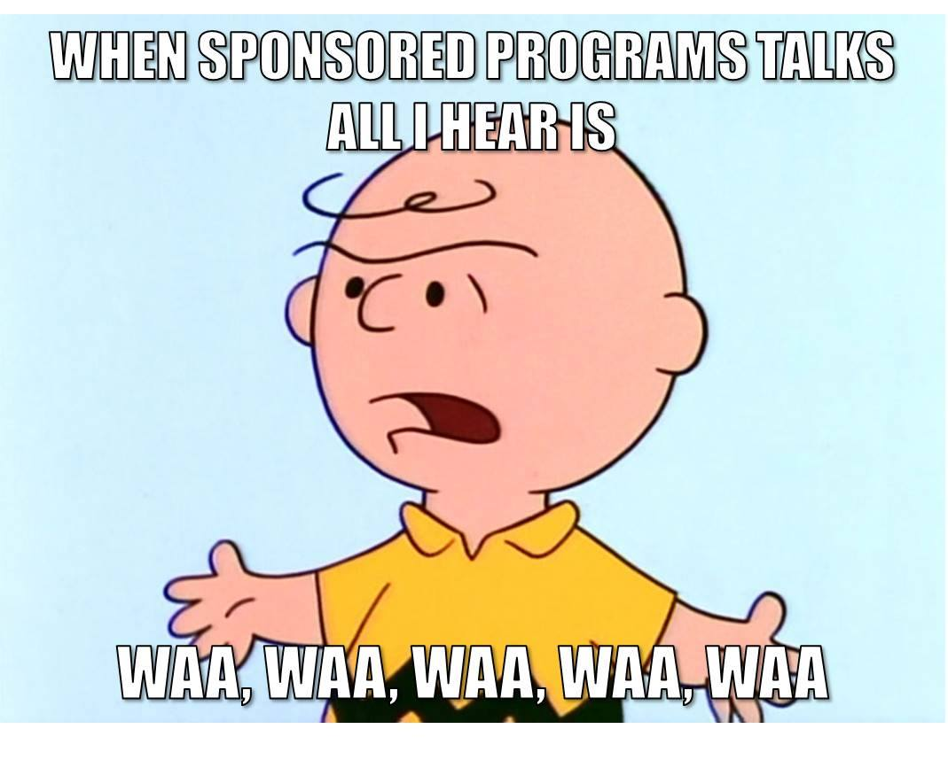
We are here to help!!!
80

Slide 81
Summary - Michon
There are a lot of rules, many are confusing!
We realize that
We have been to a lot of training and want to help you keep yourselves and your PI’s out of trouble
Please consider us your partners and call with any questions anytime!!
THANK YOU!!!!
81

