Slide 1
CUBuyplus®
I’m Registered… now what?

Slide 2
Introductions:
Joe Zaborowski – Director of Purchasing at Creighton University
Daniel Perry – Supplier Relations and Support, Unimarket North America
Ed DuPree – Assistant Director of Purchasing at Creighton University

Slide 3
Agenda
Background on eProcurement
Issues that lead to the change
Results
Who Benefits
Demo from the end-user view
Demo of Supplier Experience
Q & A

Slide 4
Background
Issues Needing Resolution
Volume of paper
Timeline old vs. new
Size of the supplier database
Accuracy/Reliability of Supplier Information
Government requirements

Slide 5
Results of the Process
Unimarket North America – clear choice
Tool name
Invitation process
Supplier selection
Initially and then by department
What does this mean to Creighton?
What does this mean to our Suppliers?

Slide 6
Your Customer’s View
Types of users
Browser
Buyer
Supply Chain Specialist
Types of Supplier sites
Roundtrip
Hosted Catalog
Non-Catalog

Slide 7
Ordering through CUBuyplus

Slide 8
Supplier view of CUBuyplus
Premium vs. Registered
Setting up a catalog
Changing your information
Providing quotes
Responding
RFQ
RFX
Collaboration
Invoicing
One-off purchases

Slide 9
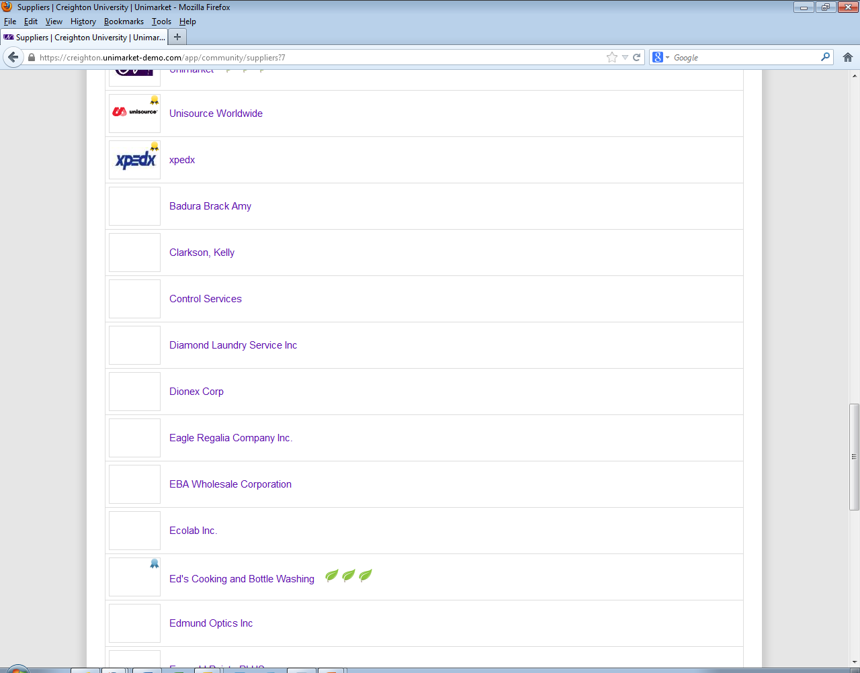
Premium vs. Registered

Slide 10
CUBuyplus® Supplier Benefits
Benefit | Premium | Registered
Location on marketplace | Alpha begins with Premium suppliers | Alpha following Premium suppliers
Hosted punchout catalog | Yes | No
Point and Click shopping experience | Yes | Manual process
Request for quote | Yes | No
Request for proposal | Yes, no additional fee | Yes, small fee for winner
eInvoicing | Yes | No
Cost | Yes, less than % charged for P-Card | No cost
Sustainability indicator | Yes | Yes
Minority spend indicator | Yes | Yes
Worldwide marketing exposure | Yes | Limited

Slide 11
Supplier View of CUBuyplus
Setting up a catalog
Changes
Providing a quote
Responding to RFQ
Responding to RFX
substitutions
Forums
Collaboration
Invoicing

Slide 12
Questions?

Slide 13
Thank you!

