Slide 1
Contractors Information Session
Purchasing Department
Joe Zaborowski-Director
Ed DuPree-Asst. Director

Slide 2

Welcome
Introductions

Slide 3

State of the Economy at Creighton University
News of late
Projects
Turnaround

Slide 4
You Have the Business if?
PO
Credit Card
Notice to Proceed
Need a lien waver
NE Const Lien Act
Capital projects only
Signed and returned with invoice after job is complete

Slide 5
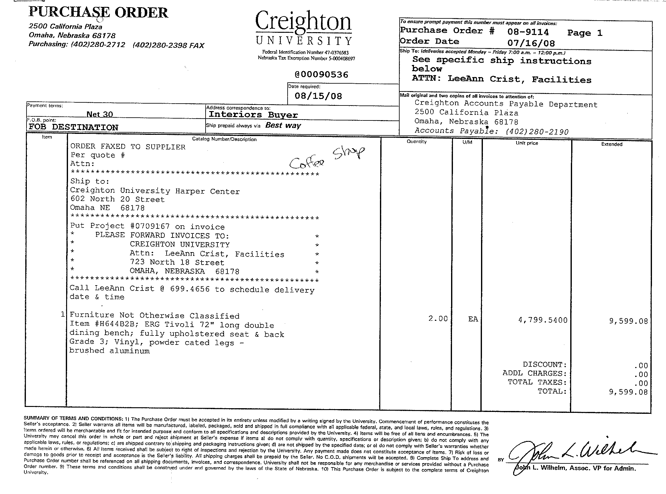
Creighton Purchase Order

Slide 6
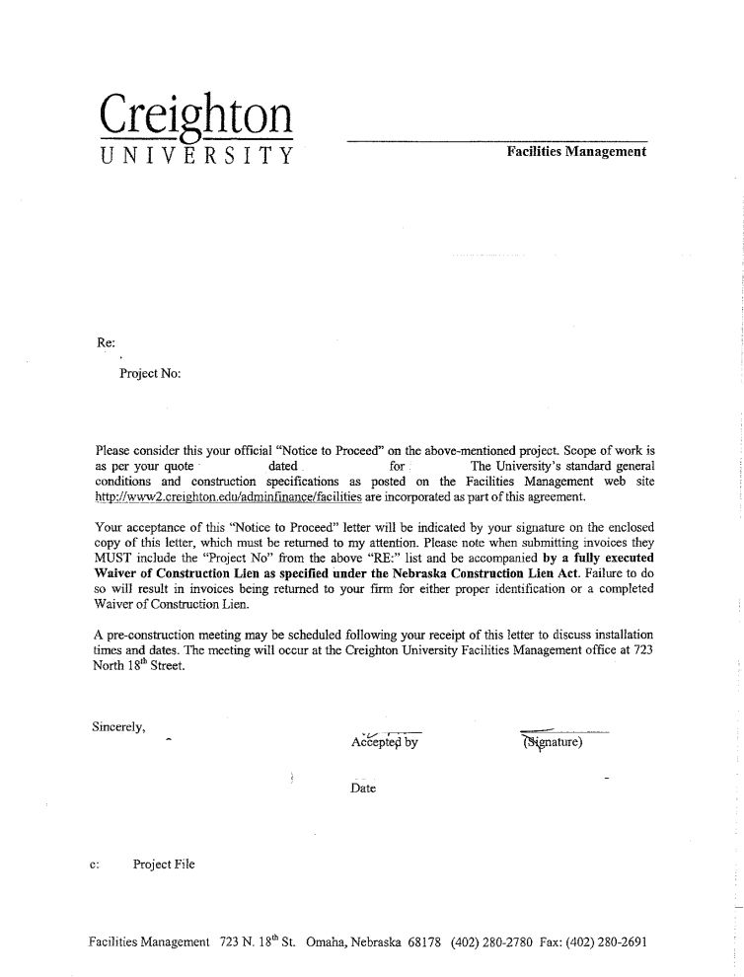
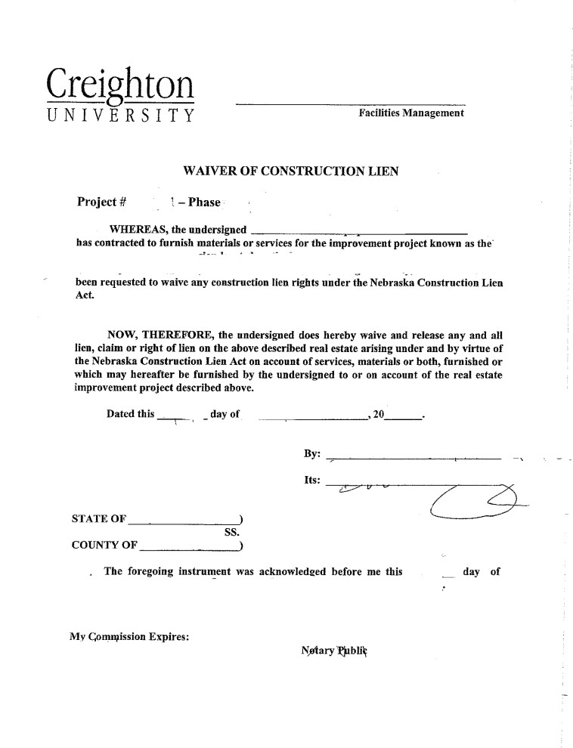
Notice to Proceed Lien Waiver

Slide 7
Responsibility Level
Purchasing
Initial contact for CU business
Can delegate to client or other CU departments
Facilities
Project Managers

Slide 8

Moving
Campus Moving Services
CU internal process
CU responsibility
Moving companies
Reconfigures and installation

Slide 9
Transportation
Delivery Costs – What’s included?
Fuel costs http://tonto.eia.doe.gov/oog/info/gdu/gasdiesel.asp
Inconsistent charges
Fuel charges
Handling fees
Install costs on jobs

Slide 10
Delivery
Schedule designated time on campus
Fee would included in cost of goods/services
Same day each week if possible except for emergencies
Larger jobs would need special scheduling

Slide 11
Routine Deliveries
Pricing Model
Labor and delivery included
No trip charges
Quote not to exceed
Figure the worst possibilities
Inventory
Allow for 1.5 turns per delivery period

Slide 12
Installations
Schedule install and deliveries with LeeAnn first
Department to be notified by CU
CU to schedule other facets of job for completion
IT
Computer
Printer
Facilities
Painters
Carpet

Slide 13
Invoicing
Correct Information on Invoice
Include PO number
Verify pricing with PO, they should match
Send to Accounts Payable
Not the Department when a PO has been issued
Exceptions
Approval of job to be completed
Relocation invoices should be sent to Ed DuPree
If a “Project” follow instructions on the PO

Slide 14
Suppliers on Campus
Background check employees
Vehicles should be marked & moved if idle
Employees identified by uniform or logoed shirt
Check in at Facilities daily for temporary badge and key sign out if needed
Badges available for more permanent workers
(Name, picture, CU contractor, CU logo, expiration date, $3.00)
Sales staff falls into the guest category
Parking should be arranged through Public Safety
This is a tobacco free zone

Slide 15
Services for CU
Samples available to CU (if needed)
Drawings and proofs as part of project
Communication
Working with department without CU knowledge, Purchasing needs to know 1st.
Copy all quotes and communication to Purchasing while working with CU dept
Quotes- turnaround time
Customer Service

Slide 16
Becoming a Partner
Fair price – Trends in pricing Purchasing.com – The Magazine of Procurement & Supply Chain Management Best Practices
Sustainability
Hottest item on campus today
Environment and Social Justice
MWBE
Service – Service - Service
Partnering for savings

Slide 17
Creighton Web Sites
Purchasing
http://www2.creighton.edu/adminfinance/purchasing/supplierspage/index.php
Facilities
http://www2.creighton.edu/adminfinance/facilities/planninganddesign/supplierregistration/index.php
President’s Office
http://www.creighton.edu/administration/president/presidentsupdate/index.php

Slide 18
Questions & Answers

