Slide 1

Is There a Gender Gap
in Service-Learning Faculty?
Dann J. May, M.S., M.A.
Adjunct Professor of Religion & Director of Service-Learning
Wimberly School of Religion
2009 National CASTL Institute Conference
“Ethics of Inquiry”
Creighton University, Omaha, Nebraska
June 3-6, 2009

Slide 2

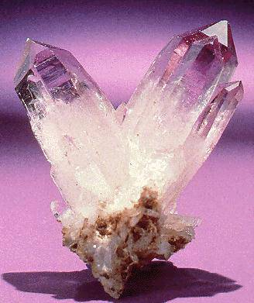

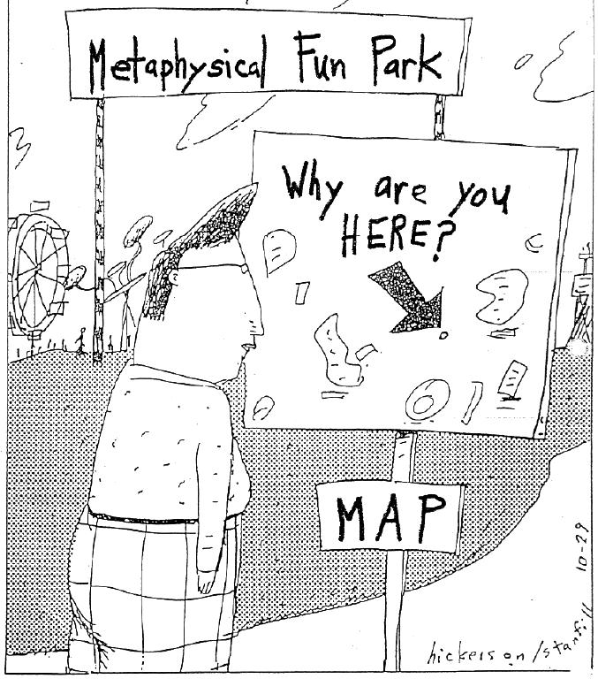
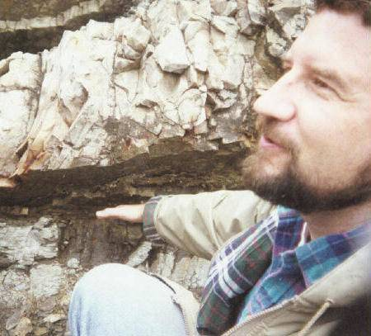
My first two degrees are in geology -- specifically paleontology. My third degree is in philosophy of religion.

Slide 3
Outline
1. Introduction
Overview of OCU’s service-learning (SL) program
The Gender Gap revealed
SL faculty surveys reveal further gender gaps
Conclusions / Possible Hypotheses
6. My questions

Slide 4
My SoTL Research Questions
Is there a gender gap in service-learning faculty? Yes – women are more likely to teach a SL course, and teach it repeatedly.
What are the causes or explanations of this gap?
3. What are the implications of this gap?
For promotion and tenure, for student learning, for the broad faculty and administrative acceptance of SL?

Slide 5
What is Service-Learning?
Service learning is an educational methodology that integrates community service with academic instruction as it focuses on critical, reflective thinking and civic engagement. Students participate in organized community service that addresses community needs, while developing their academic skills, sense of civic responsibility, and commitment to the community. -- en.wikipedia.org/wiki/Service_learning, emphasis mine

Slide 6
What is Service-Learning?
Volunteerism Internships
Service-Learning
Volunteerism primarily benefits the community
Internships primarily benefits the student
Service-learning combines service to the community with academic learning in order to benefit both society and the student.

Slide 7
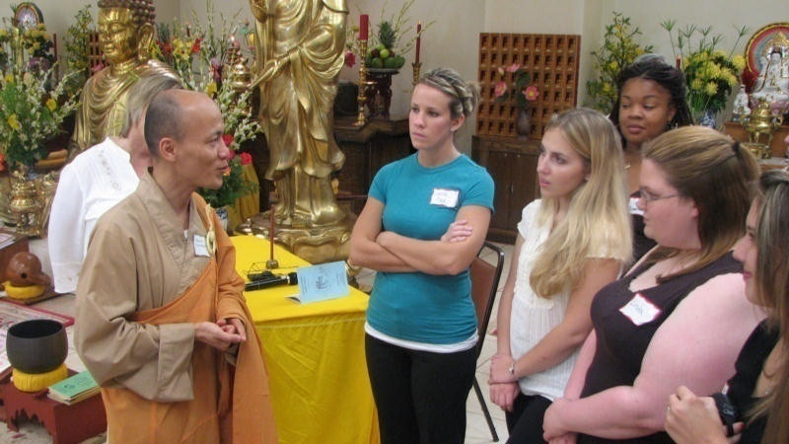
Service-Learning Research at OCU
Part I: Overview and General Comments
Service-learning religion students at the OK Buddhist Conference, Fall 2007

Slide 8
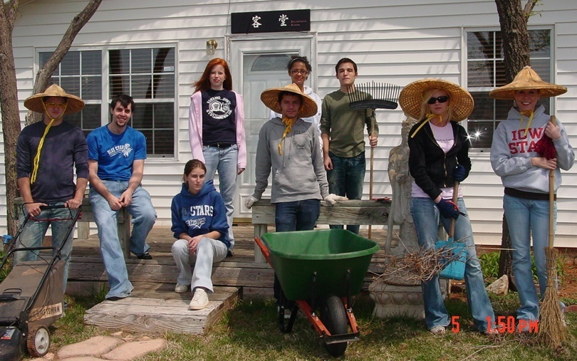
Service-Learning at OCU
Since the inception of the service-learning (SL) program in the 2002 spring semester, OCU has offered 179 service-learning courses.
Service-learning
students at
the Buddha Mind
Monastery,
Spring 2008

Slide 9
Service-Learning at OCU
Starting in fall 2003, a SL course was made part of the general education requirement for all undergraduates.
OCU was the first in OK to have this requirement.
Full-time faculty who submit proposals for new SL courses are eligible for stipends ranging from $500-$2000.

Slide 10
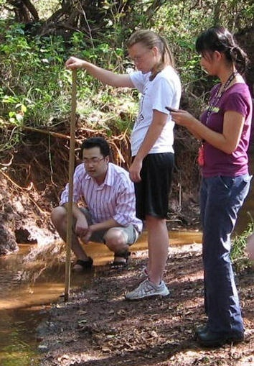
Service-Learning at OCU
Some Statistics (F2008-S2009):
26% of students in 2008-2009 completed a SL course (of 1942 FTE undergraduates)
39 S-L courses were taught (3% of total courses offered)
13 separate academic programs and departments offered SL courses
24 faculty (4 adjuncts) / 241 FTE faculty
Students working with Blue Thumb Stream Assessment, BIOL 1015

Slide 11
Service-Learning at OCU
Data:
1. Service-learning master course list
-- 179 courses since fall 2002
-- 202 courses by fall 2009
2. 53 faculty surveys since fall 2008
-- fall 2008 & spring 2009 semesters
3. Reflection papers
4. 500+ student surveys

Slide 12
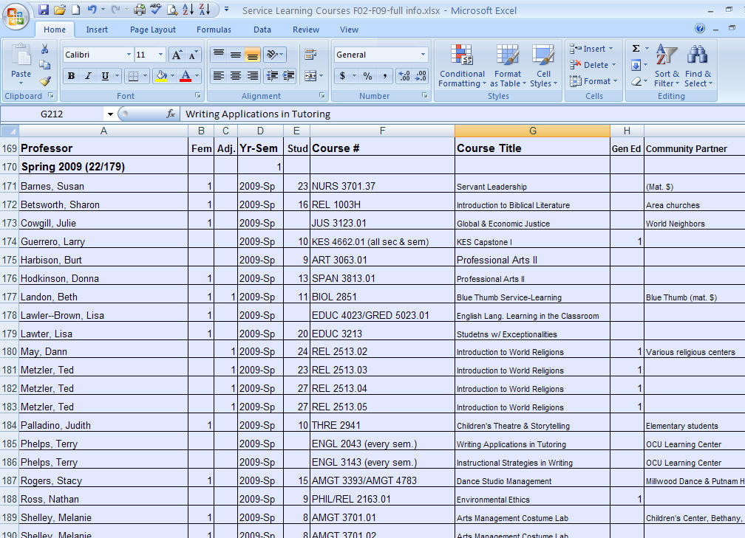
Page from SL Master Course List

Slide 13
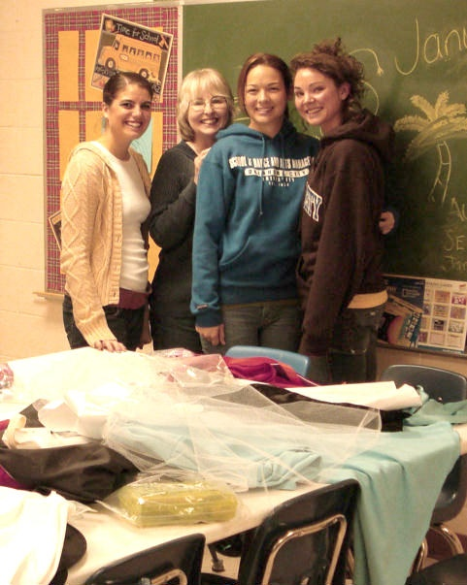
Faculty SL Survey
The faculty survey is located at Qualtrics.com:
http://qualtrics.com/
Service-learning dance students at Positive Tomorrows, Spring 2008

Slide 14
Service-Learning at OCU: Fall 08–Spring 09
39 Separate Courses Across 6 Schools & Colleges
(currently no SL courses in Law or Music)

Slide 15
Service-Learning at OCU: Spring 02–Fall 09

Slide 16
Service-Learning at OCU Since Fall 2002
At least 50 separate courses across 6 Schools & Colleges
(no SL courses in Law or Music)

Slide 17
Service-Learning at OCU Since Fall 2002
At least 50 separate courses across 23 academic units and programs.

Slide 18
23 Academic Units with SL Courses
Accounting
Art
Biology
Chemistry
Dance
Dance Management
Computer Science
Economics
Education
English
History
Justice Studies / Sociology
Kinesiology
Management
Mass Communications
Nursing
Philosophy
Photography
Psychology
Religion
Sociology
Spanish
Theatre

Slide 19
Service-Learning at OCU Since Fall 2002
60 General Education Courses Taught as SL

Slide 20
Service-Learning at OCU Since Fall 2002
26 of 179 S-L Courses Taught by Adjuncts

Slide 21
Student Reflection: The Unexpected Things Students’ Learn and Experience
“My experience at the Buddhist Mind Monastery was like nothing I could have predicted. I thought we would just do a few hours of volunteer work. . . . Instead, I got the opportunity to meet two insightful nuns, learn more about Buddhism, learn how to meditate… I even got to try eggplant for the first time ever. I was given the opportunity to do some rewarding work inside and outside the monastery.”
-V. Nsikak, OCU student, REL 2513: Introduction to World Religions, emphasis mine

Slide 22
Service-Learning Gender Differences at OCU (since fall 2002)
52 full-time faculty have offered a SL course:
38 women & 14 men
239 Full-Time Faculty at
OCU in Fall 2008
Service-Learning Faculty

Slide 23
Service-Learning Gender Differences at OCU (F2008-S2009)
24 Faculty taught a SL course

Slide 24
Service-Learning Gender Differences at OCU (since fall 2002)
Female Faculty More Likely to Repeat a SL Course
(includes Full-Time, Adjuncts & Dean of SOR)
#
of
Facu
l t y

Slide 25
Service-Learning Gender Differences at OCU (since fall 2002)
Female Faculty More Likely to Repeat a SL Course
#of
Facul t y

Slide 26
Service-Learning Gender Differences at OCU (since fall 2002)
57 faculty have taught at least one SL course:
52 full-time & 5 adjuncts: 39 women & 18 men

Slide 27
Service-Learning Gender Differences at OCU (since fall 2002)
Female Faculty More Likely to Receive a Stipend
- 36 full-time faculty have received a SL stipend:
- 25 women and 11 men
# of
Facul
ty

Slide 28
Service-Learning Gender Differences at OCU (since fall 2002)
111 of 179 SL courses taught by women:

Slide 29
Service-Learning Gender Differences at OCU (since fall 2002)

Slide 30
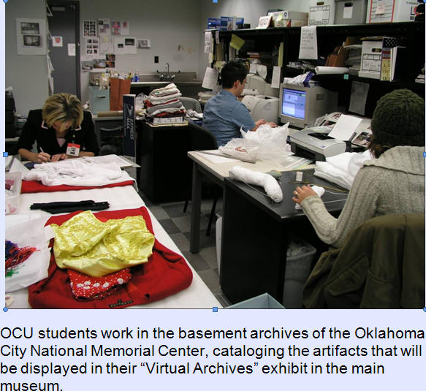
Part II: Survey of Service-Learning Faculty Fall 2008 – Spring 2009
53 Responses: 29 Faculty Members 12 males
17 females 31 Different SL Courses 15 departments and academic units

Slide 31
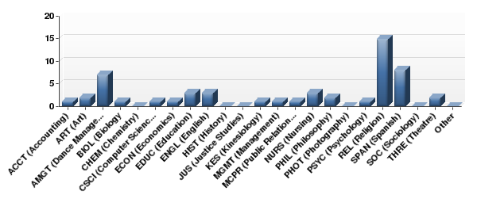
Select the course department abbreviation for your service-learning course.
REL 28%
AMGT13%
SPAN15%
Statistic | Value
Mean | 13.53
Variance | 48.29
Standard Deviation | 6.95
Total Responses | 53

Slide 32
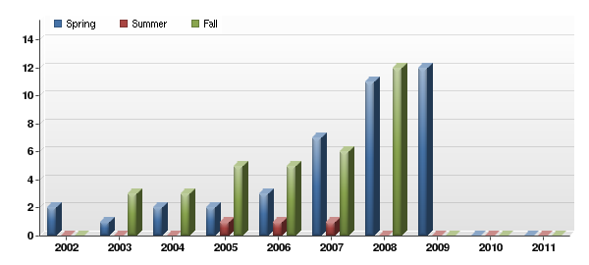
Semester Service-Learning Course was Taught
Statistic | 2002 | 2003 | 2004 | 2005 | 2006 | 2007 | 2008 | 2009 | 2010 | 2011
Total Responses | 2 | 4 | 5 | 8 | 8 | 13 | 22 | 12 | 0 | 0

Slide 33
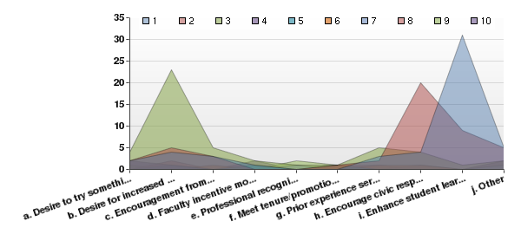
What were your top reasons for deciding to teach a course using service-learning as a teaching method?
#1
#2
SL Stipend
#3
#1: Enhance student learning
#2: Desire for increased relevance in course
#3: Encourage civic responsibility

Slide 34
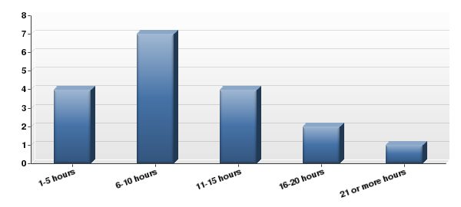
On average, how many hours did each student serve?
39%
Statistic | Value
Mean | 2.39
Variance | 1.31
Standard Deviation | 1.14
Total Responses | 18

Slide 35
Service-Learning Survey: Faculty Comments
“The course (NURS 3701) was already in existence, but no faculty member volunteered to do it. It is sad to say that is how I got involved, but it really did change my life!!! It was a wonderful experience.” -- Susan Barnes, spring 2008
“Richer context for student learning.”
-- Donna Hodkinson, teaches 6 different Spanish courses as service- learning, fall 2008

Slide 36
Service-Learning Faculty Comments
“It is quite difficult for college students to fully understand the difference between children’s cognitive processes and abilities and their own when students only study theory. It is also difficult for college students to appreciate the power and benefits of folk tales and fairy tales ‘in theory.’ college students also listen with skepticism when told reading to children helps a child succeed in school. All three of these theories become visible and comprehensible to college students as they participate in children’s education at Wilson Elementary School.” -- Judith Palladino, THRE 2941: Children’s Theatre Lab/Storytelling, spring 2008

Slide 37
Faculty Responses to the SL Survey: Gender Differences
29 faculty members responded (2002-2009):
12 male faculty members
17 female faculty members

Slide 38
53 Responses to the SL Survey: Gender Differences
Statistic | Value
Mean | 1.58
Variance | 0.25
Standard Deviation | 0.50
Total Responses | 53
# | Answer | Response | %
1 | Male | 22 | 42%
2 | Female | 31 | 58%
 | Total | 53 | 100%

Slide 39
Faculty Responses to the SL Survey: Gender Differences
29 faculty members responded
53 responses
to the survey

Slide 40
Faculty Responses to the SL Survey: Gender Differences
24 Faculty taught a SL course

Slide 41
1. Service-learning enhanced my ability to communicate the core competencies of the subject matter I teach.
92% Agreed or Strongly Agreed:
38% of all male faculty responses
54% of all female faculty responses
53 Responses from 29 Faculty Members (12 males & 17 females)

Slide 42
2. The service-learning project helped my students see the relevance of the course subject matter.
92% Agreed or Strongly Agreed:
40% of all male faculty responses
52% of all female faculty responses
53 Responses from 29 Faculty Members (12 males & 17 females)

Slide 43
3. The service-learning aspect of this course helped my students see how the subject matter they learned can be applied to everyday life.
90% Agreed or Strongly Agreed:
38% of all male faculty responses
52% of all female faculty responses
53 Responses from 29 Faculty Members (12 males & 17 females)

Slide 44
4. The service my students completed was beneficial to Oklahoma City University.
88% Agreed or Strongly Agreed:
39% of all male faculty responses
49% of all female faculty responses
53 Responses from 29 Faculty Members (12 males & 17 females)

Slide 45
5. The service my students completed was beneficial to the community.
96% Agreed or Strongly Agreed:
42% of all male faculty responses
54% of all female faculty responses
53 Responses from 29 Faculty Members (12 males & 17 females)

Slide 46
6. The service my students competed interfered with their other academic responsibilities.
27% Agreed or Strongly Agreed:
6% of male faculty responses
21% of female faculty responses
60% Disagreed or Strongly Disagreed:
35% of male faculty responses
25% of female faculty responses

Slide 47
Student SL Survey: Pg 4 Sect 3 Q5: Compared to regular classes, I found that service-learning interfered with my other academic responsibilities.
Range- 1-5
218 Respondents
37% Agree
or Strongly
Agree
36% Disagree
or Strongly
Disagree

Slide 48
7. Using service-learning required more of my time as a teacher.
63% Agreed or Strongly Agreed:
17% of all male faculty responses
46% of all female faculty responses
53 Responses from 29 Faculty Members (12 males & 17 females)

Slide 49
8. Using service-learning was worth the effort.
91% Agreed or Strongly Agreed:
37% of all male faculty responses
54% of all female faculty responses
53 Responses from 29 Faculty Members (12 males & 17 females)

Slide 50
9. I will use service-learning as a teaching strategy with future courses.
85% Agreed or Strongly Agreed:
35% of all male faculty responses
50% of all female faculty responses
53 Responses from 29 Faculty Members (12 males & 17 females)

Slide 51
10. Service-learning helps fulfill Oklahoma City University's mission.
94% Agreed or Strongly Agreed:
37% of all male faculty responses
57% of all female faculty responses
53 Responses from 29 Faculty Members (12 males & 17 females)

Slide 52
11. There should be more courses offering service-learning at Oklahoma City University.
64% Agreed or Strongly Agreed:
35% of all male faculty responses
29% of all female faculty responses
53 Responses from 29 Faculty Members (12 males & 17 females)

Slide 53
12. I am satisfied with the assistance I received with the mechanics of service-learning
69% Agreed or Strongly Agreed:
29% of all male faculty responses
40% of all female faculty responses
53 Responses from 29 Faculty Members (12 males & 17 females)

Slide 54
14. Teaching a course that incorporates service-learning has affected the following (Check all that apply)
53 Responses from 29 Faculty Members (12 males & 17 females)

Slide 55
15. Have you taught this course as service-learning before?
77% Yes:
35% of all male faculty responses
42% of all female faculty responses
53 Responses from 29 Faculty Members (12 males & 17 females)

Slide 56
Is There a Gender Gap in Service-Learning Faculty?
Conclusion:
Female faculty members are more likely to offer service-learning courses and to teach such courses repeatedly.
Is this true across the country, or is this a local or regional issue?
Possible Explanations?

Slide 57
Is There a Gender Gap in Service-Learning Faculty?
Possible Hypotheses
1. Female faculty members may have different teaching styles that favor service-learning.
2. Female faculty members may be more open to newer and more engaging teaching practices.
3. Female faculty members teach courses that are more conducive to service-learning.
4. If psychologist Carol Gilligan is correct, women are more likely to have an “ethic of care” based on relationships, community and service. In contrast, men, have an “ethic of justice” that is based on more impersonal and abstract principles. (In a Different Voice: Psychological Theory and Women's Development, 1982, 1993)

Slide 58
23 Academic Units with SL Courses (2002-09)
Male Faculty (26 courses, M/F)
Art (2, 2/2)
Biology (3, 4/3)
Chemistry (1, 2/0)
Economics (2, 3/1)
Education (1, 4/1)
English (2, 3/7)
Justice Studies/Sociology (1,1/2)
Kinesiology (2, 1/2)
Philosophy (1, 4/0)
Psychology (3, 2/2)
Religion (5, 2/2)
Spanish (2,1/1)
Theatre (1, 2/2)
Total: 13 departments
10 departments with both male and female SL faculty
Female Faculty (58 courses, M/F)
Accounting (4, 2/3)
Biology (4, 4/3)
Computer Science (1,7/1)
Dance (4, 2/8)
Dance Management (2, 0/2)
Economics (2, 3/1)
Education (3, 4/1)
English (8, 3/7)
History (1, 2/2)
Justice Studies/Sociology (4, 1/2)
Mass Communications (2, 1/3)
Management (3, 3/2)
Nursing (6, 0/15)
Philosophy (1, 4/0)
Psychology (2, 2/2)
Religion (2, 2/2)
Spanish (6, 1/1)
Theatre (3, 2/2)
Total: 18 departments

Slide 59
Is There a Gender Gap in Service-Learning Faculty?
Future research:
What is the percentage of male and female faculty in each of these departments?
Is there a gender gap in our student evaluations of SL
How might focus groups, in depth interviews, etc., further reveal or explain this gap.

Slide 60
Is There a Gender Gap in Service-Learning Faculty?
Some of My Questions
How else might I analyze the data?
How do I obtain similar data from other universities?
How do I actually obtain evidence for any of my four hypotheses? (i.e., include questions about teaching styles in faculty survey)
What am I missing?

Slide 61
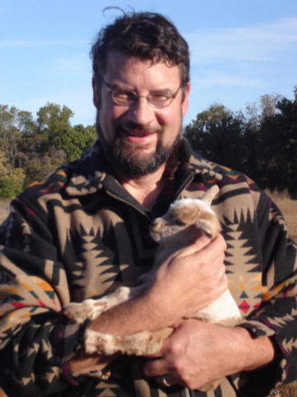
Questions & Comments
Dann J. May
Adjunct Professor of Religion and
Director for the Vivian Wimberly Center
for Ethics and Servant Leadership
Wimberly School of Religion
Oklahoma City University
2501 N. Blackwelder
Oklahoma City, OK 73106-1493
(405) 208-5175, dmay@okcu.edu,
http://www.okcu.edu
Dann with newborn baby goat on his 11 acre homestead.

