Slide 1
Why the Jesuits have it right:
an RA’s guide to
Cura Personalis
Shea Sennett
Head Resident Assistant
College of the Holy Cross
July 9, 2009

Slide 2
What is Cura Personalis?
This Latin phrase translates as "Care of the Person," and originally was used to describe the responsibility of the Jesuit Superior to care for each man in the community with his unique gifts, challenges, needs and possibilities. “Cura Personalis” suggests individualized attention to the needs of the other, distinct respect for his or her unique circumstances and concerns, and an appropriate appreciation for his or her particular gifts and insights.
(As given to us by www.georgetown.edu)

Slide 3
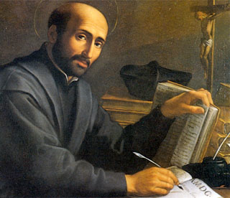
So what is the big deal?
As an RA, this is exactly what we do!
Paying attention to the needs of our residents and helping them develop to the best of their abilities is strongly routed in Cura Personalis.
Each individual will get something
different out of a Cura Personalis
experience.
You may even learn something
new.

Slide 4
But Shea……
I love throwing pizza parties, girl talk
nights and video game nights with my
residents. Cura Personalis sounds like
something a Jesuit or professional staff
member is trying to get me to do. I work
sooooo many hours and don’t get paid
enough as it is…
Alright, the idea of Cura Personalis does seem a little academic and dry, but it is so much more than that!

Slide 5
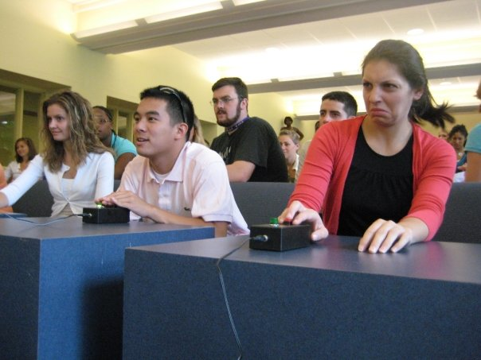
The real power of Cura Personalis
Sit back and think about a program you have done for your residents, even if it is just a pizza party or movie night.
Ask yourself what that program did for your residents.
Next, think about how you could use the idea of Cura Personalis to enhance that program or look at what you did in a new light.
What did we come up with?

Slide 6
The nitty gritty of Cura Personalis
Cura Personalis allows us to look at all that we do in a new light.
Consider the activity we just did, do you view programs you have done in the past differently?
You will find that using Cura Personalis as a programming guide will make future programming easier.
Cura Personalis as a programming
tool is effective because it is
Adaptable
Broad
Can always go further

Slide 7
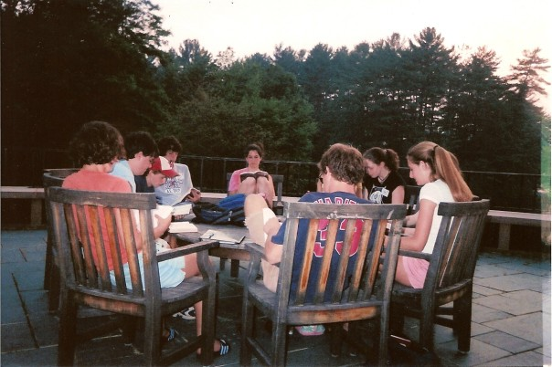
Your turn again!
Try your hand at figuring out how
you could incorporate Cura Personalis
into these programs:
1.) A movie night
2.) A program about alcohol awareness
3.) A program about the LBGTQ community on campus
4.) Yoga party!
5.) Kindergarten night
6.) Going to a sporting event together
7.) Video game night
8.) Volunteering
9.) A program around a common reading
10.) Political Debate

Slide 8
What did we learn?
If Cura Personalis is so amazingly awesome, how come nobody has told me how to use it in programming before?
Remember the possiblities
Don’t let Cura Personalis limit your programming, let it expand upon the programming you already do!

Slide 9
Taking things a bit further…
So here is the tough part – using Cura Personalis sneakily.
Remember to keep it fun and try not to limit yourself. Let Cura Personalis enhance your programs, not predetermine them.
Using the idea of Cura Personalis to help those you are programming for develop in their own way is what we strive for.
Cura Personalis is one size fits all because it means something different for each individual.
Finally and most importantly…
Just because you are a peer of your fellow students does not mean you cannot help them develop and learn as much as a professional staff member, professor or Jesuit could. We all have something to learn from one another

Slide 10
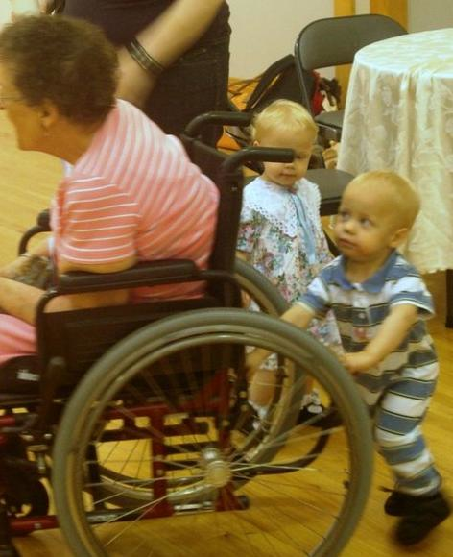
…
Just because you are a peer of your fellow students does not mean you cannot help them develop and learn as much as a professional staff member, professor or Jesuit could. We all have something to learn from one another.

Slide 11
Any questions?

Slide 12
Thanks!
Shea Sennett
Head Resident Assistant
College of the Holy Cross
snsenn10@holycross.edu

