Slide 1
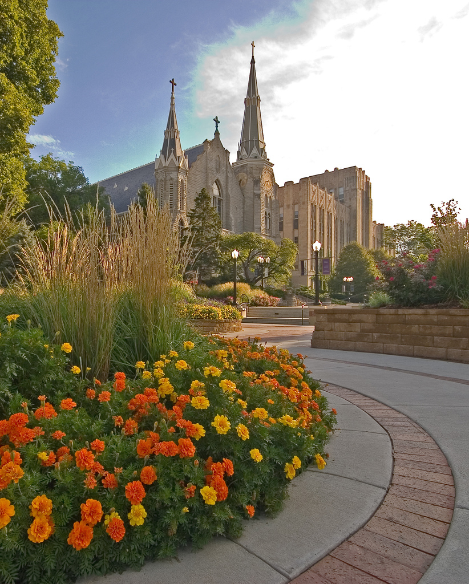
Creighton University Climate Action Plan
Implementation Kickoff
Tuesday, October 31, 2012 10:00-11:00am

Slide 2
Agenda
Sustainability at Creighton (Lennis Pederson)
Climate Action Plan Implementation Kickoff (Dan Burkey)
Sustainability and the Jesuit Mission (John O’Keefe)
Creighton’s Climate Action Plan (Brendle Group)
Greenhouse Gas Inventory
Reduction Strategies
Next Steps
Q&A

Slide 3
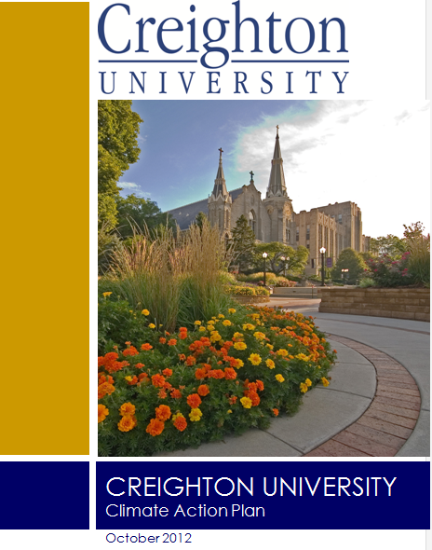

Sustainability at Creighton
Climate Action Plan Implementation Kick-off
Sustainability and the Catholic, Jesuit Mission

Slide 4
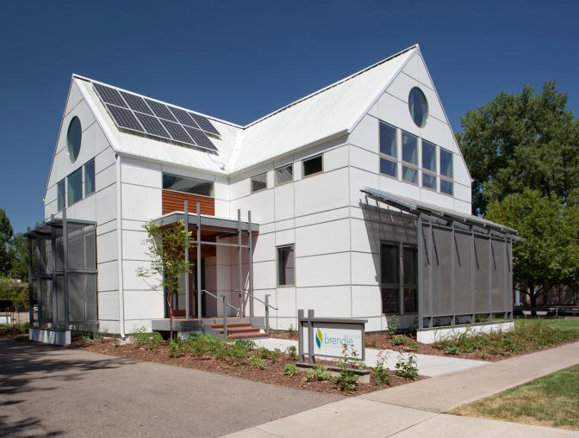
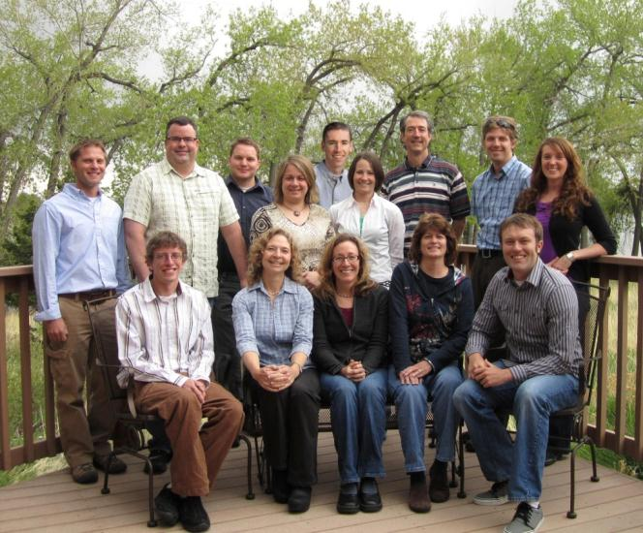
Introducing Brendle Group
Sustainability focused engineering consulting firm
Headquartered in Fort Collins, CO- working nationwide

Slide 5
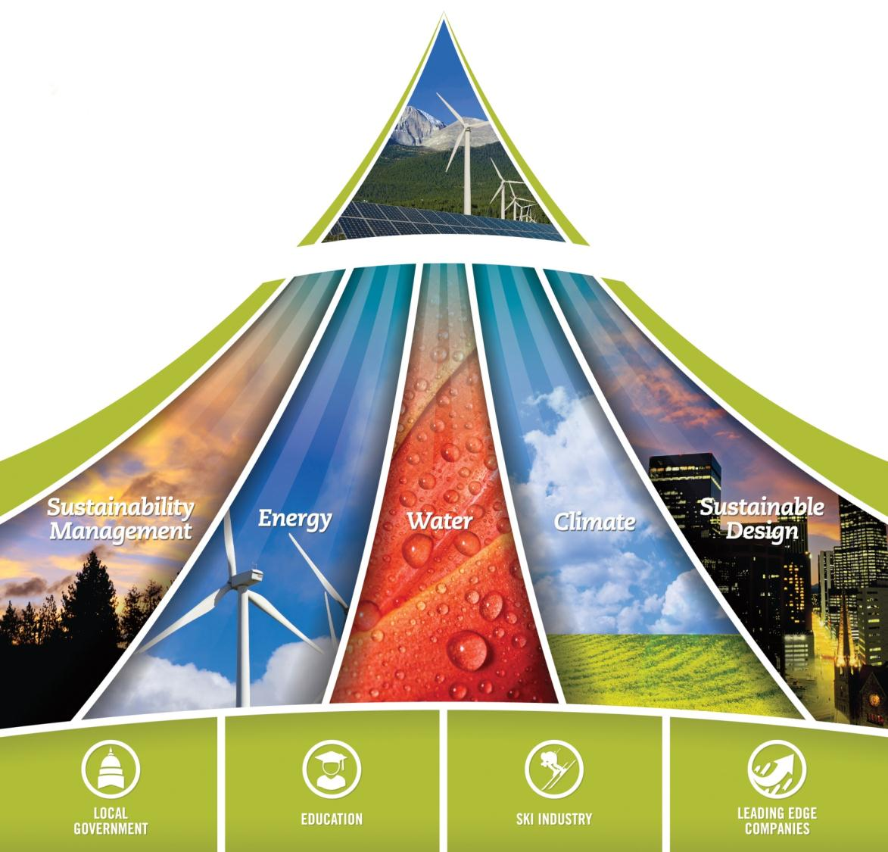


Notes:
Over 200 Sustainability Projects
Over 100 Clients
45 Million Square Feet of Buildings Assessed
Over 20 Million kWh of Energy Savings Identified
Over 460 Million Gallons of Water Savings Identified
Engaging Thousands of People in Sustainability-
Utah projects

Slide 6
Our Approach to Climate and sustainability planning
Top-down meets bottom-up
POLICY AND GUIDING PRINCIPLES
TOPIC AREAS AND GOALS
STRATEGIES
BASELINE INFORMATION
WEB SURVEY
WORKSHOPS
INTERVIEWS

Slide 7
Our Approach to Climate and sustainability planning (Cont’D)
Making effective use of external frameworks
ACUPCC Reporting Requirements
AASHE Stars
Others (Architecture 2030, LEED, etc)
Planning in real-time, rather than a blank slate
Link and align with existing planning and management systems
Strategies: Build on what’s working, troubleshoot what’s not, fill gaps
Analyze and prioritize options
Determine implementation paths, within an existing system
Might mean changing/improving organizational systems
Economic analysis: a plan that makes financial sense and pays for itself

Slide 8
Our Approach to Climate and sustainability planning (Cont’D)
Short-term project for long-term change: continuous improvement and capacity building
Vision / Policy Goals
Strategies
Implement
Measure & Report
Planning Core
Annual Implementation and Monitoring

Slide 9
Climate Planning Process
Develop inventory
Forecast emissions
Develop strategies to reach targets and establish Climate Action Plan
Set GHG reduction targets
Update inventory, revisit goals, and track progress
Completed in 2010; revised as part of CAP development
Based on growth projections; preliminary analysis completed
ACUPCC requires climate neutral but allows institution to establish timeline and intermediate goals
Draft strategies developed with feedback from Sustainability Council
PLAN-DO-CHECK-ACT. ACUPCC requires regular inventories and a monitoring plan

Slide 10
Climate Action Plan Development Schedule
Task | July | Aug | Sept | Oct | Nov | Dec
Task 1: Kickoff Meeting
Task 2: Strategy Development
Task 3: Review Draft Strategies
Task 4: Campus Workshop
Task 5: Campus Survey
Task 6: Document Development
Task 7: Present Final CAP
Task 8: Implementation Support

Slide 11
Fall 2012 Sustainability Survey Results

Slide 12
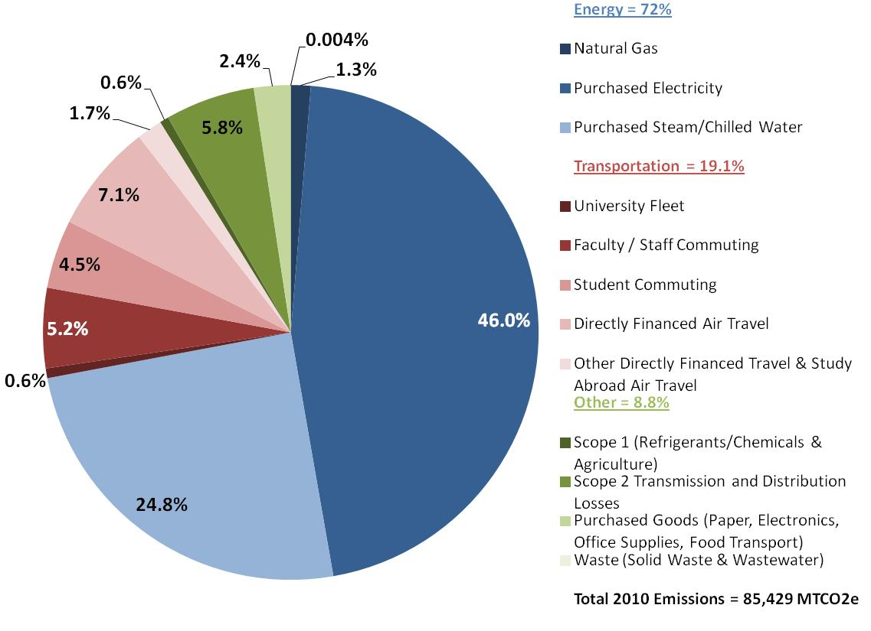
Creighton Fiscal Year 2010 Emissions by Sector
Notes:
ESC emissions factor?

Slide 13
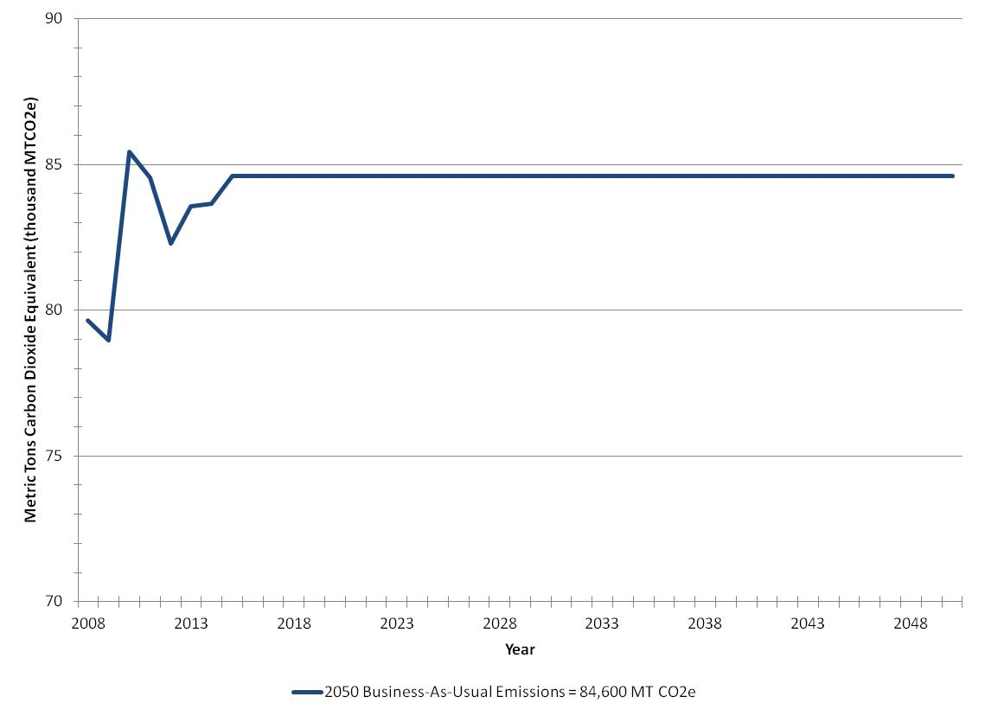
Historical Trends and Business-As-Usual Forecast
Notes:
ESC emissions factor?

Slide 14
Draft Climate Action Plan
Outlines two paths for climate neutrality
Scenario 1 – Climate neutral by 2050
Scenario 2 – Climate neutral by 2028
Integration into Creighton’s Mission and Curriculum
Implementing the CAP
Organizational Development
Continuous Improvement (Plan-Do-Check-Act)
Financing the Plan

Slide 15
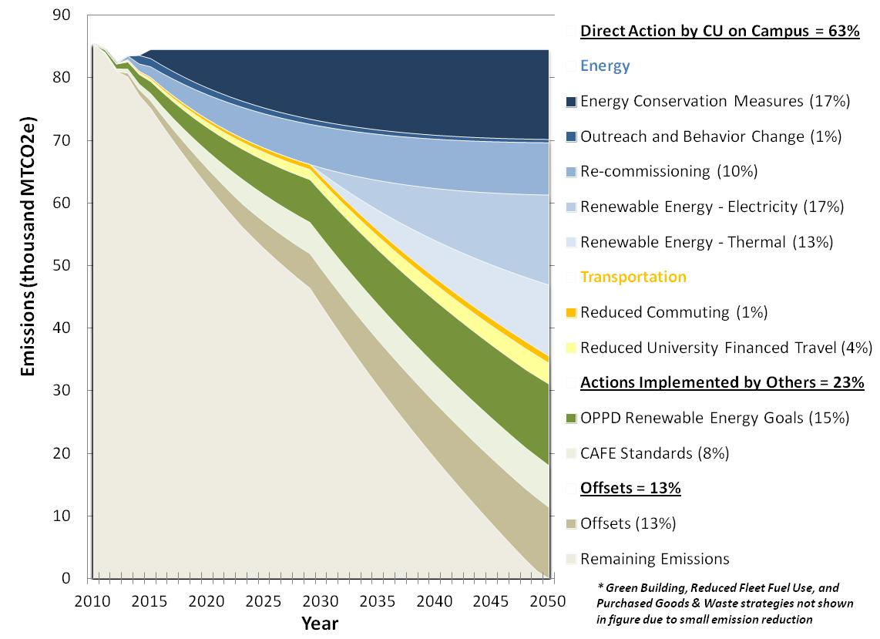
Scenario 1 - Climate Neutral by 2050

Slide 16
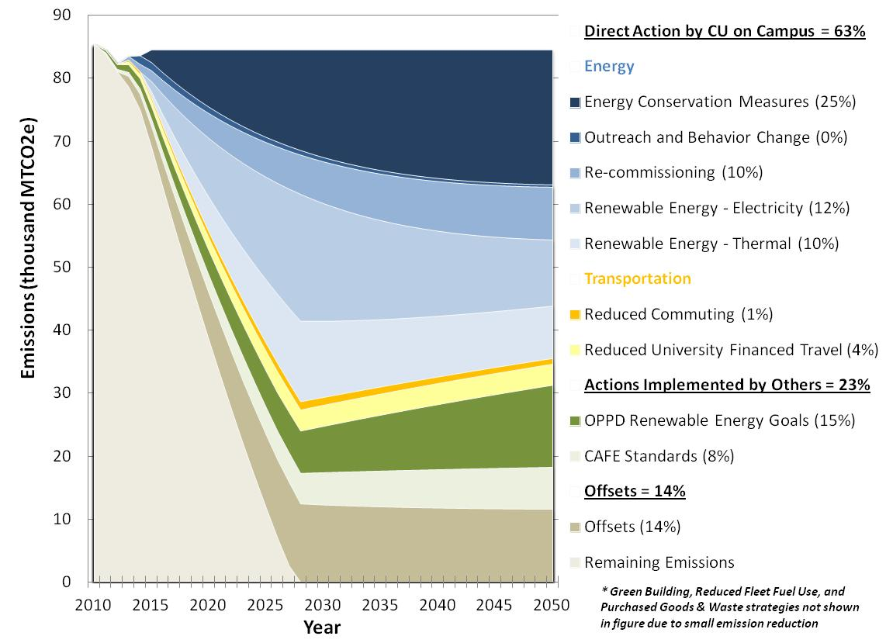
Scenario 2 – Climate Neutral by 2028

Slide 17
Next Steps
Brendle Group
Implementation support (Nov-Dec 2012)
Incorporate feedback into next iteration of plan (Dec 2012)
Integration with strategic planning process (Spring 2013)
Develop detailed approach for first phase of implementation
Prioritized actions
Responsible parties
Funding
Student engagement (Green Jays, curriculum, etc)

Slide 18
Questions?

Slide 19


