Slide 1
Creighton University Chemical inventory system
https://cems.unh.edu/creighton/

Slide 2
Activating your account
Please also include your name, department, and net ID.
You will also want to include any staff, students, or faculty that will be working in your lab.
They will be giving permissions based on title and what you as the PI would like them to have access to.
To activate your labs account please email Mary Duda or Sandra Leighton
maryduda@Creighton.edu or sandraleighton@Creighton.edu

Slide 3
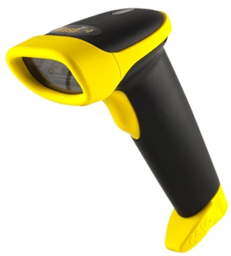
hardware
Any device that has internet access.
Kindles that are available for check out.
https://cems.unh.edu/creighton/CEMS/Login
You will need to login there with your BLUE credentials (netID)
Scanner
You will need to obtain a scanner or check one out.
You can type in all of the barcodes as well – this is not recommended due to human error.
Labels
Creighton labels have been created and will need to be given to you once you have an account
2 Sizes available
Safe at -80C
Creighton University
100131
(not to scale)

Slide 4
CEMS-UNH
Logging in

Slide 5
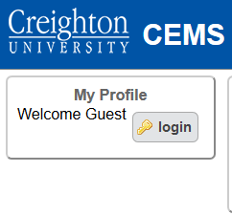
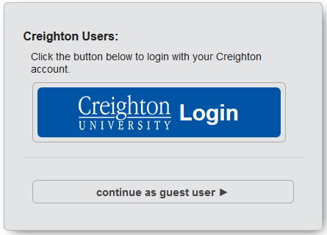
Logging in
You are going to check out a Kindle.
Kindle- Open the Silk Browser
This should take you to CEMS Login page
Other devices use your choice browser
(i.e. Firefox, Safari)
https://cems.unh.edu/creighton/CEMS/Login
Click on the login button
It will take you to the login screen
Click the blue Creighton button
You will be taken to the Creighton login page
Use your NetID email and password

Slide 6
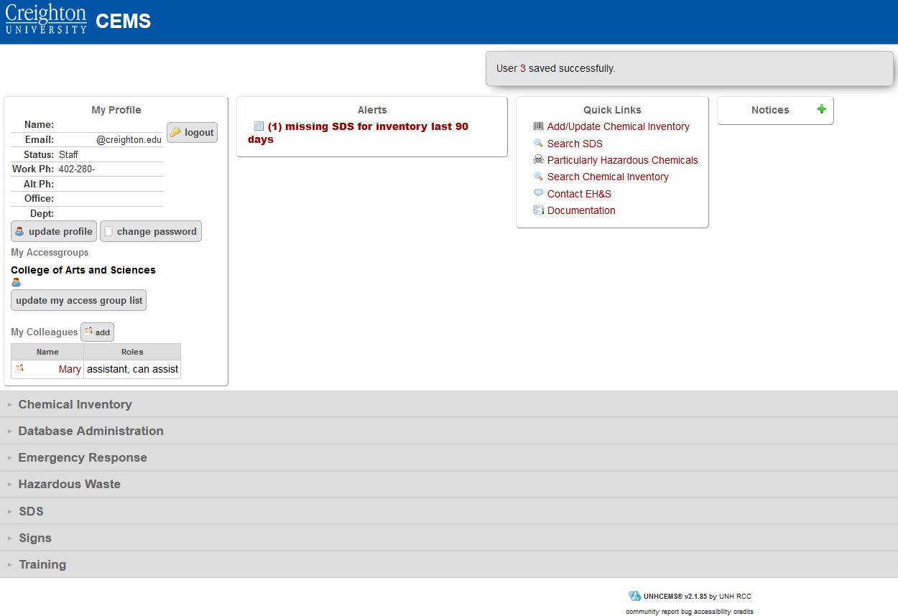
Logging in
This will then take you to the dashboard where you can get started with your inventory.

Slide 7
Adding inventory
Select the add/update inventory

Slide 8
Adding inventory
Adding a chemical to inventory
Scan the Creighton barcode. It should populate in this field
If you have more than one of the same item to add
Insert a (,) and scan as many Creighton barcodes as bottles
If the chemical is newer it will have a barcode on the side. Scan it in this field
This should populate the remaining fields
If product number is available enter it here (type in)
Chemical name is required
THIS IS A LAST RESORT
A list will appear if you haven’t given enough information in the above fields for it to be generated.

Slide 9
Deleting inventory
Deleting inventory is easy and should be done when a container is empty
Click the multi scan mode (ONLY FOR DELETING)
Scan the Creighton barcode. It should populate in this field
If you have more than one of the same item to add
Insert a (,) and scan as many Creighton barcodes as bottles
You will then get the option to delete from inventory.
Once you have deleted then it will be removed and the empty bottle can be trashed appropriately.

Slide 10
Adding inventory
Once you enter the previous slide and save you will get “Edit Chemical Record”
Here you can see the information that you are missing about your specific chemical.
Items highlighted in blue are required entries.
SDS
Make sure to click the associate related SDS

Slide 11
Adding inventory
Populating an SDS
Some chemicals are old enough or catalog numbers have changed.
In this case click the associate related this will bring up a list of generic SDS for you chemical
Choose the one that matches to yours
If one is NOT associated, this is ok. The Research Compliance Office is taking care of missing SDSs.

Slide 12
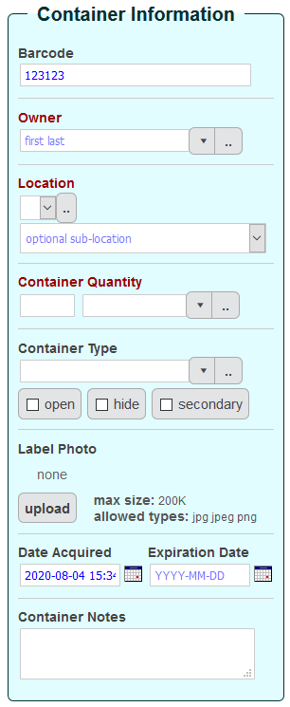
Adding inventory
Choose the PI’s name from the “Owner” dropdown
Choose the location from that dropdown
If your location is not on the list, click the [..] button and add it by clicking on the on the top right
Sub-location refers to areas such as “east shelf” or “flammable cabinet” within the main room.
Please enter each room separately; do not make rooms sub-locations of other rooms.
If the container information is not already populated, add this information.
Once complete “SAVE”
This enters the chemical into your inventory

Slide 13
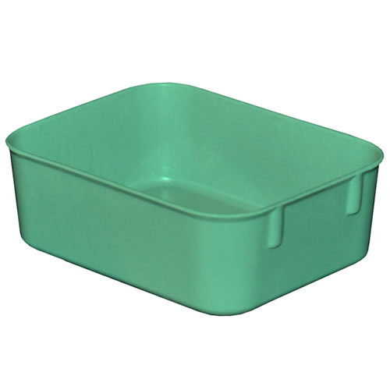
Tracking
Your lab will have a green tote for inventory updates:
Please place:
Empty Bottles
Inventory you no longer use.
Full SMALL waste containers with proper label.
https://www.usplastic.com/
Catalog # : 53460

