Slide 1
Students as mentors—an investigation of student learning in a cell biology course
Laura Salem
Biology Department
Rockhurst University
Mr. Yusuf Kandir
Science Teacher
Brookside Frontier Math and Science School (BFMASS)

Slide 2
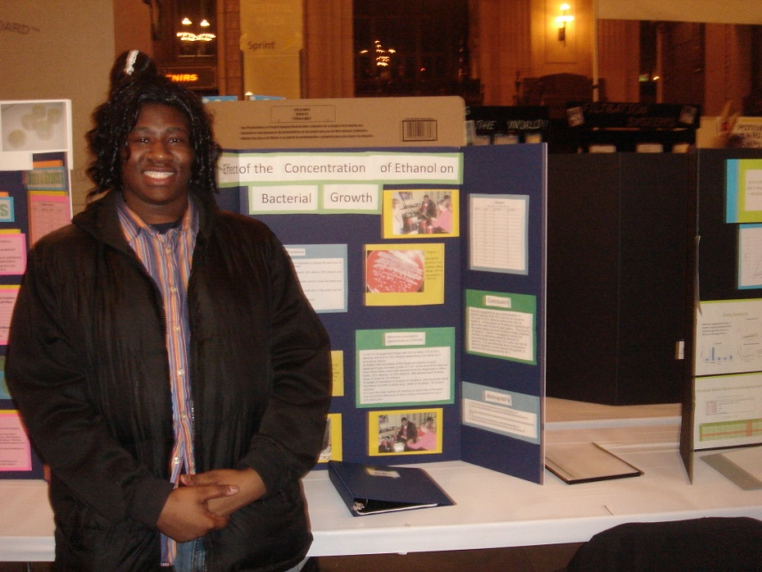
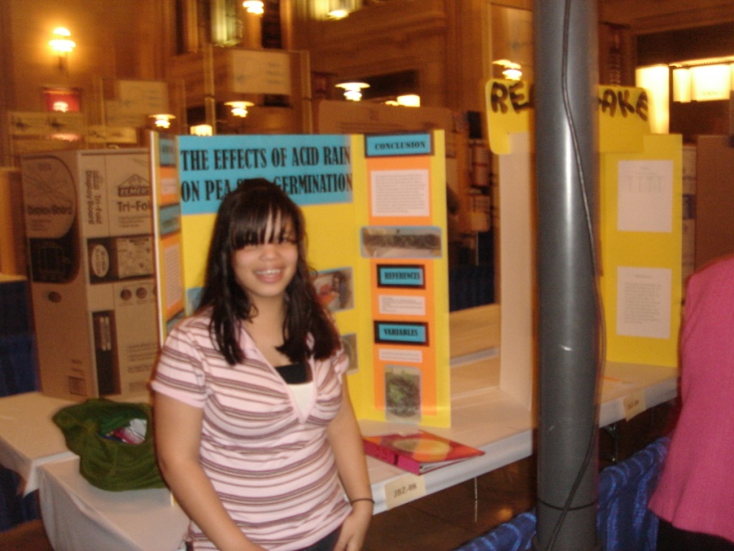
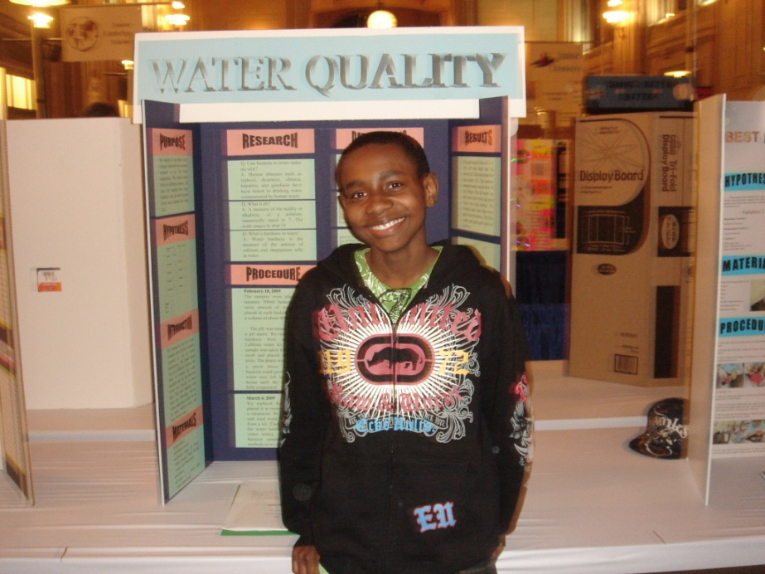
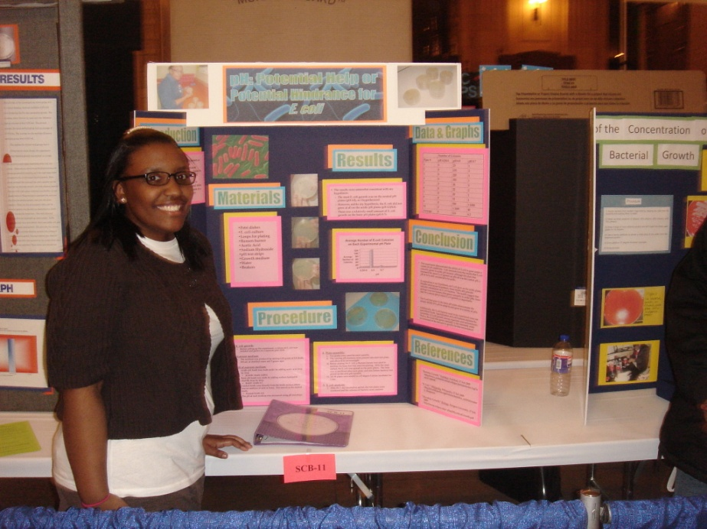

Slide 3
Cell Biology Course at Rockhurst: BL3620/3621
-48 students
-Junior and senior biology or biochemistry majors
-Lecture twice a week for 1 ½ hours
-Lab once a week for 4 hours

Slide 4
What is the central question, issue, or problem you plan to
explore in your proposed work?
It is not uncommon for students in the sciences to have courses heavy in
content, with less emphasis on scientific methodology. To address this issue,
forty eight students in my cell biology course are serving as science fair
project mentors for 6-10 grade students at a local inner city charter school
(BFMASS).
My central focus is on whether or not students who serve as mentors for
science fair projects will have a better understanding of scientific process
and a deeper commitment to the Jesuit mission.
Question: How do students come to understand science as a process
rather than a collection of facts?

Slide 5
Why is your central question, issue, or problem important to
you and to others who might benefit from or build on
your findings?
In order to compete for post-undergraduate education or jobs in
biotechnology, students need to have a solid background in scientific
research and laboratory skills. This project not only allows students to
design and implement individual research projects, but it does so in the
context of students serving as mentors in the community.
Interested audiences for this work may include:
Faculty at institutions who value service learning in the classroom
Biology faculty interested in incorporating research projects into their
  curriculum

Slide 6
Excerpts from course syllabus
This is a service learning course. We will be partnering with students from Brookside Frontier Math and Science School (BFMASS) to help them design and implement science fair projects. More information about the school can be found on their website:
http://www.bfmass.org/
As stated on the Rockhurst website, “Rockhurst University exists to transform lives by creating a learning community centered on excellence in undergraduate liberal education and graduate education. Rockhurst is Catholic and Jesuit, involved in the life and growth of the city and the region, and committed to the service of the contemporary world. Students receive two transcripts when they graduate–one for academic work and another for their service activities.”

Slide 7
Excerpts from course syllabus continued
Learning Objectives :
Participate in service learning with BFMASS by actively engaging students in the scientific method.
Work effectively and collaboratively in groups
Analyze complex problems in cell biology using an investigative, case-based approach.
Explain the genetic and biochemical factors controlling cell division.
Describe the basic function of cellular organelles at the level of detail of the textbook.
Analyze lab results from both your group data and from class data sets.
Describe connections between service experiences and course content and goals.

Slide 8
In this project, Rockhurst students work in groups of three to mentor a single student (in 6-10th grade) from BFMASS.
The project involves:
Brainstorming for experimental ideas.
Filling out appropriate paper work for the science fair.
Writing and submitting a research plan for approval by science fair officials.
Making a supply list.
Conducting experiments (at BFMASS).
Collecting and organizing data.
Poster assembly.
Periodic reflection pieces and final reflection paper.

Slide 9
Types of evidence being collected:
Pre and post Views About Science Survey (VASS).
Periodic reflection papers.
Performance on exam questions related to data interpretation.

Slide 10
Preliminary analysis of the VASS:
Each question offers students two contrasting answers. On a scale of 1 – 8 the students are then asked to rate their view based on the following criteria:
Only a, never b
Mostly a, rarely b
More a than b
Equally a and b
More b than a
Mostly b, rarely a
Only b, never a
Neither a nor b
Example question:
How well I do on biology exams depends on how well I can:
a) Recall material in the way it was presented in class
b) Answer questions that are somewhat different from ones I have seen before

Slide 11
How well I do on biology exams depends on how well I can:
a) Recall material in the way it was presented in class
Answer questions that are somewhat different from ones I have seen before
Average score first day of class: 3.7
Average score last day of class: 5.6

Slide 12
In order to answer a biology question, I need to:
Have seen the answer to a similar question before
Know how to apply general reasoning skills
Average score first day of class: 4.2
Average score last day of class: 5.9

Slide 13
Examples from Service Reflection Papers
Choose a quote that captures your experience working with the BFMASS students and display it at the very beginning of your paper. Why did you choose this quote? How does it relate to your experience?
What values, opinions, beliefs have changed about BFMASS students, the science fair, and/or public education?
What impact did you have on the community?
Look back at your syllabus and read the course goals. Look at the Rockhurst website and read the mission of the University. After looking back at BOTH sources, please clearly articulate how your service learning experience in this course relates to the course goals and the university mission.
Would you recommend that this project continue in the Cell Biology course at Rockhurst? Why or why not?

Slide 14
Choose a quote that captures your experience working with the BFMASS students and display it at the very beginning of your paper. Why did you choose this quote? How does it relate to your experience?
Example:
“We must not, in trying to think about how we can make a big difference, ignore the small daily differences we can make which, over time, add up to big differences that we often cannot foresee.”
-Marian Wright Edelman

Slide 15
What values, opinions, beliefs have changed about BFMASS students, the science fair, and/or public education?
Example:
“The kids that go to BFMASS and other urban public schools get a
reputation that they are the type of kids that are going to grow up to
cause nothing but problems. However, after spending time with them
in the classroom and in the lab, it is clear that they are just kids, no
different from the kids I went to school with. They looked up to us
as role models, a part I was happy to play.”

Slide 16
What impact did you have on the community?
Example:
“The success the students achieved in the science fair helped the community realize not only the great potential of their students, but also the intelligence and dedication of their students. I hope my work with Christina has helped raise community awareness for the significance of science in our lives and also the great abilities of youth to become leaders in science in the future.”

Slide 17
Look back at your syllabus and read the course goals. Look at the Rockhurst website and read the mission of the University. After looking back at BOTH sources, please clearly articulate how your service learning experience in this course relates to the course goals and the university mission.
“One of the course goals was to actively engage BFMASS students in the scientific method. This goal was achieved by meeting with the students, planning the experiments, working through the project using scientific methodology, drawing conclusions from our data, and reporting our results in a display poster. By conferring our assistance to a neighborhood school, we were able to increase the academic growth and overall well-being of our local community.”

Slide 18
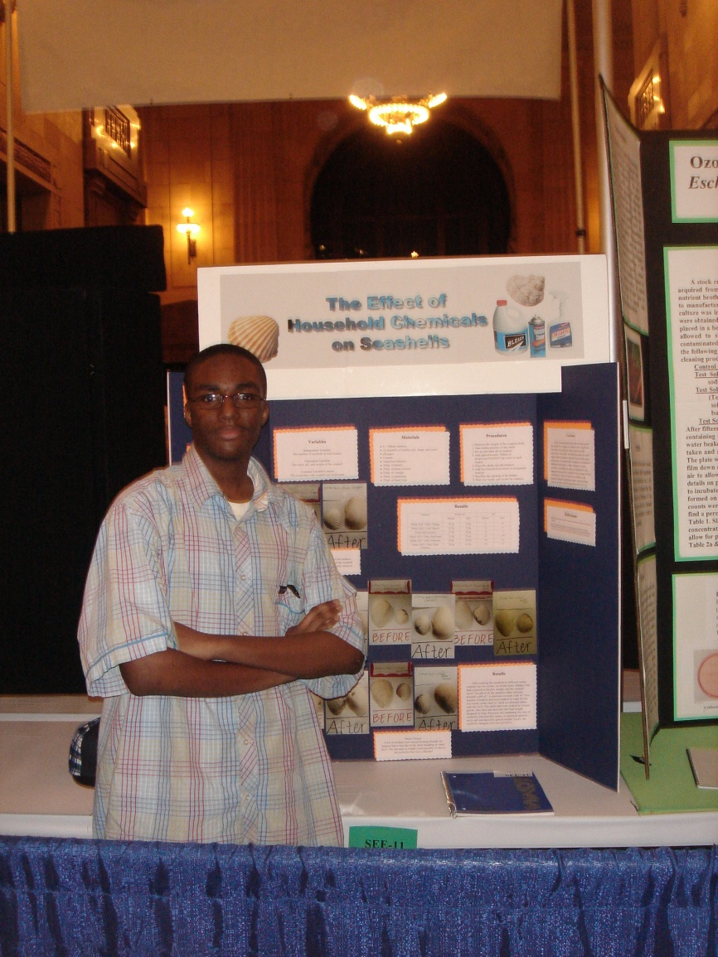
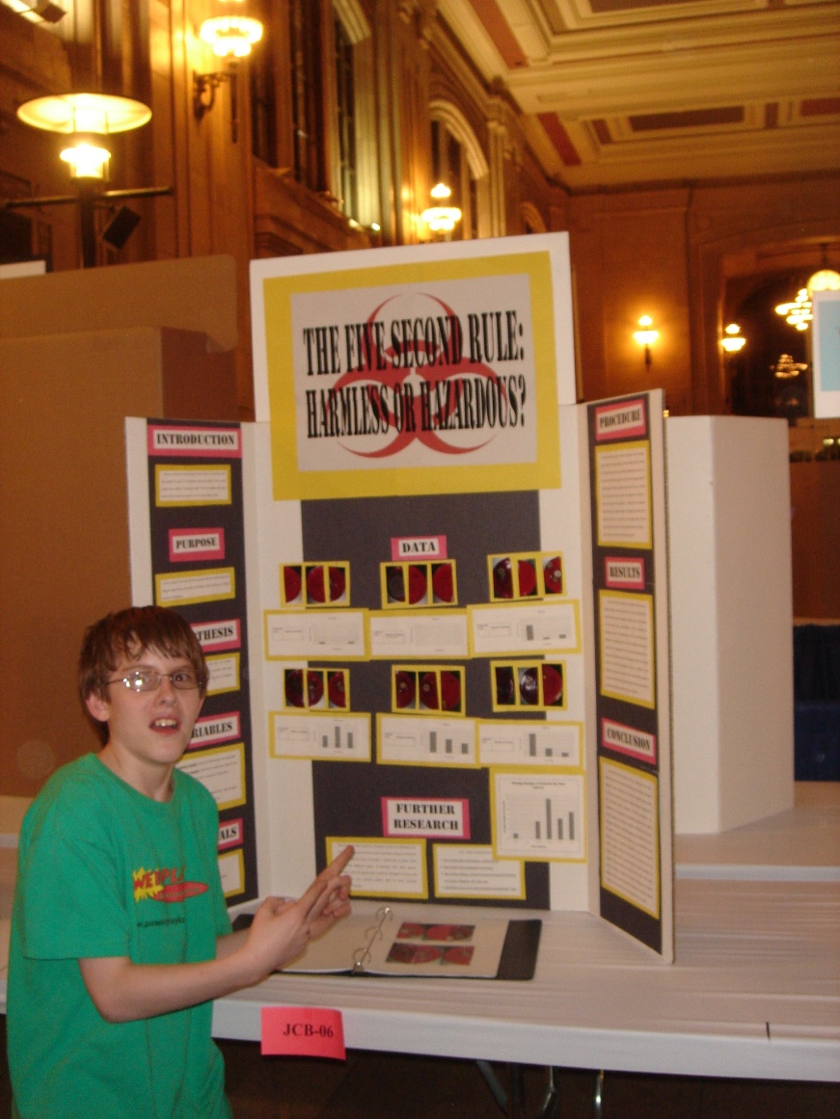
11 of the 13 projects mentored by Rockhurst students received awards at the
Greater Kansas City Science Fair

Slide 19
Would you recommend that this project continue in the Cell Biology course at Rockhurst? Why or why not?
Example:
“I think that it is really important that this project continues in Cell Biology. Besides this class, I haven’t really had the opportunity to make connections with my education and the community very often. Sure, I do volunteer hours, but all of that seems disconnected from my classes. When I leave Rockhurst and move on to the next chapter in my life, this class will make me more aware of the need to always make community work at the heart of everything I do.”
Overall, 100% of students recommended continuing the project.

Slide 20
Questions and Ideas for Future Directions:
Revision of my question/problem?
Clarify a process to evaluate the evidence of student learning
Think more carefully about how to measure the impact of the project on BFMASS students.
Include documentation student-mentor interactions? (possibly via taping of sessions)
Set specific/measurable criteria for science fair projects
Gather evidence of the impact of the project over a longer period of time. For example, do BFMASS students who participate in this project continue to pursue scientific research opportunities? Do Rockhurst students who participate in this project continue to be involved in community work?

