Slide 1

SINOPHIL
Eosinophilic Esophagitis
Bob Kizer MD
Assistant Professor of Medicine
Creighton University School of Medicine
October 28, 2023

Slide 2
Disclosures
None

Slide 3
Objectives
Review the clinical presentation of Eosinophilic Esophagitis (EoE)
Understand methods of diagnosis and initial treatment
Appraise treatment options
Dilation
Dietary therapy
Medications, including the newer agent, dupilumab

Slide 4
Question #1
A 23 year old male presents to the ED with the feeling that a piece of chicken is “stuck” at the level of his suprasternal notch.
He has had this feeling about 6 or 7 times in the past 2 years, but the food usually has passed after drinking lots of water. He is healthy except for mild-intermittent asthma, and some eczema.
Before the GI arrives, he notes that the sensation is gone, and can once again drink liquids. ED plans to discharge, but asks for your follow-up recommendations?

Slide 5
Question #1
Order a barium esophagram
Begin a trial of Omeprazole, 20mg daily
Refer for EGD with biopsy and possible dilation
Refer to an allergist
Encourage him to chew better, and follow-up as needed

Slide 6
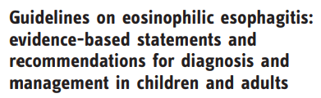
Conceptual Definition
Eosinophilic Esophagitis (EoE)
A chronic, local immune / antigen-mediated esophageal disease
Characterized clinically by symptoms related to esophageal dysfunction
Characterized histologically by eosinophil-predominant inflammation
United European Gastroenterology Journal 2017, Vol. 5(3) 335–35
Notes:
Although this may not clarify much, it provides a good skeleton which the rest of the document fleshes out. It also allows for current uncertainties in the definition and diagnosis of this disease without abandoning a definition alltogether.

Slide 7
Clinical Presentation In Adults
Intermittent solid food dysphagia: 29-100%
Food impaction: 33-54%
Less common / less specific:
GERD-like symptoms: 7-100%
Chest pain: 1-58%
Abdominal pain: 3-25%

Slide 8
Incidence / Prevalence
Currently unclear
Prevalence of 0.4-6.5%
15% of people presenting with dysphagia
Aliment Pharmacol Ther 2008;289:280-2
Up to 50% of patients presenting with food impaction
Studies based on histology alone over-represent prevalence
Increasing recognition that people previously believed to have severe GERD or atypical chest pain may have EoE

Slide 9
What to ask?
What causes more problems - solid foods or liquids?
Liquids: oropharyngeal dysphagia
Do you cough and sputter when you swallow?
Coughing - think oropharyngeal
Is the problem with the “gulp”, or after the “gulp”?
If the problem is after the gulp, supports esophageal dysphagia
Do you take a longer time eating than other members of your family?
People with gradual onset of symptoms, may adjust eating behavior without knowing that they have done so.
Do you have problems or symptoms more during meals, or in between meals?
People complaining of “something there” between meals without noticing it during meals may have globus sensation

Slide 10
Epidemiology and Presentation
Adult and pediatric presentations differ
3:1 male to female ratio
Presentation in the third and fourth decade of life
Has been described in multiple ethnicities and geographic locations
Predominance of non-Hispanic whites

Slide 11
Natural History
This is a chronic symptomatic disease
In “adult onset” EoE, there is no apparent adverse effect on nutritional status / longevity
EoE (even untreated) has not been associated with progression to Barrett’s Esophagus, esophageal adenocarcinoma or squamous cell carcinoma of the esophagus

Slide 12
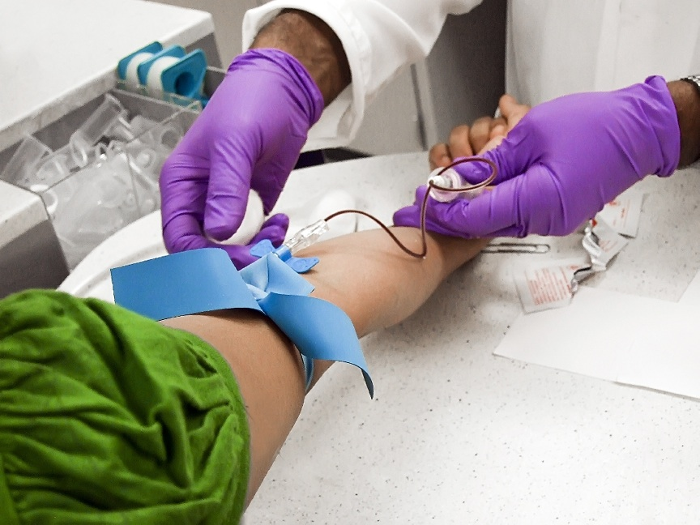
Laboratory Evaluation?
40-50% of patients may have peripheral eosinophilia
Data does not support the use of a single peripheral marker of disease or disease activity

Slide 13
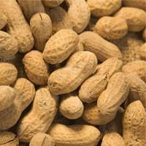

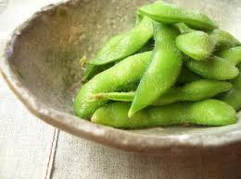
Allergy Testing? – Not a helpful first step
24-78% of adults with EoE have allergic rhinitis and/or sensitization to aeroallergens
Seasonal variability
50% of adults with EoE had positive food-specific IgE testing
Peanut (38%), egg (27%), soy (23%)

Slide 14
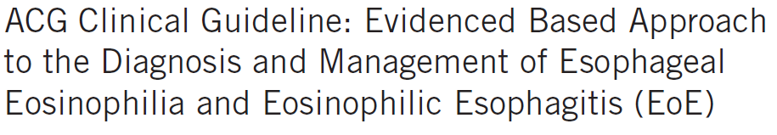
Am J Gastroenterol 2013; 108:679–692
Consider EoE in any person with recurrent dysphagia, chest pain, or refractory reflux symptoms
If no dysphagia, consider 8 week trial of PPI prior to endoscopy
Diagnosis requires EGD with biopsy, and exclusion of other causes of eosinophilia
This is a chronic condition, and symptoms tend to recur off of therapy. Treatment is recommended:
Medical therapy: PPI, steroids, dupilumab
Dietary Therapy
Dilation PRN

Slide 15
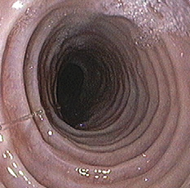
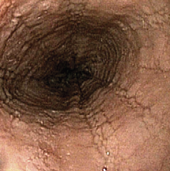
Upper Endoscopy
Notes:
Fixed rings / strictures –termed “corrugated esophagus” or “trachealization of the esophagus”
Longtutinal Furrows

Slide 16
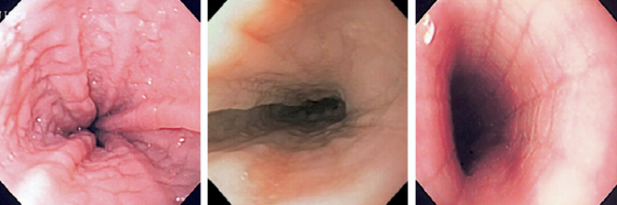
Endoscopic Findings
Notes:
Here you see combinations of the above features, as well as transient rings called felinization, marked edema, and deep furrowing. When the esophagus is inflated, vertical lines can be seen extending the length of the esophagus.

Slide 17
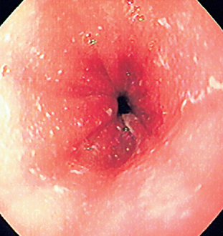
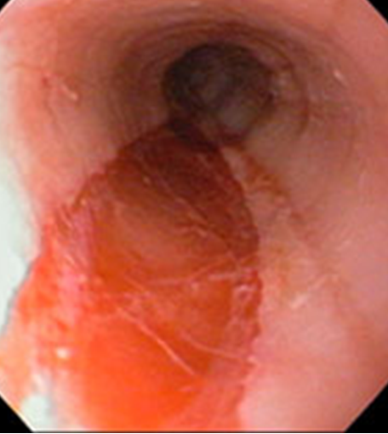
Endoscopic Findings
GI Motility online (May 2006) | doi:10.1038/gimo49
Notes:
Pinpoint white mucosal exudates – represent eosinophilic abscesses
The Dreaded Esopageal Rent or Tear – which can occur without dilation. Can occur with passage of the endoscope, or with removal of a food bolus.

Slide 18
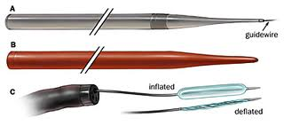
Diagnosis and Therapy:
Biopsy and Dilation
Symptom relief with esophageal dilation
Mucosal tears are common, but perforations are not
CHEST PAIN is more common than in dilations done for peptic structures (75%)
Discuss with patients, provide narcotics

Slide 19
Differential Dx of Intra-esophageal Eosinophilia
GERD
Infections
Drug-induced injury (pill esophagitis)
Crohn’s Disease
Eosinophilic gastroenteritis
Malignancies
Chemotherapy
Radiation

Slide 20
Treatment Goals
Dilation relieves the dysphagia but does not prevent recurrence!
Goals of therapy?
Endoscopic / histologic improvement?
Symptomatic improvement?
Exact correlation between histology, endoscopic appearance, and symptoms are not clearly defined

Slide 21
Medical Therapy
Proton pump inhibitors - 40% response rate
Topical steroids - 40% response rate
Systemic steroids - only for severe symptoms, short term
Dupilumab - 60% response rate

Slide 22
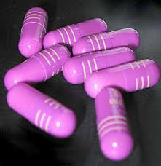
PPI: GI Doc’s Best Friend
Initially, PPI-Responsive Esophageal Eosinophilia was described as a distinct disorder
EVERYthing looks the same as “classic” EoE, including pH monitoring
Gets better on PPI – so not EoE?
PPIs Block eotaxin-3 expression in esophageal squamous cells
Cheng E, et al., Gut 2013;62:824–832
PPIs have been shown to down-regulate Th2 inflammation
Molina-Infante J, et al., Aliment Pharmacol Ther 2014; 40: 955–965
As such, PPI response to therapy should not necessarily change your diagnosis
DOSING: Omeprazole 40mg BID (or equivalent)

Slide 23
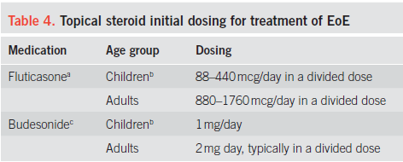
Corticosteroid Therapy
Topical steroids are effective in relieving symptoms and improving endoscopic and histologic findings
Effects typically last for 4 months or less without maintenance therapy
Recurrence is common with withdrawal of therapy
Not FDA approved: costly!

Slide 24
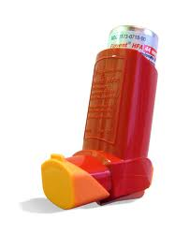
Duration of Therapy
High likelihood of recurrence if therapy discontinued
After histologic improvement, could then decrease dose by 50%
No observed risk of adrenal suppression with long-term use
Risk of candida: 5-30%

Slide 25
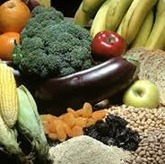
Dietary Therapy:
6-Food Elimination Diet
Soy
Egg
Milk
Wheat
Nuts
Seafood
Treat 6-8 weeks
Follow EGD / symptoms
Re-introduce foods 1-2 at a time
Can induce remission in up to 75% of patients

Slide 26
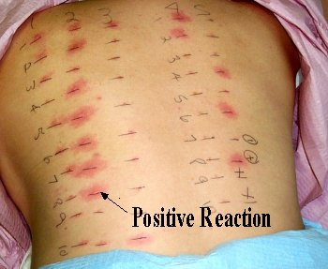
Dietary Therapy
Dietary therapy may be used as first or second-line therapy
Four-Food: Remission in 50%
Dairy products
Wheat
Egg
Legumes
Two-food: Remission in 40%
Animal milk
Gluten containing cereals
Can consider skin test guidance for dietary therapy
Scope intensive!!!

Slide 27
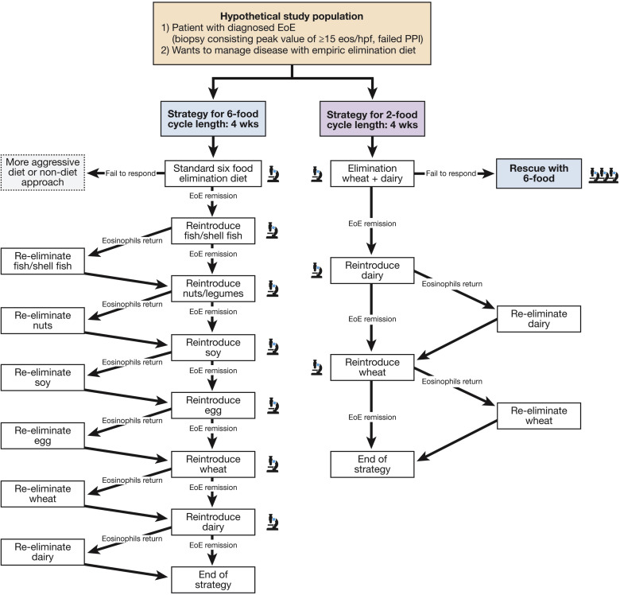
Zhan et. al, Clinical Gastroenterology and Hepatology, 2018-11-01, Volume 16, Issue 11, Pages 1730-1737

Slide 28
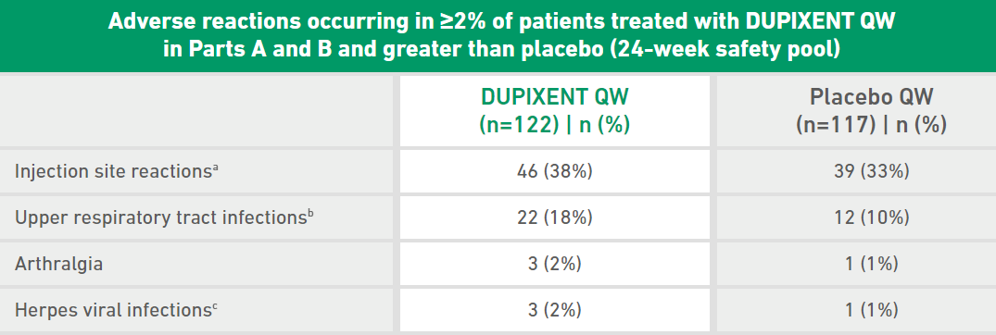
Dupilumab
Interleukin (IL)-4 receptor alpha antagonist
Inhibits signaling of IL-4 and IL-13 cytokines
Moderates Th2 driven inflammation
FDA approved for treatment of EoE in adults and in pediatric patients who are 12 years of age and older and weigh at least 40 kilograms
300mg weekly subcutaneous injection
60% histologic remission rate at 24 weeks
81% reduction in dysphagia symptoms at 52 weeks
Side effects: https://www.dupixenthcp.com/eoe/efficacy/safety-data

Slide 29
Dilate As Needed
Pros:
My paycheck is bigger
Safe
Experienced patients do a good job monitoring their own symptoms
Cons:
Cost
Frequency?
Risk for interim impactions
Requires good provider / patient communication

Slide 30
How I Do It:
PPI 40mg BID x 8 weeks, then repeat EGD w biopsies
Not improved: dupilumab, repeat EGD in 8 weeks
Improved: continue PPI at current dose for additional 4 months
Not improved: Elimination diet or PRN dilation
Improved: continue indefinitely?
Asymptomatic? Decrease dose to daily PPI

Slide 31
CONCLUSIONS
Consider EoE in any person with recurrent dysphagia, chest pain, or refractory reflux symptoms
If no dysphagia, consider 8-week trial of PPI prior to endoscopy
Diagnosis requires EGD with biopsy, and exclusion of other causes of eosinophilia
This is a chronic condition, and symptoms tend to recur off of therapy. Treatment is recommended:
Medical therapy: PPI, steroids, dupilumab
Dietary Therapy
Dilation PRN

Slide 32
Thank you!

