Slide 1
SURGICAL TREATMENT AND OUTCOMES OF INFECTED TOTAL KNEE ARTHROPLASTY
Erik Otterberg, MD

Slide 2
NO DISCLOSERS

Slide 3
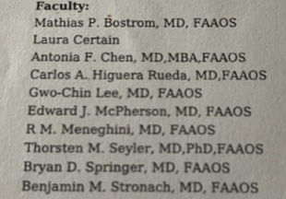
CONTRIBUTORS

Slide 4
OCCURANCE
1-3% in primary TKA
4-5% in revision TKA

Slide 5
RISK FACTORS
OBESITY
SMOKING
DIABETES
PREVIOUS KNEE SURGERY
RHEUMATOID ARTHRITIS
IMMUNOSUPPRESSANT MEDICATIONS
PERIPHERAL VASCULAR DISEASE
PROLONGED INCISIONAL DRAINAGE

Slide 6
PREVENTION
GOOD STERILE TECHNIQUE
IV ANTIBIOTICS ½ HOUR BEFORE INCISION
LIMIT OPERATING ROOM TRAFFIC
VANCOMYCIN POWDER
VARIOUS COMMERCIAL WASHES OR IRRIGATIONS

Slide 7
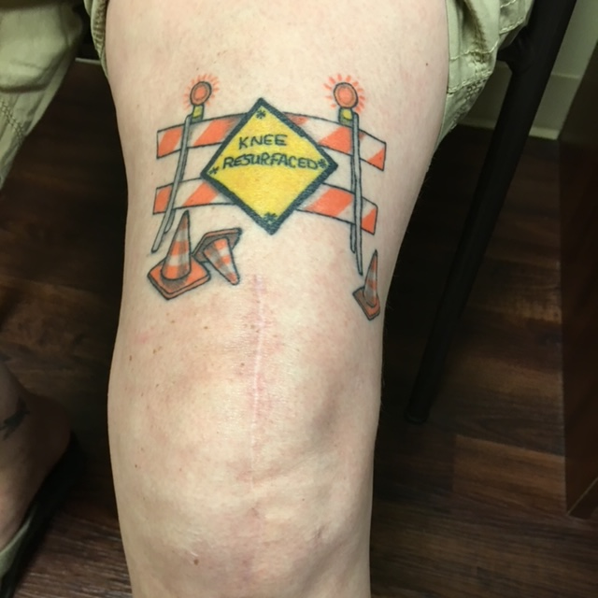
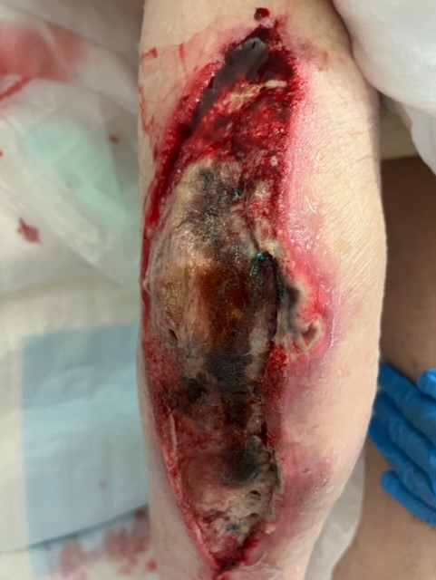
DIAGNOSIS

Slide 8
CHALLENGING
PATIENT COMORBIDITIES
LOW VIRULANCE PATHOGENS
RECENT ANTIBIOTIS
15% INFECTED TKA'S CULTURE NEGATIVE

Slide 9
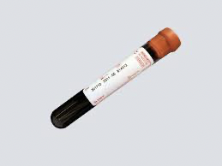
SERUM TESTING
C-REACTIVE PROTEIN (CRP)
ERYTHROCYTE SEDIMENTATION RATE (ESR)
D-DIMER
INTERLEUKIN-6

Slide 10
SYNOVIAL FLUID
WBC COUNT
POLYMORPHONUCLEAR (PNC) CELL COUNT
PRESENCE OF ALPHA DEFENSIN
SYNOVIAL FLUID CRP
PRESENCE OF LEUKOCYTE ESTERACE
CULTURE

Slide 11
SYNOVIAL TISSUE
3 OR MORE INTRAOPERATIVE SAMPLES
NUMBER OF WBC'S PER HIGH POWER FIELD
CULTURE FOR 14 DAYS

Slide 12
NO SINGLE TEST

Slide 13
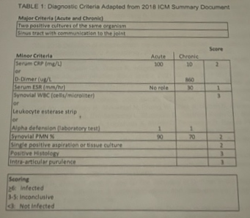

Slide 14
DO YOU DAIR?
DEBRIDEMENT, ANTIBIOTICS, AND IMPLANT RETENTION

Slide 15
PRINCIPLES OF DAIR
REDUCE PATHOGEN BURDEN
RELIES ON ANTIBIOTICS AND HOST IMMUNE RESPONSE TO CONTROL OR ELIMINATE REMAINING

Slide 16
DAIR
INFECTION CONTROL RATES 11%-100%
REASONS FOR FAILURE
BIOFILMS
POOR TECHNIQUE
PATIENT COMORBIDITIES

Slide 17
DAIR INDICATIONS
ACUTE POSTOPERATIVE INFECTIONS
ACUTE HEMATOGENOUS INFECTIONS
PATIENTS WITH SEVERE COMORBIDITIES

Slide 18
DAIR SURGICAL PRINCIPLES
WIDE, OPEN (NOT ARTHROSCOPIC) SURGICAL DEBRIDEMENT
EXCHANGE MODULAR COMPONENTS
MECHANICAL AND CHEMICAL TREATMENT IMPLANT SURFACES
ANTISEPTIC AND/OR ANTIBIOTIC ADJUNCTS
DILUTED PROVIDONE-IODINE
DILUTED CHLORHEXIDINE
VARIOUS COMMERCIAL PRODUCTS

Slide 19
DOUBLE DAIR
DAIR PLUS REPEAT DAIR IN 5-6 DAYS
EARLY PROMISING RESULTS

Slide 20
SINGLE STAGE REVISION
"ONE AND DONE"
HOPEFULLY

Slide 21
SINGLE STAGE REVISION
75-90% SUCCESS WHEN STRICT CRITERIA FOLLOWED
INCREASINGLY MORE POPULAR
ONGOING MULTICENTER RANDOMIZED CONTROLLED STUDY

Slide 22
SINGLE STAGE REVISION
AGGRESSIVE DEBRIDEMENT
TURN OVER SURGICAL FIELD OR NEW ROOM
ANTIBIOTIC CEMENT
MASSIVE BONE DEFECTS
CONSTRAINED OR HINGED COMPONENTS

Slide 23
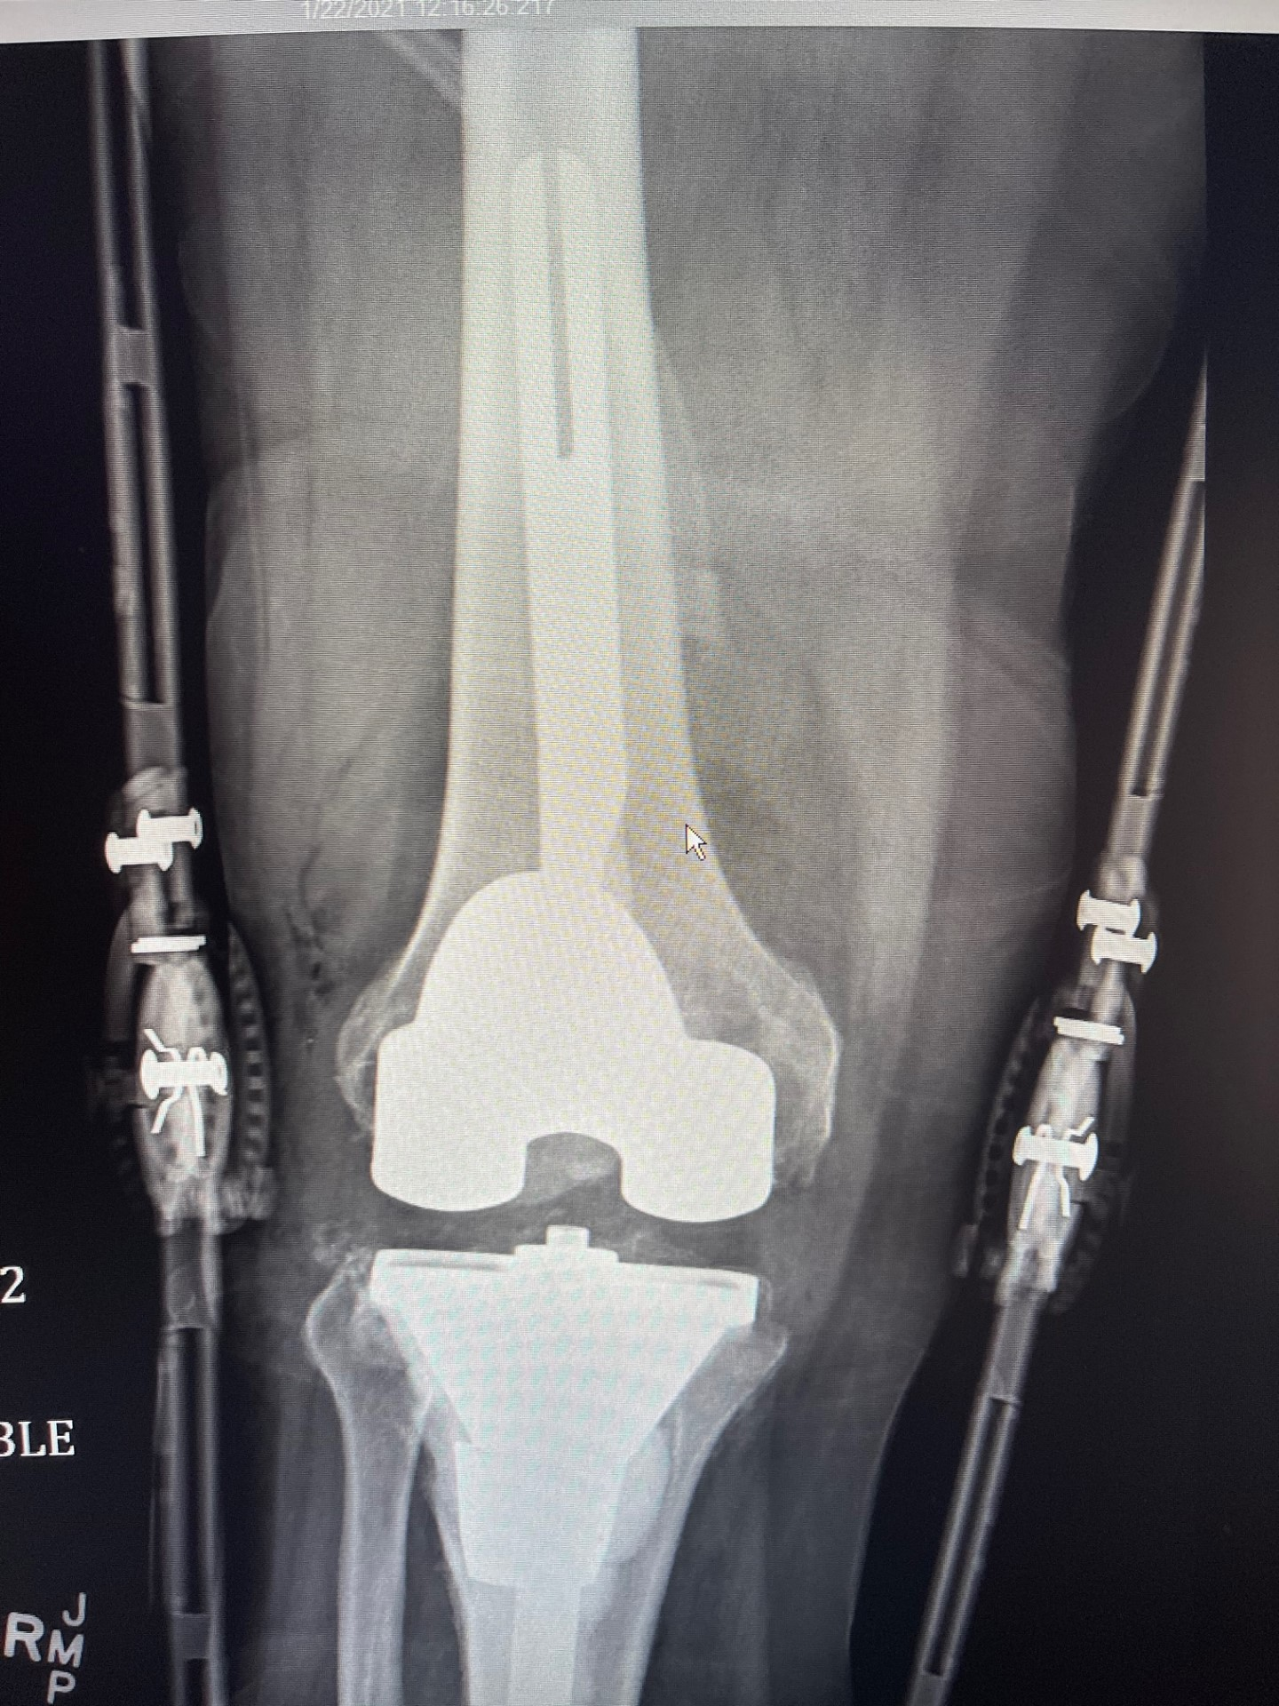
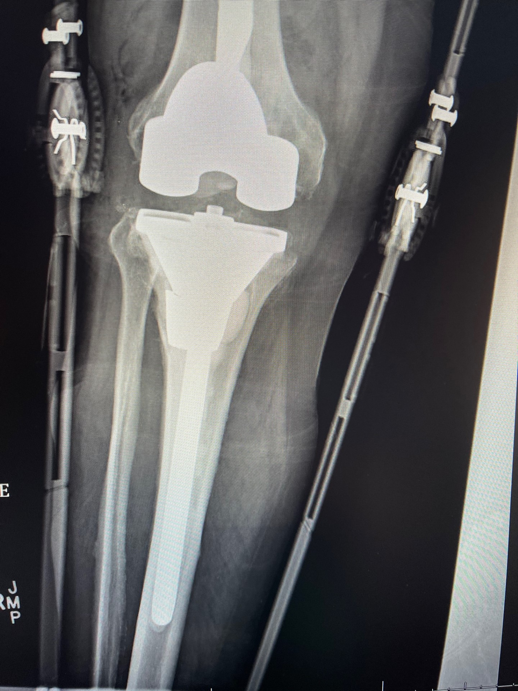
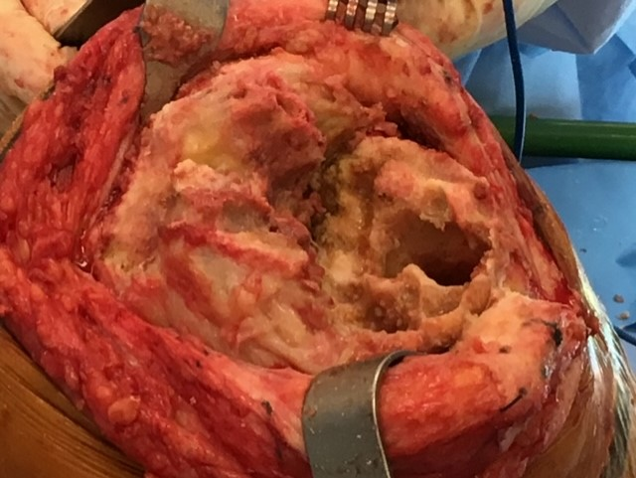

Slide 24
SINGLE STAGE REVISION
INDICATIONS
RELATIVE CONTRAINDICATIONS
NON-IMMUNOCOMPROMISED HOST
NO SYSTEMIC SEPSIS
TREATABLE BONE AND SOFT TISSUE LOSS
PRIMARY WOUND CLOSURE POSSIBLE
KNOWN ORGANISM
COMPLEX SINUS TRACT
WOUND THAT CANNOT BE CLOSED PRIMARILY
RADICAL DEBRIDEMENT NOT POSSIBLE
INSUFFICIENT BONE STOCK

Slide 25
TWO STAGE REVISION
THE GOLD STANDARD

Slide 26
TWO STAGE REVISION
EVERYTHING OUT
AGGRESSIVE DEBRIDEMENT
SPACER WITH ANTIBIOTIC CEMENT
STATIC
ANTIBIOTIC SPACERS
METAL AND POLYETHYLENE
ANTIBIOTIC THERAPY
IMPLANT REMOVAL, REVISION TKA

Slide 27
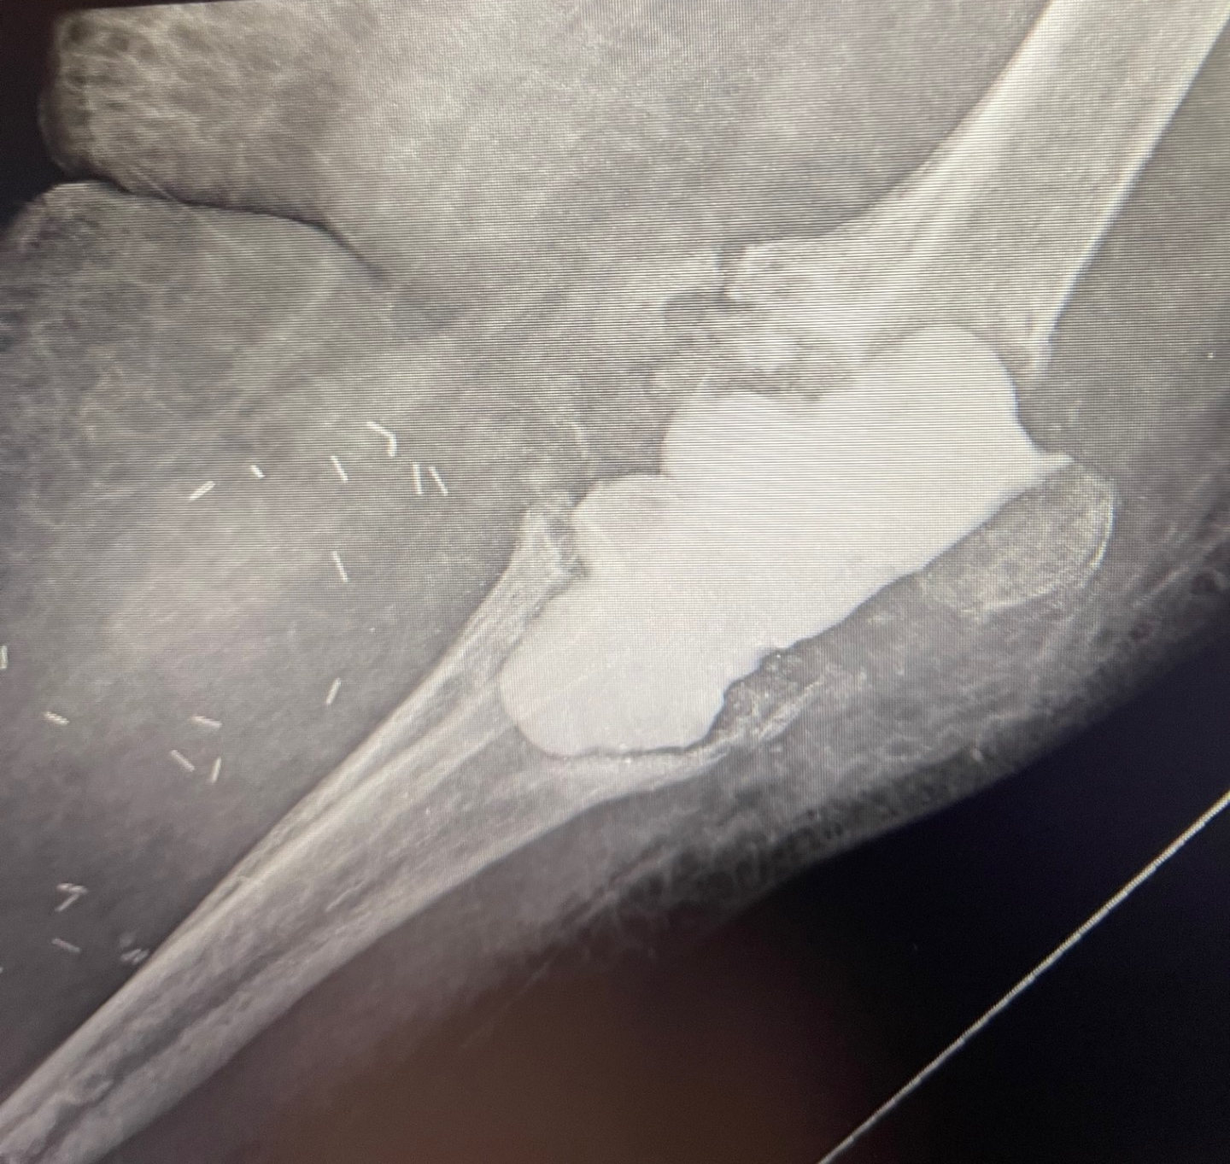

Slide 28
TWO STAGE REVISION
WHEN TO REIMPLANT?
IS THE INFECTION GONE?

Slide 29
WHEN TO REIMPLANT?
ESR AND CRP LEVELS – UNRELIABLE
REPEAT ASPIRATION
SERUM STUDIES
CULTURES
"ANTIBIOTIC HOLIDAY"
MULTIPLE CULTURES DURING REIMPLANTATION

Slide 30
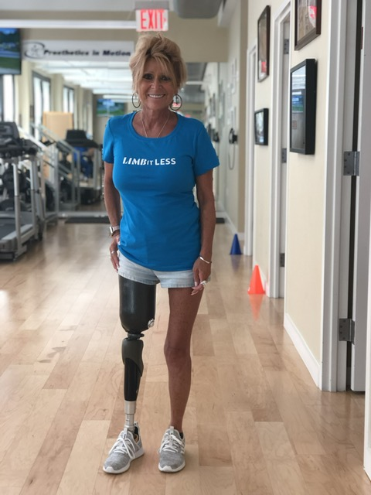
WHEN ALL ELSE FAILS
INCOMPETENT EXTENSOR MECHANISM
UNMANAGEABLE SOFT TISSUE DEFECT
BONE LOSS LIMITING COMPONENT IMPLANTATION
FAILED ANTIBIOTIC SUPPRESSION WITH SEPSIS

Slide 31
THANK YOU

