Slide 1
Biologics in IBD:
What We All Need to Know
BOB KIZER MD
ASSISTANT PROFESSOR OF MEDICINE
CREIGHTON UNIVERSITY SCHOOL OF MEDICINE
October 28, 2023

Slide 2
DISCLOSURES
NONE

Slide 3
OBJECTIVES
Review the classes of biologic medications available for treatment of IBD
Discuss common side effects attributable to these agents
Identify issues in the use of vaccines in patients on biologic agents
Assess current recommendations on use of biologic agents in pregnancy

Slide 4


WHAT ARE BIOLOGICS? WHY DO GASTROENTEROLOGISTS
PICK ONE OVER THE OTHER?

Slide 5
CURRENT OPTIONS FOR MANAGEMENT OF MODERATE TO SEVERE IBD
Biologics
Anti-TNF alpha Agents: infliximab, adalimumab, certolizumab (Crohn's Disease), golimumab (Ulcerative Colitis)
Anti-IL 23 Agents: ustekinumab (CD and UC), risankizumab (CD)
Alpha-4 beta-7 Integrin Binder: vedolizumab (CD and UC)
Small Molecules
Janus Kinase Inhibitors: tofacitinib (UC) and upadacitinib (UC and CD)
More options than before, but not a lot.
Clinical response of most agents is at best 50-60%.
All biologics carry risk of immunogenicity.

Slide 6
WHAT IS IMPORTANT TO THE PATIENT?
Efficacy
Cost
Safety
Lifestyle

Slide 7
SAFETY: ANTI-TNF AGENTS
Infections
10% risk of “serious” infections, which can increase to 30% if on steroids as well
Most common infections include pneumococcal pneumonias and sinus infections
Increased risk for opportunistic infections and fungal infections (histoplasmosis)
Reactivation of Hep B and TB
MITIGATIONS TO THE RESCUE!
Set mutual goal to avoid steroids
Screen for TB and Hep B annually
Vaccinate against most common pneumococcal strains (PCV 20)
Screen for histoplasmosis in those at risk: persons from Midwestern states located in the Ohio and Mississippi River valleys

Slide 8
SAFETY: ANTI-TNF AGENTS
The BIG BAD: Cancer
Conflicting data based on multiple registries from across the Northern Hemisphere
Does the drug or the disease increase the risk?
Lymphoma
Conflicting data about the increase risk of NHL, and whether there is an increase
Most data comes from use in patients with Rheumatoid Arthritis (RA), and is still conflicting
Melanoma
Similar issues
Whether it is the disease that increases the risk, or the drug, mitigation of risk involves avoiding sunburns, and getting a skin check annually – JUST LIKE WE RECOMMEND TO EVERYONE ELSE
Breast Cancer – no increased risk

Slide 9
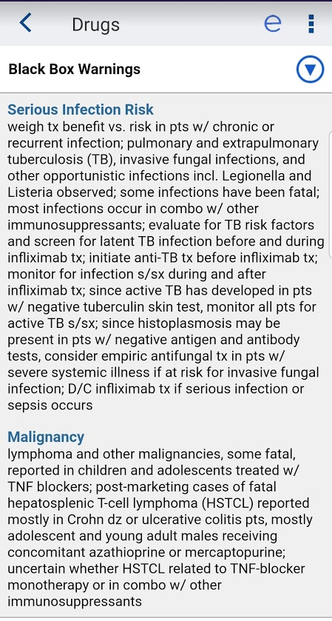
SAFETY: ANTI-TNF AGENTS
Previous malignancy = caution advised
Black Box Warnings
Heart Failure
Recommendations are based on trials of the use of Infliximab in the treatment of heart failure
Mortality was higher in patients receiving treatment with 10mg/kg - single dose, at one year
So – use with "caution" in those with NYHA Class III/IV Heart Failure and avoid high dose
Demyelinating diseases
Links and case reports

Slide 10
SAFETY: USTEKINUMAB, RISANKIZUMAB
7% infections, primarily URI
No malignancy
No serious infections

Slide 11
SAFETY: VEDOLIZUMAB
4.5% Nasal congestion
That’s it. Really.
Experience: FDA approval for CD and UC in 2014

Slide 12
SAFETY LEADERBOARD
#1. Vedolizumab
#2. Ustekinumab / Risankizumab
#3. Anti-TNF Medications

Slide 13
RELATABLE RELATIVE RISK
From the National Safety Council
https://www.nsc.org/work-safety/tools-resources/injury-facts/chart
Risk of dying in a motor vehicle crash: 1 in 114
Risk of dying in a fall: 1 in 127
We all accept certain risks every day without really thinking of it.

Slide 14
HOW DO YOU HELP KEEP YOUR PATIENTS
WHO USE BIOLOGICS SAFE?
How do reduce risks of infections?
Vaccinate against pneumococcal infections
Vaccinate against Herpes Zoster
AVOID STEROIDS while on anti-TNF agents
Help keep your patients calm using relatable descriptions of risk and mitigation
Infections – “I take care of doctors, nurses, and school lunch ladies who use these medications, and none of them have to quit their jobs.”
Infections – “So, you should wash your hands before you touch your face holes, which is true of everyone, everywhere.”

Slide 15
HOW DO YOU HELP KEEP YOUR PATIENTS
WHO USE BIOLOGICS SAFE?
How to reduce the risk of skin cancer?
Skin cancers – “I will tell you to avoid sunburn and to get annual skin checks, just like all doctors tell all patients.”
Annual skin checks (like everyone!!! - but consider a dermatologist referral)
How to reduce the risk of colon cancer?
Encourage follow-up with the gastroenterologist

Slide 16
VACCINES: AN OPPORTUNITY FOR IMPROVEMENT
IBD patients are at increased risk of cervical cancer, pneumococcal infections, and developing zoster – irrespective of medication use
Many patients with IBD require prednisone at immunosuppressant doses, immunomodulators, or biologic medications that can further increase risk of preventable infections
Despite these risks, IBD patients appear to be vaccinated at a rate less than the general population

Slide 17
WHY?
Patients may see their gastroenterologist as their PCP
Gastroenterologists may believe that vaccinations are the role of the PCP
PCPs may have concerns about providing vaccinations to patients receiving immunomodulators and biologics
Gastroenterologist offices may not be equipped to provide vaccinations
In this region, a close collaboration between Gastroenterologists and PCPs is essential to ensure our IBD patients receive recommended preventative care

Slide 18
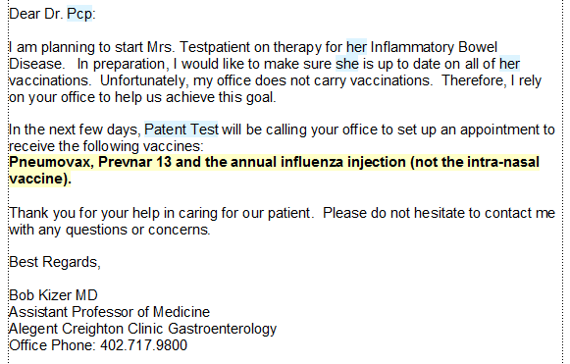
IT’S A TEAM APPROACH

Slide 19
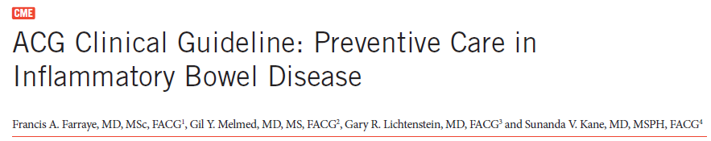


Slide 20
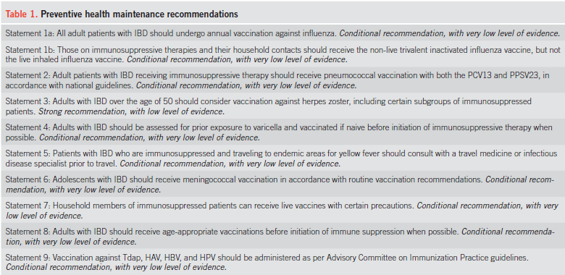
Cliff notes version: Follow the ACIP guidelines based on age, but avoid live vaccines in the immunosuppressed, and start pneumococcal vaccines early

Slide 21
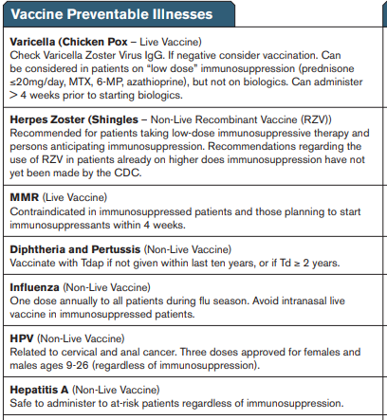
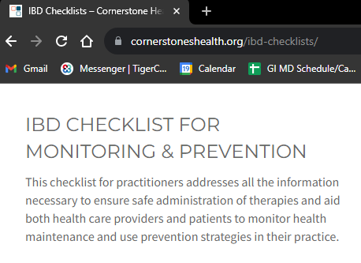
CORNERSTONES CHECKLIST

Slide 22
THE VACCINES: INFLUENZA
HIGHLY RECOMMENDED, ANNUALLY
36,000 deaths annually from influenza
Inactivated (dead) - “the shot”
Acceptable for the immunosuppressed and non-immunosuppressed (and you can not get the actual flu from this vaccine)
Live-nasal spray (FluMist)
Only for those not on immune suppressing medications
May be given to household contacts of patients with IBD

Slide 23
FAMILY PLANNING AND BIOLOGIC THERAPY:
THE RULES
Keeping your IBD under the best control possible will give you the best chance of achieving and maintaining a healthy pregnancy
Get your IBD under control before you begin trying to conceive, and keep it under control while trying to conceive
Whatever got your IBD under control before pregnancy is what we will use to keep it under control during pregnancy
Biologic therapy is safe for the mother and the baby
Does not seem to reduce efficacy of infant vaccinations

Slide 24
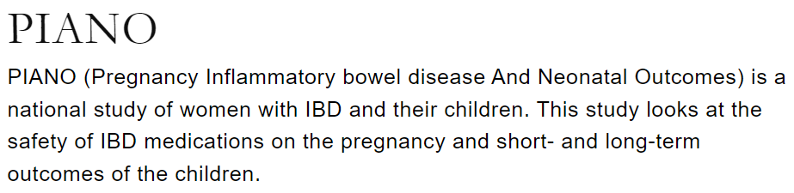

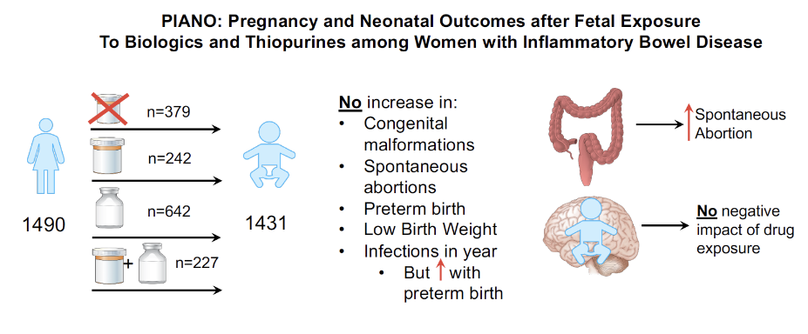
https://gastroenterology.ucsf.edu/research/piano

Slide 25
CONCLUSIONS
When used appropriately, biologic agents can induce and maintain remission in IBD
Risks associated with IBD are acceptable, with ways to mitigate the most significant risks
Patients with IBD are a special population, at risk for suboptimal vaccination status
Partnership between GIs and PCPs is essential to get “the basics” of vaccination correct, every time
For those considering pregnancy, the management of IBD should be optimized before conception
During pregnancy, biologic therapy can and should be maintained for the health of the mother and the baby

Slide 26
Thank you!

