Slide 1
Refractory Heartburn
Haitam Buaisha, MBBCh.
Assistant Professor of Medicine
Division of Gastroenterology and Hepatology
October 28, 2023

Slide 2
Clinical case
A 35-year-old woman presents to her PCP with heartburn for the past 12 months.
Severe burning discomfort beneath the breastbone occurring throughout the day.
The patient has no history of dysphagia, vomiting, weight loss, or gastrointestinal bleeding.
She reports regurgitation once a month, unchanged in the recent past
She was prescribed omeprazole 20 mg daily

Slide 3
Empiric PPI trial
Empiric acid suppression therapy for 4-8 weeks can be tried in patients who:
Typical GERD symptoms
Without warning signs or symptoms:
Dysphagia
Odynophagia
Weight loss
Melena
Anemia

Slide 4
Clinical case
Two weeks later the patient phones her provider to report that her heartburn is unchanged.
She confirmed adherence to the medication

Slide 5
WTN?
PPIs should ideally be taken 30 to 60 minutes prior to meals
PPIs bind only to gastric proton pumps that are actively secreting acid.
<10% active during fasting
>70% are active when stimulated by meals
Neurogastroenterol Motil. 2021;33(4):e14075.

Slide 6
WTN?
Switch to to a different PPI?

Slide 7
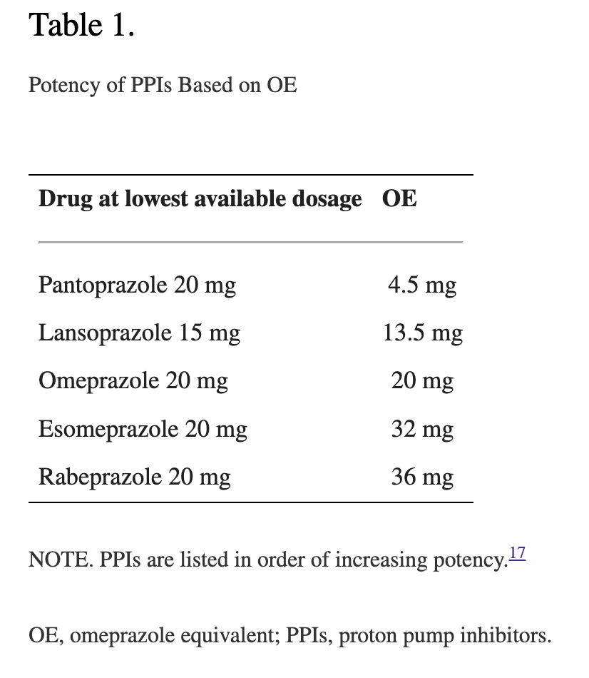
40 mg of pantoprazole and 9 mg of omeprazole were similarly effective when assessed by pH-4 time
Clin Gastroenterol Hepatol. 2018;16(6):800-808.e7.

Slide 8
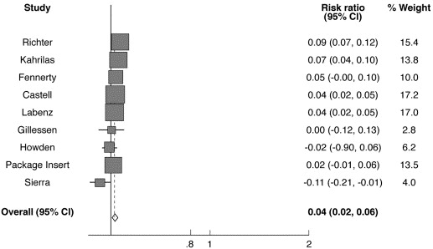
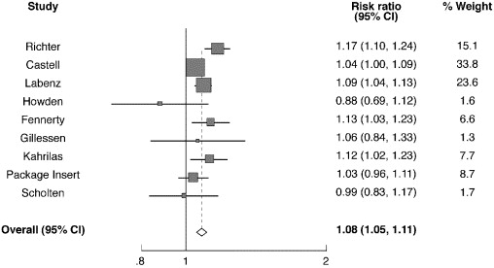


Figure 4
Copyright © 2006 AGA Institute
Clinical Gastroenterology and Hepatology 2006 41452-1458DOI: (10.1016/j.cgh.2006.09.013)
Notes:
Absolute risk reduction forest plot in healing of erosive esophagitis at 8 weeks (n = 15,099). ARR = 4% yielding an NNT = 25.

Slide 9
WTN?
Increase the dose to 40 mg once daily?
Or
Increase the dose to 20 mg BID?

Slide 10
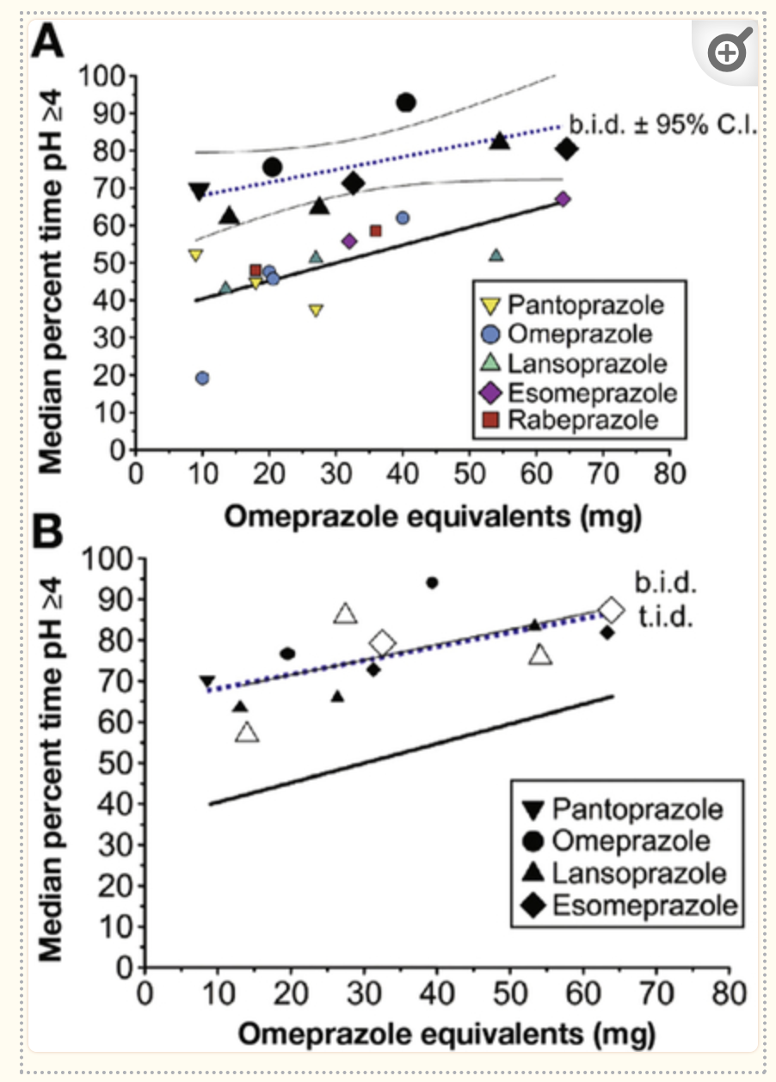
Split (twice-daily) PPI dosing maintains intragastric pH above 4 for higher proportions of the day compared with standard (once-daily) dosing
Clin Gastroenterol Hepatol. 2018;16(6):800-808.e7.

Slide 11
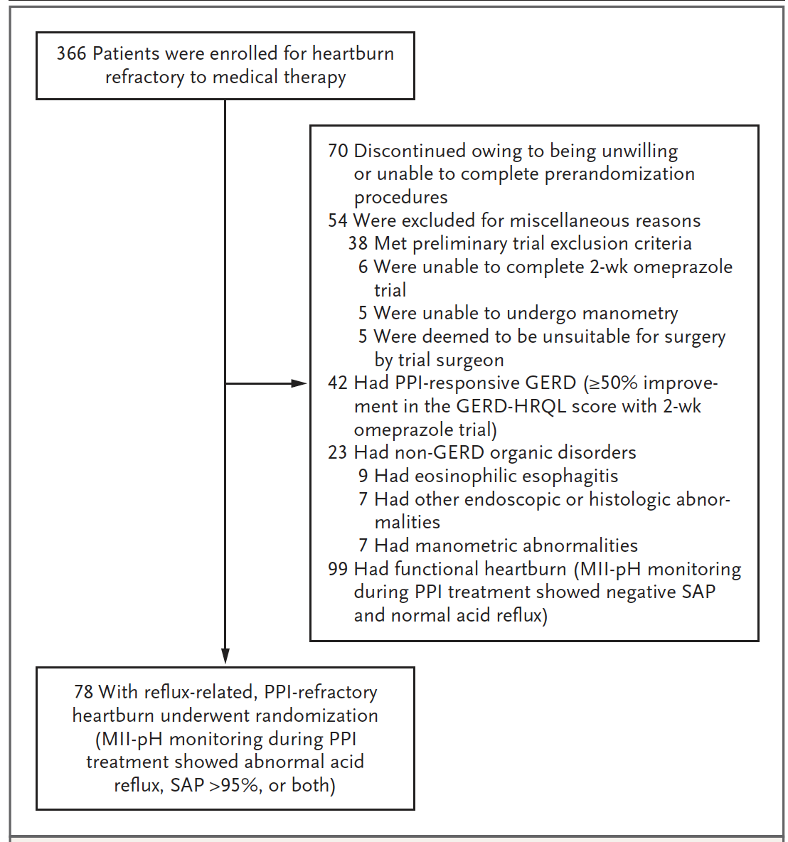
N Engl J Med 2019; 381:1513-1523

Slide 12
In summary
PPIs should ideally be taken 30 to 60 minutes prior to meals
PPIs may vary in their ability to suppress acid based on the proportion of time the intragastric pH is higher than 4.
BID dose of even the relatively least potent PPI =/> the effectiveness of the higher doses of the most potent PPIs given once daily

Slide 13
Clinical case
Her PPI therapy was optimized
Seen in clinic after 8 weeks and she reports <20% improvement in her heartburn

Slide 14
Gastroesophageal Reflux Disease (GERD)–Health Related Quality of Life
score (range, 0 to 50, with higher scores indicating worse symptoms)
DOI:10.1016/j.jamcollsurg.2013.04.039

Slide 15
Refractory Heartburn

Slide 16
Epidemiology
In the US, 20% of adults regularly have symptoms of gastroesophageal reflux disease (GERD)
Annual costs for managing GERD exceed $12 billion
Patients with heartburn, the cardinal symptom of GERD, report reduced work productivity and significant impairments in health-related quality of life
Gastroenterology 1997;112: 1448-56.
Gastroenterology 2009; 136: 376-86.
Aliment Pharmacol Ther 2003; 17: 1309-17.
Arch Intern Med 2001; 161: 45-52.

Slide 17
Epidemiology
GERD symptoms persist in ~30% of patients treated with PPIs.
Only 58% of patients taking prescription PPIs for chronic heartburn report complete satisfaction with this treatment
PPI-refractory GERD” is the most common reason for GERD-related referrals to gastroenterologists
Am J Gastroenterol 2013; 108: 308-28.
Nat Rev Gastroenterol Hepatol 2016; 13: 281-94.
J Clin Outcomes Manag 2000; 7(11): 29-34.
Gut 2009; 58: 295-309.

Slide 18
Deferential diagnosis
Abnormal acid reflux persists despite PPI therapy
Reflux hypersensitivity
Esophageal disorders
Eosinophilic esophagitis
Lymphocytic esophagitis
Infectious esophagitis
Pill esophagitis
Achalasia
Skin disorders involving the esophagus
Malignancy
Extraesophageal disorders (e.g., heart disease)
Functional heartburn

Slide 19
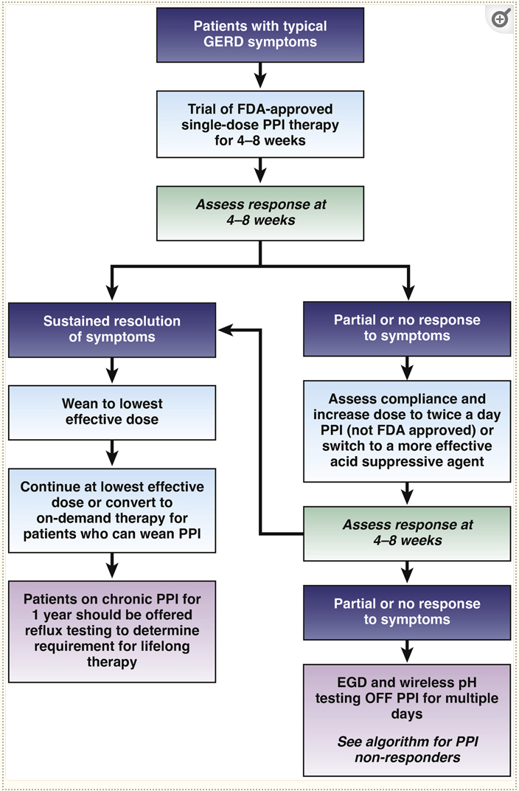
Diagnosis
Clin Gastroenterol Hepatol. 2022 May; 20(5): 984–994.e1.

Slide 20
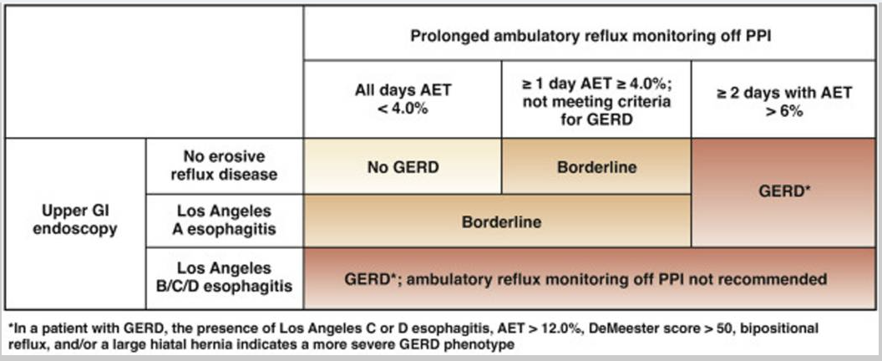
Clin Gastroenterol Hepatol. 2022 May; 20(5): 984–994.e1.

Slide 21
Clin Gastroenterol Hepatol. 2022 May; 20(5): 984–994.e1.

Slide 22
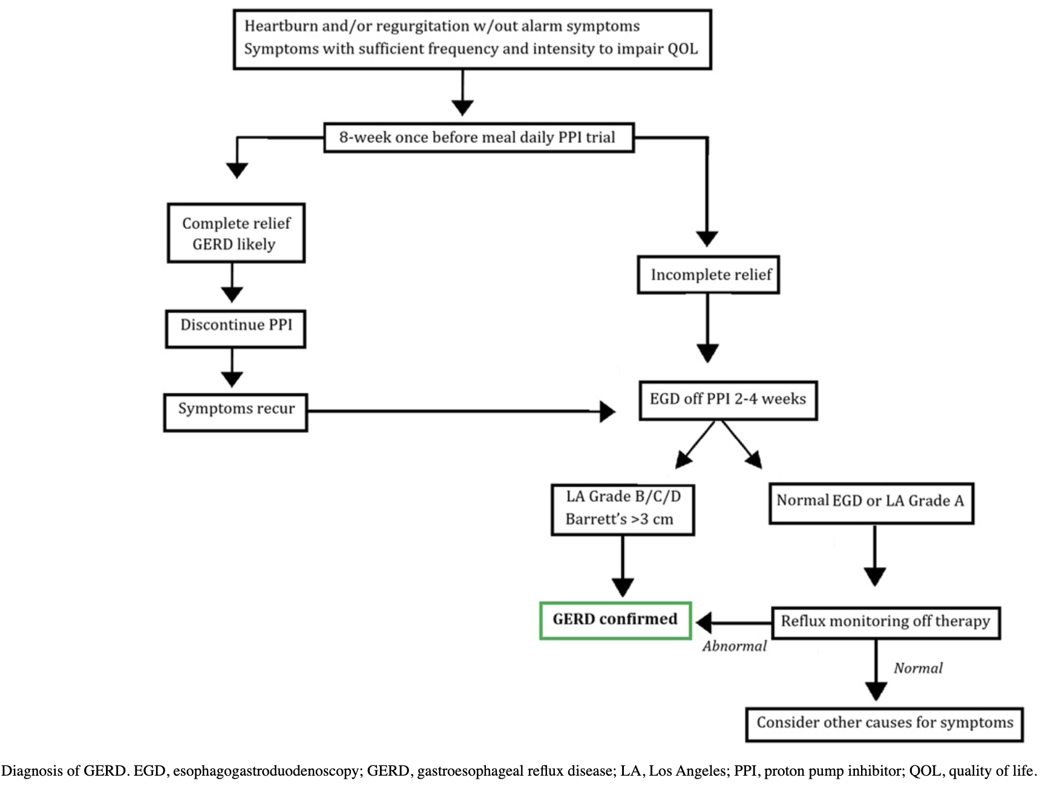
The American Journal of Gastroenterology 117(1):p 27-56, January 2022.

Slide 23
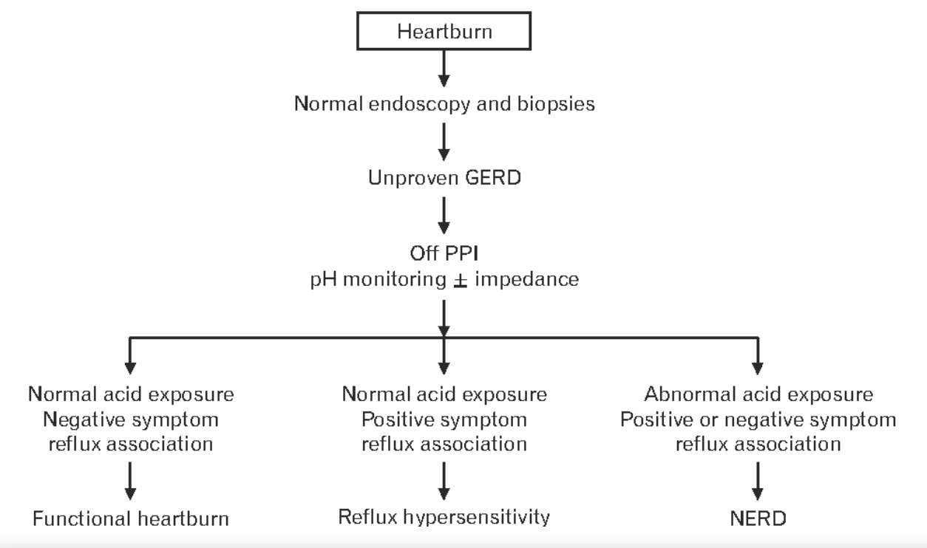
Rome IV
J Neurogastroenterol Motil, Vol. 23 No. 4 October, 2017

Slide 24
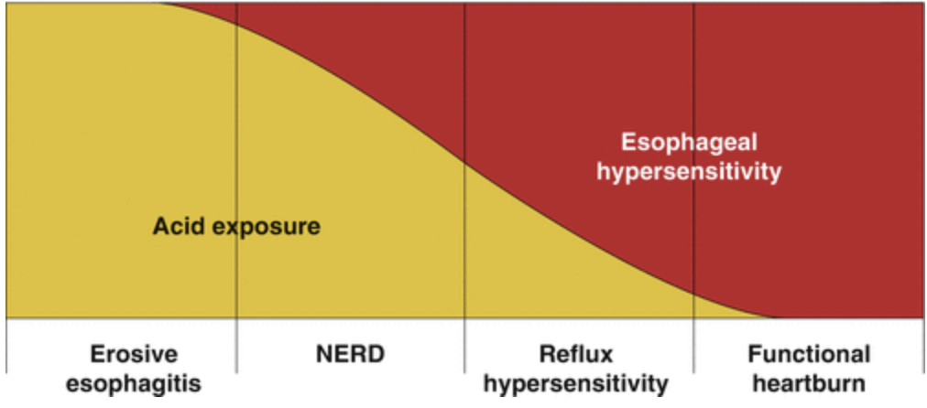
abdominalkey

Slide 25
Clinical case
The patient had discontinued taking omeprazole 14 days before the endoscopy.
EGD with normal esophageal mucosa and no HH
A Wireless esophageal pH monitoring was deployed during EGD
Esophageal acid exposure on days 1 and 2 was 1.3% and 2.8% respectively
Reported heartburn on 21 occasions. The symptom-association probability was not significant (36%).

Slide 26
What is the diagnosis?
Functional heartburn

Slide 27
Clinical case
Patient was reassured and prescribed low dose TCA
After 2 months, she reported 80% improvement in her symptoms
Other treatment options:
CBT
Gut directed hypnotherapy

Slide 28
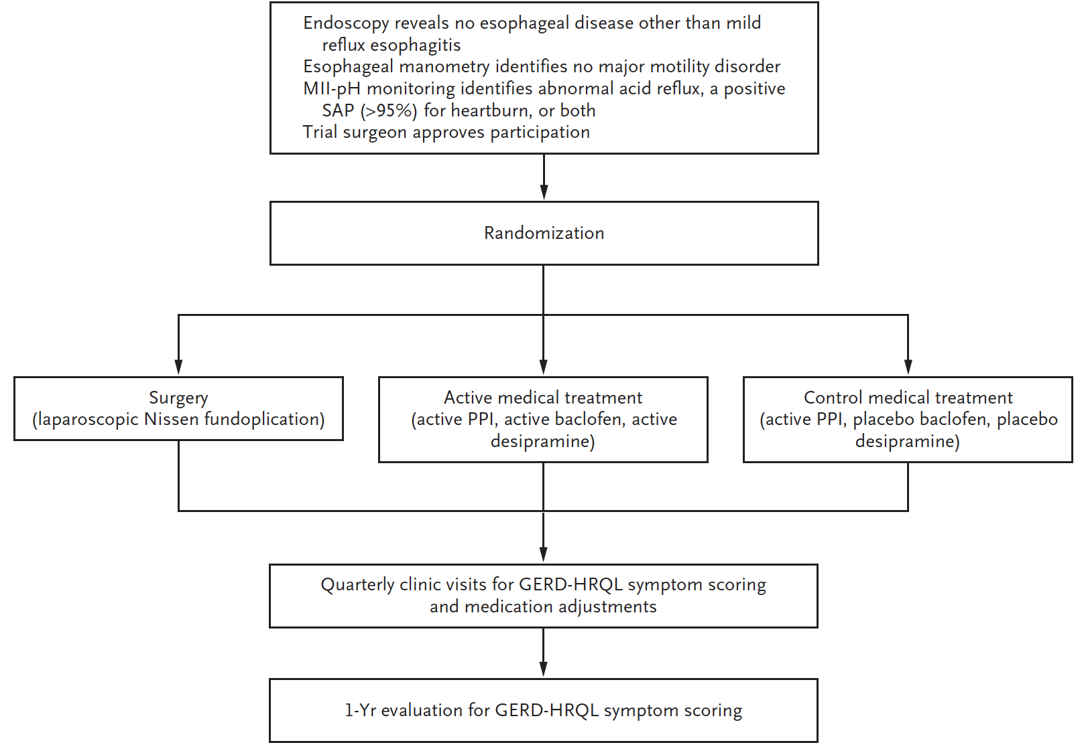
N Engl J Med 2019; 381:1513-1523

Slide 29
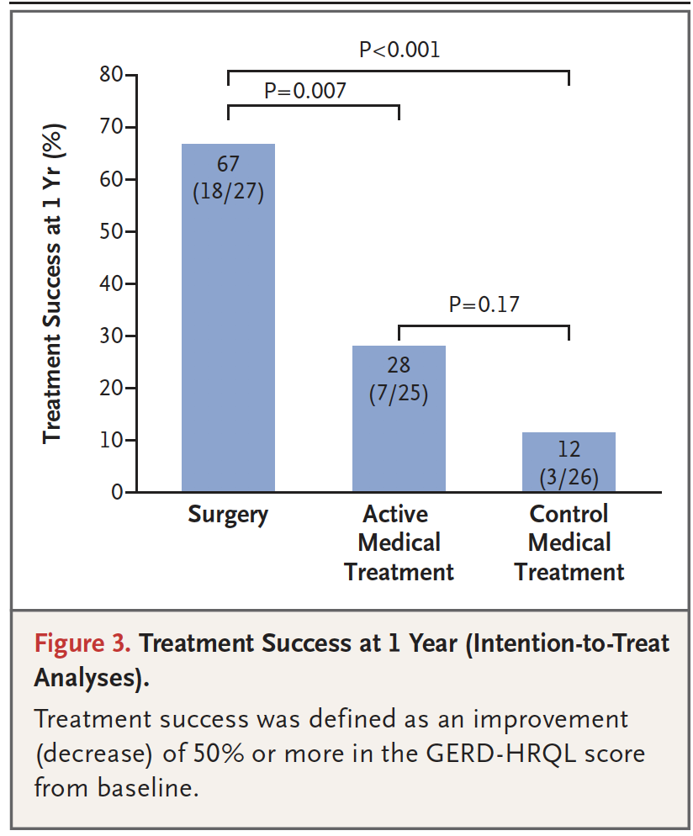
N Engl J Med 2019; 381:1513-1523

Slide 30
Management of Refractory GERD
Lifestyle interventions (no late meal, head bed elevation, Wt. loss, Diaphragmatic breathing).
Optimization of pharmacologic therapies
Alginate antacid →Postprandial symptoms
PPI
Histamine type-2 receptor antagonists (H2RAs)→ Nocturnal symptoms
Baclofen (↓tLESRs)→ regurgitation or belch predominant symptoms
Potassium-competitive acid blockers (P-CABs)→not available in the US.
Persistent refractory GERD symptoms (particularly regurgitation)→endoscopic or surgical antireflux intervention options
Gastroenterology & Hepatology Volume 17, Issue 7 July 2021

Slide 31
Take home point
Optimize PPI therapy (30-60 min before meals and split dosing)
Order EGD off PPI for 2-4 weeks if refractory heartburn
LA grade B/C/D or presence of Barrett's are strong evidence of GERD
Consider PH monitoring OFF THERAPY for patient with negative EGD
Diagnosis of Functional heartburn: negative EGD, normal AET (<4%), and no symptoms correlation
Diagnose esophageal hypersensitivity if EGD is normal, AET <4%, with symptoms correlation
Manage functional heartburn with reassurance, low dose TCA, or CBT.
Management of esophageal hypersensitivity can target acid reflux and functional component

Slide 32
Thank you

