Slide 1
Integrating Behavioral Health into Pediatric Primary Care
Allison Grennan, PhD
Associate Professor, Licensed Psychologist
Director of Internship Training
Munroe-Meyer Institute, UNMC

Slide 2

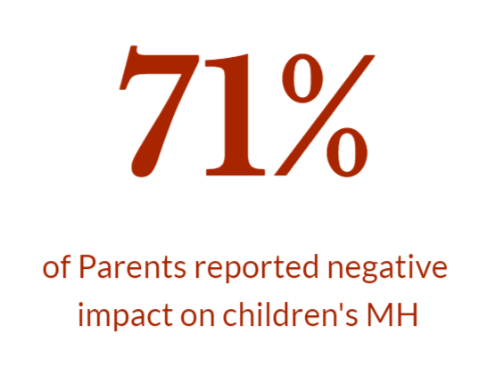
Kid’s Mental Health
1 in 5 Children with diagnosed Mental Health condition in 2022
Notes:
As I am sure we’re all aware, the last few years have been fairly difficult for all of us, especially children and adolescents. Depression, Anxiety, and suicidal ideation are all at some of the all time highs for kids, and ED admissions for these concerns skyrocketed during the pandemic. In fact, in one survey, 71% of parents reported that the pandemic had negatively impacted their child’s mental health. In 2022, the number of children with a diagnosable mental health condition rose to 1 in 5, and we know that is likely an underestimate given that unfortunately, a large number of children with mental and behavioral issues do not access services.

Slide 3
Where are most kids?
Behavioral health concerns in children highly common and increasing¹
Physicians as De Facto Mental Health providers²
75% of children with mental health concerns are seen in primary care³
Sources: 1 – SAMSHA, 2013; 2 - Stein et al., 2008; 3 - National Institute of Health Care Management Foundation 2009
Notes:
As it turns out, there are a few places most kids go – schools and doctors, for example. As a result, physicans have been called de facto mental health providers as Behavioral Health Concerns brought up in 50-80% of medical visits in primary care

Slide 4
Behavioral Health Needs
67% of individuals with a behavioral health disorder do not receive behavioral health treatment¹
30-50% of referrals to behavioral health from primary care don’t make first appt^{2,3}
Two-thirds of primary care physicians reported not being able to access outpatient behavioral health for their patients⁴ due to:
Shortages of mental health care providers
Health plan barriers
Lack of coverage or inadequate coverage
Sources: ¹Kessler et al., NEJM. 2005;352:515-23. ²Fisher & Ransom, Arch Intern Med. 1997;6:324-333. ³Hoge et al., JAMA. 2006;95:1023-1032.
Notes:
In fact, although we have staggering needs across the lifespan, most people with mental and behavioral health needs who need services do not receive treatment. As medical providers, I am sure you have felt the tug of referring a child to outside behavioral health services and the unfortunate reality that many times that family does not make it all the way to treatment and in some cases, even to the first appointment.

Slide 5
BH Takes time…
Valleley, R. J. Polaha, J., Begeny, J., & Evans, J. H. (2006). Running out of time: Physician management of behavioral health concerns in rural pediatric primary care. Pediatrics Electronic Pages, 118, e132-e138.
Notes:
Though there are several difficulties primary care providers face, in the context of providing medical care with a behavioral component and addressing behavrioal concerns, we know that this takes a lot of time. I know I am speaking to a virtual room of experts on this, but we actually have research that shows a large discrepancy between the amount of time primary care providers spend on medical only visits versus behavioral visits, and unsuprsingly, providers spend even more time on visits that have both medical and behavioral components. In this particular study, a group of my colleagues looked at these visits in a rural pediatric primary care clinic, and we also know that rural behavioral health concerns can be even more complicated due to lack of access.

Slide 6
And Money…
Meadows, Valleley, Haack, Evans, and Thorson (2011). Physician “Costs” in Providing Behavioral Health in Primary Care. Clinical Pediatrics, 50, 447-455.
Notes:
And, although we are all here because we care about the health and well being of kids, we all have to keep the lights on! There are real “costs” to providing behavioral health services for medical providers – unfortunately, behavioral health services are reimbursed at a much lower rate than medical services, likely in part because many times physicans are not able to bill for these services.

Slide 7
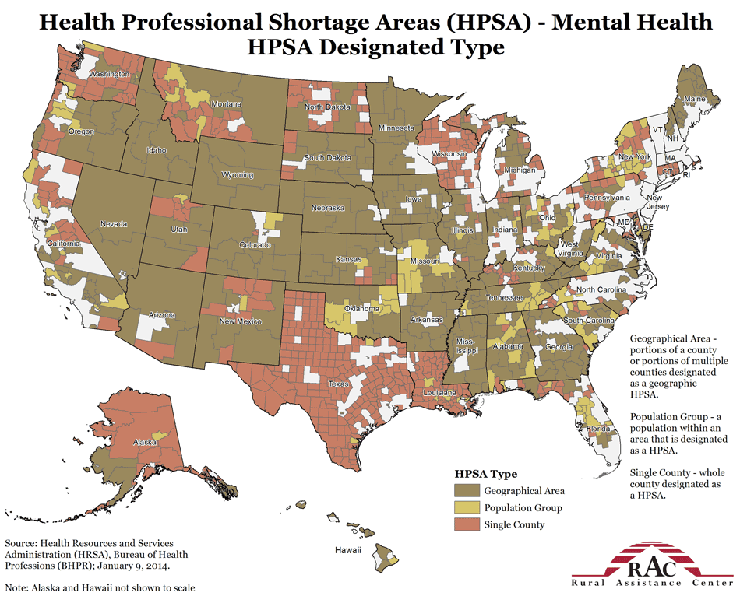
Notes:
Unfortunately -- as many of you I’m sure are noticing – there is also a painful shortage of mental health professionals in our communities, particularly in Nebraska.
In Nebraska, 88 of 93 counties are Federally identified Mental Health Professions Shortage Areas
74% of MH professionals practice in Metropolitan
Omaha and Lincoln
32 counties have 0 MH professionals of any kind
Of 156 licensed psychiatrists, only 27 (17%) practice in rural Nebraska and only 4 rural counties have a Child Psychiatrist

Slide 8
What is Integrated Care?
Notes:
And yet, you may be sitting here on a Friday morning, nodding along because this sounds good, but also asking yourself- what does it actually mean? What is integrated care? Who decides or decided what to call it? How do we know if we are “integrated”?? In fact – the patient centered medical home is one, but not the only, specific model of integrating behavioral health into primary care
As you may be noticing, if you haven’t already, there is substantial overlap between mental and behavioral health AND physical health, and this is felt by anyone working in primary care.

Slide 9
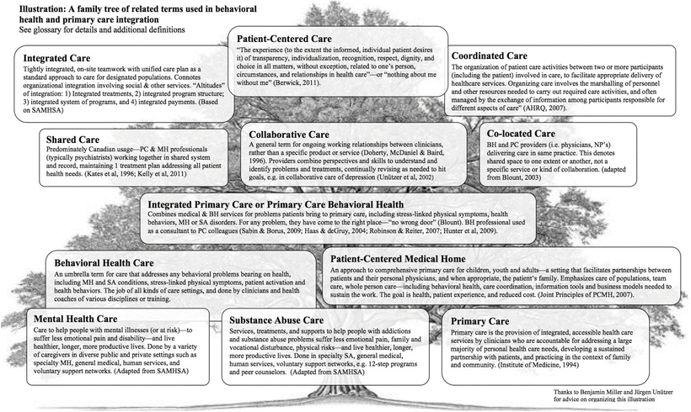
From: Peek CJ and the National Integration Academy Council. Lexicon for Behavioral Health and Primary Care Integration: AHRQ Publication No.13-IP001-EF. Rockville, MD
Notes:
AND in our field, in fact NONE of those are easy answers!! I love to look at this family tree, which was put out by the national integration academy council.
This family tree is often used to highlight common terms and models in integrated care. It also includes definitions often used in integration of behavioral and physical health.
These are high frequency definitions in integrated care. Some of these definitions focus on the location of where care is provided such as :
Co-located models consist of Behavioral health providers and primary care providers (e.g., physicians, nurse practitioners) delivering care in the same practice. Co-location is more of a description of where services are provided rather than a speciﬁc service; however, co-location maintains a referral process, which may begin as medical cases and are transferred to behavioral health (Blount, 2003).
In the Coordinated care model, Behavioral health and PCPs practice separately within their respective systems. Information regarding mutual patients maybe exchanged as-needed, and collaboration is limited outside of the initial referral (Blount, 2003).
Some of the definitions focus on the type of service being offered:
Care management Speciﬁc type of service which is often disease speciﬁc (e.g., depression, congestive heart failure) whereby a behavioral health clinician, provides assessment, intervention, care facilitation, and follow up (e.g., Belnap et al., 2006).
Collaborative care An overarching term describing ongoing relationships between clinicians (e.g., behavioral health and primary care) over time (Doherty, McDaniel & Baird, 1996). This is not a ﬁxed model, but a larger construct consisting of various components which when combined create models of collaborative care (Craven & Bland, 2006; Peek, 2007).
Integrated care Tightly integrated, on-site teamwork with uniﬁed care plan. Often connotes close organizational integration as well, perhaps involving social and other services (Blount, 2003; Blount et al., 2007).
And some of these definitions are model of integrated care such as
The Primary Care Behavioral Health Model
Collaborative Care Model
Integrated Care combines primary health care and mental health care in one setting. There are many ways to integrate care, and they may go by different names, including “Collaborative Care” or "Health Homes." This is an important model of care because:
Primary care settings, like a doctor's office, provide about half of all mental health care for common psychiatric disorders
People with common physical health conditions also have higher rates of mental health issues.
Providing Integrated Care helps patients and their providers. It blends the expertise of mental health, substance use, and primary care clinicians, with feedback from patients and their caregivers. This creates a team-based approach where mental health care and general medical care are offered in the same setting. Coordinating primary care and mental health care in this way can help address the physical health problems of people with serious mental illnesses.
Source:
Source: Peek CJ and the National Integration Academy Council. Lexicon for Behavioral Health and Primary Care Integration: AHRQ Publication No.13-IP001-EF. Rockville, MD

Slide 10
Models of Integrated Care
Primary Care Behavioral Health (PCBH) describes how licensed mental health providers/psychologists and primary care providers work in collaborative environments to address physical and behavioral health
Collaborative Care or CoCM is a specific framework of integrated care by the American Psychiatric Association “Collaborative Care Model”
Notes:
From the definition tree earlier in this presentation, we have covered a variety of definitions in integrated care such as location of services, type of collaboration and level of collaboration.
Models are delivery strategies that prescribe specific ways in which professionals will work together to provide healthcare services.
The majority of work in integrated care models centers on primary care with two main models of integrating behavioral and medical care: The Primary Care Behavioral Health Model or PCBH and the Collaborative Care Model or CoCM. These models are not mutually exclusive as we see a variations of these models in practice.
PCBH is a model of care that seeks to optimize access to behavioral health support within the primary care environment across all possible patient presentations. In this model behavioral health professionals, often called Behavioral Health clinicians/consultants (BHC), work alongside medical providers in real-time. They are often called into exam rooms to work with patients in what is called a “warm hand-off” where the patient sees the physician first and then sees the BHC. On follow-up visits the patient may see both providers or only one of the pair depending on the situation and need. BHCs can provide support for mental health concerns such as depression, anxiety or ADHD as well as physical health concerns such as management of diabetes, hypertension or sleep issues to name a few. One of the central goals of the PCBH model is to improve access to care (referral out of primary care to specialists has been shown to be difficult) while supporting the interventions of the medical care team. Evidencefor the effectiveness of the PCBH model exists here. For more on the PCBH model see our PCBH Special Interest Group pages.
The Collaborative Care Model two types of services to usual primary care: behavioral health care management and consultations with a mental health specialist.
The behavioral health care manager becomes part of the patient’s treatment team and helps the primary care provider evaluate the patient’s mental health. If the patient receives a diagnosis of a mental health disorder, and wants treatment, the care manager, primary care provider, and patient work together to develop a treatment plan. This plan may include medication, psychotherapy, or other appropriate options.
Later, the care manager reaches out to see if the patient likes the plan, is following the plan, and if the plan is working or if changes are needed. The care manager and the primary care provider also regularly review the patient’s status and care plan with a mental health specialist, like a psychiatrist or psychiatric nurse, to be sure the patient is getting the best treatment options and improving.

Slide 11
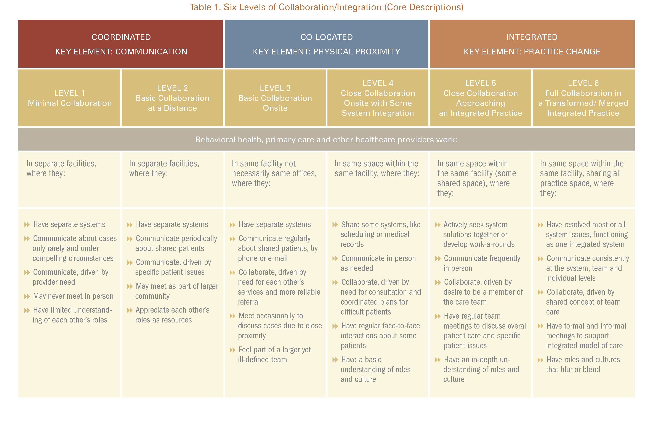
Notes:
This is an overview of some of the components in the 6-level continuum. Let’s look at it each level a little closer
Center for Integrated Health Solutions (CIHS) through SAMHSA has developed a description of varying :
https://www.integration.samhsa.gov/resource/standard-framework-for-levels-of-integrated-healthcare
Common to these models is a collaboration between behavioral health and primary care providers

Slide 12
Adult Behavioral Health in Primary Care
Anxiety
Pain
Depression
Substance Abuse
50% - 70% of physical complaints have no identifiable physical cause (O’Donohue, 2003)
Notes:
Like many things, A large majority of the theory and research on Integrated behavioral health in primary care has been done with adults.

Slide 13
Children vs Adults in IPC
Focus on the developing child
Families play an active role in treatment
Treatment focuses on coping and adjustment and behavior management
NIMH
Notes:
The National Institute of Mental Health distinguishes pediatric ic from adult ic and why it might look different. Working with children and families is often very different than working with adults with complex medical conditions. Pediatric Integrated Care differs from adult Integrated Care in three main ways:
The general principles of Integrated Care apply to adults as well as children and adolescents, but work with developing youth and their families is often different from the work with adults with complex medical illness. In addition, ongoing evaluation for intellectual disability and developmental delays will be emphasized in pediatric evaluations.
There is an increased sensitivity to how children are developing, both mentally and emotionally
Families play an important role
Treatment emphasizes coping and adjustment techniques in addition to standard care
Treating Children
Most children with mental health conditions are treated in a primary care setting instead of a specialized mental health setting. About half of all mental health disorders begin by age 14. Accurate diagnoses and quality care are vital in a primary care setting.
Treating Adults
Adults are also more likely to be seen in a primary care setting than within a mental health system. Primary care providers deliver half of the mental health care for common conditions such as anxiety, ADHD, depression, behavioral problems, and substance use. Yet, people with mental illnesses who are treated in a primary care setting are less likely to receive effective behavioral health care. For example, 75 percent of adult patients with depression see primary care providers, but only half are accurately diagnosed. When a referral is made to a mental health provider, only about half of patients follow through with making an appointment. As a result, many behavioral health problems go undetected, undertreated, and/or untreated.

Slide 14
Pediatric Integrated Care
Screening
Early Intervention
Prevention
SAMHSA: https://www.samhsa.gov/capt/practicing-effective-prevention/prevention-behavioral-health/adverse-childhood-experiences
Notes:
In pediatric primary care, BH integration focuses on screening, prevention, and early intervention.
Early identification and tx of trauma, social, emotional, and behavioral problems in children can lead to better quality of life and better health outcomes.
Integrated care for children involves the child, adolescent and her/his family.

Slide 15
Primary Care Behavioral Health Model (PCBH)
Model of care that integrates behavioral health in the primary care setting
Goal: Optimize access to behavioral health support across a variety of patient presentations
PCP sees patient and provides referral to the BHC
Licensed behavioral health professionals are referred to as Behavioral Health Clinician “BHC’s”
Behavioral health assessment and treatment delivered in the same space as the PCP’s
Notes:
So, PCBH models are quite common and the general framework for most of our pediatric primary care clinics at Munroe-Meyer Institute. The PCBH model seeks to improve and optimize access to behavioral health services, including brief treatment and assessment, warm hand offs, and consultation across a variety of presenting concerns. We always say we are trained to be generalists and to quote “see anything that walks in the door,” but by that I mean, see anything that is fit for primary care and referred from the primary care physician or the pediatric primary care team
BHCs are licensed providers and work in the same clinic location as primary care providers

Slide 16
Child-Adolescent Behavioral Health Concerns
Non-compliance
Excessive Tantrums
Elimination Disorders
ADHD
School Behavior Problems & Refusal
Sleep Disorders
Learning Disabilities
Developmental Delays
Depression
Anxiety
Relationship Problems

Slide 17
Behavioral Health Needs
Medical and BH Provider in Primary Care
75-80%
Referrals and Community Care
10-15%
Specialty Care
5%

Slide 18
Example Components of Integrated Care
Screening by PCP | Collaboration and Teamwork
Coordinated assessment and treatment plan | Shared practice space
Communication (formal and informal) | Shared office space
Timely access to behavioral health | System to share records
https://www.integration.samhsa.gov/workforce/Integration_Competencies_Final.pdf

Slide 19
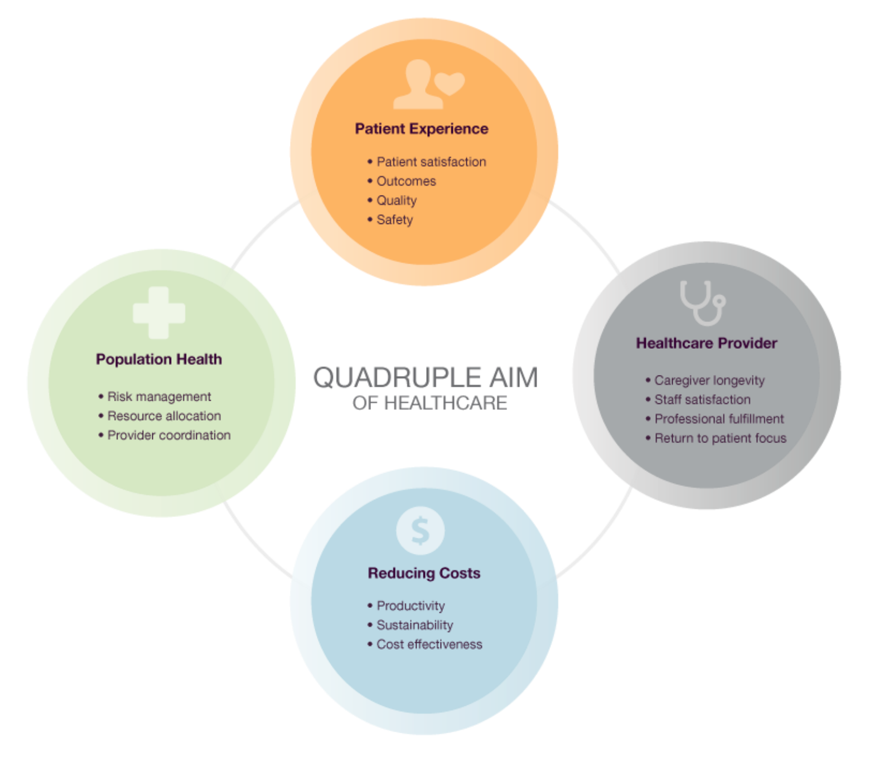
Why Integrated Care?
https://www.kumc.edu/documents/internalmed/quadruple-aim-healthcare-image.pdf

Slide 20
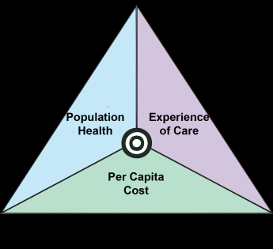
Six Reasons Why Behavioral Health Should be Part of the Primary Care Medical Home
High prevalence of behavioral health problems in primary care (needing long-term follow-up)
High burden of behavioral health in primary care
High cost of unmet behavioral health needs
Lower cost when behavioral health needs are met
Better health outcomes
Improved satisfaction
Improving work life of health care providers
Quadruple Aim
Behavioral health integration achieves the quadruple aim.
Notes:
Has been recently expanded to “Quadruple Aim” and now includes improving the work life of health care providers. Reduction in burnout.
Society expects more and more of physicians and practices, particularly in primary care. Patients want their health to be better, to be seen in a timely fashion with empathy, and to enjoy a continuous relationship with a high-quality clinician whom they choose.³ A patient-centered practice has been described as, “They give me exactly the help I need and want exactly when I need and want it.”⁴ Yet for primary care, society has not provided the resources to meet these lofty benchmarks (Bodenheimer, T. & Sinsky, C. (2014). From Triple to Quadruple Aim: Care of the Patient Requires Care of the Provider. Annals of Family Medicine, 12, 573-576.

Slide 21
Does it work?
Notes:
At this point, you may be thinking – okay. Allison seems okay, I guess I wouldn’t mind having her in the clinic to help with kids who are destroying the waiting room, or screaming and refusing to get their flu shot, or you know, and she seems alright to chat with, especially about Creighton basketball until they lose in the last second of the elite eight on a garbage call….
But does it actually work? Does integrating behavioral health into primary care make a difference?

Slide 22
Why Integrated Care?
Research is finding…
Increases access to behavioral health care.
Improves health outcomes for patients with mental illness and/or substance use disorders.
Improves health behaviors such as compliance with treatment recommendations, exercise, and diet.
Reduces overall health care costs, thus representing the opportunity for shared savings for primary care practices.
http://www.jabfm.org/content/30/1/25.full?sid=f635119b-7243-4bfe-bbd2-3241c11377f4; https://www.ncbi.nlm.nih.gov/pubmed/28379819; http://medicaleconomics.modernmedicine.com/medical-economics/content/tags/affordable-care-act/integrating-primary-care-and-mental-health-key-im?page=full
Notes:
In fact, we have evidence to suggest that integrated primary care does improve access, it does improve health and mental health outcomes as well as health behaviors, and it does reduce overall health care costs
http://www.jabfm.org/content/30/1/25.full?sid=f635119b-7243-4bfe-bbd2-3241c11377f4
https://www.ncbi.nlm.nih.gov/pubmed/28379819
http://medicaleconomics.modernmedicine.com/medical-economics/content/tags/affordable-care-act/integrating-primary-care-and-mental-health-key-im?page=full

Slide 23
Improved Access
Valleley, R.J., Kosse, S., Schemm, A., Foster, N., Evans, J., & Polaha, J. (2007). Integrated Care for Children in Rural Communities: An Examination of Patient Attendance to Behavioral Health Services. Families, Systems, & Health, 25, 323-332.
Valleley, Meadows, Burt, Menousek, Hembree, Evans, Gathje, Kupzyk, Sevecke, Lancaster (2020). Demonstrating the impact of collocated behavioral health in pediatric primary care. Clinical Practice in Pediatric Psychology, 8(1), 13-24.
Notes:
Just a a few examples based on our work, though we could discuss this at length and I would certainly love to talk to anyone who is interested more about the effectiveness and program evaluation research
our team has looked at whether or not the integration of a behavioral health provider can improve that ever important first session attendance – and we’ve found an over 80% attendance rate for first session in both 2007 and in 2020

Slide 24
Provider Satisfaction
Physicians who have adopted an integrated model of care report strong agreement that this type of model helps to improve factors such as:
Quality and continuity of care for their patients
time that it allows them to spend on medical issues
Cost
Follow-up
Confidence with identification/management of problems
Reduced stigma for their patients
Hine, Grennan, Menousek, Robertson, Valleley, & Evans. (2016). Physician Satisfaction with Integrated Behavioral Health in Pediatric Primary Care: Consistency Across Rural and Urban Settings. Journal of Primary Care and Community Health. 1-5.
Notes:
Physicians who have adopted an integrated model of care report strong agreement that this type of model helps to improve factors such as:
Quality and continuity of care for their patients
time that it allows them to spend on medical issues
Cost
Follow-up
Confidence with identification/management of problems
Reduced stigma for their patients.
Hine, Grennan, Menousek, Robertson, Valleley, & Evans. (2016). Physician Satisfaction with Integrated Behavioral Health in Pediatric Primary Care: Consistency Across Rural and Urban Settings. Journal of Primary Care and Community Health. 1-5.

Slide 25
Exciting Directions
Training and Supervision in IPC
Early evaluation and identification for Autism Spectrum Disorders
Trauma-Informed Care
Notes:
One thing I think is so great about being in primary care and health psychology in general is emphasis on evidence-based and empirically supported treatments.

Slide 26
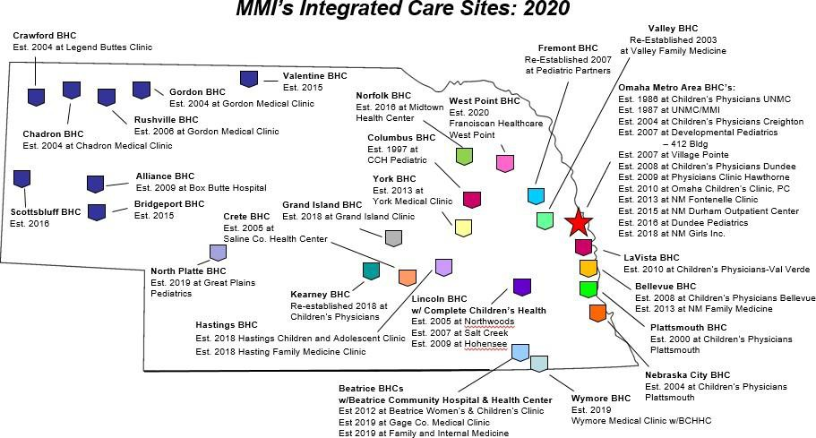

Slide 27
Mid-America Mental Health Technology and Transfer Center
Funded by the Substance Abuse and Mental Health Services Administration
5-year grant awarded to Dr. Joseph Evans at the University of Nebraska Medical Center
Aligns mental health systems and professional competencies with evidence-based practices
Primary target states: Missouri, Iowa, Nebraska, and Kansas - but available to any provider(s).
Provides free/low cost training and technical assistance on topics leading to effective behavioral health practice
https://mhttcnetwork.org/centers/content/mid-america-mhttc

Slide 28
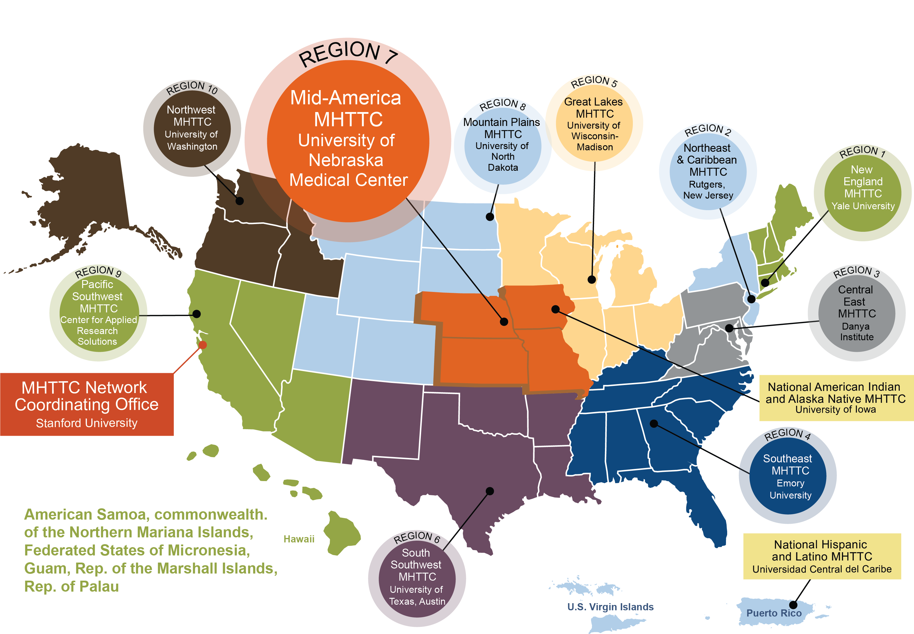
Mid-America MHTTC
Notes:
Joe

