Slide 1

Sarah Stamm PA-C
Clinical Evaluation
of
Adolescent Back Pain

Slide 2
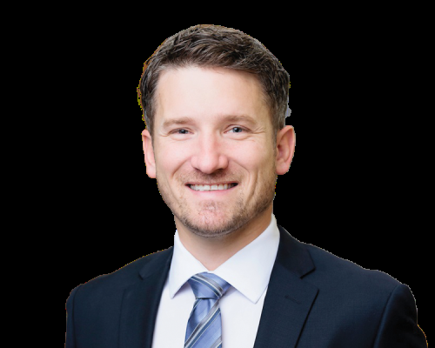


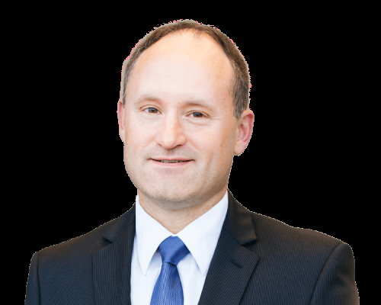




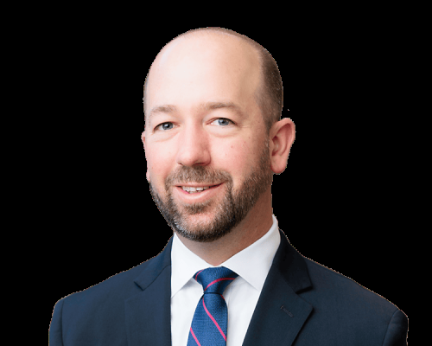

Travis L. Bailey, M.D.
Orthopedic Spine Surgeon
Timothy A Burd,M.D.
Orthopedic Spine Surgeon
J. Brian Gill, M.D., M.B.A. Orthopedic Spine Surgeon
John D. Hain, M.D. Neurosurgeon
Scott Haughawout, D.O., CIME Interventional Spine Care-Spine & Musculoskeletal Medicine
Jeremiah P. Ladd, M.D. Interventional Spine Care-Spine & Musculoskeletal Medicine
Michael C. Longley, M.D., Orthopedic Spine Surgeon
John W. McClellan III, M.D., Orthopedic Spine Surgeon
Chase C. Woodward, M.D. MPH Orthopedic Spine Surgeon
Matthew P. West, M.D., CSCS Interventional Spine Care – Spine & Musculoskeletal Medicine

Slide 3
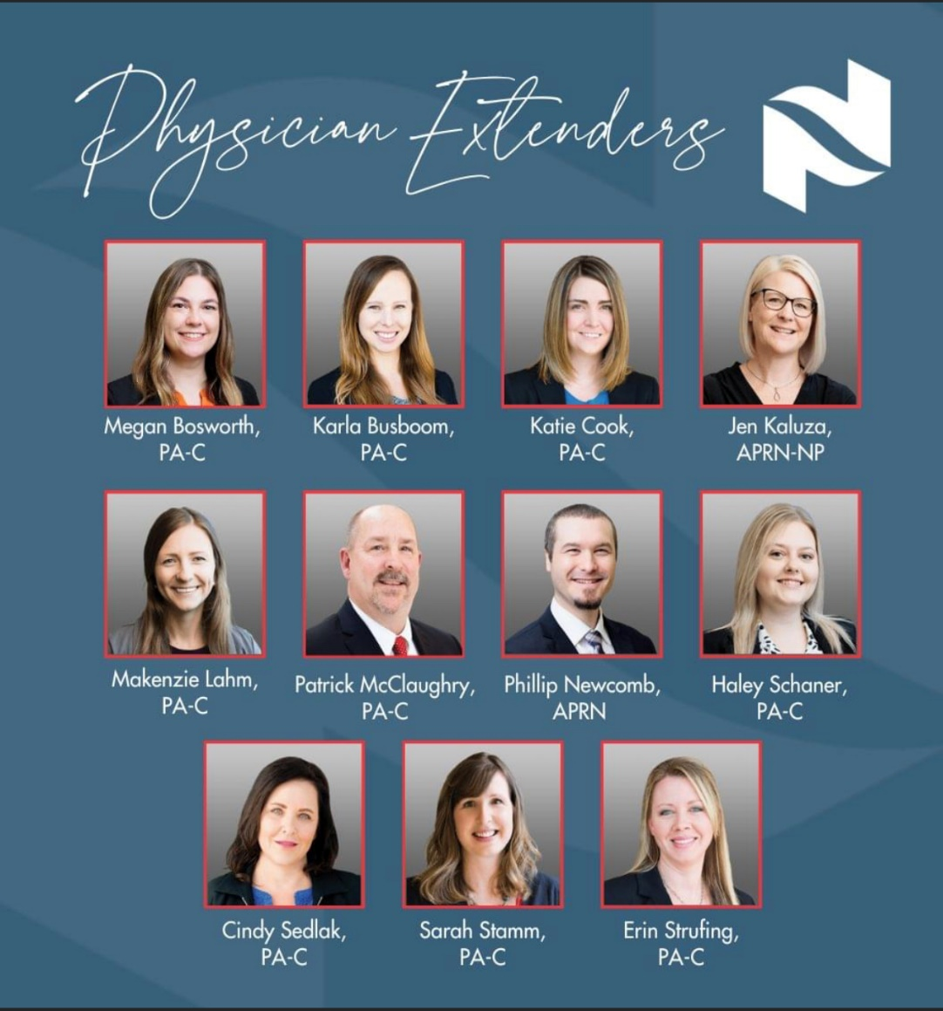

Slide 4
Goals of Presentation
Identify various pain generators/pathology for adolescent back pain
Work together to raise the standard of care for children and adolescents with back pain
Discuss various treatment options and lifestyle modifications for adolescent back pain

Slide 5
Audience Participation:
Who has treated a child with back pain in the past month?
What was the cause of the pain
Trauma
Sports
Insidious

Slide 6
What did you find on exam?
Fever or Systemic complaints
Abnormal skin
Pain with palpation
Spinal deformity
Neurologic exam
Did your exam help you to narrow the differential diagnosis?

Slide 7
What studies did you order?
Plain films
MRI
CT
Nuclear Medicine Bone scan
Did you know what you were going to
find before you ordered the test?

Slide 8
What diagnosis did you make?
Lumbar strain
Growing pains
Apophyseal ring fracture
Stress fracture
Schmorl’s node
Sacro Iliac Strain
Other
Kidney stone
IBD
Cancer
Juvenile Autoimmune disorders

Slide 9
What treatment did you recommend?
Activity as tolerated Rest / Discontinue sport NSAID Tylenol Brace Physical Therapy

Slide 10
Did the pain resolve? Yes or No Will your care help to prevent recurrence? Yes or No

Slide 11
Outline for Presentation
Prevalence of adolescent back pain
5 Factors contributing to Prevalence
History
Exam
Imaging Studies
Common Case Examples

Slide 12
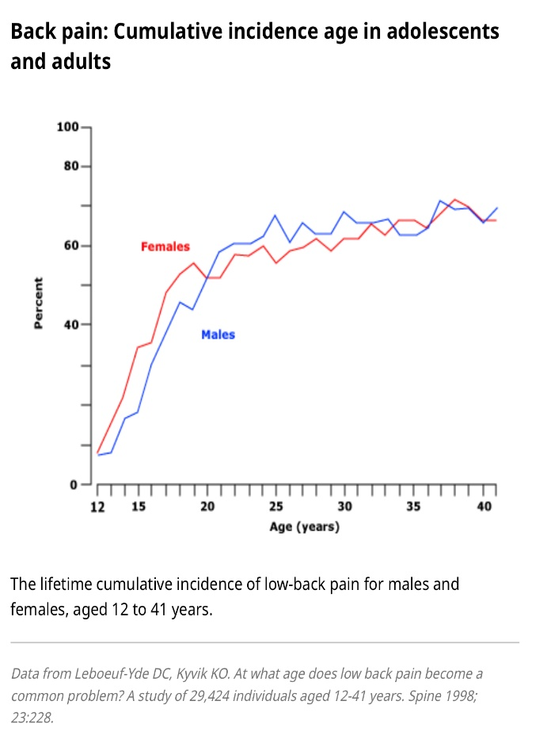
Adolescent Back Pain
36% of School age children
1/3 Resulting in restricted activity
70 – 80% at age 20
Watson et al, Salmimen et al, Olsen et al

Slide 13
Five Factors Contributing to Prevalence of Lumbar Pain in Children
Body Habitus
Lifestyle Factors
Physical activity
Sedentary activity
Lifting
Load of School Bag
Squat / Olympic lifts
Psychological, Social, Behavioral
Nutritional

Slide 14
Factor One: Body Habitus
BMI, Height, Weight: Not predictive of Pain
Growth spurt **** SOFT BONE *****
Will discuss Vitamin D later

Slide 15
Factor Two: Lifestyle
Too Sedentary
Video games/TV: More than 2 hours
Too Active
Excessive Sports
Overtraining or insufficient recovery periods,

Slide 16
Factor Three: Backpacks!
Backpack weight of greater than 20% of child’s weight – double the risk of back pain.
Emma McClellan Study
Potentially not as problematic with technology

Slide 17
FACTOR THREE: WEIGHT TRAINING
Study presented at NASS in 2011
Lumbar extension is felt to be a significant factor in adolescent lumbar fractures of the pars interarticularis.
Many of the author’s adolescent patients with pars fractures reported their injury occurred during the squat lift.
Fracture healing following acute fractures is poor: 3% for bilateral and 25% for unilateral pars fractures.

Slide 18
The Effects of Two Different Types of Squat Exercises on Radiography of the Lumbar Spine
John W. McClellan, III, M.D., Nicholas S. Aberle, II, M.D., Travis Manners, PT, CSCS, Kay Ryschon, MS
The squat exercise significantly increases the sacral slope altering the sagittal alignment of the lumbar spine and pelvis, resulting in horizontalization of the sacrum.
This was most noticeable during the back squat.

Slide 19
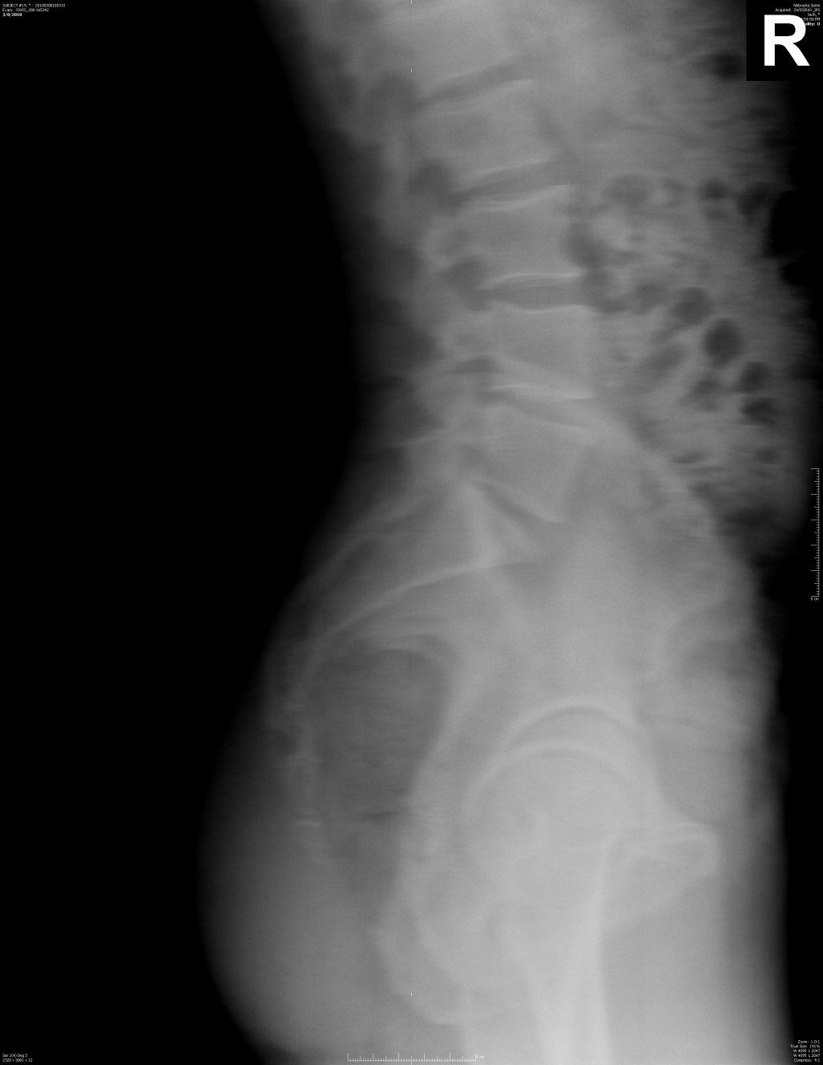
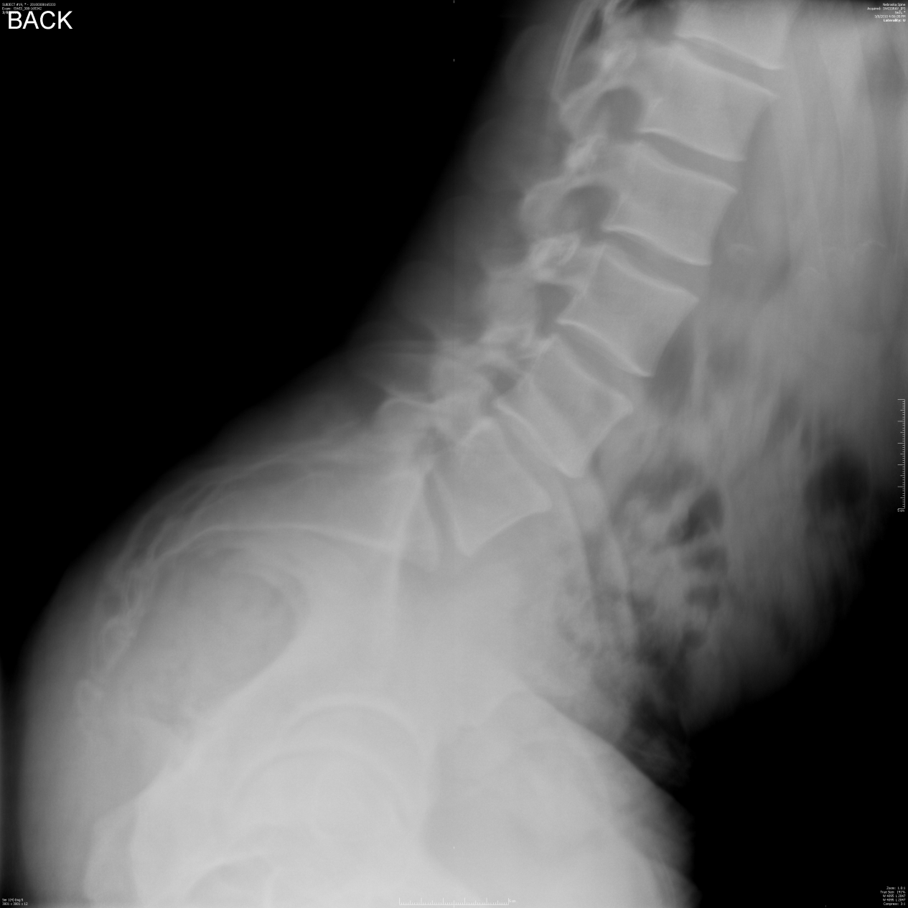
Factor Three: Weight Training
Nebraska Spine Center Research 2010

Slide 20
Factor Four: Psychological/Social/Behavioral
Emotional conduct disorders
twice as likely to report low back pain
Depression and Sleeping Disorders
Athletes with Inadequate Rest/Sleep****

Slide 21
Factor Five: Role of Nutrition
Time Periods when Calcium needs outpace the supply!!!
Rapid growth periods AIS
Sports
Low Vitamin D3: impaired calcium absorption
Lack of sun exposure

Slide 22
Erin McClellan, Laura Burnett, Sarah Stamm PA-C
Vitamin D3 deficiency in Nebraska
Bone Mineralization
88% Vitamin D3 Deficient
Presurgical visits at Nebraska Spine Center
NASS Vienna Austria 2009

Slide 23
Should vitamin D3 levels be tested in adolescents with lumbar stress fractures of the pars interarticularis?
John W. McClellan, III, M.D., Brian A. Vernon, M.D., Michael White, B.S., Sarah L. Stamm, MPAC, Kay L. Ryschon, M.S.
Routine vitamin D3 testing in patients with pars fractures is recommended.
Clinicians should strive to initiate vitamin D3 supplementation in patients with low levels to optimize bone healing and prevention of future fractures.
In this study, 15 (62.5%) of patients with lumbar stress fractures of the pars interarticularis had an insufficiency or deficiency of vitamin D3.

Slide 24
It’s important to evaluate all adolescents with back pain thoroughly as a cause can often be found.
Appropriate diagnosis is necessary for appropriate care!!!

Slide 25
History
Duration of Pain
Location of Pain
Aggravating / Relieving Factors ***
Activity Level
How many sports do they play at once???
Stress Level
Duration greater than 1 week
Duration greater than 1 month ***

Slide 26
History and Exam Pearls
Night-time Pain
Sciatic Pain
Pain with extension**********
Generally indicate a specific diagnosis will be found!!!

Slide 27
Nebraska Spine Center 122 Adolescents with Back Pain
30 Lumbar Stress fractures
32 Disc Pathology
42 Spinal Deformity
18 Other (Kidney stones / IBD)
2006 - J McClellan, T Burd,
L Kabuli HO3 UNMC Ortho Resident

Slide 28
Outline for Presentation
Prevalence of adolescent back pain
5 Factors
History
Exam
Imaging Studies
Common Case Examples

Slide 29
Physical Exam of adolescents with back pain
Evaluate family dynamics (Athletes)
Deformity Exam
Skin Exam
Abdominal Exam
Neuro Exam (Heel and Toe Exam)
Lumbar Range of Motion

Slide 30
Examination Pearl!
Pay particular attention to direction of bend associated with pain
Strength Test****
(kitchen test at home)

Slide 31
Imaging of adolescents
Plain films
Should be taken standing!
Forget the Obliques
Estimated Cancer Risk
1/1,000,000 (chest xray)
Spine 2010 Richards et al
2021 meta-analysis found that CT exposure in childhood is associated with increased cancer risk, but no associated risk was found for x-rays.
-Abalo KD et al

Slide 32
Imaging of adolescents
MRI Scan
Most common test ordered
Shows soft tissues and fluids
65% remain undiagnosed after MRI study
Many injuries missed by Radiologists on scan
Radiologists have to be told what
you are looking for!!!!!

Slide 33
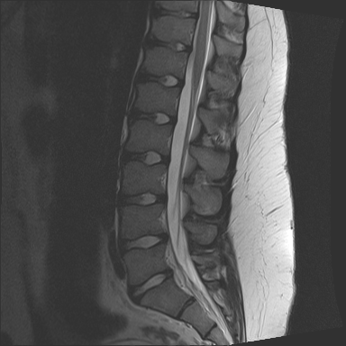
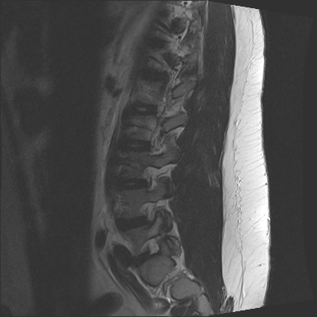
MRI findings

Slide 34
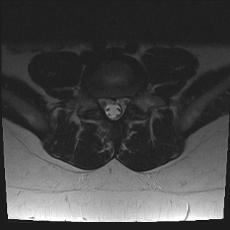
Mri axial image left pars

Slide 35
Imaging of adolescents
Bone scan
Good sensitivity between 2 weeks and 9 mo.
Helps determine healing potential
Helpful in athletes
*Gives 3 dimensional information!!!!!

Slide 36
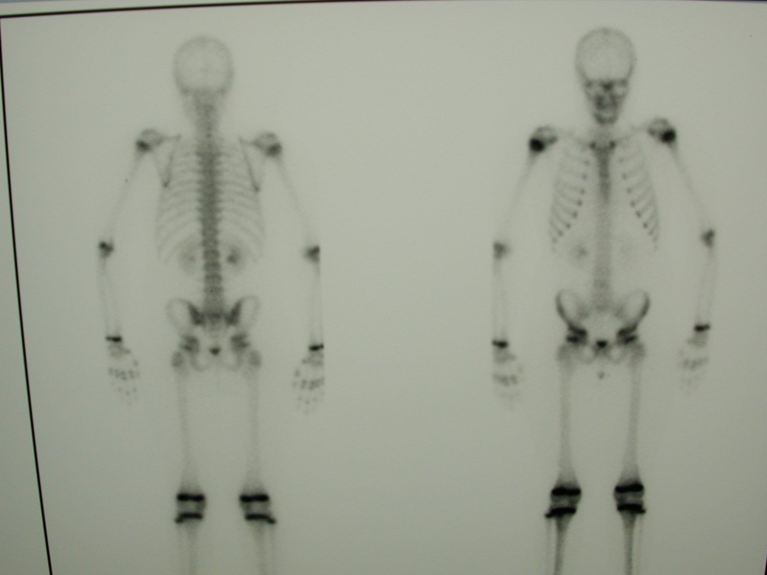
Bone Spect Scan

Slide 37
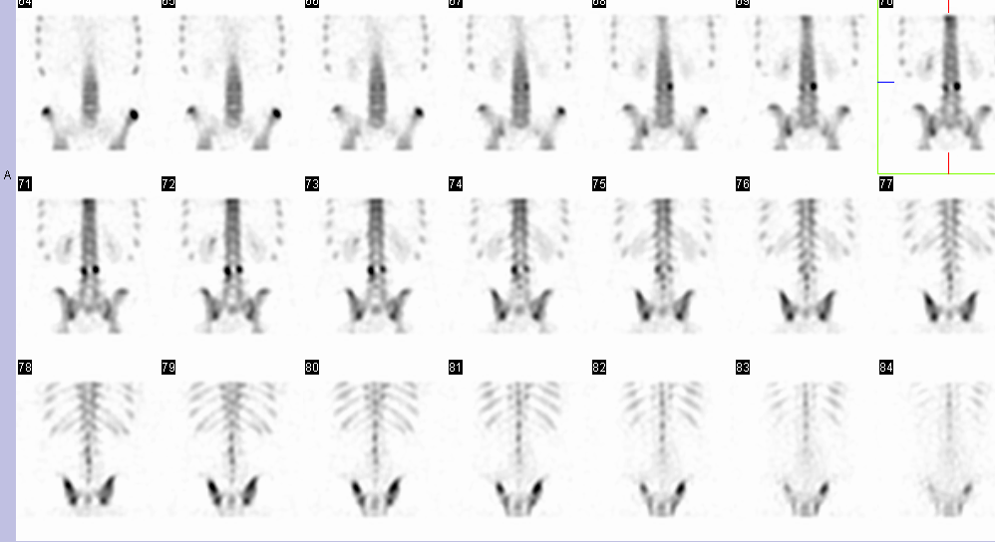
Bone Spect Scan
Healing Potential of Injuries

Slide 38
Imaging of adolescents with lumbar back pain
CT study
Identifies Bone Injuries!
Balance x-ray exposure with need for diagnosis.
Not an appropriate screening tool for children!
MUST limit exam to necessary area
Cancer risk 1/3200 for Full Lumbar CT
Spine 2010 Vol 35 Richards et al

Slide 39
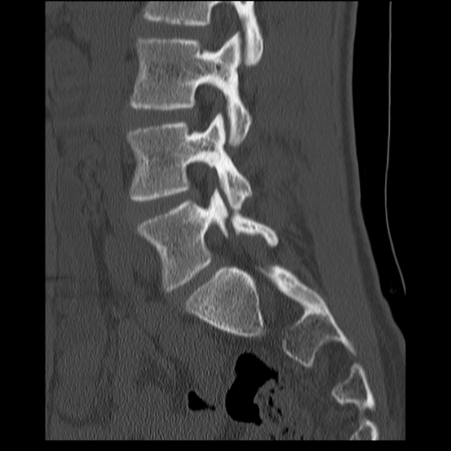
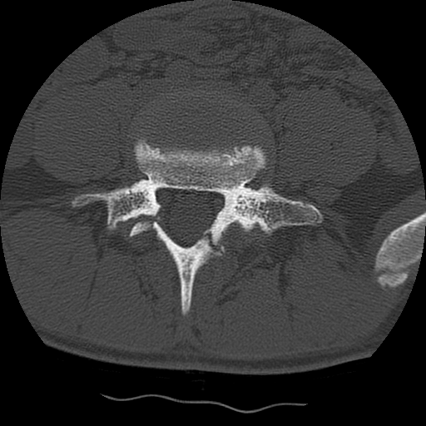
Imaging CT Scan
Immediate CT 4 mo Later

Slide 40
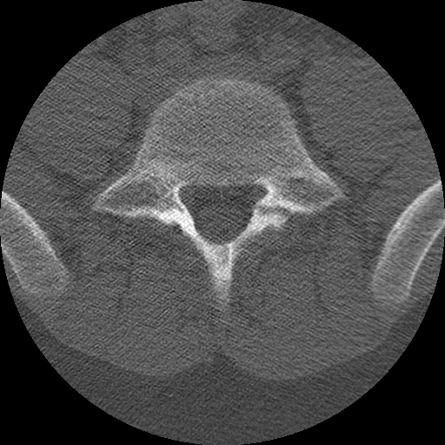
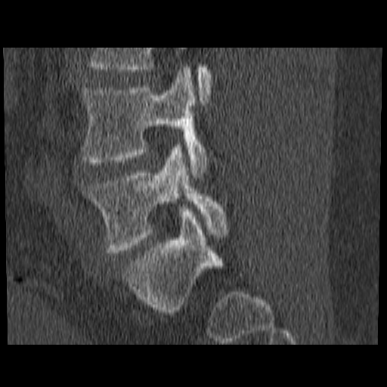
Imaging CT Scan
Determine the “anatomy” of the defect
Assess the status of “healing”
Thin cut 1-2 mm to find fractures

Slide 41
Adolescent Back Pain
Associated Conditions Found on Imaging Studies
24-70%
5-7%
Spina Bifida
Occulta
Scoliosis

Slide 42
WE HAVE ordered dexa’s on adolescents
Adolescent Scoliosis (females)
10% rate of osteopenia
Does Not improve with age
Boys and girls with acute endplate fractures or chronic thoracic or lumbar pain!!
Schmorl’s nodes

Slide 43
Treatment of Adolescent Back Pain
Diagnosis Specific
Avoid NSAIDs and PT until diagnosed
NSAIDS block bone from healing
PT not good for stress fractures ***

Slide 44
Importance of Appropriate Diagnosis prior to treatment
“Children with back pain always gets better!
All they need is a little physical therapy,
Motrin and Time.”
Famous Quote by Dr Anita Disk

Slide 45
Health consequence and disease impact of lumbar back pain
33%
Adolescents experience back pain into adulthood.
Greater risk in older adolescents
.

Slide 46
Case #1 Herniated Disc Apophyseal Ring Fracture
History: Traumatic (most recent football tackle)
Exam Unable to forward Bend
Neuro Exam + SLR
Time to resolution several months
All better when they can touch toes!

Slide 47
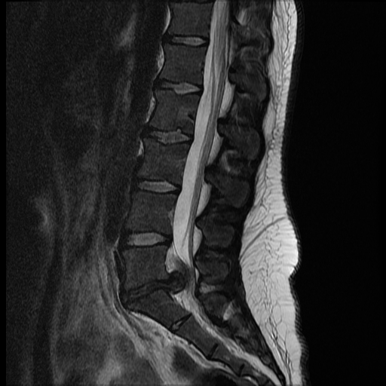
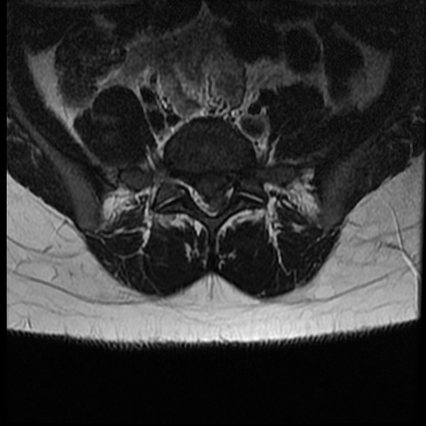
17 year old female

Slide 48
Case #2 Schmorl’s Node
History: Traumatic vs deformity related
Exam findings: Kyphosis
Neuro exam: normal
Time to resolution: Years
Dexa scan for kids and check Vitamin D3
Discussion concerning activity/sports modifications with lifting and one sport at a time

Slide 49
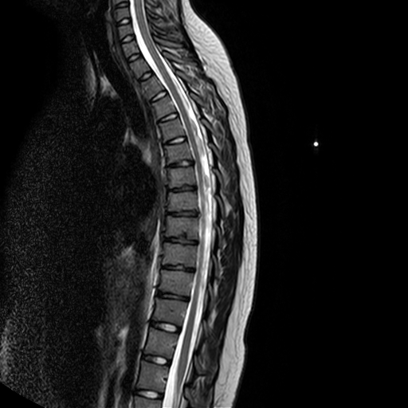

Slide 50
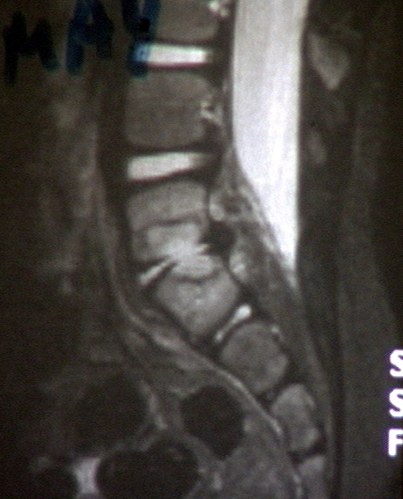
Discitis
1-12 yrs
refusal to walk
+/- fever
MRI
ESR
Rest / brace

Slide 51
Case #3 Tumor
History: Chronic pain vs Acute
Acute suggesting Pathologic Fracture
Night time pain (Red Flag!)
Exam: Normal Difficult to find****

Slide 52
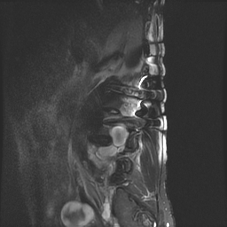
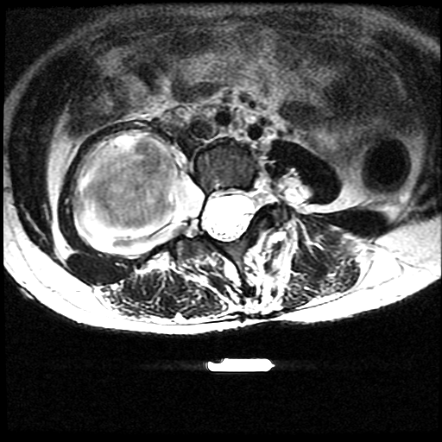
Notes:
Rhabdomyosarcoma

Slide 53
Case #4 Spinal Deformity Pain
12 yo Female
Thoracic and upper lumbar pain
Insidiuous Onset
Relieved with Rest
Worse with Sitting
No pain with flexion and extension
Idiopathic Scoliosis
Neurologic Exam normal

Slide 54
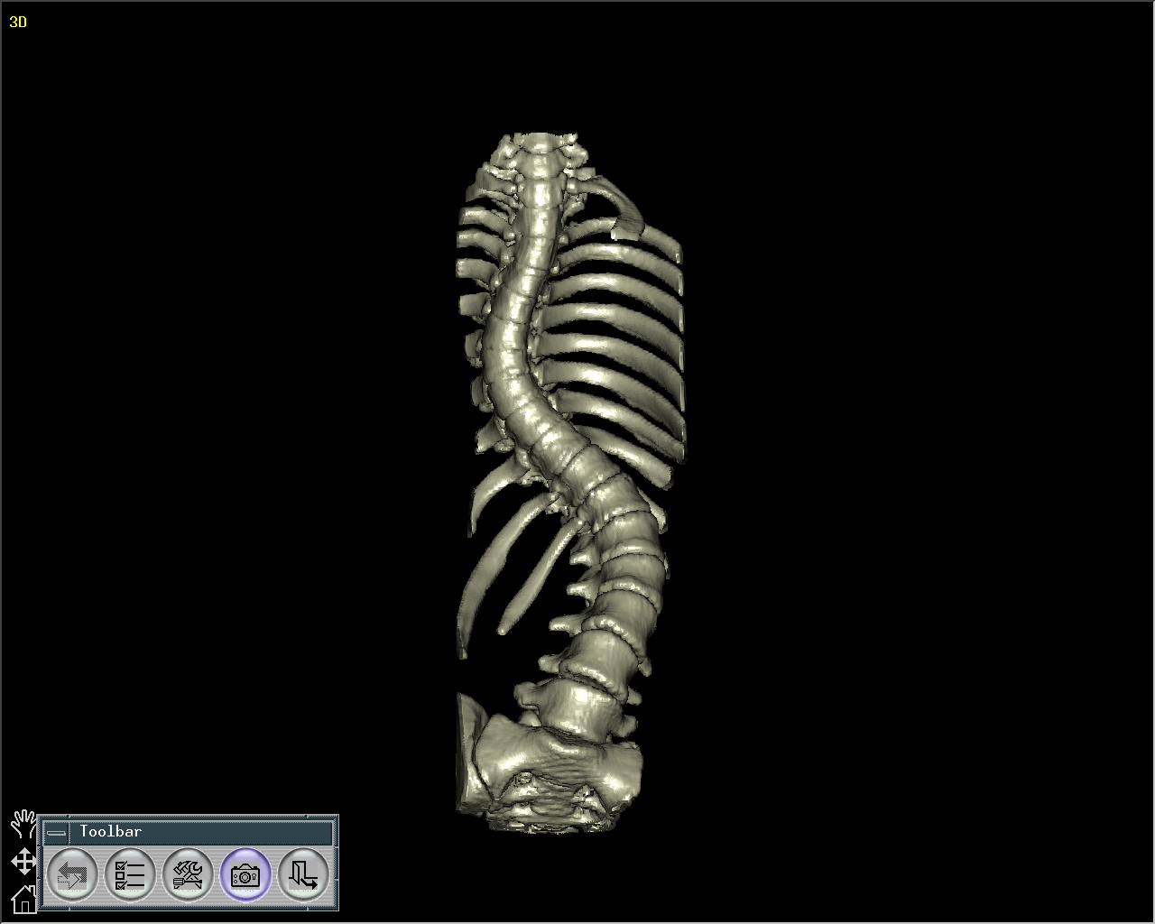
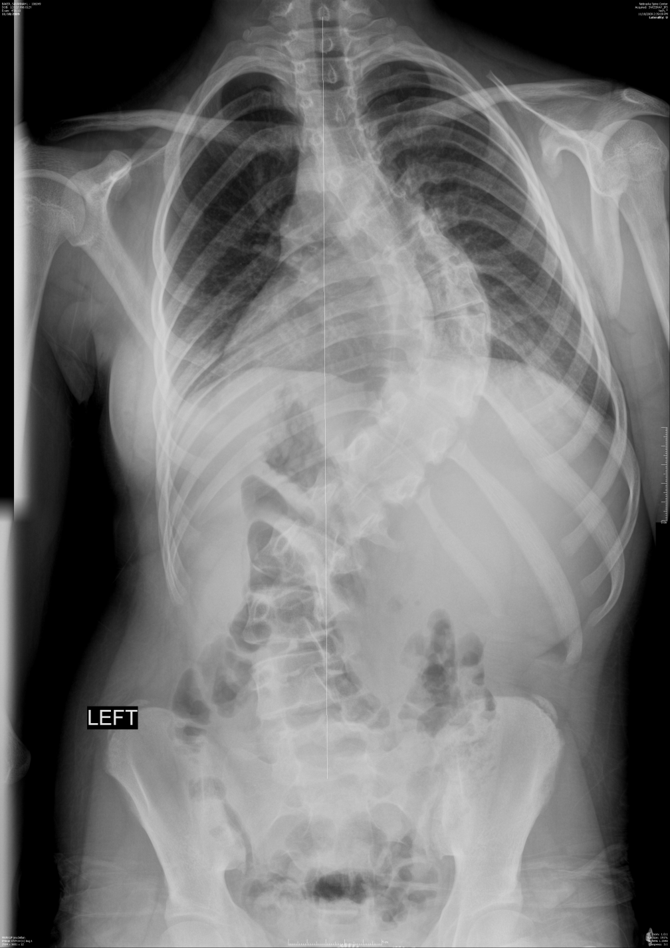

Slide 55
Case #4 Lumbar Stress Fracture
14 yo Male
Lumbar pain for one year
Onset: Squatting in weight room
Relieved with Rest
Worse with extension and swinging bat
No pain with flexion
Exam C/W Posterior Element Injury
Neurologic Exam normal

Slide 56
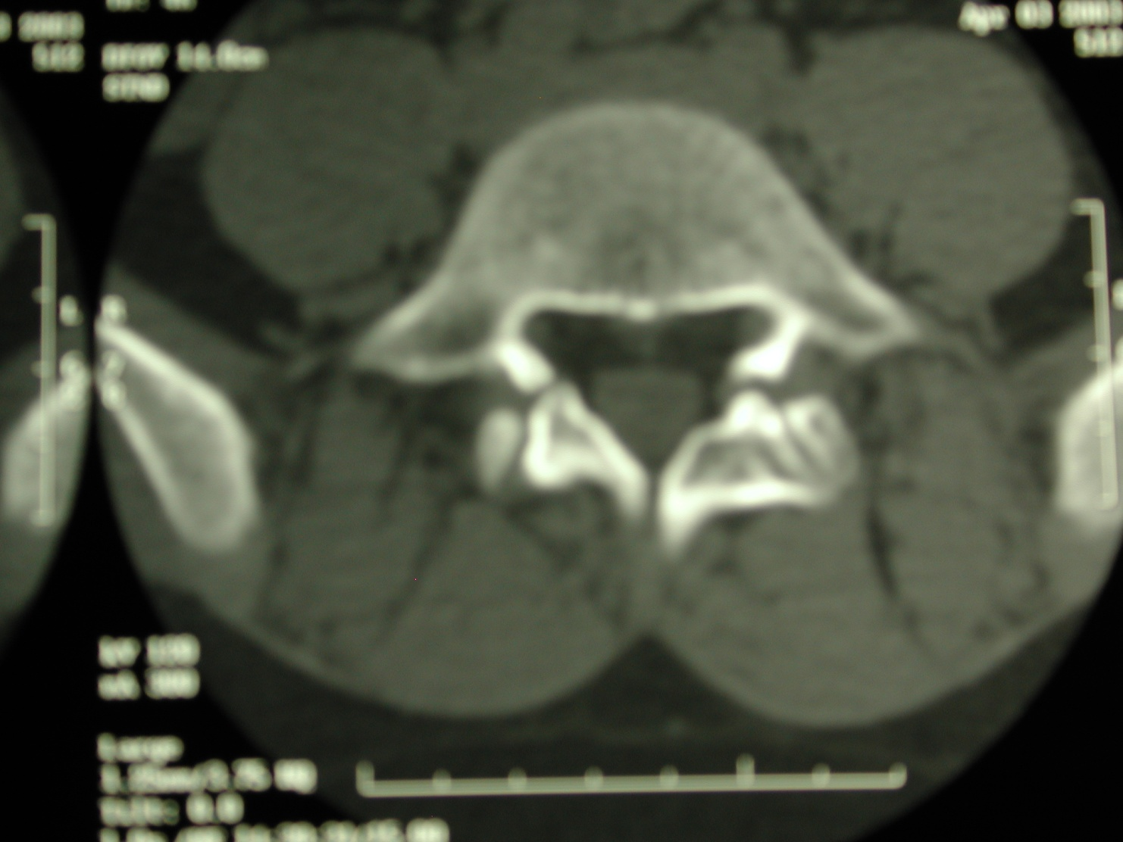
CT Scan (Axial View)

Slide 57
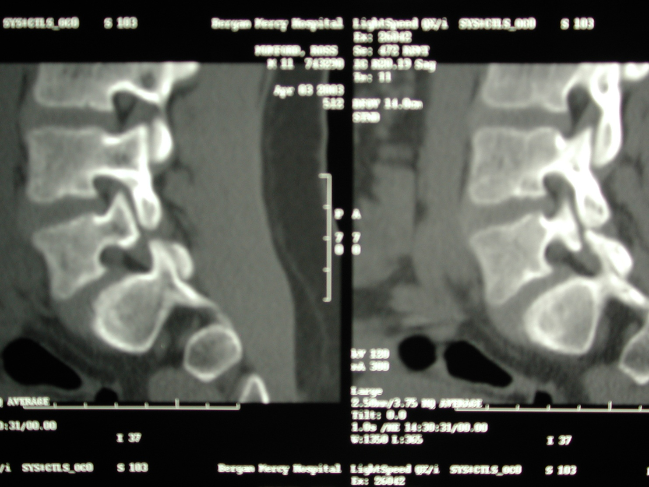

Slide 58
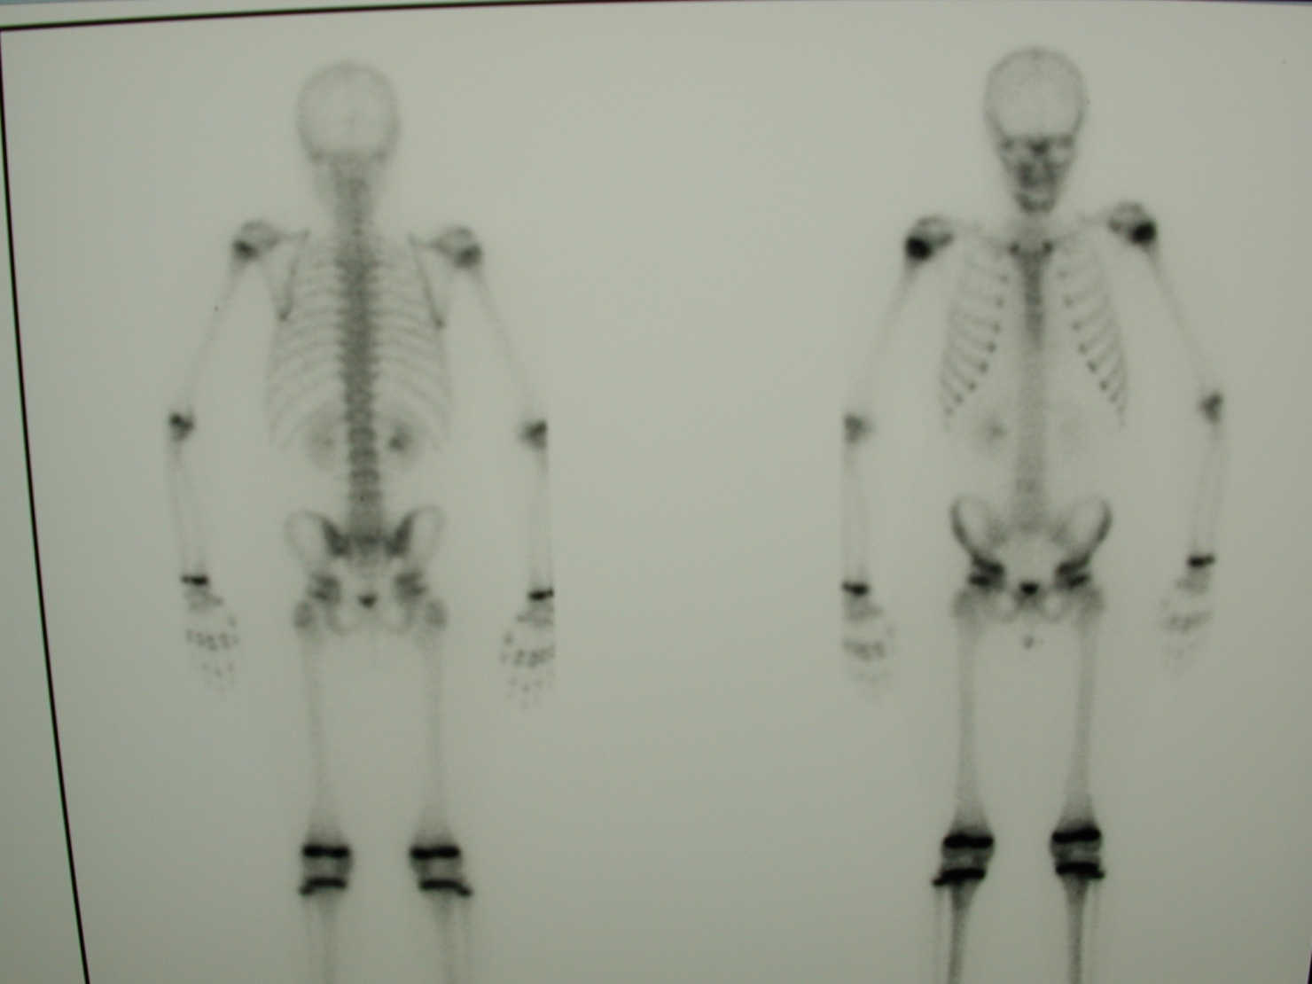
Normal Bone Spect Scan
“Hot Spots”
Represent
Normal
Growth
Plates
BACK FRONT

Slide 59
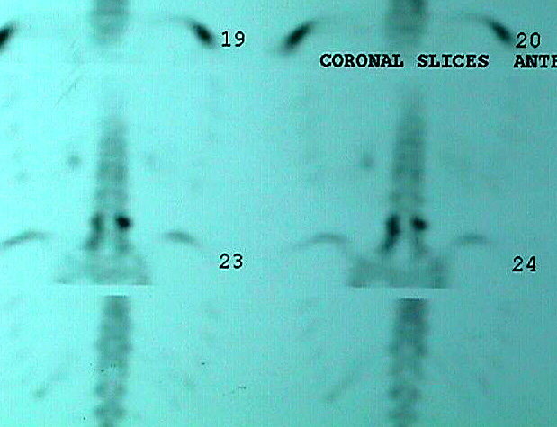
SPECT-Bone Scan
Evaluation of adolescent pain
Evaluate healing
potential of pars
fracture
Hot Bone Spect Scan
Positive Healing Potential !

Slide 60
Common Pitfalls in Treating Stress Fractures
Common diagnosis: Lumbar pars fractures.
A referral to PT may permanently limit healing potential.
Motrin and anti-inflammatories prevent bone healing.
MRI results miss lumbar stress fractures; stating exam as normal. 65% patients undiagnosed after MRI.

Slide 61
Healing Rate of 124 Adolescent Lumbar Pars Interarticularis Fractures Treated Conservatively
J McClellan MD, S Stamm PA-C
Nebraska Spine Center
Scoliosis Research Society
San Antonio 2009

Slide 62
SRS abstract 2009. Dr. John W. McClellan, Sarah Stamm, PA-C.
Conclusion:
“Only 3% of adolescents with lumbar stress fractures will heal if treated in a traditional fashion”

Slide 63
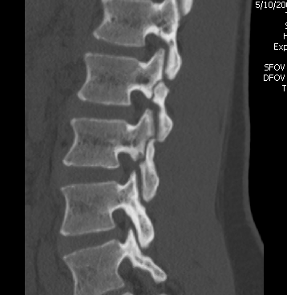
Appropriate diagnosis is critical to maximize healing potential and minimize long term consequences
4 fractures

Slide 64
Final Example: SI Stress Injuries
14 yo Female
Highly select volleyball –
National Tournament.
2 Year History of Pain
Worse with sitting and sports
Unable to play sports

Slide 65
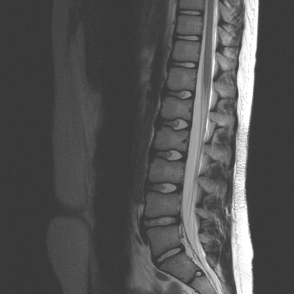
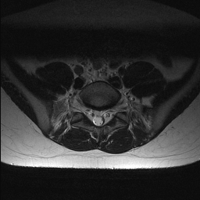

Slide 66
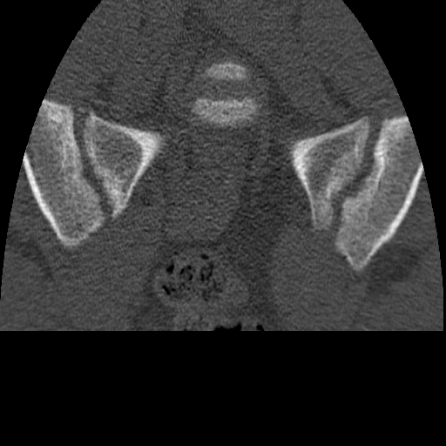
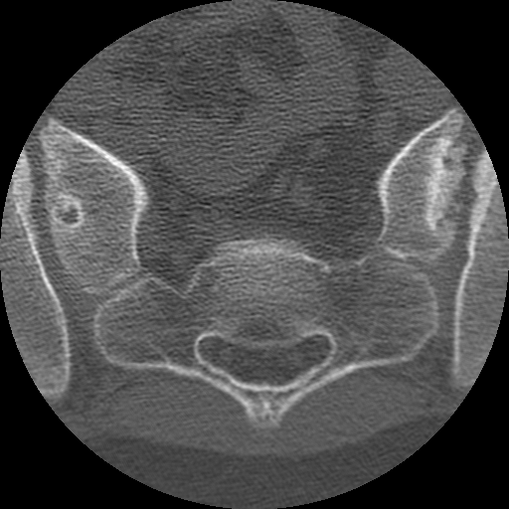

Slide 67
How Do We Minimize Recurrence or Chronic Pain?
Appropriate Education is critical for treatment
and prevention of recurrence symptoms
Need to evaluate the number of sports and amount of weight training
Evaluate sleep, stress and nutritional needs

Slide 68
Health consequence and disease impact of lumbar back pain
Prevalence of pediatric low back pain has been increasing since the 1980s
33% of adolescents will experience recurrent back pain during adulthood.
Appropriate diagnosis and treatment is critical to prevent chronic problems in adulthood
.

Slide 69
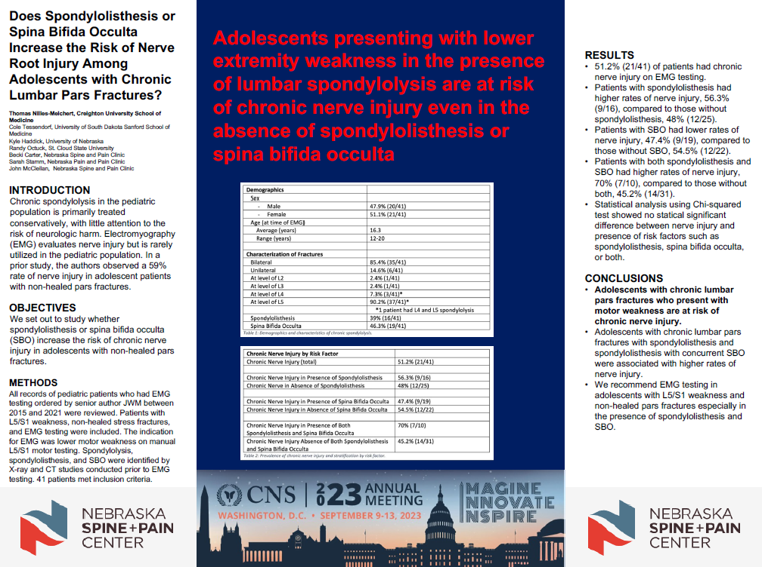

Slide 70
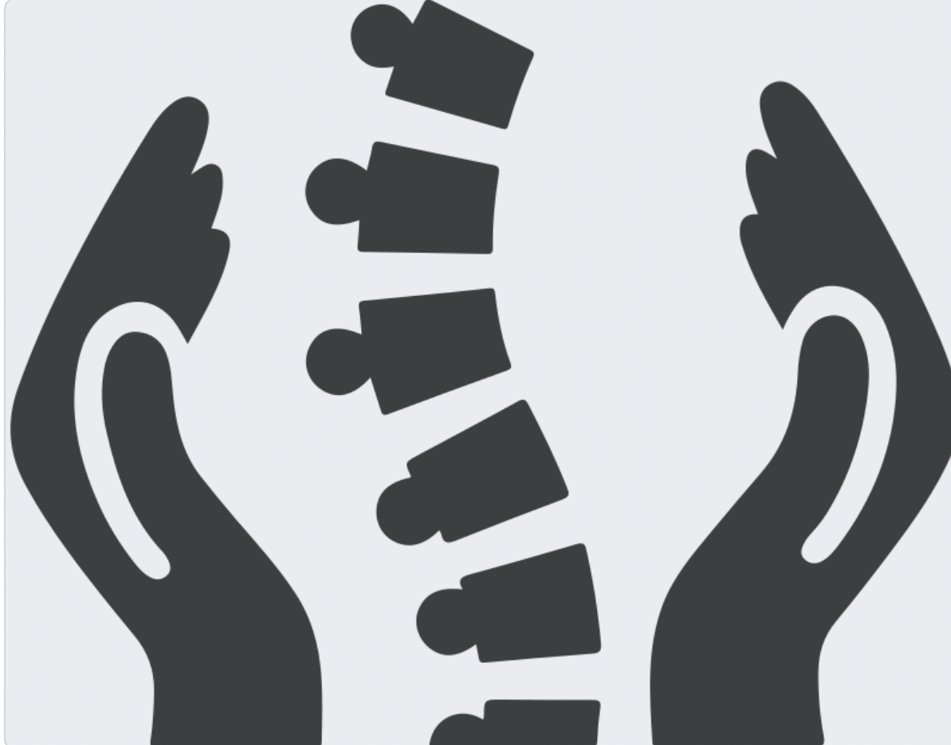
THE ONE SPINE FOR THE REST OF YOUR LIFE

Slide 71
THANK YOU
SARAH STAMM PA-C

