Slide 1
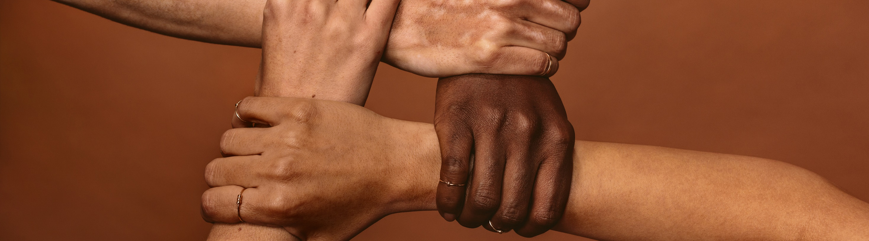
Addressing Vaccine Disparities
Lynn Bahta, RN, MPH | Immunization Clinical Consultant
June 2, 2023
health.state.mn.us

Slide 2
Conflicts of Interest
I have no conflicts to disclose

Slide 3
“We are only as strong as the weakest members.”
Adapted from an Old Basque Proverb- “A thread usually breaks from where it is thinnest.”
Notes:
Why address vaccine disparities.
This adapted proverb emphasizes the importance of our communities as a collective, and the public health function of preventing vaccine-preventable diseases.
This concept was often challenged during the COVID pandemic vaccination program, So my hope is as we move into a new normal, we can reset our mind frame of why we do what we do.

Slide 4
Objectives
At the end of this session participants will be able to:
Describe evidence components that are used to make vaccine policy.
Characterize key factors that contribute to immunization coverage disparities.
Describe key principles to address immunization disparities.
List strategies that can be adopted to mitigate vaccine disparities.

Slide 5
Making vaccine recommendations: A briefer
Advisory Committee on Immunization Practices (ACIP)
Provide advice and guidance to the Director of the Centers for Disease Control and Prevention (CDC)
Use of vaccines and related products in the U.S. civilian population
Control of vaccine-preventable diseases
Approve the list of vaccines for the Vaccines for Children Program
Notes:
Before I get into the meat of the topic, I want to take you upstream of the implementation of vaccine recommendations.
For some this may be a review, for others, it may help you understand and be assured of the level of scrutiny vaccine recommendations go through once they are licensed
A national body of individual appointed by the Secretary of Health and Human Services drive the vaccine policy process. This body is called the

Slide 6
Making vaccine recommendations: Evidential Review
Disease incidence and burden
Vaccine immunogenicity/effectiveness
Vaccine safety profile
Acceptance
Program implementation feasibility
Health equity
Economic analysis
Deliberation is conducted publicly via webcast so anyone may hear the evidence and subsequent discussions leading to a recommendation.
Notes:
What is that process
Much of the background work is done in workgroups who in turn present that information to the members for public discussion. For each of these elements, evidence is presented that leads the workgroup to determine if the evidence is sufficient

Slide 7



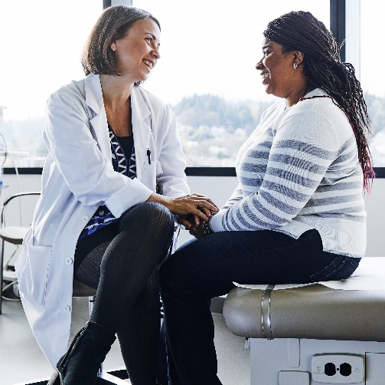
Recommendation categories
ACIP recommends vaccination for all persons in an age group or a group at increased risk for vaccine-preventable disease;
ACIP does not recommend the use of a vaccine; or
ACIP recommendation relies on the guidance of the clinician in the context of the individual patient situation
Notes:
The end result of this evidential process will result in one of three decisions.
However, just because we have a recommendation does not mean that vaccines get into everyone’s arms
It is important for us to understand all the elements that are necessary to get vaccines to everyone

Slide 8
Components of getting vaccinated
Confidence
-Knowledge, awareness, beliefs
-Level of intent
-Risk tolerance
Access
Level of intent
Cost and effort
All forms of access: physical, emotional, safety
-Vaccination experience
-Trust
Source: CDC: The Confidence Project, UNICEF: Journey to Health
Notes:
These concepts come from CDC and UNICEF and describe the components that can impact the goal of getting vaccinated, these were stressed quite a bit during the pandemic as we attempted to vaccinate as many people as possible, but the concepts apply to any vaccine that we hope to provide
I took the liberty of sub-dividing these into components that impact confidence and those that impact access
I have found it helpful as I begin to think about disparate rates or non vaccination and consider what components may associated with the issue

Slide 9
Intersecting factors
Perceptions about vaccines are influenced by
Race
Age
Political party
Geography
Personal faith background
Questions do not imply hesitancy
Source: deBeaumont Foundation: www.changingthecovidconversation.org
Notes:
While people may feel hesitant about vaccines for different reasons, the reality is that there is considerable overlap among diverse perspectives.
These are influenced by
Race –
Age
Political party
Geography
Personal faith background
Past vaccination experience
Risk tolerance – disease not that bad
The next slide demonstrates this using the COVID vaccine campaign as an example.

Slide 10
A spectrum of vaccination status & influencing factors
KFF COVID-19 Vaccine Monitor: November 2021 | KFF
Already gotten
Ready access to information
Time for the process
ASAP
Wait and see
If required
Definitely not
Staunchly anti-vaccine – willingly disseminating dis- and mis- information
Convinced by misinformation
Technical competence and resources
Early eligibility
Resources for travel
Aligned to partisan position
Perceived as mild
Not eligible
Concerns about newness
Safety concerns
Too much hassle to find appointment
Not accessible
Mistrust
Need more information
Cannot afford time off
Hearing misinformation
Not convinced it is necessary
Awaiting specific resource availability- rides, location, time off, technology to make appointments, interpreter
Notes:
ANIMATION
In their November COVID-19 Vaccine Monitor, the Kaiser Family Foundation provided the results of their most recent survey describing the status of vaccination for the U.S. population.
Previous graphs showed much larger categories of ASAP, and wait and see,
By November’s survey the categories of ASAP and the Wait and See were essentially eliminated
The categories of only if required and definitely not did not show change
So let’s apply these categories to see how components of getting vaccinated play a role in vaccine uptake.
CLICK
The more barriers created among the components, the longer it took for many to seek vaccination.
Some of the components impact underserved populations more than others.
In MN we were constantly assessing where the barriers were and build strategies to mitigate these barriers.

Slide 11

Addressing disparities when confidence and access intersect
Our experience in Minnesota and lessons learned for everyone

Slide 12
Hints of an issue emerge
Summer 2008: Hesitancy issues raised
“It’s the vaccines,” claimed a parent when asked about the community’s concerns with autism.
The community made several attempts to get the Minnesota Department of Health to find resources for overwhelmed parents.
Spring 2009: Minneapolis Early Childhood Special Education enrollment data analyzed
Higher numbers of community’s children enrolled
Fueled fear of autism and accelerated MMR vaccine refusal
2010: Increasing anecdotes from clinicians of MMR vaccine refusal
2011: Measles outbreak prompted MDH to look at MMR rates
Notes:
Lynn
A study conducted in 2000 showed that Somali parents were generally supportive of immunization
It wasn’t until the summer of 2008 that MDH learned differently. A local TV news network featured a story about parents who were concerned that there were disproportionately high numbers of Somali children participating in the early childhood special education programs and who had autism.
In the middle of the report a parent stated, “It’s the vaccines.”
“Autism” was a new phenomenon to Somali parents, reported as not seen in Somalia, there was no word for it
Parents began searching for information about autism and inadvertently linked themselves to national groups that hold fast to the debunked MMR- autism claim
An MDH analysis confirmed that there were higher enrollment numbers but could not confirm diagnosis, could not determine prevalence, or whether the child was using the services but lived outside of MPLS
Subsequently MDH began to receive reports from clinicians concerned that Somali parents were refusing the 12-month shots.

Slide 13
Comparison of MMR Rates at age 24 Months in Minnesota-borne Community children versus Non-community, 2004-2009, Minnesota
Community MMR rates
Non-community MMR rates
Year of Birth
Data from Minnesota Immunization Information Connection, assessed March 2011
Notes:
LYNN
The data we got instilled a bit of panic in the immunization team – to better explain this graph – this is data from our immunization information system, MIIC
MIIC uses birth certificate data to populate the registry which includes race and ethnicity data. The Somali-specific data is from mothers indicating Somali ethnicity on the birth certificate
It shows the MMR rate in each 24 month old cohort since 2004 – we stopped at 2009 because the age of children born in 2010 would range from as young as 13 months. As you can see there is a clear disparity between children of Somali descent and non-Somali children and there was a precipitous drop between the 2006 and 2007 birth cohort

Slide 14
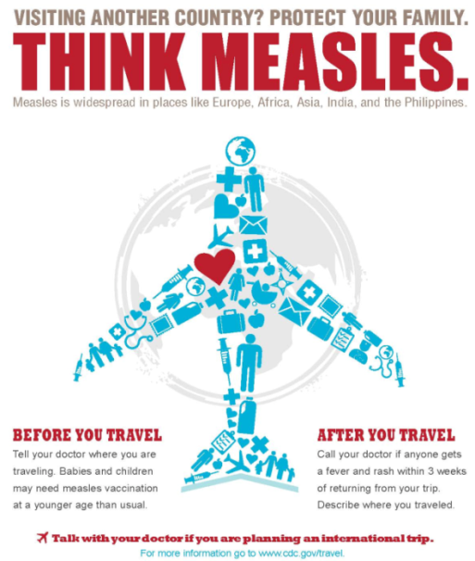
Early BROAD-Stroke Response: Ineffective
Information campaigns via diverse media, mostly written and radio
Distribution of travel immunization information
Promotion of YouTube videos on immunizations and on autism
Notes:
Lynn
The MDH immunization program began to develop interventions that targeted the broad Somali community with information about the importance of vaccination and the dangers of measles, however rates continued to decline – it was clearly evident that our efforts were not working
It was clear that strategies were not working
The need to regroup and to re-strategize became evident & necessary
Regrouping brought together the division of community & family health (which houses Children and Youth with Special Health Needs program), the refugee and international health program, the immunization program and the office of communication.
More importantly we realized that we could not move forward without improving our institutional cultural competence. The first thing we did was hire Somali staff.

Slide 15
Bringing in the community
Hired representative liaisons, permanent full-time positions
An RN, MPH who was well-connected to the community
An outreach educator
Created an internal interdepartmental working group
Immunization program
Children and Youth with Special Needs program
Communications office
Heeded the advice of our liaison colleagues

Slide 16
Expand Understanding of the Issue
Qualitative study on how diverse communities access ASD resources
Families of children with autism in the Somali community
Comparing the experiences of African American, American Indian and immigrant, refugee and migrant groups
Key Informant Interviews
Somali Minnesotan community members
Clinicians
Notes:
Asli
Community specific information and data to guide the plan of action was identified important. Sources include:
Community leaders meeting at the time of measles outbreak (2011)
Minnesota Legislature authorized study of the experiences of having a child with autism among the Somali community. The study was intended to understand “cultural- and resource-based aspects of autism spectrum disorders (ASD) that are unique to the Somali community.” With the approval of the Minnesota Department of Health, the study was extended to also include the Hmong and Latino communities.
2013 the immunization program conducted KII with Somali Community members and clinicians who care for Somali Minnesotan children
Focused on the importance of MMR vaccination
Danger of measles
Benefit of MMR vaccine
MMR vaccine does not cause autism

Slide 17
What we learned
Autism is feared
Parent weighed the risk of autism versus the risk of measles in Minnesota
Parents need information, common gaps included:
Understanding normal child development
About ASD and its early signs
Which childhood diseases are prevented by vaccination
Our goal was to present the facts so parents can make the best decision for their child.
Cannot address immunizations without addressing autism concerns
Messages need to come from respected community health professionals/leaders and lay influencers (doulas, faith assistants, interpreters)
Notes:
Asli:
4 important themes emerged from the data and the key informant interviews .
The fear of autism was real- parents need factual information-some of them were misinformed
Parents were asking the signs & symptoms of ASD-culturally this community monitors the growth of the child but not the development. Parents had little knowledge of autism but wanted to let more. Parents need to know what each vaccine prevents
The concepts of autism and immunization are entrenched together – you cannot talk about one without addressing the other
They wanted to hear the information from trusted community sources.

Slide 18
Adjusting our interventions
Built internal agency cultural competence
Developed key strategies:
Community engagement/partnerships
Effective informational training and outreach
Disease control/mitigation

Slide 19
Adjusting our interventions: more learning
Worried parents need the opportunity to purge their questions and concerns
Smaller outreach sessions supported trust building
We need to encourage clinicians to have the immunization discussion earlier than the day the child is due for vaccination (in this case, MMR)
There is always a need to adapt to newer audiences
Younger mothers are “Google-ers”
The decline in MMR rates slowed down and nearly leveled off
BUT not before a large measles outbreak occurred
Notes:
Worried parents have a need to purge the questions they have
Often requires one-to-one conversations
Showing videos is incomplete
Smaller outreach sessions supported trust building
Provides flexibility during information sessions
Individuals feel less shy about voicing questions and concerns
We need to encourage clinicians to have the immunization discussion earlier than the day the child is due for vaccination (in this case, MMR)

Slide 20
Measles outbreak in 2017
Deeply impacted this community.
Huge toll financially, educationally
Socially stigmatizing
The quick response was the result of the relationship MDH had established with community leaders.
Community engagement was led by community leaders.
Provided prevention messages in specific settings:
Childcare
Schools
Faith centers
Notes:
In the first month of the outbreak, most cases occurred among children in this community with a median age range of 2 years old.

Slide 21
Measles outbreak in 2017
Information was disseminated using previous mediums for which we had contracts:
TV
Radio
Teleconferencing
Community faith gatherings
We did see a large increase in MMR vaccination during the outbreak.
Notes:
The work we had been doing beforehand facilitated a more streamlined response.

Slide 22
Comparison of MMR rates at 24 months in Minnesota-borne community children versus non-community children, MIIC, Birth Years 2004-2019, Minnesota
Data from Minnesota Immunization Information Connection, assessed March 2022
Notes:
This assessment was conducted a year ago – notice the steep rise and then subsequent decline. As with other MN children, MMR coverage dropped off during the pandemic.
It is frightening

Slide 23
Post-outbreak
Follow-up study on driving factors of vaccination
Weighing the risk of measles over the risk of autism
Much input from mothers about their clinic experience
Continue:
Expand outreach to childcare centers
Education/training of health care professionals and trusted community leaders
Amplify efforts
Build local capacity
Community engagement using community-based organizations
Explore immunization coverage in other communities
Notes:
: African American, American Indian and immigrant, refugee and migrant groups

Slide 24
Ongoing challenges
Sustaining interest/involvement post outbreak
Finding monies to support community-based work
Retirement of the community nurse who led the leadership activities
Continual insertion of vaccine misinformation
The pandemic
It shut down our outreach
A vehicle for mainstreaming anti-vaccine sentiment
Notes:
Lost of community nurse
Educating people new to the issue
Avoid repeating previous ineffective interventions

Slide 25
Learning from the pandemic
Established a new model to promote health equity and reduce disparities
The pandemic response included a Cultural, Faith, and Disability branch
Staffed by persons representing a community that has been persistently underserved
Conveyed information to the community
Brought attention to the needs and concerns of their community
Notes:
Identified disparate services and brought feedback to response leads

Slide 26
Learning from the pandemic
Subject matter experts provided training and technical support to staff representatives.
The staff’s ability to learn and translate the information into culturally appropriate messages facilitated:
Trust building
Credibility
Mutual problem solving
The health department is committed to maintaining this model post-pandemic
Notes:
So as I wrap up, I would like to summarize key points that can be adopted by clinics and agencies that are working to address disparities. These are the concepts we have been learning along the way to address a critical disparity among our Minnesota community.
The health department is committed to maintaining this model and is restructuring to build a new division committed to addressing health equity.

Slide 27
Key Principles
TRUST: Build and sustain relationships among communities where disparities exist.
BUILD CAPACITY: Hire representative staff.
FOSTER CULTURAL COMPETENCY: Knowing information does not equal communicating effectively.
MAKE NO ASSUMPTIONS. Take on an attitude of humility. There are many ways to achieve the same goal.
LEARN: Listen. Listen to more than one voice.

Slide 28
Take aways in addressing disparities
Hire staff that are members of the communities you serve.
Until then…
Identify resources and dedicate staff time to ongoing community engagement.
Resources should include staff that represent the community.
Recognize that the voice of the community cannot be represented by a single voice or perspective.
Plan with the community, not after you have developed a plan

Slide 29
Take aways in addressing disparities
Establish and maintain ongoing relationships
Don’t wait for an emergency
Learn who has inherent credibility
Set up media contracts with vendors used by the communities.
Learn what works so that information gets disseminated, understood, and acted upon.
Cultural norms, beliefs and values – how does vaccination fit into these?
What is important to a specific community? Our priority may not be their priority?
Where does the community congregate, what type of events would be appropriate there?

Slide 30
Take aways in addressing disparities
Advocate for competent interpretation services
This includes agencies providing direct health services.
Double check translations to ensure cultural appropriateness.
Train persons who provide interpretive services
If we are not a member of the community,
Take on a supportive role and allow hired staff from the community to take the lead.
Be a mentor, an advocate, a buffer against bureaucratic processes.
“Mind meld” your expertise.
Learn from them.
Notes:
providing Interpreter services is an equity issue

Slide 31
Thank You!
Acknowledgements:
Asli Ashkir
Hinda Omar
MDH IIS team
Countless community partners
Lynn Bahta
lynn.bahta@state.mn.us

Slide 32
Land Acknowledgement
Every community owes its existence and vitality to generations from around the world who contributed their hopes, dreams, and energy to making the history that led to this moment. Some were brought here against their will, some were drawn to leave their distant homes in hope of a better life, and some have lived on this land for more generations than can be counted. Truth and acknowledgment are critical to building mutual respect and connection across all barriers of heritage and difference.
We begin this effort to acknowledge what has been buried by honoring the truth. We are standing on the ancestral lands of the Dakota people. We want to acknowledge the Dakota, the Ojibwe, the Ho Chunk, and the other nations of people who also called this place home. We pay respects to their elders past and present. Please take a moment to consider the treaties made by the Tribal nations that entitle non-Native people to live and work on traditional Native lands. Consider the many legacies of violence, displacement, migration, and settlement that bring us together here today. Please join us in uncovering such truths at any and all public events.*
*This is the acknowledgment given in the USDAC Honor Native Land Guide – edited to reflect this space by Shannon Geshick, MTAG, Executive Director Minnesota Indian Affairs Council

Slide 33
Recognition of past trauma and abuse
The state of Minnesota and the Department of Health recognize trauma, medical abuse, and discrimination that have happened to our Black, Indigenous, people of color, disability, and LGBTQ+ communities, leading to distrust in medicine and public health.
MDH, local public health, medical providers, and other partners are actively working to rebuild trust with communities and bring community members' voices to the table.
Notes:
Script:
The state of Minnesota and the Department of Health recognize that there is trauma and medical abuse that happens to our Black, Indigenous, people of color, disability and LGBTQ+ communities, some which the state has played a role in, leading to distrust in medicine and public health. The Minnesota Department of Health, local public health, medical providers, and other partners are actively working on rebuilding trust with these communities and looking for ways to bring community member's voices to the table.
______________________________________________________________
ADDITIONAL INFORMATION – examples
Tuskegee syphilis clinical trial where 600 black men – 399 with syphilis, 201 who did not have the disease were recruited to a syphilis study to learn the natural history of the disease (how to affects the body over time). Even after treatment was discovered in 1947 (and other patients were treated), the men in the study continued to be given placebos and mineral supplements because researchers wanted to monitor the development of syphilis. Many went blind, insane, spread syphilis to their family members, and died. As a result of the Tuskegee experiment, many African Americans developed a lingering, deep mistrust of public health officials and vaccines. (source: https://www.cdc.gov/tuskegee/timeline.htm; https://www.annemergmed.com/article/S0196-0644(03)00518-3/fulltext)
Delayed polio treatment of Black children – Race-based medicine. Blacks, medical experts insisted, were not susceptible to Polio, and therefore research and treatment efforts that focused on Black patients were neither medically necessary nor fiscally justified.
Theft of Henrietta Lacks’s cancer cells – Steal a Black women's human cells without any consent. The hospital where her cells were collected was one of only a few that provided medical care to Black people. None of the biotechnology or other companies that profited from her cells passed any money back to her family. And, for decades after her death, doctors and scientists repeatedly failed to ask her family for consent as they revealed Lacks’s name publicly, gave her medical records to the media, and even published her cells’ genome online.
Misuse of Havasupai Tribe members’ blood samples – Havasupai tribe worked with nearby university to conduct a study about diabetes. Their blood samples were misused by universities and laboratories throughout the country to study schizophrenia, inbreeding and theories about migration from Asia to North America. In addition, medical records of approximately 100 Havasupai tribal members were reviewed without their knowledge or consent.
Forced sterilization – 60,000 people with disabilities and minorities were forcibly sterilized in 32 states throughout the 1900s.
The medical abuse, racism and trauma continues today.
Disproportionately affected by COVID-19
Intersectionality
BIPOC population
LGBTQ+ population
Persons with disabilities
Frontline and essential workers
Difficulty accessing and navigating healthcare system

