Slide 1

Diabetic Foot Infection
Infectious Diseases Spring Symposium 2023
Creighton University
4/22/2023
Cezarina Mindru, M.D.
Assistant Professor of Medicine, Baylor College of Medicine
Staff ID Attending VA Michael E Debakey
Houston, TX

Slide 2
Objectives
Emphasize the role of ID physician in improving care coordination and outcome in patients with diabetic foot infections (DFI).
Briefly discuss the pathophysiology, microbiology and presentation of DFI
List the treatment and management options available.
No financial conflict of interest
Notes:
Of course , though the lens of ID physician

Slide 3
VA DeBakey
Limb Salvage team- Vascular surgery (Dr. N. Barshes+2); podiatry (3); wound care geriatric MD(3); ID (1); ortho (2); prosthetic specialist (1)
Texas Medical Center- Dr J Mills, Dr L. Poythress
VA study INTRERPRID (planned antibiotics+/- rifampin)
GitHub - nealbarshes/nealbarshes.github.io: GitHub page
Who we are – DF Blog (diabeticfootonline.com)

Slide 4
The Basics
>37 million Americans have diabetes
25% will develop a diabetic foot ulcer
50% will get infected; Of those >70% will die or undergo amputation;
five year mortality and direct costs of care for people with DF complications are comparable to cancer.
Limb loss negative impact on quality of life > any other complication including ESRD or blindness
Brennan MB et al. J Diabetes Complications. 2017;31(3):556-61
Armstrong DG et al. J Foot Ankle Res. 2020;13:16.
Notes:
327 billion
70% of those with a foot ulcer will die or undergo major amputation, defined as above-ankle amputation
Furthermore, the ones who are most likely to have poor outcomes are those with either osteomyelitis or gangrene- our patients.
Preventing major amputation and death associated with diabetic foot ulcers
For the infectious disease physicians in the room, we need to realize that we are seeing the tip of the iceberg- only 2.7% of patients with diabetic foot ulcers.
Our podiatry colleagues are shouldering a larger proportion of the burden- closer to 60%.
ID needs to be playing a larger role for these patients, and we also need to ensure equitable access to our expertise.
Can be a VVC, a discussion, being involved in care not in the same room, and participating on, these multidisciplinary teams that are becoming increasingly common.

Slide 5
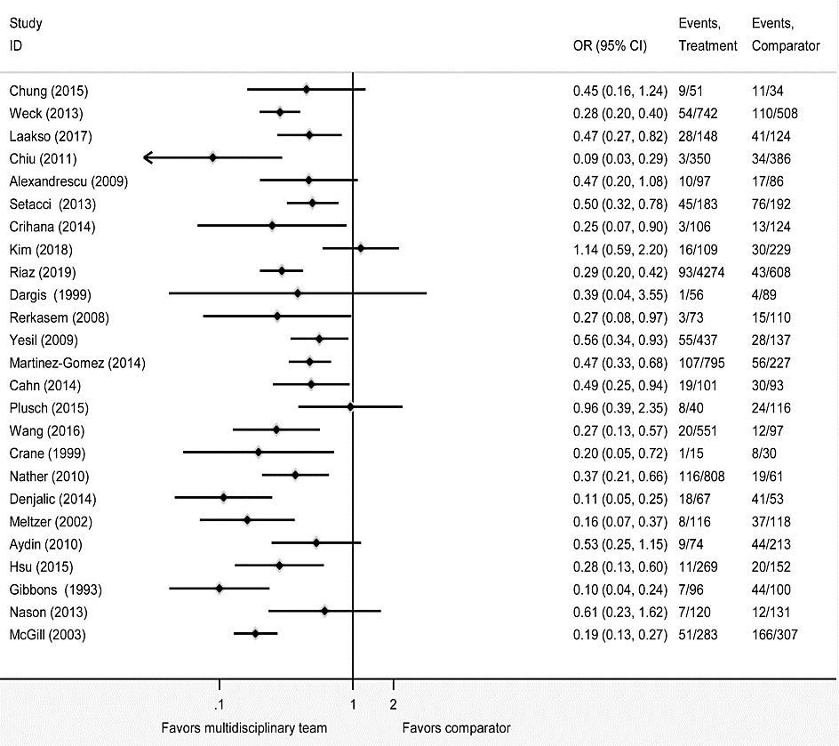
Multidisciplinary Teams Are Associated with a Reduced Risk of Amputation
ID sees 2.7%
Podiatry sees 60%
Infection is usually the last straw.
Musuuza J et al. J Vasc Surg. 2020;71(4):1433-46
Notes:
All but two studies, or 94%, reported a reduction in major amputations. The absolute percentage point change in major amputations ranged from a 2% increase to a 51% decrease.
So we asked ourselves, how did the teams do this?

Slide 6
DF : ulcer→ infection→ osteomyelitis
DFU=necrosis, gangrene or skin defect distal to ankle in DM
Primary prevention is important
education.
close follow-up
clear communication among members of a multidisciplinary team (surgeons, hospitalists, endocrinologists, infectious disease specialists, and wound care experts), nursing staff
Notes:
84 % of nontraumatic amputations are due to DFU
Amputation= horrific impact on QOL, heavy economic burden

Slide 7
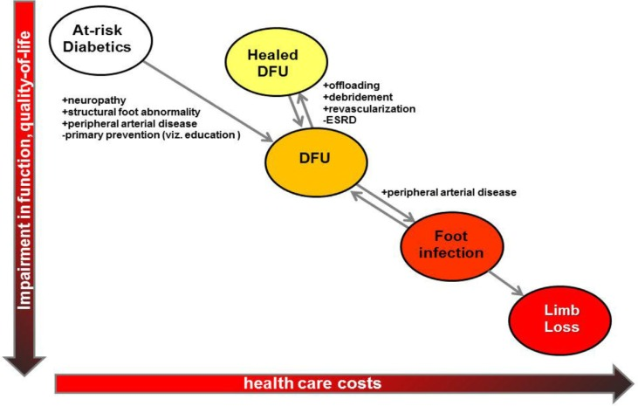
The system of care for the diabetic foot: objectives, outcomes, and opportunities
Barshes NR et al, Diabetic Foot & Ankle 2013
Notes:
The last straw in DFU trajectory to limb loss is infcetion

Slide 8
Contributing factors
Structural foot abnormalities
Sensory neuropathy (40-60%)
PAD (20-30% of patients)
Other
ESRD
Visual impairment
Improper fitted shoes
Autonomic neuropathy
Depressive sx

Slide 9
Secondary prevention
Deep infections get drained/incised. (https://nealbarshes.github.io/FootInfection/)
Ensure or establish adequate arterial inflow. (https://nealbarshes.github.io/PAD/)
Reconstruct, reestablishing intact epithelium over the entire extremity.(https://nealbarshes.github.io/FootHealing/)
Maintain mobility – even if amputation is performed. (https://nealbarshes.github.io/LegAmputation/)

Slide 10
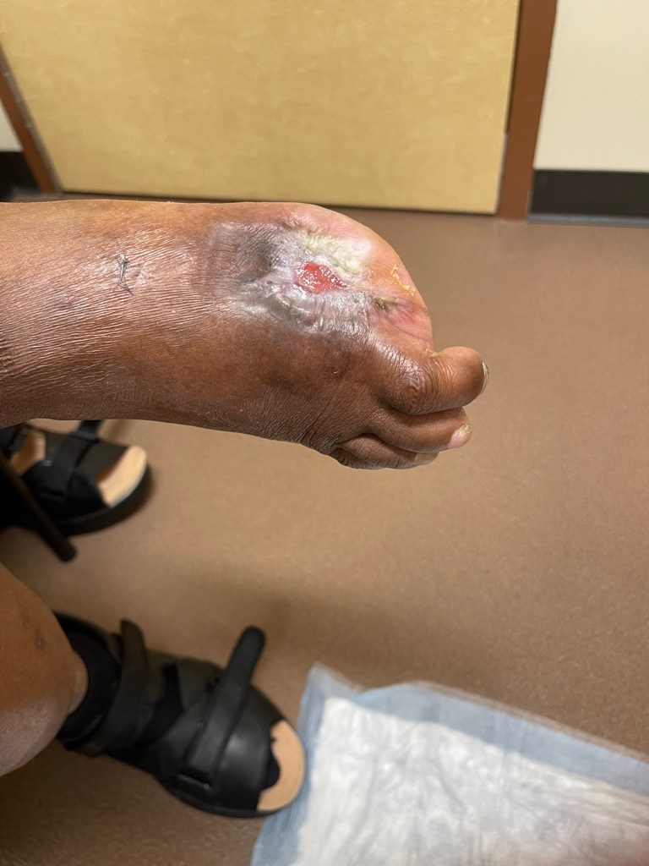
Case 1
56 y.o. man with h/o DM presents with one month history of foot ulcer at the site of the amputation (outside procedure).
No systemic symptoms.
Smoker
Looking well, VS normal
1x1.5 cm ulcer, clean base, no exudate; no cellulitis, minimal discharge
Somewhat decreased pulses
H/o neuropathy, on gabapentin
Monofilament + impaired sensation
What do you do next?

Slide 11
Assessment DFI
Signs /symptoms of sepsis
Foot exam- WOUND, INFECTION
active disease- ulcer, cellulitis, gangrene
probe to bone
temp and color changes
Screen for PAD-ISCHEMIA
rest pain/claudication
palpate DP/TP
check prior ABI results
Screen for loss of protection
neuropathic pain
monofilament
Imaging (PLAIN Xray, maybe MRI) Labs(CMP/CBC+diff/ESR/CRP/Prealbumin/HbA1c)
Wound culture:
Do Not:
Culture a wound that appears uninfected
Swab the wound for culture
Culture without first cleaning and debriding a wound
Bone biopsy (IR around 68% yield)
Consult: ortho/vascular/ID/wound care/diabetes specialist/prosthetics/others
Mills JL (WIfI). J Vasc Surg 2014
Notes:
PTB does not have a great PP; high risk-good PPV; low risk –good NPV; IDSA Bone Biopsy recommendations:
1. Uncertainty about diagnosis despite clinical and imaging evaluations
2. Absence or confusing mix of culture data from soft tissue specimins
3. Failure to respond to empiric therapy
4. Desire to use antibx that may be especially effective for OM but have high potential for selecting resistant organisms.
Bone Path is Gold Standard but there is a lack of a standard pathological definition, especially with Charcot changes
Cultures: Surface swabbing <50% concordance with bone culture. Bone Culture data is also variable as to benefit in response to treatment. Some studies show patients with biopsy/culture did better, others say no difference vs empiric treatment
Bone sampling is not performed on all patients in many centers. Ischemia, bone size, pathology department, prior culture results from lab.
(Sada)

Slide 12
Case 1 (con’t)
Chronic Foot Ulcer – with positive SIRS criteria → send to ED/admit; surgical consult/ID for iv antibiotic
Chronic Foot Ulcer – with cellulitis → outpatient antibiotics x 7-14 days; ID, further work-up
Chronic Foot Ulcer – without cellulitis → wound care consult

Slide 13
Case 1 (con’t)
No emergency
Basic wound care
Offloading
Xray (don’t jump to MRI)
Labs
ABI order
+/- antibiotics empirically
Smoking cessation

Slide 14
Basic Wound Care Orders
Cleanse Wound; pat dry: Skintegrity /Vashe/Skin cleaning solution
Apply Peri-Wound Care: Zinc oxide paste 16%
Apply wound care products
Exudative: silver alginate
Dry: Iodine based gel/paste; collagenase(*Use ONLY with normal saline; NOT on heels )
Dressings and wrapping
Gauze Pad /Abdominal pad/wrap/tape

Slide 15
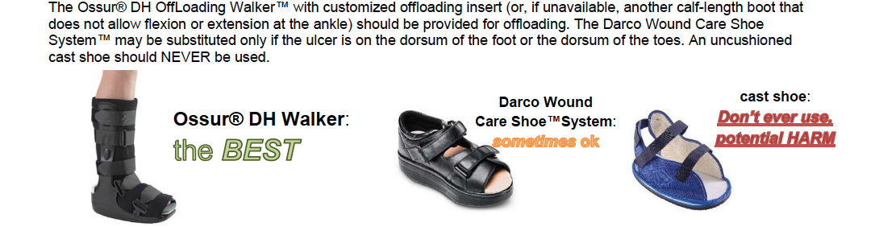
Prosthetics
Urgent Footwear Consult for offloading devices (only for plantar wounds)
Walking boot (partial foot amp, newly debrided, large plantar wound, or need to immobilize the ankle)-DH walker
Wound Care Sandal
Orthotic Consult/Braces
ABP (All Purpose Shoe)
foot wound not on plantar surface
to provide general protection and accommodate the bandages and swelling

Slide 16
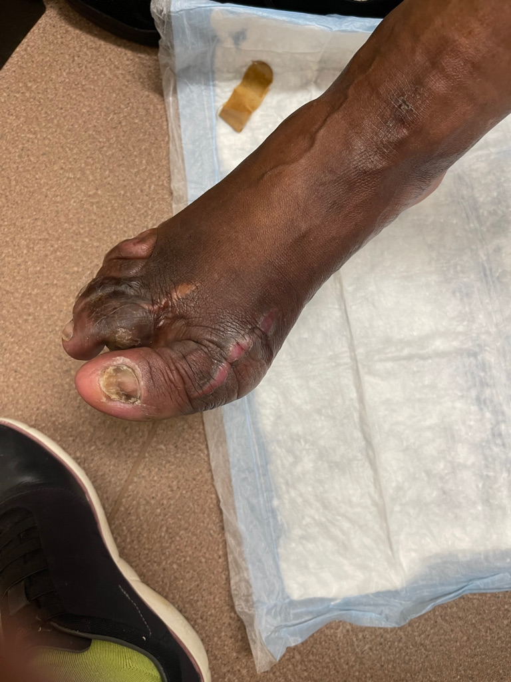
Case 2
60 yo man
Obesity h/o gastric bypass
Severe neuropathy
Multiple surgeries to “fix” the digits
Multiple course of iv and po antibiotic
MRI done by podiatry- “osteomyelitis”
Stable VS
Just small ulcerations between toes
No cellulitis/rest pain
Good pulses
What do you do next?

Slide 17
Case 2 (con’t)
Foot deformities- podiatry
ABI –not urgent
Offloading- specific by podiatry
Wound care basic orders
MRI with OM is likely “overread”—but send to ID if antimicrobials planned!

Slide 18
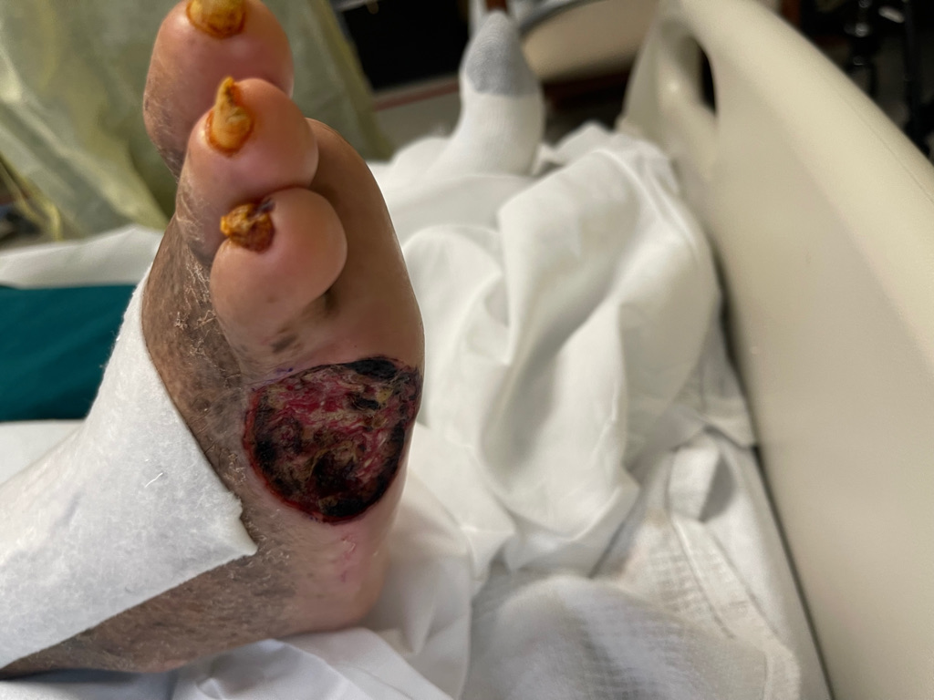
Case 3
69 yo man , DM (HbA1c 12.5)
Chronic ulcer x3 mo
Foul smelling ulcer
Former 5th MTP head resection
Pain 5/10
Exam- wound with moderate discharge, 5x3x 0.5 cm; tender
Cellulitis
Pulses ok
What do you do?

Slide 19
Pulses: PAD
Incidence of PAD 20-30% (general DM); 50% (when ulcer present)
Palpation of pulses - limited sensitivity (even with vascular surgeons)
ABI (false negative rates in up to 35%) ^{still -}primary evaluation tool
Angiography is gold standard limited by cost, risk, invasiveness
There is no “Small Vessel Disease” in DFU
assessed best strategy to identify PAD in diabetic patients
If Normal Pulses: TBI (toe brachial index) 93% sensitive or SPP (skin perfusion pressure) 92% sensitive are best assessments
If Abnormal Pulses: Angiography
REC: ABI for all patients with DFU. It includes TBI. If ABI or TBI abnormal needs Vasc Surgery eval and/or CT Angio.
Barshes et al 2016 J Vasc Surgery:

Slide 20
Case 3 (Con’t)
X-ray
Labs
Wound care consult
Offloading
Po antibiotics until gets to ID
Limb salvage consult
ID consult

Slide 21
Microbiology DFO
Staphylococcus; S aureus
MSSA→ amoxicillin-clavulanate, cephalexin, tetracycline(2nd ), TMP-SMX (2nd); levofloxacin
MRSA→ tetracycline, TMP-SMX
Strep- beta hemolytic → beta-lactam
Enterococcus → amoxicillin
Gram Negative- Proteus, E. coli (associated with treatment failure)
Pseudomonas 3%
Know your local antibiogram!
Clinda has increasing resistance in Strep; 50% luck with MRSA; C diff
Cipro- not good for MSSA/Strep →Levo is superior
Barshes NR et al, The International Journal of Lower Extremity Wounds. 2016

Slide 22
Questions commonly asked:
Is po as good as iv for antimicrobials?
IF oral regimens are appropriately selected, they can be as effective, more convenient, and less costly (OVIVA trail)
Do we need empirical Pseudomonas coverage?
No! 3-4 %
Is the presence of MRSA leading to worse outcome
The presence of MRSA in bone culture and whether antibiotic use had anti-MRSA activity was not associated with increased treatment failure of diabetic foot osteomyelitis
Is surgery better than antibiotics in forefoot DFI?
Similar outcomes in selected population
Li HK et al, OVIVA , N Engl J Med 2019;380:425–436
Barshes NR et al, The International Journal of Lower Extremity Wounds. 2016
Ashong CN et al., (Larchmt) 2017

Slide 23
OPTIMIZE
Medications
Hyperglycemia –SGL 2 inhibitors; Goal is 7.5% Hb1c
Risk for CAD-Aspirin 81mg ; Statin therapy
Infection- antibiotics, if indicated PRESERVE THOSE! THE INFECTION CONTROL /ANTIBIOTIC STEWARDSHIP WILL BE GRATEFUL.
Mild/moderate: Amoxicillin 500mg/clavulanic acid 125mg PO Q8H ** plus/minus Doxycycline 100mg PO Q12H-renal adjustment)
Empirically target the most common pathogens retrieved in DFI
If bone cultures available, use culture targeted antibiotic
.

Slide 24
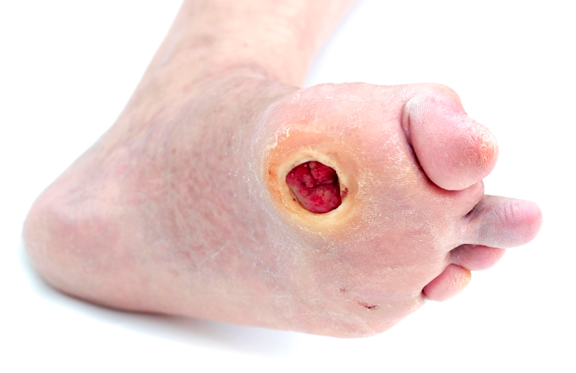
Hyperglycemia
Secondary Infection
Vascular Disease
Biomechanics
Courtesy of Dr Brennan, Madison VA
Notes:
So with that final demo, we have concluded our tour of the three other physiologic factors that need to be addressed before we hone in on antibiotics and infection. Maybe you’ll talk to an endocrinologist about SGLT2 inhibitors, or a vascular surgeon about BEST CLI. You might shock a podiatrist by mentioning the peroneus brevis. But the most important thing is that we start talking to each other. I hope I’ve given you just a few conversation starters.

Slide 25
Educational
https://github.com/nealbarshes/nealbarshes.github.io/blob/main/brochures/01%20Guard%20your%20Feet%20%5BENGLISH%5D.pdf

Slide 26
If further questions
mindru@bcm.edu
cezarina.mindru1@va.gov

