Slide 1
Dyspepsia
Erin Jenkins Wessling, MD
Oct. 28, 2023

Slide 2
Objectives:
Understand definition of dyspepsia and functional dyspepsia
Determine which patients with dyspepsia benefit from upper endoscopy
Analyze the dyspepsia management algorithm

Slide 3
Clinical Question 1:
22 y/o M presents to office with 1 month of upper abdominal pain after all meals and epigastric fullness, worse after meals. Not on NSAIDS. He and his parents are very concerned. Next best step:
A. Refer for EGD
B. Refer for EGD and CT scan
C. Refer for EGD and CT scan and tell him to go to ED if his pain is severe
D. Test stool for H. pylori, treat if positive
Notes:
D. He has dyspepsia. Guidelines recommend H pylori testing as first test in young patients. The other options are extrmely costly with some risk ( sedation/ radiation) and minimal or no benefit.

Slide 4

Dyspepsia definition: Symptom-Based Diagnosis
Predominant epigastric pain o lasting more than a month
1
Symptoms referable to the upper gastrointestinal tract
2
Symptoms at least weekly x > 1 month
3
ROME IV Criteria Require symptom onset for > 6 months to diagnose functional dyspepsia
Notes:
Insert diagram of epigastrium

Slide 5
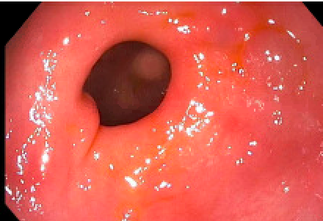
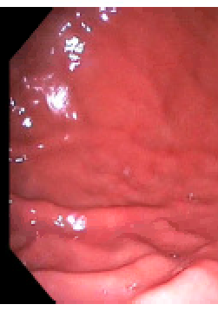
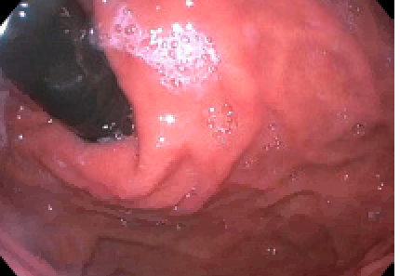
Dyspepsia
Most common finding

Slide 6
Dyspepsia: Scope of the Problem
7% of adults have dyspepsia – 20% + incidence over time
Estimated cost $18 million dollars/ year in US
Normal life expectancy
Recent guidelines take a symptom-based approach to avoid un- necessary testing

Slide 7
Cardinal and Associated symptoms of dyspepsia
Post – prandial fullness
Epigastric pain
Early Satiation
Epigastric burning
Epigastric Pain Syndrome
Post – prandial distress syndrome

Slide 8
Associated Symptoms of Dyspepsia
Upper abdominal bloating
Heartburn
Nausea
Belching

Slide 9

Pick a Bucket....
Dyspepsia
IBS
GERD
Nausea

Slide 10
Uninvestigated Dyspepsia
Functional Dyspepsia
70%
Organic Dyspepsia
30%
-Esophagitis
-Peptic ulcer disease
EGD
Normal EGD
Abnormal EGD

Slide 11
Ford et al Clinical Gastro and Hepatology 2010 vol 8 issue 10

Slide 12
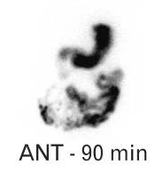

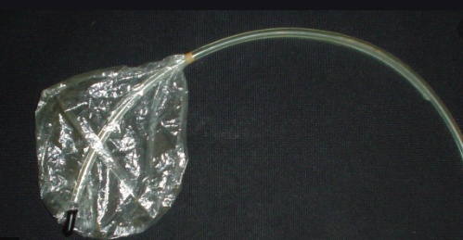
Etiology of Functional Dyspepsia
Disorder of gut - brain interaction (previously functional GI disorder)
Altered motility
Hypersensitivity
Impaired Gastric accommodation
Tack. Functional Dyspepsia – What is it and How Do you Treat it?
DDW 2018
Notes:
Contracted stomach in fasting state. Stomach relaxes or accomodates to allow space for meal.

Slide 13
Differential for Upper Abdominal Pain
Symptoms/ Risks | Disease
Pain radiating to back/ biliary colic | Gallbladder Disease
Vascular disease risk factors, weight loss, pain with meals, sitophobia | Chronic Mesenteric Ischemia
NSAIDS, GLP-1 antagonists, amylin analogs, iron | Medication induced
Vomiting many hours after meals, strong risk factors | Gastroparesis (don’t evaluate everyone with nausea)
Fear of eating; no vascular risk factors, | ARFID – avoidant restrictive food disorder or anorexia
Age over 60 and weight loss | Pancreatic cancer

Slide 14
American College of Gastroenterology Dyspepsia Guidelines 2017: Major Changes
Changed age for automatic EGD to age 60 (up from 55)
Change in “ red flags”
Do not need automatic EGD even with weight loss, early satiety as the VAST majority of EGD in younger patients will be negative even with red flags
Recommends starting with empiric therapies rather than testing in most young patients
Moayeddi et al. Management of Dyspepsia. American Journal of Gastroenterology 2017

Slide 15
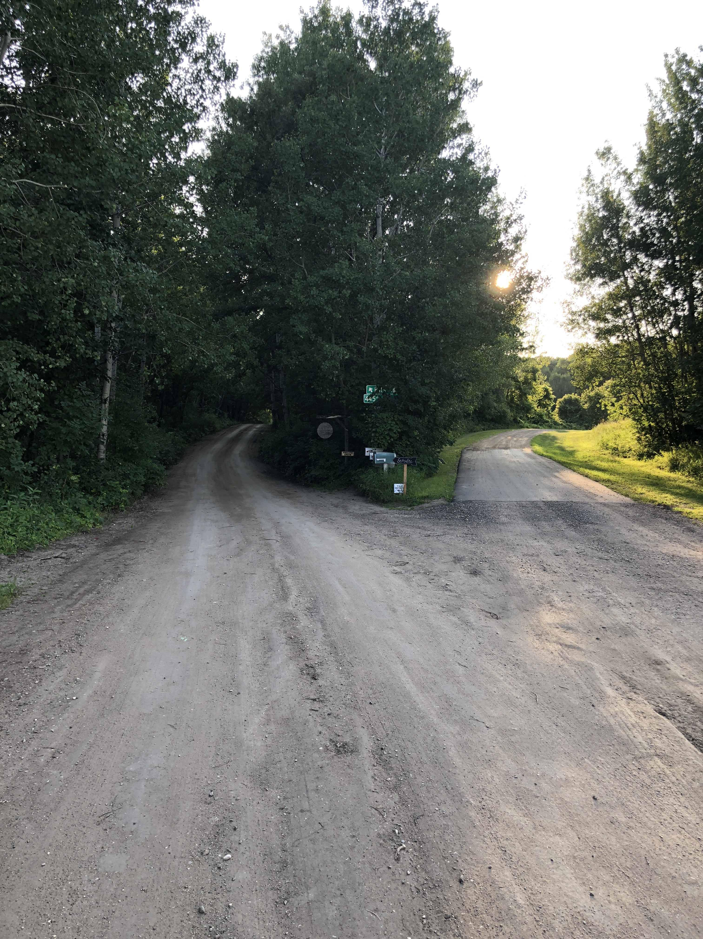
Diagnostic Workup: Age Matters
Age > 60: Proceed to Endoscopy
Age < 60: No endoscopy; proceed for H. pylori testing and empiric therapy
Age?

Slide 16
Think about YOUR Patient
Geography:
Gastric cancer risk is much higher in those originally born in parts of Asia, Central/South America
Exam
Age - Pancreatic cancer should be considered in those > than 60 (Cross- sectional imaging)
Pancreatic cancer rate 0.01% ( less than 1/10,000) in those < than 60,

Slide 17
Clinical Question 2
A 45 y/o F presents with epigastric pain and burning along with early satiety and weight loss. She was born and raised in Korea and is visiting for graduate school. Her mother died of gastric cancer at age 55. Which of the following is the next best step.
A. Start PPI – does not need further follow up.
B. EGD due to country of origin and family history
C. Test for H. pylori and treat if positive. No further follow up if testing negative
D. Recommend she adjust her diet to a bland diet
Notes:
Answer B. EGD due to risks related to country of origin and family history
Patients with specific high risk factors may not fit into the general guideline

Slide 18

Red flags
Patients with dyspepsia and “red flag” symptoms do NOT always require endoscopic evaluation in young patients < than 60
Early satiety is a common coexisting symptom,
Some weight loss also not uncommon
Yield of upper endoscopy in young patients even with red flags very low
Anemia, progressive dysphagia are signs of other disorders and may need evaluation
Notes:
Purpose is to free MD of “ mandatory EGD” in a classic patient - doesn’t mean EGD not indifcated for evaluation of other atypical symptms

Slide 19
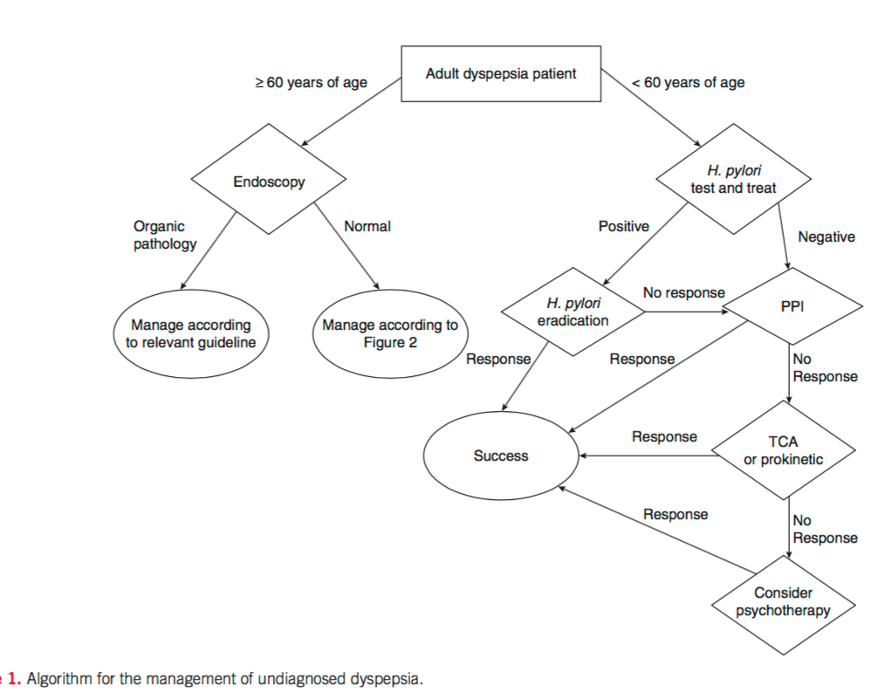
Management of Undiagnosed Dyspepsia:
Moayeddi et al. Management of Dyspepsia. American Journal of Gastroenterology 2017

Slide 20
Management of Dyspepsia and Proton Pump Inhibitor:
Start empiric PPI in H. pylori negative individuals
Strong Recommendation/ High quality of evidence
NNT = 6
Once daily dosing
Withdrawal trials every 6-12 months
Concern about long term PPI safety?
Recent prospective safety trials reassuring

Slide 21
Management of Dyspepsia and Tricyclic Antidepressant (TCA)
Start TCA in those who do not respond to PPI
Conditional Recommendation/ moderate evidence
NNT = 6
Pain modulation effect
Effective in dyspepsia patients WITHOUT mood disorder
Low dose and titrate up ( 10 mg--> 20-50)
Anti-cholinergic Side effects: drowsiness, dry mouth, constipation, QT prolongation
Nortriptyline and imipramine are less anticholinergic than amitriptyline
2nd line treatment in British guidelines

Slide 22
Management of Dyspepsia and Prokinetic Therapy
Consider Prokinetic in those who fail PPI and TCA
Conditional Recommendation/ low quality of evidence
All studies are on medicines NOT available to us in US
Domperidone showed some efficacy in small trials– NNT 3
Up to 10% of functional dyspepsia patients have modest delay in emptying
Metoclopramide (Reglan) NOT proven in dyspepsia

Slide 23
British Guidelines – First LineTreatment
Regular aerobic exercise (strong / very low evidence)
Insufficient evidence to recommend low FODMAP
PPI- no dose response so low dose recommended
Promotility – tegaserod ( not available)
Prucalopride – better studied in gastroparesis

Slide 24
British Guidelines – First LineTreatment
Effective and empathic Dr/ pt relationship is key and reduces healthcare utilization
Importance of explaining pathophysiology and triggers, and natural history to the patient
Role of stress, diet, microbiome/ post - infectious

Slide 25
Dyspepsia and Psychotherapy
Recommend psychotherapy in those with dyspepsia who did not respond to PPI, TCA or pro-motility
Conditional recommendation/ very low level of evidence
NNT= 3
No one specific psychotherapy intervention studied
CBT, hypnotherapy, stress management

Slide 26

Off the Algorithm: Other treatments for functional dyspepsia
Buspirone – increases gastric accommodation
Mirtazapine – decreased pain and weight gain - 15 mg nightly
SSRI – NO benefit above placebo
Baclofen – may help with belching
Pregabalin75 mg once daily
Notes:
Mirtazapine – weak 5 HT3 agonist
Buspirone – 5 HT1 receptor

Slide 27
Clinical Question #3
30 y/o F comes with symptoms consistent with dyspepsia including post-prandial pain, nausea, bloating, and burning. H. pylori negative. States “I don’t want to take a pill. I just want to find out what is wrong. I don’t like using unnatural medicine. I practice clean eating so I don’t know why this is happening to me. Which of the following have some small studies for alleviating one of her symptoms?
A. Dietary changes
B. Ginger
C. Peppermint oil
D. Curcurmin
E. All of the above

Slide 28





Slide 29

Severe and Refractory Dyspepsia
Consider multidisciplinary approach
Dietitian to encourage food trials/ discourage avoidance
Psychologic support - CBT or other treatments
Severe and refractory - evaluate for eating disorder

Slide 30
Summary:
Dyspepsia is a common problem; typically no specific organic cause
Findings at EGD usually do NOT change management of dyspepsia; reserve EGD for those over age 60 or with specific risk factors
Cross sectional imaging if > 55-60 and red flags
Exclude H pylori, treat if positive
Explain functional dyspepsia etiology to patient
Treat empirically with PPI, tricyclic anti-depressant, in a step wise manner

