Slide 1
Hand Therapy: Contracture Treatment
Anthony Flores OTR/L, CLT, CEASE

Slide 2








Slide 3
Objectives
Summarize the role of hand therapy in contracture management
Be able to identify 3 risk factors leading to developing contractures
Identify 2 options for treatment

Slide 4
Understanding Contractures
Types of contractures
Treatment options
Notes:
But first

Slide 5
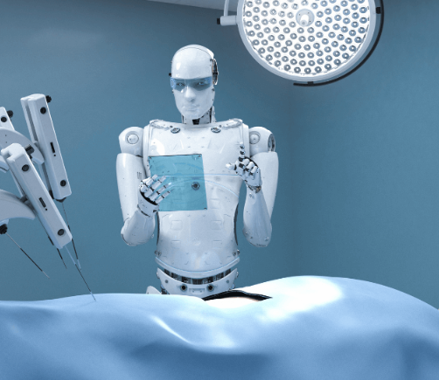
Artificial Intelligence (AI)
In Healthcare

Slide 6

Why did the contracture refuse to sign the contract?

Slide 7
Because it felt too "bound" by commitment!

Slide 8
Contractures
Chronic loss of join mobility caused by structural changes in non-bony tissues, including muscles, ligaments, facia and tendons.
Develop when otherwise normal tissues are replaced by inelastic tissue.
Resulting in shortening and hardening of these tissues
Leading to rigidity
Join deformities.
Loss of movement around joint
Loss of functional ability

Slide 9
Etiology
Hereditary conditions
Congenital conditions
Immobility
Burns
Neurological
Join replacement
Notes:
The most common type of contracture is immobility.

Slide 10
Heredity
Dupuytren Contracture
  Genetic disorder that is predominantly a Myofibroblastic disease that typically affects the palmar and digital fascia of hand. Multiple fibromas (tumors) develop in connective tissue.
Peyronie (penis)- Related to DC, believes to stem from common developmental point
    Post injury
    Intralesional collagenase injections (Xiaflex)
Ledderhose (feet)
Garrod disease (knuckle pads)
  Associated with diabetes, seizure disorder, smoking, alcoholism, HIV, and vascular disease.
Notes:
Pay run nees
- Fibros tissue developes in penis

Slide 11
Dupuytren Contracture
Many factors to consider
What is the impact on quality of life? Pain? Function?
Treatment will differ significantly depending on
    Individual person
    Symptoms
    Severity of disease
    Type of procedure
    Timeframe.

Slide 12
Prevention
Promote tissue remodeling by applying low-load tension through orthoses or tissue mobilization and reduce fibrous adhesions using cross massage.
“Despite the tendency for improved digital joint extension using these techniques, alone or in combination, a systematic review has concluded there is insufficient evidence of their efficacy” (Turesson, 2018)
No evidence showing hand therapy can play a significant part in preventing the disease process

Slide 13
Hand therapy will not prevent or reduce the disease process of Dupuytren Contracture
However, hand therapy pre-surgical intervention can be utilized to:
Increase overall strength
Increase function ability in impacted extremity
Reduce pain/symptoms
Provide patient education
Modification strategies
Improve quality of life
Notes:
Little research shows hand therapy will prevent normal process of contractures. We will not “cure” DD with our therapy interventions. That being said, what can we do? Assess each person individually, find out what is limiting them. Where is their quality of life impacted?

Slide 14
Treatment
Steroid injection
  Corticosteroids- Reduce symptom
Collagenase injection
  Enzyme to break down collagen
Needle aponeurotomy
  Break up cord to improve ROM
Fasciotomy
  Divides the cord
Partial palmar fasciectomy
  Removes tissue
Notes:
While corticosteroids may help with symptoms, they are not likely to keep the disease from getting worse; therefore, they are a treatment, not a cure.

Slide 15
Preoperatively
Establish patient profile
Patient reported outcomes
  Disability of the Arm, Shoulder and Hand (DASH)
  Unité Rhumatologique des Affections de la Main (URAM) scale
  Southampton Dupuytren’s Scoring scheme
Physical measurements
Joint range of motion
Grip strength
Sensation
Pain
Notes:
Therapy can play a role in pre op situation to provide patient education, establish patient profile, gather pt reported outcomes and measurements.

Slide 16
Postoperative
Depends on procedure and stage of healing
Active range of motion exercises
  Frequency/intensity will need to be assessed depending on stage of healing
  Gentle digit active flexion/extension exercises
  Tendon glides beginning first week progressing as appropriate
Orthoses- Used in combination with other modalities
  Protect surgical site
  Low low prolonged stretch
  Maintain or improve finger extension
  Splint after dressing are removed and worn 24hrs as tolerated, progress to nighttime use
Studies have shown that splinting has a “positive effect on severe proximal interphalangeal joint but no effect on natural course of disease” (Turesson, 2018)
Notes:
Splint after dressing are removed and worn 24hrs as tolerated, progress to nighttime use
o Studies have shown that splint has a “positive effect on severe proximal interphalangeal joint but no effect on natural course of disease” (jkkkok)
- Edema control
o Active motion
o Pressure garments
- Scar tissue management
- Patient education
- Modification

Slide 17
Postoperative Cont.
Edema control
  Active motion
  Pressure garments
Scar tissue management
Patient education
Modification

Slide 18
There is evidence to support that hand therapy in utilizing mutiple modalities post corrective procedure is beneficial and resulted in improved joint mobility (Turesson, 2018)
Hand therapy treatment for Dupuytren requires a person first individualized treatment approach utilizing multiple treatment modalities.
Each patient will present with unique set of client factors that will need to be assessed.
The therapist must evaluate the patients needs/goals, history of the disease, corrective procedure, current healing process and physical abilities in combination with the most current research.

Slide 19
Immobility
Protein syntheses reduces, muscle fibers shorten
Protein synthesis: Process of producing new muscle protein (myosin and actin) within the muscle. These proteins are directly involved in ability for the muscle contract and relax.
Protein synthesis within the muscle fibers reduces within 6 hours after joint immobilization.
Shortening of muscle fibers occurs within 24 hours

Slide 20
Immobility cont.
Post insult to the body
Natural reaction to injured body part is to immobilize
Reduced use/mobility

Slide 21
Therapy General Approach to Immobilization
Prevention
  Early detection and early intervention
  Proper positioning/posture
  Stretching
  Strengthening
  Increased participation with functional activities
Treatment
  Prolong long load stretches
  Splinting/bracing
  Active range of motion (agonist-antagonist)
  Modalities
  Participation with meaningful functional activities

Slide 22
Immobility ICU
“slight tendency of benefits related to passive motion in sedated and ventilated patients in the ICU observed in the muscle structure, in the microcirculation and in the inflammation factors and the immune system” (Vollenweider, 2022)
“slight positive benefits of passive motion on muscle fibers, protein loss and muscle thickness and circumference, when compared to standard therapy or no intervention, without being able to completely prevent muscle loss” (Vollenweider, 2022)
  Assessment of joint mobility
  Managing edema and skin health
  Assess and implement proper positioning
Notes:
Systematic review looking at passive ROM with LE sedated and ventilated.

Slide 23
Congenital Conditions
Duchenne Muscular Dystrophy
  Replacement of functioning muscle fibers with collagen and fatty tissue in concert with chronically shortened resting muscle length results in contracture formation (Skalsky et al, 2013)
Cerebral Palsy
  Although CP is caused by damage to the developing brain , critical symptoms manifest in the muscle. Contractures and spasticity seen clinically correspond to changes in muscle sarcomere length, fiber type, ECM concentration, fiber and fiber bundle stiffness, and even stem cell numbers (Mathewson et al, 2015)
Strength, range of motion
Positioning/skin health
Increase functional participation
Assistive device recommendation

Slide 24
Neurological Conditions
Neurologic injuries increases muscle tone or weakness cause a muscle imbalance, which results in a tonic contraction. In this way, many joint contractures are preceded by spasticity. Gone untreated, the spastic joint becomes immobilized and a contracture develops.
  Stroke
  Brain injury
  Spinal cord injury

Slide 25
Congenital and Neurological
Return or preserve the highest level of quality of life.
  Maintain or preserve function
  Manage compromised skin integrity
  Pain management
  Exercises
  Mobility devices
  Adaptive devices

Slide 26
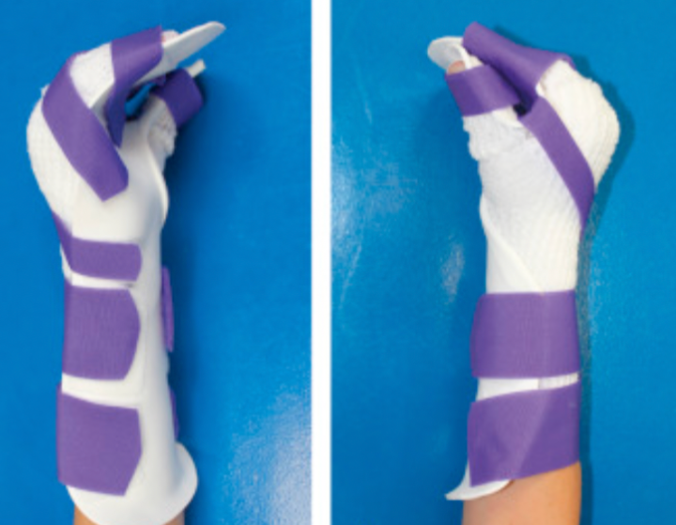
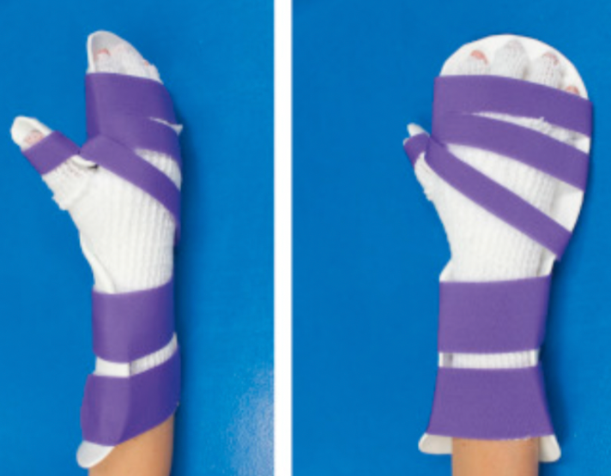
Burns
Scar matures, thickens, and tightens, preventing movement
All second and third degree burns are healed by scarring
Skin graphing 2nd or 3rd degree burns
Depending on size of injury, procedure, client factors
  Dressing changes
  Pain management (collaborate with provider)
  Postural management
    Elevated head, shoulders, upper extremities
    Positioning (heels, neutral positum
    Splinting while healing
Notes:
is the tightening of the skin after a second or third degree burn. When skin is burned, the surrounding skin begins to pull together,
Pain management is crucial with any aspect with burn treatment

Slide 27
Role of Hand therapy in Contracture management
Hand therapy treatment for contracture management requires a person first individualized treatment approach utilizing multiple treatment modalities. Each patient will present with unique set of client factors that will need to be assessed. The therapist must evaluate the patients needs/goals, history of the disease, corrective procedure, current healing process and physical abilities in combination with the most current research.

Slide 28
Resources
Knadmin. (2023, July 20). Contractures. PM&R KnowledgeNow.
Dupuytren contracture - StatPearls - NCBI Bookshelf. (n.d.-a).
Knadmin. (2023, July 20). Contractures. PM&R KnowledgeNow. https://now.aapmr.org/contractures/
Portal, Diva (n.d.-b) The role of hand therapy in Dupuytren Disease
Skalsky, A. J., & McDonald, C. M. (2012a, August). Prevention and management of limb contractures in neuromuscular diseases. Physical medicine and rehabilitation clinics of North America.
UH;, W. J. P. (n.d.). Dupuytren contracture. National Center for Biotechnology Information.

