Slide 1

Recent Developments in Clinical Microbiology - Primary Care Perspective
Stephen J. Cavalieri, Ph.D., D(ABMM)
Professor of Pathology
Director of Microbiology
4/5/2023

Slide 2
OBJECTIVES
Describe 2 test methods for the diagnosis of "strep throat"
Describe 2 test methods for the diagnosis of viral upper respiratory infections
Describe the testing algorithm for HIV and HCV screening

Slide 3
Rapid/POC ID Tests
“Strep throat”
CoVID
Influenza
RSV
HIV
HCV

Slide 4
Rapid/POC ID Tests
Advantages
  Ease of use
  Inexpensive
  Fast – patient satisfier
Disadvantages
  Accuracy – low sensitivity
  Predictive value – depends on prevalence
  Need for confirmatory tests

Slide 5
PHARYNGITIS
Bacterial - 40%
  Streptococcus pyogenes (GAS)
    10-17% adults
    15-37% in children
  Non-group A ß-streptococci (Grps C & G) - 5%
  Others - 5-10%
Viral - 25-45%
Unknown – 20%
Notes:
Bacterial
Mycoplasma pneumoniae – 3-14%
Chlamydophila pneumoniae – 3-8%
Arcanobacterium haemolyticum – 0.5% older children & younger adults
Neisseria gonorrhoeae – 1-6% in STI clinics
Corynebacterium diphtheriae - rare
Fusobacterium necrophorum - ≤10%
Viral
Adenoviruses – 12-23%
Rhinoviruses
Enteroviruses
Coronaviruses
Herpes viruses (HSV, EBV, CMV)
RSV
Influenza & parainfluenza viruses
Metapneumovirus & human bocavirus

Slide 6
EPIDEMIOLOGY
More prevalent in winter - early spring
Person-to-person transmission
Primarily (50%) a disease of 5-24 yo
6-10 million children & 5 million adult clinic visits/yr
Most get antibiotic therapy

Slide 7
CLINICAL MANIFESTATIONS
Viral
  Scratchiness, soreness, irritation, cough, HA, HFM
  Appearance – normal to mild edema & erythema
  Can present with severe pain, dysphagia, fever, chills, malaise, myalgia, exudate, & painful LA
  Self-limited
“Strep throat”
  Sudden onset
  Pharyngeal pain, dysphagia, fever*, headache, fiery red pharyngeal membranes*, thick exudate* edema*, LA*, tonsillar enlargement, rash, absence of cough, leukocytosis, elevated CRP
  Self-limited; sequelae – suppurative & non-suppurative
Notes:
HA - Herpangina – hyperemia of throat, with vesicle or ulcerations; fever; enteroviruses mostly group A coxsackie viruses
HFM disease – Hand, Foot and Mouth disease – erythematous vesicles and ulcerations in throat, hands, feet & buttocks; enteroviruses
* Hallmarks signs/symptoms
Suppurative sequelae – abscess, sinusitis, otitis media, pneumonia, meningitis, TSS, sepsis
Nonsuppurative sequelae – acute Rheumatic fever (ARF); acute glomerulonephritis (AGN)

Slide 8
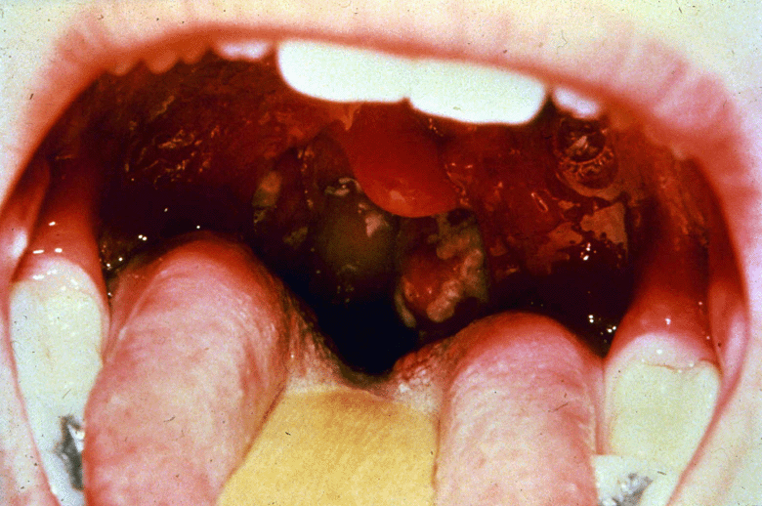
TREATMENT
Viral - symptomatic; oseltamivir for flu
GAS - 10 days of penicillin; oral cephalosporin; amoxicillin/clavulanate

Slide 9
DIAGNOSIS
Distinguish viral from GAS pharyngitis
GAS - treat to reduce severity, shorten course, prevent spread, prevent suppurative & nonsuppurative sequelae
Viral - treatment with antibiotics of no benefit; increased bacterial resistance; CDI
Clinical diagnosis - not definitive; Centor criteria
Notes:
Suppurative sequelae – abscess, sinusitis, otitis media, pneumonia, meningitis, TSS, sepsis
Nonsuppurative sequelae – acute Rheumatic fever ARF); acute glomerulonephritis (AGN)
CDI – C. difficile infection
Centor criteria – scoring system based on symptoms (fever, cough, swollen/tender lymph nodes, tonsillar swelling/exudate, age)

Slide 10
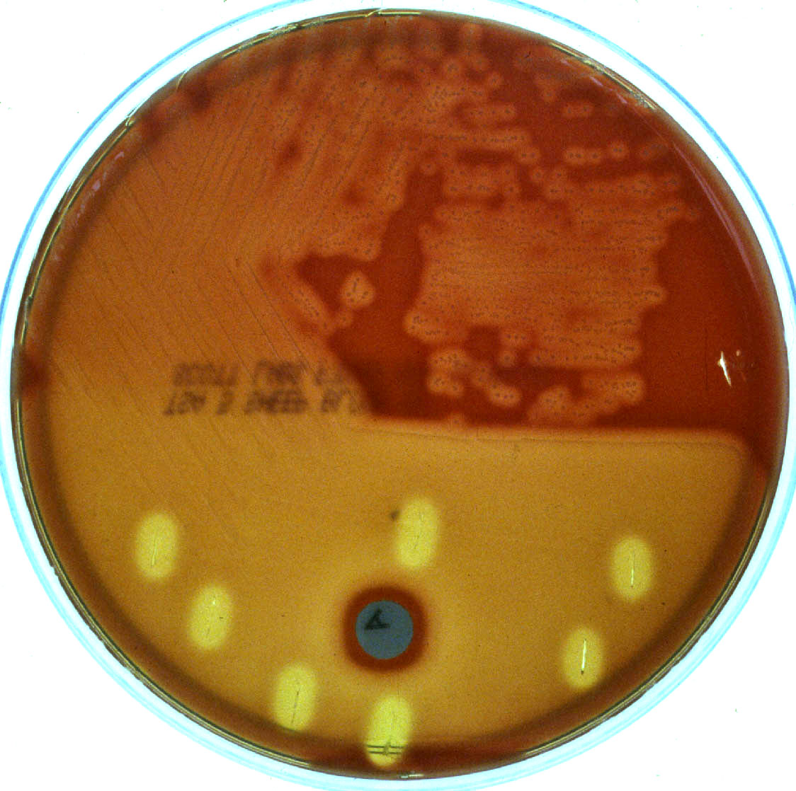
CULTURE
Throat swab
Incubate 48 hrs, anaerobic for first 24 hrs (SLO)
Sensitivity 90-99%; Specificity 80-90%, >95% if asymptomatic patients excluded
Identification - ß-hemolysis; bacitracin, LA, MALDI
ß-hemolysis
Bacitracin disk
Zone of inhibition
Notes:
Selective BAP – reduced recovery of non-GAS
*Additional media needed for other organisms, e.g., TM for GC
SLO – streptolysin O is an oxygen labile hemolysin

Slide 11
DIRECT DETECTION
Antigen methods – 1st and 2nd generation tests
  Enzyme or Fluorescent Immunoassay (EIA or FIA)
  Immunochromatographic (ICG) – lateral flow assays (LFA)
Throat swab - extraction, anti-GAS antibody conjugate, substrate/indicator
Rapid - 10-60 minutes
Low sensitivity* - 55-94%; higher specificity 81-99%
Performed in physician’s office by nurses & other HCW; waived test (CLIA)
Notes:
*Backup cultures for negative rapid EIA/ICA recommended for children; adults controversial because of low incidence of RHD
HCW = Health-Care Workers
CLIA – Clinical Laboratory Improvement Act

Slide 12
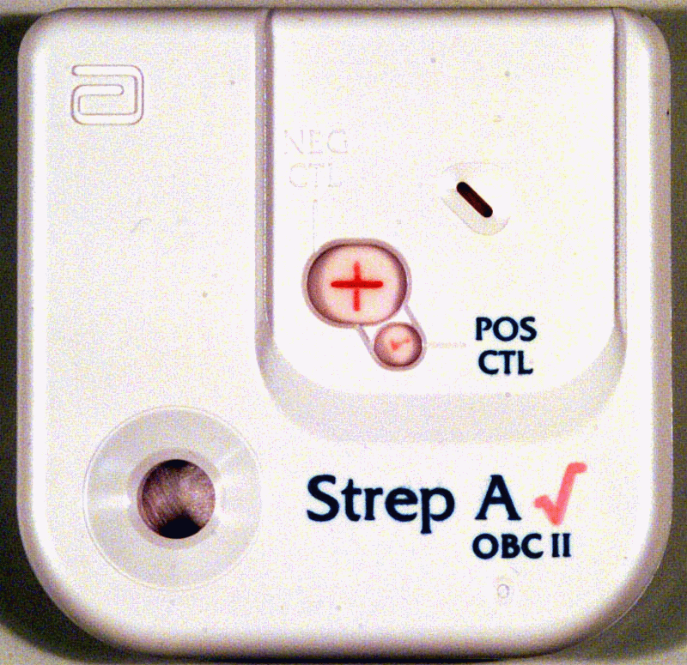
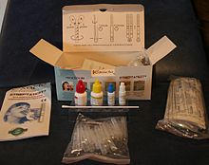
Rapid GAS EIA/LFA – 1st Gen

Slide 13
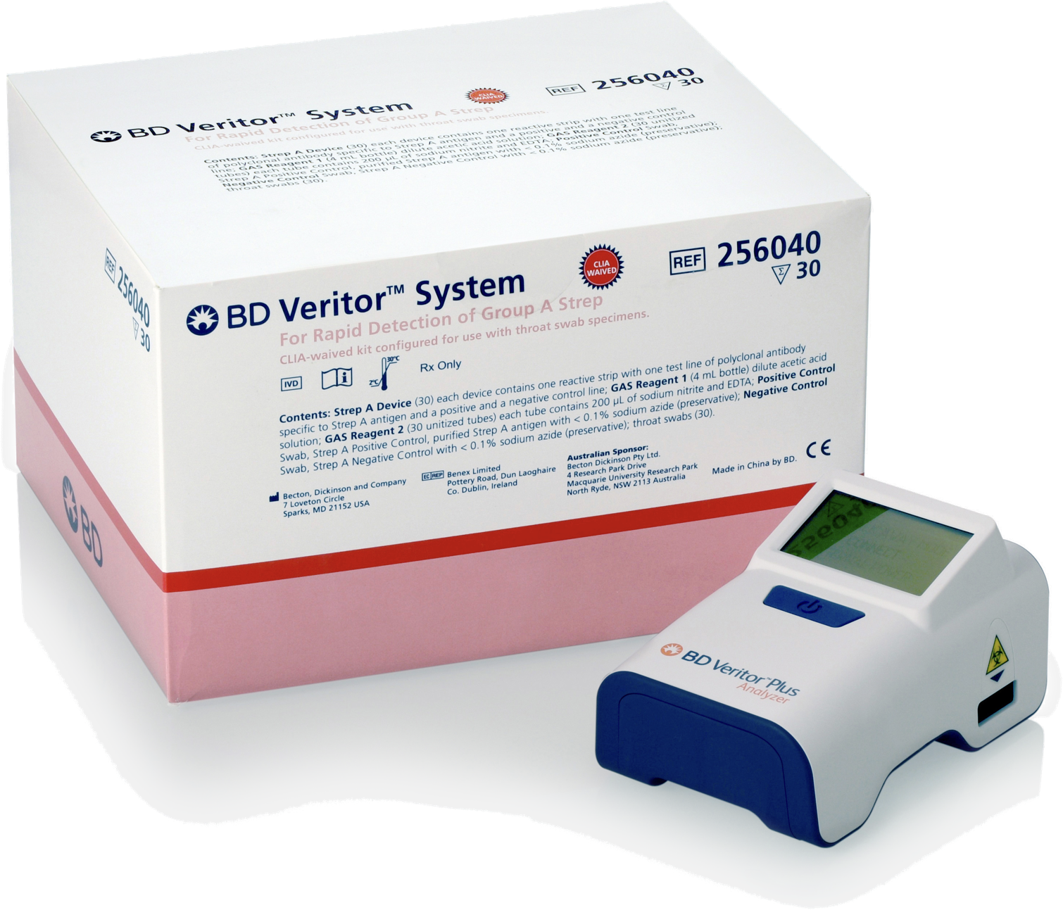
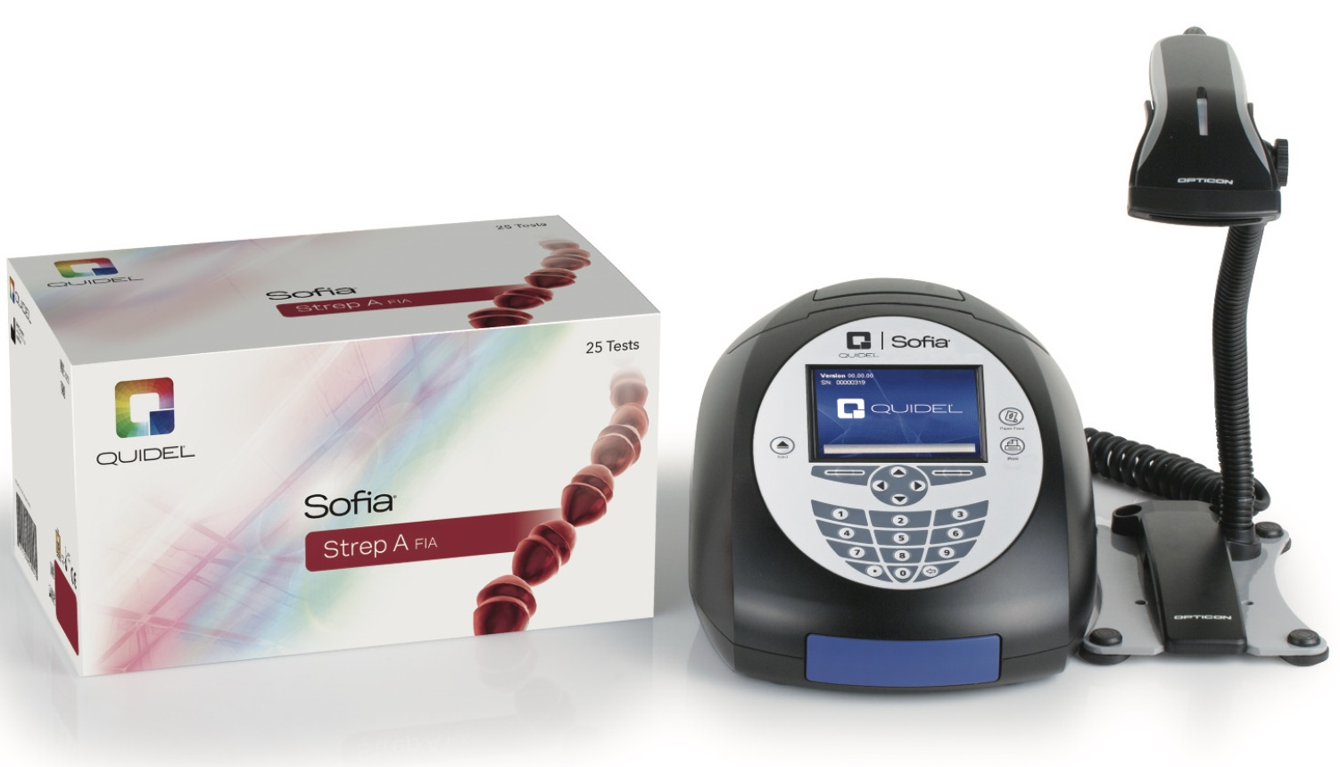
Rapid GAS - 2nd Generation

Slide 14
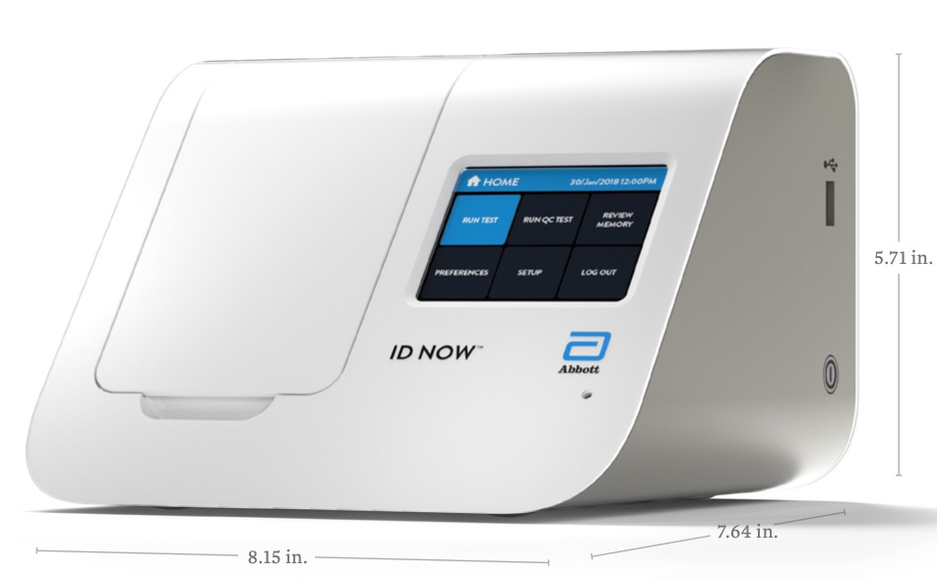
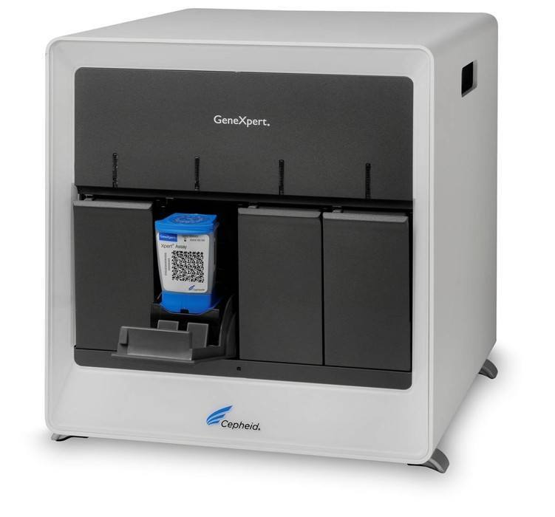
DIRECT DETECTION
Molecular methods - probe, PCR
  DNA probe
    Sensitivity 90-95%; specificity 90-99%
  PCR, e.g., Cepheid Xpert, Abbott ID Now
    Sensitivity 92-98%; specificity 91-99%
  TAT – 1-2 hrs; more accurate; easy to use; not as rapid as antigen detection
  Expense; replacement for culture

Slide 15
DIAGNOSTIC OPTIONS
Diagnose & treat clinically
Culture/PCR & treat until results known
Culture/PCR & no treatment until results known
Rapid antigen test & treat based on results
Rapid antigen test with culture/PCR backup for neg
  Rapid test + ➔ treat
  Rapid test - ➔ no Rx until culture/PCR results known

Slide 16
RECOMMENDATIONS
American Academy of Pediatrics
  Confirm negative rapid antigen with culture/PCR
  Positive results do not need confirmation
  Negative PCR does not need culture confirmation
Infectious Disease Society of America
  Similar to AAP
  Adults lower incidence of GAS pharyngitis & very low risk of ARF - no need to confirm negative rapid antigen w/ culture/PCR

Slide 17
RECOMMENDATIONS
CDC/ACP/ASIM/AAFP
  Adults with pharyngitis screened for 4 “Centor criteria” - fever, tonsillar exudate, absence of cough, tender anterior cervical lymphadenopathy
  None or one - not tested/not treated
  ≥ 2 – 3 - options
    Rapid antigen; treat if +
    Rapid antigen if 2-3 criteria; treat if + or if 4 criteria
    Treat if ≥ 3 criteria
  Excessive antibiotic treatment?

Slide 18
Upper Respiratory Infections
Viruses
  RSV*
  Influenza viruses*
  Parainfluenza viruses
  hMPV
  Coronaviruses#*
  Rhinoviruses
  Adenoviruses
Bacteria
  Mycoplasma pneumoniae
  Chlamydophila pneumoniae
  Bordetella pertussis
Notes:
* Including SARS-CoV-2 (CoVID-19)

Slide 19
RSV
Paramyxoviridae
Enveloped, ssRNA; A & B antigenic grps
Acute upper & lower respiratory infections
Winter predominance in temperate zones
Leading cause of bronchiolitis in infants
Droplet transmission
Treatment – supportive; ribavirin
Prevention - palivizumab
Notes:
Ribavirin - infants with severe LRTI, aerosolized; modest benefit
Palivizumab - humanized monoclonal antibody; passive immunity for high-risk children < 2yo.

Slide 20
INFLUENZA
Orthomyxoviridae
Enveloped, ssRNA virus; Types A, B, C
Transmitted via respiratory route – droplet/airborne
Epidemic disease – winter; antigenic variation
Significant cause of morbidity & mortality; characteristic fever & cough
Treatment – oseltamivir, zanamivir, peramivir
Prevention – annual flu vaccination
Notes:
Peramivir (trade name Rapivab) is an antiviral drug developed by BioCryst Pharmaceuticals for the treatment of influenza. Peramivir is a neuraminidase inhibitor, acting as a transition-state analogue inhibitor of influenza neuraminidase and thereby preventing new viruses from emerging from infected cells. It is approved for intravenous administration.

Slide 21
SARS-CoV-2
Coronaviridae
Enveloped, ssRNA
Coronaviruses cause 15% of common colds; winter/spring
  MERS, SARS, CoVID-19 – severe & sometimes fatal respiratory disease
Wuhan, Hubei Province, China; 2019
  Global – 762 million cases; 6.9 million deaths (0.9%)
    USA – 103 million cases; about 1.1 million deaths (1.1%)*
    Nebraska – 563,000 cases; 4800 deaths (0.9%)*
CoVID treatment/prevention – supportive; antivirals; steroids, monoclonal antibodies**; vaccination
Notes:
SARS – severe acute respiratory syndrome
MERS - Middle East respiratory syndrome
* As of April 11, 2023
** Bamlanivimab + etesevimab (variants less susceptible-not recommended), casirivimab + imdevimab, sotrovimab

Slide 22
CONVENTIONAL DX
Diagnosis – age/season → clinical
Laboratory diagnosis
  Rapid antigen (RSV, FluA/B, CoVID) - clinics, ER; fast, but low sensitivity (65-80%) & suboptimal specificity
  DFA (RSV, Flu, ADV, Paraflu) – similar
  Culture – low sensitivity/high specificity; 3-28 days
  Serology – IgM, acute/convalescent

Slide 23
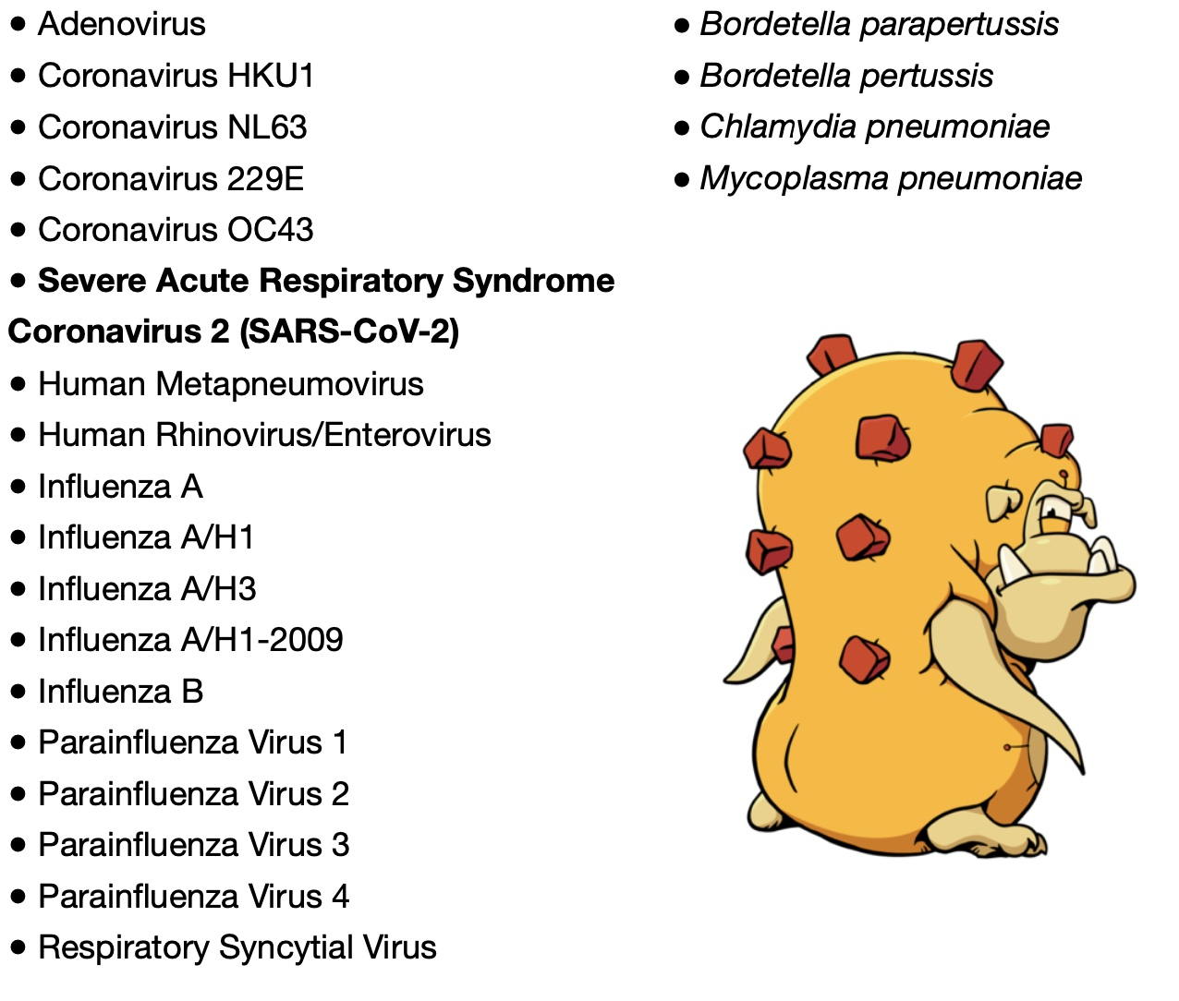
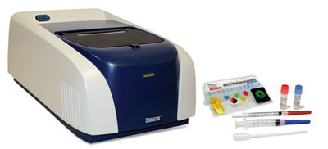
MOLECULAR DIAGNOSIS
Several methods/ approaches
  Single or limited multiple PCR methods
    Flu A/B + RSV
    SARS-CoV-2 alone or with Flu/RSV → “4-plex”
  Multiplex panels - signal/NA amplification
    Verigene
    BioFire
BioFire RP 2.1

Slide 24
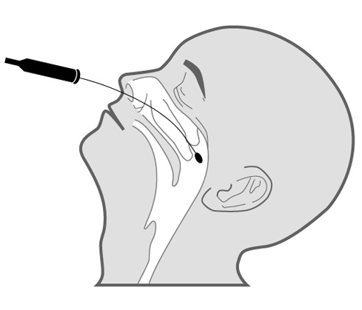
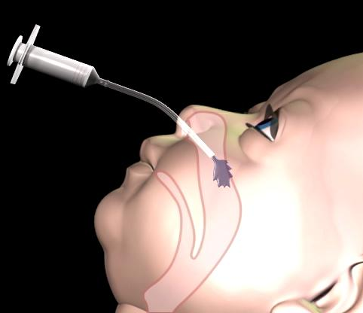
NP SWAB & ASPIRATE
NP Swab NP Aspirate

Slide 25
CLINICAL IMPACT
Very few studies
Difficult to control variables
Uneven distribution of pathogens
Population dependent
Often underpowered
Useful for influenza
Impact on antibiotic Rx
  No impact
  Less use for shorter periods
Impact on other tests
  Less CXR
Other impacts
  Infection prevention
  Patient satisfier
  Epidemiologic tracking

Slide 26
HIV
Etiologic agent of AIDS - progressive deterioration of immune system; usually fatal if untreated
Worldwide
  38.4 million infected worldwide; 1.5 million new cases (2021), decreasing
  650K deaths - 4th leading cause of death worldwide; 40 million overall (2021)
  2nd leading cause of death in young adults
USA – 1.2 million cases (2020); 30,635 new cases reported; decreasing

Slide 27
HIV
Acute HIV infection (AHI) – time between positive viral load and seroconversion
  Very high viral loads in genital secretions and blood; persists for 10-12 weeks
  Rate of transmission 26 times higher vs established HIV infection
  May account for 10-50% of all new HIV infections

Slide 28
LABORATORY DIAGNOSIS
Diagnosis of acute HIV infection
  Improve understanding of transmission
  Early intervention may limit replication & integration to the latent (incurable) state
  Maximally contagious
  Early diagnosis - opportunities for treatment and prevention interventions
    Routine screening
    Use of short time to positivity (TTP) tests
Notes:
Maximally contagious - due to high viral loads, unknown viral properties, or lack of specific antibodies

Slide 29
SCREENING TESTS
Most cases – antibody HIV-1/HIV-2
3rd Generation Tests
  Ag sandwich EIA, sensitivity 99.9%; specificity 98.8%
  Detect all classes of Ab; groups N & O
  Greater sensitivity in early infection – 22-25 days
4th Generation Tests – p24/Ab combination; earlier diagnosis – 15-16 days; ≥ 99% sensitivity/specificity
5th Generation test – separate results for p24 & HIV-1/HIV-2 antibody
Notes:
Detuned assays - highly sensitive to detect all infections + less sensitive designed not to detect low quantity or avidity Ab; if +/- early infection
Immunocapture - detects & quantitates Ab to gp41 as a fraction of total IgG; concentration directly proportional to duration of infection

Slide 30
SCREENING TESTS
HIV Ab 3rd – 5th Gen EIA
False negatives - absence/low level Ab (or Ag) in early primary infection (0.02-0.3%)
Fewer false positives
  Neonates – positive 18-24 months – maternal Ab
Low prevalence (0.5%); PPV = 50%
  Confirmatory test needed for positives
Notes:
False + - HLA cross reactions, heat inactivation, hemodialysis, cystic fibrosis, HBIG, HBV/flu/rabies vaccine, blood transfusions, SLE, RA, transplants, alcoholic hepatitis, monoclonal gammopathy, mycobacterial infections

Slide 31
CONFIRMATORY TESTS
Western Blot
Use of WB as confirmatory test “essential” to exclude false positive results – old algorithm
Detection of Ab to individual proteins
  Ab to Gag proteins (p17, p24, p55) appear earliest (30 days); decrease with progression
  Ab to Env proteins (gp160, gp120/gp41) appear later but persist even w/ advanced AIDS
Notes:
* Primary emphasis on specificity

Slide 32
NEW CONFIRMATORY ASSAYS
Multispot® HIV 1/2 rapid test - differentiates HIV-1 antibody from HIV-2 antibody
  2 HIV-1 proteins; 1 HIV-2 protein
  Sensitivity >99%; specificity 99%
Geenius™ HIV 1/2 supplemental assay
  4 HIV-1 proteins; 2 HIV-2 proteins
  Sensitivity >99%; specificity 96%
HIV-1 Nucleic acid Amplification Test (NAT)
  APTIMA HIV-1 RNA Qual (Hologic Gen-Probe)
  Procleix Ultrio (Novartis)

Slide 33
RAPID TESTS
Membrane EIA & immunochromatographic; oral/blood specimens
Simple; sensitivity & specificity comparable in ideal conditions but lower in field; skill level
Several test kits available including waived
New 4th gen rapid tests include Ag detection
More expensive; longer TTP; group N
Parturient women, needle stick injuries
If reactive, must enter new algorithm

Slide 34
ALGORITHM ISSUES
Focus change from “specificity” to “sensitivity”
Time to positivity (TTP) of tests; acute HIV
4th generation tests (4GT)
  Earlier TTP (14-16d); close to HIV RNA VL (8-10d)
  89% of VL+/Ab- ➔ 4GT+
  Cheaper than VL - $50 vs $6
WB long TTP – 25-35 days; no longer part of HIV testing algorithm
Multispot®/Geenius™ – differentiation/ confirmatory test
Notes:
Specificity – false positives will be discovered and promptly resolved whereas false negatives may take months-years to discover; treatment less effective & inc transmission
VL+/Ab-/FGT+ viral load >30K; VL+/Ab-/FGT- viral load <14K

Slide 35
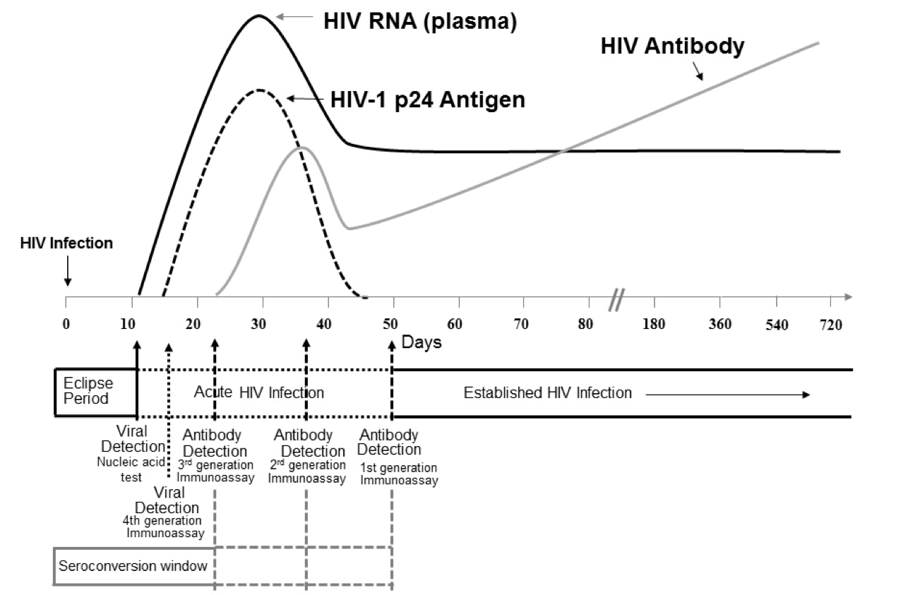
SEQUENCE OF LAB MARKERS
WB
CDC: June 27, 2014
Notes:
Note. Units for vertical axis are not noted because their magnitude differs for RNA, p24 antigen, and antibody. Modified from MP Busch, GA Satten (1997)50 with updated data from Fiebig (2003),48 Owen (2008),49 and Masciotra (2011, 2013).46,66

Slide 36
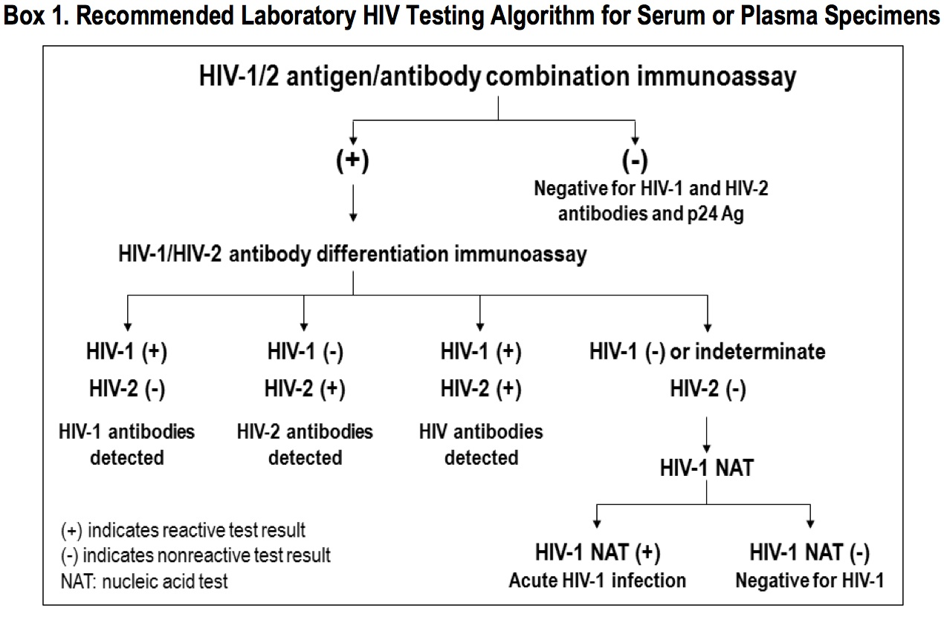
If high risk, consider
CDC: June 27, 2014
Notes:
Laboratories should conduct initial testing for HIV with an FDA-approved antigen/antibody combination immunoassayª that detects HIV-1 and HIV-2 antibodies and HIV-1 p24 antigen to screen for established infection with HIV-1 or HIV-2 and for acute HIV-1 infection. No further testing is required for specimens that are nonreactive on the initial immunoassay.
Specimens with a reactive antigen/antibody combination immunoassay result (or repeatedly reactive, if repeat testing is recommended by the manufacturer or required by regulatory authorities) should be tested with an FDA-approved antibody immunoassay that differentiates HIV-1 antibodies from HIV-2 antibodies. Reactive results on the initial antigen/antibody combination immunoassay and the HIV- 1/HIV-2 antibody differentiation immunoassay should be interpreted as positive for HIV-1 antibodies, HIV-2 antibodies, or HIV antibodies, undifferentiated.
Specimens that are reactive on the initial antigen/antibody combination immunoassay and nonreactive or indeterminate on the HIV-1/HIV-2 antibody differentiation immunoassay should be tested with an FDA-approved HIV-1 nucleic acid test (NAT).
A reactive HIV-1 NAT result and nonreactive HIV-1/HIV-2 antibody differentiation immunoassay result indicates laboratory evidence for acute HIV-1 infection.
A reactive HIV-1 NAT result and indeterminate HIV-1/HIV-2 antibody differentiation immunoassay result indicates the presence of HIV-1 infection confirmed by HIV-1 NAT.
A negative HIV-1 NAT result and nonreactive or indeterminate HIV-1/HIV-2 antibody differentiation immunoassay result indicates a false-positive result on the initial immunoassay^{b}.
Laboratories should use this same testing algorithm, beginning with an antigen/antibody combination immunoassay, with serum or plasma specimens submitted for testing after a reactive (preliminary positive) result from any rapid HIV test.
a Exception: As of April 2014, data are insufficient to recommend use of the FDA-approved single-use rapid HIV- 1/HIV-2 antigen/antibody combination immunoassay as the initial assay in the algorithm.
b See Section M, Additional Considerations, for a discussion of issues related to acute HIV-2 infection.

Slide 37
HEPATITIS C VIRUS
RNA virus – Flaviviridae; complex antigenic structure
Six major genotypes (1-6); 11 subtypes
Occurrence of virus - blood (months to years); usually absent elsewhere; transmission - percutaneous & IVDU
Worldwide – 160 million; US 180,000 w/ 3363 new cases (2019)
Chronic active hepatitis (75%); cirrhosis, hepatocellular carcinoma (30%)
Notes:
Complex antigenic structure
Nucleocapsid - Protein C
Envelope glycoproteins - E1 & E2
Nonstructural proteins - NS2-5

Slide 38
THERAPY
  Pre-2013 - pegylated interferon + ribavirin for 24-48 weeks, depending on genotype
    Boceprevir, telaprevir – improved response rates (20-40%) for genotype 1
  New drugs – glecaprevir/pibrentasvir (MAVYRET®); sofosbuvir/velpatasvir (EPCLUSA®); ledipasvir/sofobuvir (HARVONI®); others
    Better response rates (>90%) in shorter timeframe (8-24 weeks)
    Eliminates the need for interferon therapy
    Screening recommended
http://www.hcvguidelines.org

Slide 39
SEROLOGIC DIAGNOSIS
Third generation - EIA, CIA
  Detects Ab to multiple proteins
  High sensitivity (99%) & specificity (≥99%)
  Positive 1-2 weeks after exposure but seroconversion rarely delayed for months
  Remains + but declines slowly if disease spontaneously resolves; may become negative after 18-20 yrs in 40%
  Poor PPV in low prevalence population

Slide 40
SEROLOGIC DIAGNOSIS
Confirmatory assays
  Recombinant ImmunoBlot Assay (RIBA) – not available
  NAT
    Quantitative PCR for HCV RNA
    Indicates active infection; baseline viral load if positive
If EIA/CIA+, confirm with NAT
  Positive NAT - anti-HCV positive & active HCV infection
  Negative NAT - resolved infection or false positive serology
    s/co <3.8 (EIA), <8.0 (CIA) → false+ more likely

Slide 41
SUMMARY
Rapid antigen tests for GAS, Flu A/B, RSV and now CoVID have been available for many years
Attractive – inexpensive, fast, easy (POC); BUT suboptimal accuracy
Molecular methods – more accurate, TAT improving (1-2 hrs), easy to use; expensive
HIV/HCV – screening recommended; testing algorithms; treatment

Slide 42
Recent Developments in Clinical Microbiology - Primary Care Perspective
Questions?
Comments?

