Slide 1
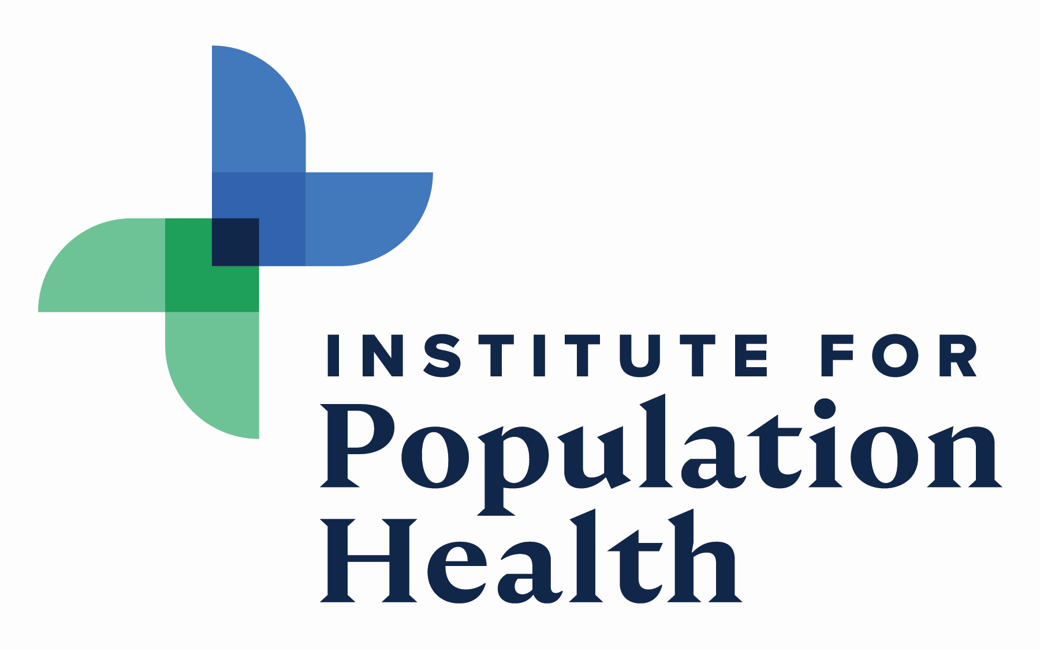
Innovative Solutions to Promote Access to Rural Surgical Care Scott Shipman, MD, MPH CyncHealth Chair in Population Health Executive Director, Institute for Population Health Creighton University Sept 2023

Slide 2

Building population health as a cornerstone for Creighton
Expand regional and national distinction for Creighton through clinical and community partnerships that improve health equity, access to care, and high-value care.
Clinical transformation
Research and policy
Education and workforce development
Community engagement

Slide 3
Innovative solutions to mitigate rural access barriers:
Training
Team-based care
Technology & virtual care models
Policy
Clinical innovations, redesign

Slide 4

Approaching & planning innovation, redesign
“Skate to where the puck is going”
-Wayne Gretzky

Slide 5

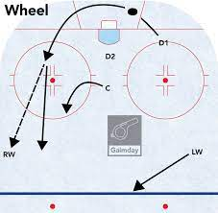
Approaching & planning innovation, redesign
“The puck is here. Hit it.”
“Skate to where the puck is going”
“Skate to where the puck may be going next, after it gets to where it’s going now”

Slide 6
Approaching & planning innovation, redesign
“The puck is here. Hit it.”
“Skate to where the puck is going”
“Skate to where the puck may be going next, after it gets to where it’s going now”
Need increasing tolerance for risk, error, failure

Slide 7
The puck is here: Clinical redesign is a growing necessity
Workforce shortages
Clinician, staff burn-out
New payment models increasingly reward efficiency
Complexity in care requires new workflows

Slide 8
The puck is here: Merits of Team-Based Care
Delegate tasks to reduce inefficiency
Extend effectiveness of care by outreach into community, home
Role delineation to optimize care & clinical team satisfaction

Slide 9
Connecting the dots for health: the clinical team
*
EMT
Behavioral health specialist
*
Nurse
*
Community health worker
*
PA
Emerging roles
Social worker
PT, Speech, Occ Therapy
*
MA
*
Physician
NP
Patient
Family
Clin Pharm

Slide 10
The puck is here: Leveraging telehealth
Synchronous
Asynchronous
Provider-to-patient
Provider-to-provider
RPM
mHealth

Slide 11
The puck is here: Integrating telehealth into routine care models
Better access to care for rural populations
Greater efficiency for provider, practice = ROI
Provider-to-patient: Fewer no shows, reduced bricks and mortar costs, less road time for provider & team
Provider-to-provider (eConsults): reduced low value referrals
Asynchronous: new workflows reduce clinician burden
Greater convenience for patients = greater satisfaction, loyalty to system

Slide 12
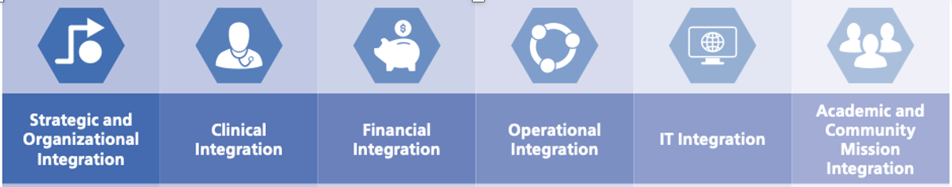
Challenges of effective telehealth integration
Change is hard: stakeholder engagement is key
Building clinician, staff skills is required
Must address the digital divide to ensure equitable access to services
Leadership engagement
Effective integration
Sustainability, scale

Slide 13
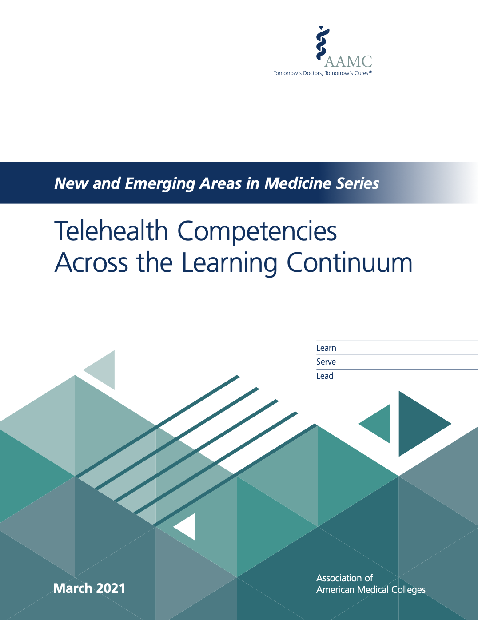
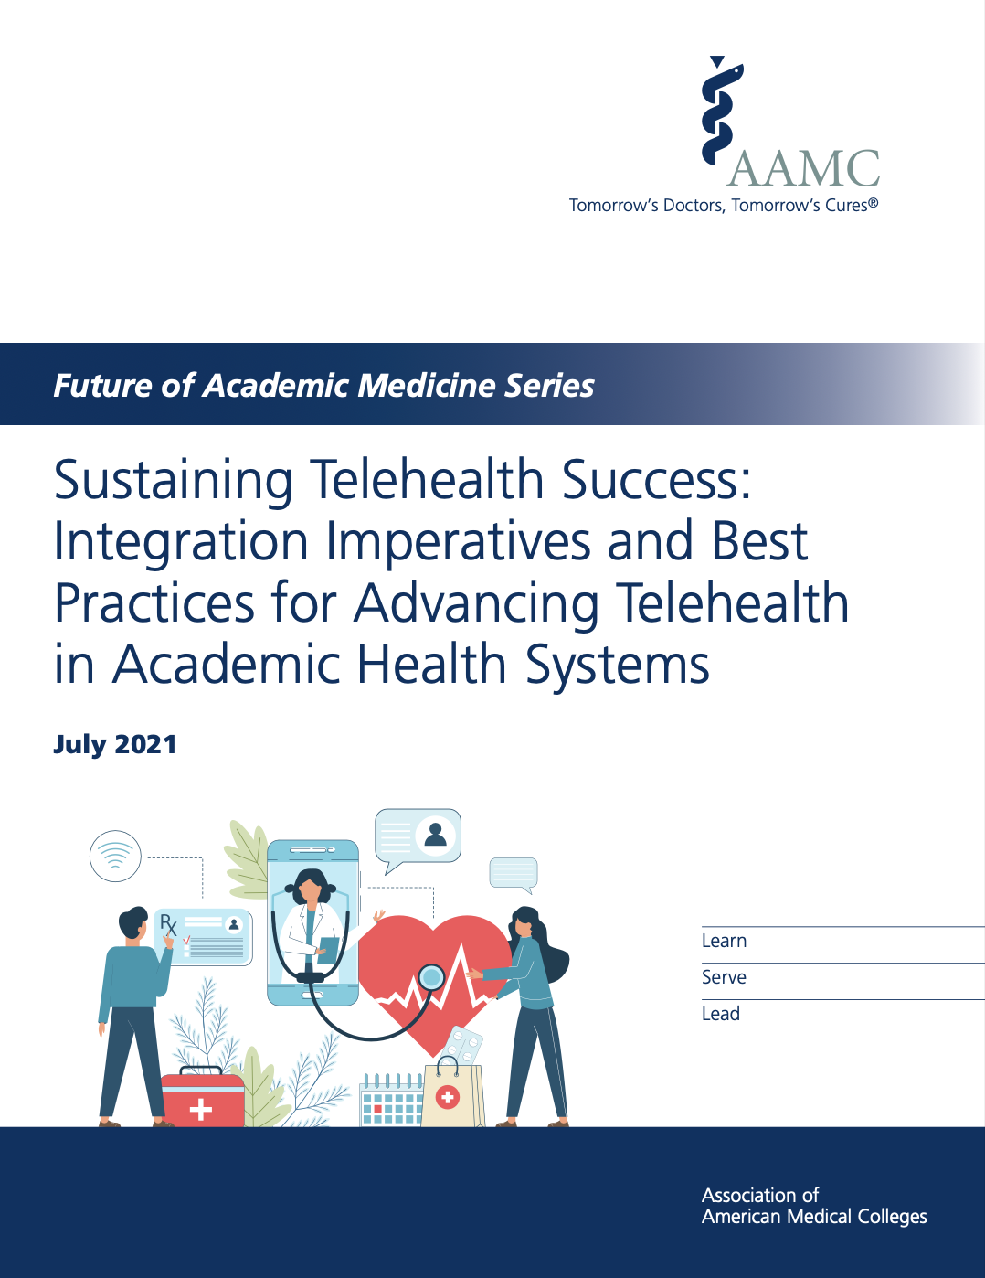


Slide 15

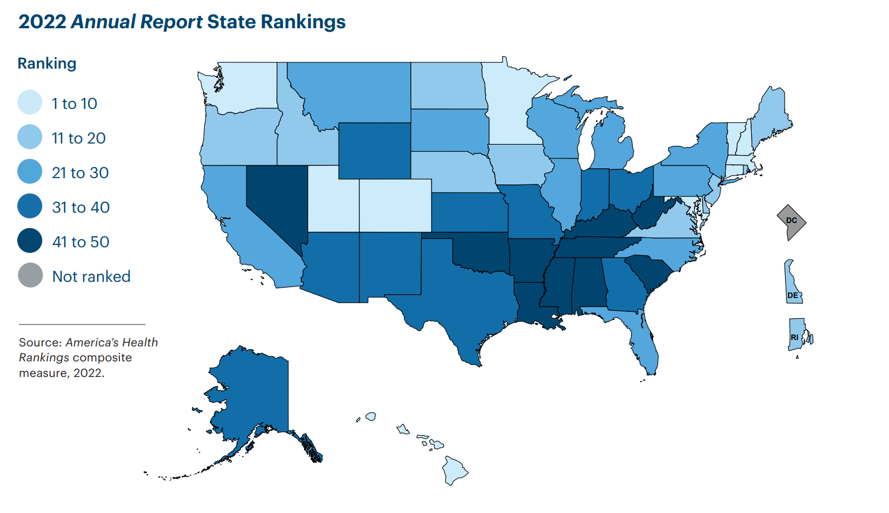

How healthy is Nebraska?
Nebraska ranked #16 in America’s Health Rankings*
*Rankings are derived from 51 measures across five categories of health: social and economic factors, physical environment, behaviors, clinical care and health outcomes.
21%
in obesity in adults between 2013 - 2021
16%
in frequent mental distress of adults between 2019 - 2021
14%
in uninsured population between 2019 - 2021
Key strengths:
Low prevalence of multiple chronic conditions
Low economic hardship index score
High adult flu vaccination rate
Key challenges:
High racial disparity in premature death rates
High prevalence of excessive drinking
High percentage of household food insecurity
Source: United Health Foundation; https://www.americashealthrankings.org/explore/states/NE

Slide 16
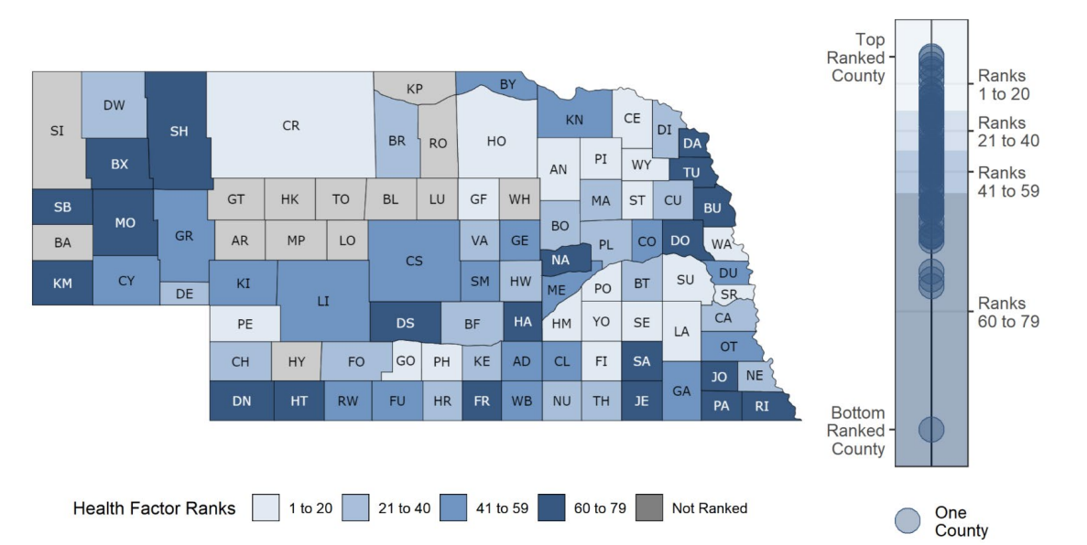
A closer look at Nebraska…and the variations among subpopulations
Nebraska County Health Rankings by Health Factors*
7.6% of adults in Nebraska report not seeing a doctor in the past 12 months because of cost as compared to 8.7% of adults nationally.
*Health Factor Rankings are derived from measures across four health factor areas: social and economic factors, physical environment, behaviors, and clinical care.
Access to Care* by Race/Ethnicity
*Adults Who Report Not Seeing a Doctor in the Past 12 Months Because of Cost
American Indian / Alaska Native
17.1%
Hispanic
23.0%
Black
20.2%
Top ranked county (1) to bottom ranked (79)
Other
11.3%
White
5.7%
Sources: University of Wisconsin Population Health Institute. County Health Rankings State Report 2022; KFF analysis of the Centers for Disease Control and Prevention (CDC)'s 2013-2021 Behavioral Risk Factor Surveillance System (BRFSS).

Slide 17
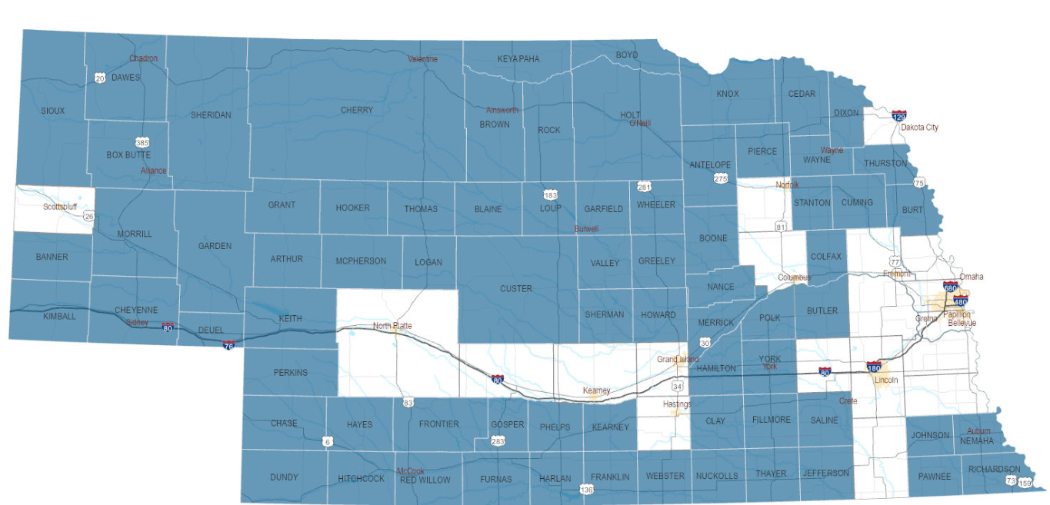
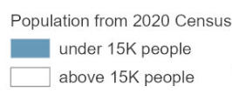
Nebraska and it’s rural population
Nebraska counties with population under 15,000
25.1% of people in NE live in a rural area; 18.7% of the U.S. population lives in rural areas.
Reduced access to care in rural populations is associated with:
40% higher rate of preventable hospitalizations
23% increase in mortality
Sources: Nebraska DHHS, https://dhhs.ne.gov/Pages/Rural-Health-Advisory-Commission.aspx; America’s Health Rankings analysis of U.S. Census Bureau, 2020, United Health Foundation, AmericasHealthRankings.org, accessed 2023, https://www.americashealthrankings.org/explore/annual/measure/pct_rural/state/NE.

Slide 18
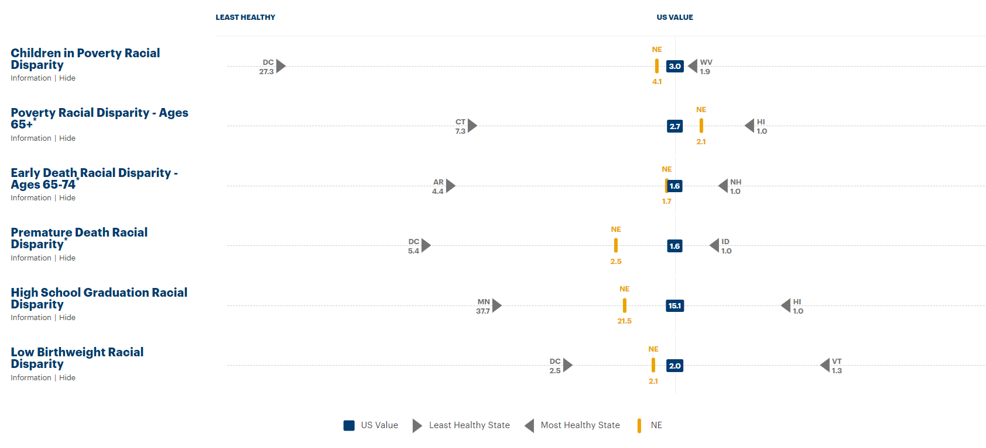

A closer look at Nebraska…and the racial disparities as compared to the U.S.
Ratio of the racial/ethnic group with the highest rate (varies by state) to that of the non-Hispanic white population
Source: America's Health Rankings composite measure, 2022, https://www.americashealthrankings.org/health-topics/71?topics=12

