Slide 1
Test your knowledge!
By Dr Mohsin Saghir, MD
Gastroenterology Fellow
Creighton University School of Medicine

Slide 2
A 35-year-old man is evaluated for a 1-year history of near-daily postprandial diarrhea, episodic abdominal cramping relieved with a bowel movement, and abdominal bloating. He is otherwise healthy, and his only medication is loperamide. This treatment has not been consistently effective in reducing diarrhea symptoms and has had no effect on the cramping and bloating, despite increased frequency of dosing.
Vital signs are normal. Diffuse tenderness to abdominal palpation is noted. Other physical examination findings are normal.
Stool testing for infection and celiac antibody testing are negative.
Colonoscopy findings are unremarkable.
What is the recommended treatment to help his complaints?
alosetron
linacolitide
low fodmap (fermentable oligosaccharides, disaccharides, monosaccharides or polyols)
lubiprostone

Slide 3
A 52-year-old man is evaluated for dysphagia of 3 months' duration. He reports regurgitating undigested food soon after eating solid food, occasional coughing and choking after swallowing, and chronic halitosis. He reports no weight loss or chest pain. He drinks two beers weekly and does not smoke.
On physical examination, vital signs are normal; BMI is 25. The remainder of the examination, including abdominal examination, is unremarkable.
Which of the following is the most appropriate diagnostic test to perform next?
barium esophagram
upper endoscopy
esophageal manometry
surgery

Slide 4
A 55-year-old woman is evaluated after screening colonoscopy showed three polyps at the rectosigmoid junction. The three polyps were 3 mm, 5 mm, and 6 mm in size. All three polyps were completely excised and pathology showed them to be hyperplastic. Colonoscopy preparation was excellent and the procedure was complete to the cecum. Family history is significant for colon cancer diagnosed in her paternal grandfather at age 80 years.
All physical examination findings, including vital signs, are normal.
When should be the next colonoscopy?
1 year
3 years
5 years
10 years
She doesn't need anymore colonoscopies

Slide 5
A 60-year-old man is evaluated for constant low-grade epigastric pain radiating to his back that worsens after he eats fatty foods. He has a 2-year history of chronic pancreatitis. The pain has progressively worsened over the preceding 6 months. His weight is stable. He has a normal bowel movement once every other day. He does not drink alcohol. He continues to smoke 2 packs of cigarettes per day as he has done for 30 years. The patient has a remote history of opioid abuse.
On physical examination, vital signs are normal. Abdominal examination shows tenderness to palpation in the epigastrium.
A contrast-enhanced CT scan of the abdomen shows calcifications throughout the pancreas with no pancreatic mass, no dilated pancreatic duct, and no cystic lesions.
Which is the most appropriate first step in management?
celiac plexus block
NSAIDs, tobacco and alcohol cessation
surgery
refer to gastroenterology
opioids
pancreatic enzyme replacement therapy

Slide 6
A 63-year-old woman is evaluated at a follow-up appointment after undergoing right hemicolectomy for colon cancer 1 year earlier. Her paternal grandfather had colon cancer diagnosed at age 75 years. She reports that she has been feeling well and takes no medication.
All physical examination findings, including vital signs, are normal.
When is the next colonoscopy?
Now
3 years
5 years
does not need another one for 10 years

Slide 7
A 55-year-old man is evaluated at a follow-up appointment 4 days after being diagnosed with acute sigmoid diverticulitis. He is on day 4 of oral antibiotics and reports that his pain is almost gone. He has no other symptoms and has never had a colonoscopy. He takes no other medication.
His vital signs are normal. Abdominal examination is positive for minimal tenderness on deep palpation in the left lower quadrant without rebound or guarding.
The CT scan of the abdomen from the emergency department shows mild sigmoid diverticulitis with no abscess.
When should be next colonoscopy?
does not need one
within 2 weeks
6- 8 weeks
1 year

Slide 8
A 45-year-old man is evaluated for a 2-month history of a burning sensation starting in his stomach and radiating into his chest, usually occurring 4 to 5 times weekly. He says that he usually eats dinner late and then goes to sleep. He often wakes up with a sour taste in his mouth. He reports no dysphagia or unintentional weight loss. He takes no medication.
On physical examination, vital signs are normal; BMI is 34. The remainder of the examination, including abdominal examination, is unremarkable.
What is the best next step?
upper endoscopy
ambulatory ph testing
2 month proton pump inhibitor trial
histamine receptor antagonist
The same patient returns after 3 months and states his symptoms improved on PPI therapy, but they recurred 3 weeks after stopping the PPI and the symptoms of heartburn are affecting his quality of life.
What is the next best step?
restart proton pump inhibitor trial therapy for 2 more months
trial histamine receptor antagonists
Ambulatory ph testing
Upper endoscopy off of proton pump inhibitor trial
The patient undergoes upper endoscopy and the exam is found to be normal. The patient returns to your clinic and wants to know what should be done.
What is the next step in management?
ambulatory ph testing off of proton pump inhibitor trial
restart proton pump inhibitor trial
Apologize and tell them there is nothing else to be done
send for esophageal manometry.

Slide 9
A 20-year-old man is evaluated for epigastric pain that has gradually increased in severity over 8 months. The pain worsens with eating and is not relieved by antacids. The patient reports no melena, diarrhea, or constipation. The patient's personal medical history is unremarkable and he takes no medication.
On physical examination, vital signs are normal. Epigastric tenderness to palpation is noted. Other findings are normal.
A complete blood count is normal.
What is the most appropriate step in management?
PPI trial
Stool H pylori testing
Ultrasound abdomen
CT scan of the abdomen
Treat with NSAIDS

Slide 10
A 65-year-old man is evaluated with upper endoscopy in follow-up for Barrett esophagus. He has had heartburn for more than 15 years, but his symptoms have been well controlled with daily omeprazole. He reports no weight loss or pain with swallowing and has no history of anemia. He stopped smoking 5 years earlier, but has a 40-pack-year history.
Vital signs and the remainder of the physical examination are normal.
On upper endoscopy, an area of salmon-colored mucosa is seen in the esophagus. Biopsies confirm evidence of Barrett esophagus with low-grade dysplasia. The pathology slides were reviewed by a second pathologist, confirming the presence of low-grade dysplasia.
What is the best next step?
Endoscopic ablation
PPI therapy only
Repeat endoscopy in 1 year
Refer to surgery

Slide 11
A 40-year-old woman is evaluated at a follow-up appointment for hepatitis B virus (HBV) infection, which was diagnosed at age 23 years. The patient also has psoriasis. She is married and is sexually active. Medications are topical clobetasol and an oral contraceptive agent.
On physical examination, vital signs are normal. Psoriatic lesions are present on the elbows and knees. No hepatosplenomegaly is noted.
Laboratory studies:
Alanine aminotransferase | 125 U/L
Aspartate aminotransferase | 112 U/L
Hepatitis B surface antigen | Positive
Hepatitis B e antigen | Positive
HBV DNA | 41,326 IU/mL
What is the most appropriate step in management?
Monitor and repeat labs in 3 months
Start Tenofovir
Start ribavirin
Start Pegylated interferon

Slide 12
A 40-year-old woman is evaluated for intermittent lower abdominal pain, daily bloating, and constipation. Her lower abdominal pain initially worsens then subsides after a bowel movement; it occurs nearly daily. She has bowel movements every 2 to 3 days and reports that most bowel movements are hard. The patient reports that adherence to a gluten-free diet has helped the bloating, but other symptoms have not responded. A twice-daily soluble fiber supplement has not affected symptoms. Miralax has been trialed, but the pain continues to be an issue. Low FODMAP diet was trialed, but patient found it difficult to perform. Her last thyroid-stimulating hormone measurement and complete blood count 6 months earlier were normal. Family history includes colon cancer diagnosed in her grandfather at age 60 years and a first cousin with celiac disease.
On physical examination, BMI is 29; all other findings are unremarkable.
What is the diagnosis and how do you manage?
Celiac disease and gluten free diet
Suspicion for colon cancer and refer for diagnostic colonoscopy
Irritable bowel syndrome; start linaclotide, lubiprostone or plecanitide
Dyssynergic defecation; refer for pelvic floor therapy and biofeedback.

Slide 13
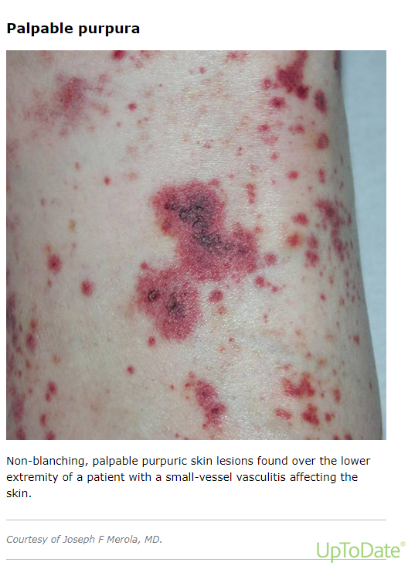
This patient has chronic hepatitis C which is untreated. He presents to your clinic saying a new rash has appeared on his lower extremities. He endorses joint pains and weakness. He is distressed because he cannot wear shorts outside due to the concern of people staring at him.
What is the next best step?
Advise him that the rash is a consequence of hepatitis C and that nothing can be done to treat it.
Start a direct acting antiviral as this will cure this problem.
Give trial of topical steroids
Refer to dermatology for punch biopsy.

