Slide 1
Fever in ICU
ID Symposium 2023
Faran Ahmad, MD. FACP.
Assistant Professor,
ID & Critical Care Medicine.
Creighton University, Omaha, NE.

Slide 2
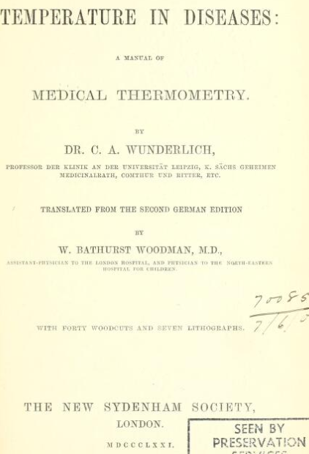
Body temperature & Febrile Response
Wunderlich’s pioneering work on temperature in 1868
Established normal body temperature as 37.0°C (98.6°F)
Currently, normal range is 36.3 to 36.5°C
ACCM and IDSA defined ICU fever as core body temperature > 38.3°C (101°F)
Notes:
Using foot-long instrument that took 20 minutes to register, he recorded more than a million axillary readings and established normal body temperature as 37.0°C (98.6°F)

Slide 3
Body temperature & Febrile Response
Lower threshold for fever (>38 C/100.4 F) may be appropriate in some patients:
Immunocompromised patients (e.g. neutropenic)
Elderly patients
Patients on scheduled acetaminophen or NSAIDs
Patients on ECMO or CRRT (continuous renal replacement therapy)
Precise temperatures may vary, depending on the site and the technique of measurement
Fever curve more informative than any single measurement
Notes:
Ideally, core temperature should be measured (e.g., rectal or esophageal temperature).

Slide 4
Fever: Temperature Measurement
Choose the most accurate and reliable method to measure temperature based on the clinical circumstances
Most accurately measured by an intravascular, esophageal, or bladder thermistor, followed by rectal, oral, and tympanic membrane measurements
Axillary measurements, temporal artery estimates, and chemical dot thermometers should not be used in the ICU
Crit Care Med. 2008, 36: 1330-1349
Notes:
Ideally, core temperature should be measured (e.g., rectal or esophageal temperature).

Slide 5
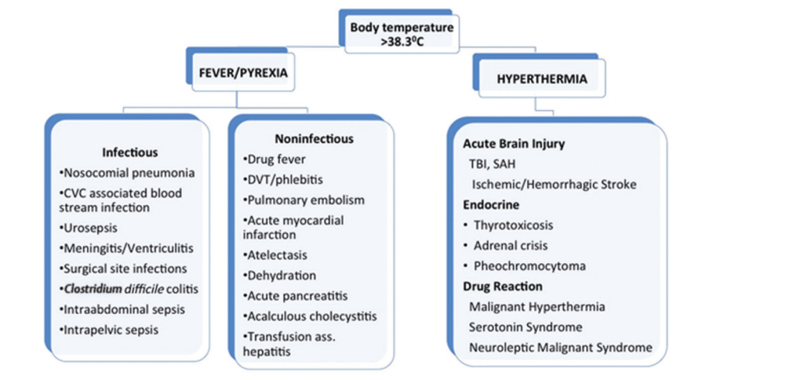
Body temperature & Febrile Response

Slide 6
Sequelae of Fever
Generates hepatic iron-sequestering compounds that bind free iron necessary for microbial replication
Augments antimicrobial activity of antibiotic agents
Induces heat-sensitive shock proteins that activate host defenses
Enhances cytokine and T-cell responses
N Engl J Med 2022; 386:463-477

Slide 7
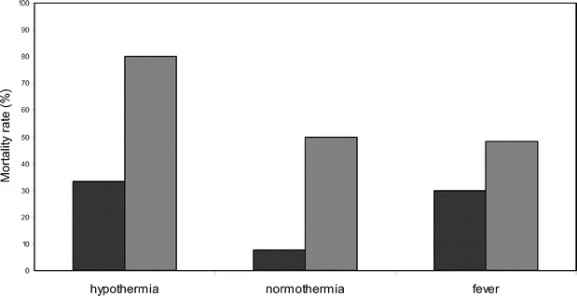
Sequelae of Fever
Prospective, observational study on adult ICU-infected 493 patients (319 males, 174 females) admitted for at least 24 h, during 6 summer months
Patients with hypothermia had a higher mortality when compared with those who had fever (80% vs. 47%)
Overall mortality rates (black bars) and mortality rates in patients with septic shock (gray bars), in the three groups of patients
Intensive Care Med 2004, 30: 811-816.

Slide 8
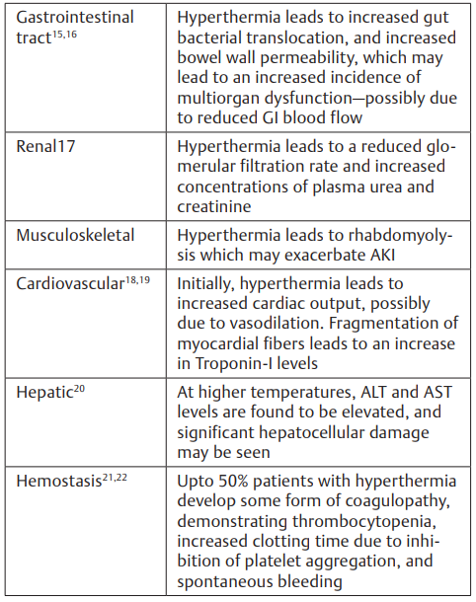
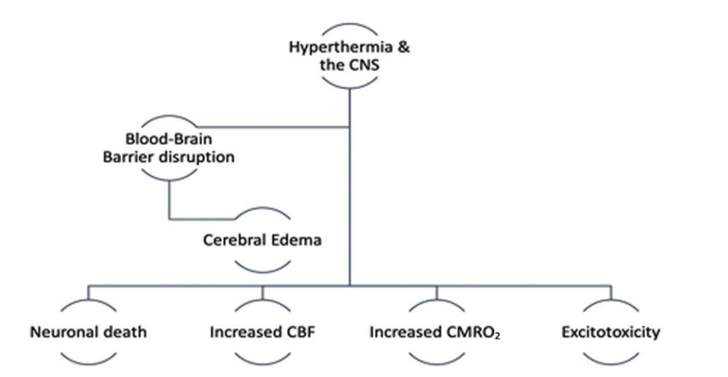
Sequelae of Fever
Effect of fever and hyperthermia on CNS
J Neuroanaesthesiol Crit Care 2019;6:275–283

Slide 9
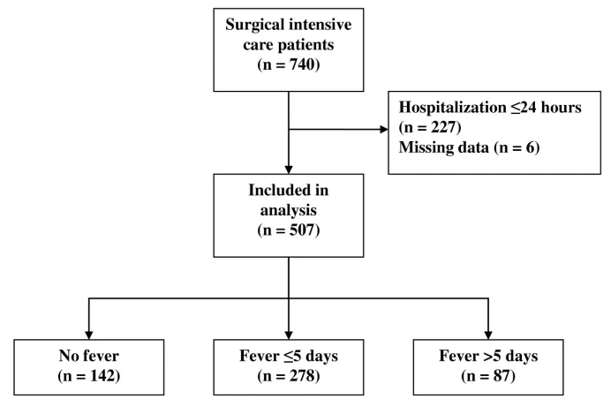
Risk factors: prolonged versus brief fever in ICU
Prospective multicenter observational study in three surgical ICUs in university hospitals in France (May to Oct 2010)
Two periods of 2 months each, with 507 patients hospitalized ≥ 24 hours
Temperature ≥ 38.3°C
Prolonged fever if as lasting > 5 days
Crit Care 16, R150 (2012)

Slide 10
Risk factors: prolonged versus brief fever in ICU
Infectious causes (62%) | Non-infectious causes (31%)
Ventilator-associated pneumonia (46%) Intra-abdominal infection (24%) | Neurogenic causes(70%)
Independent risk factors for prolonged fever
Cerebral injury at admission | OR = 5.03; 95% CI, 2.51 to 10.06
Sepsis/Septic Shock | OR = 2.79; 95% CI, 1.35 to 5.79
Number of infected sites | OR = 2.35; 95% CI, 1.43 to 3.86
Mechanical-ventilation duration | OR = 1.05; 95% CI, 1.01 to 1.09
ICU mortality did not differ significantly between prolonged vs brief fever
Crit Care 16, R150 (2012)

Slide 11
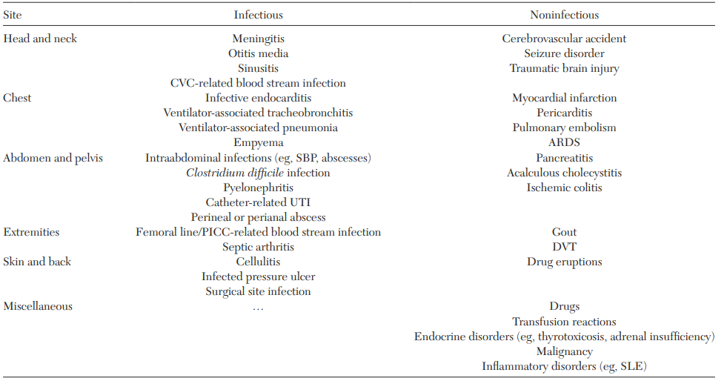
Common Causes of Persistent Fever in ICU: Head-to-Toe Approach to Differential Diagnosis

Slide 12
Persistent Fever in ICU: Approach to Differential Diagnosis
Relative Bradycardia
Pulse (beats/min) | Temperature
150 | 106 F
140 | 105 F
130 | 104 F
120 | 103 F
110 | 102 F
Infectious | Non-infectious
Legionella | CNS lesions
Typhoid Fever | Lymphomas
Leptospirosis | Drug fever
RMFS | Factitious Fever
Malaria | B-blockers

Slide 13
Persistent Fever in ICU: Approach to Differential Diagnosis
Significance of Fever Pattern
Single Fever Spike | Intermittent Fevers | Sustained Fever
Manipulation of colonized/infected mucosa | Bacteremia | Central fevers
Blood products transfusion | Abscesses (renal, abdominal, pelvic) | Drug fever
Infusion-related fever | Acute bacterial endocarditis | RMFS
Temperature error | Peritonitis | Brucellosis
 | TSS, Malaria | Psittacosis

Slide 14
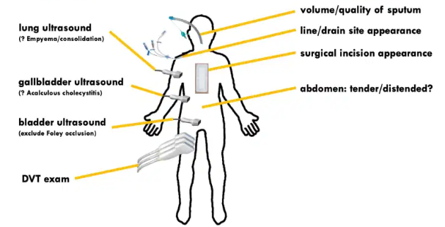
Persistent Fever in ICU: diagnostic Approach
Basic evaluation:
Physical examination
Chest X-ray if patient is intubated or has respiratory symptoms
Blood cultures: Two sets of peripheral blood cultures at different sites

Slide 15
Persistent Fever in ICU: diagnostic Approach
Challenges with urine culture:
Frequently positive in elderly patients, or anyone with a prolonged Foley catheter
Urinary bacterial colonization is generally noninvasive and limited to bladder, rather than ascending to the kidneys
Nosocomial UTI sepsis is almost exclusively associated with urologic manipulation and consequent fever/bacteremia <24 hours after invasive urologic procedure

Slide 16
Persistent Fever in ICU: diagnostic Approach
Indications to obtain urinalysis and urine culture:
Patient without foley catheter with clinical signs/symptoms of UTI
Severe / profound neutropenia
Structural urologic abnormality (recent surgery or urological procedure, or s/p renal transplant)
Bladder ultrasonography
Distended bladder indicates dysfunction of the Foley catheter hence real risk of cystitis, pyelonephritis, septic shock, and obstructive renal failure

Slide 17
Persistent Fever in ICU: diagnostic Approach
Challenges with tracheal aspirate cultures:
It will often be positive among patients with structural lung disease (i.e., COPD) or prolonged intubation
In absence of other features of pulmonary infection, reflect only colonization
Cultures should be obtained only if there is clinical suspicion of ventilator-associated pneumonia

Slide 18
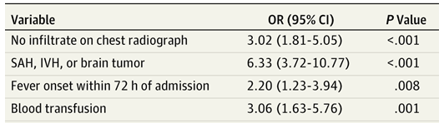
Persistent Fever in ICU: diagnostic Approach
Challenges in Critically Ill Neurologic Patients:
Occurring in up to 70% of patients in NICU and only half of them due to infection
Retrospective observational study from 2006 to 2010 in NICU in adults
( >18yr) admitted for >48hrs
Fever was central in 246 of 526 patients (46.8%)
Multivariate Analysis of Predictors of Central Fever in NICU
JAMA Neurol. 2013;70(12):1499-1504

Slide 19
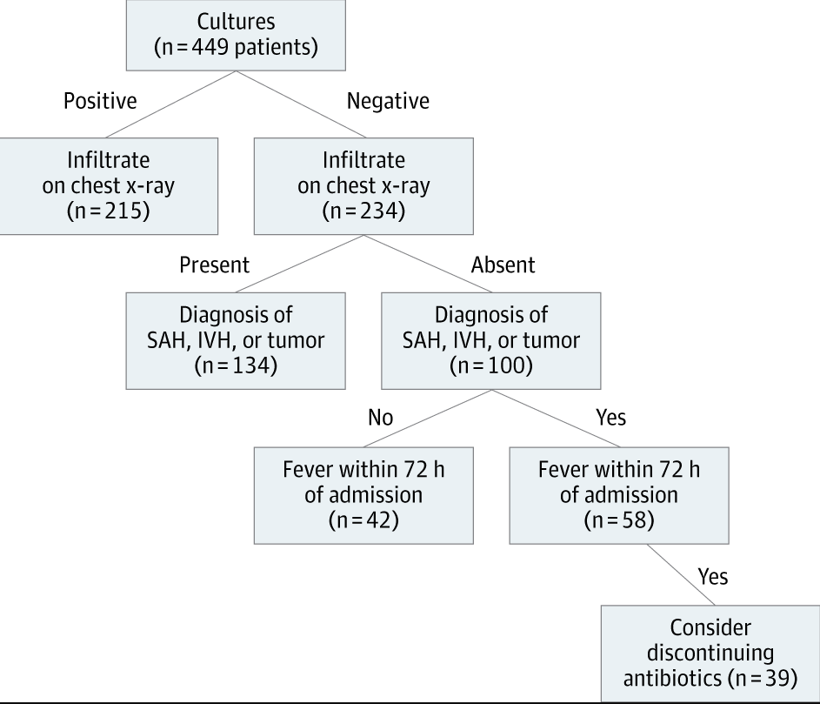
Persistent Fever in ICU: diagnostic Approach
Decision Tree for Fever Classification in NICU:
JAMA Neurol. 2013;70(12):1499-1504

Slide 20
Persistent Fever in ICU: diagnostic Approach
One blood culture is defined as sample of 20–30 mL of blood drawn at a single time from a single site, regardless of how many bottles or tubes
Challenges with blood cultures:
Cutaneous disinfection with 2% chlorhexidine gluconate in 70% isopropyl alcohol and then ≥30 secs of drying time
Aim for multiple cultures with adequate blood volume (20–30 mL for each culture) within first 24 hrs of suspected infection
Prior antibiotic exposure
Lack of strict aseptic technique
Crit Care Med. 2008, 36: 1330-1349

Slide 21
Persistent Fever in ICU: Diagnostic Approach
Intravascular Devices and Fever
Only 25–45% of episodes of sepsis in patients with long-term devices represent true device-related bloodstream infection
Staphylococci, Corynebacterium jeikeium, Bacillus species, atypical mycobacteria, Candida, or Malassezia species
Inflammation or purulence at the exit site or along the tunnel, venous thrombosis or evidence of embolic phenomena
ID consultation
Crit Care Med. 2008, 36: 1330-1349
Notes:
.A minimum of two peripheral blood cultures, or one culture drawn percutaneously and one drawn through the catheter, should be obtained. If both sets of cultures are positive for the same organism and the set drawn through the catheter becomes positive ≥120 mins earlier than the culture drawn peripherally, this is highly suggestive of catheter-related bloodstream infection

Slide 22
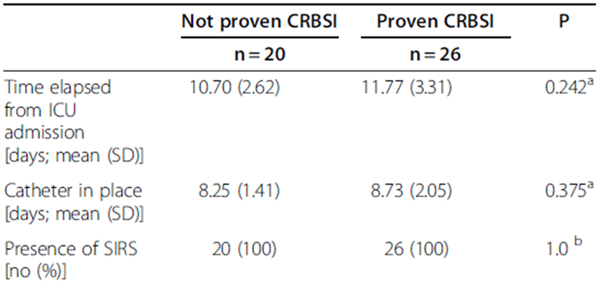
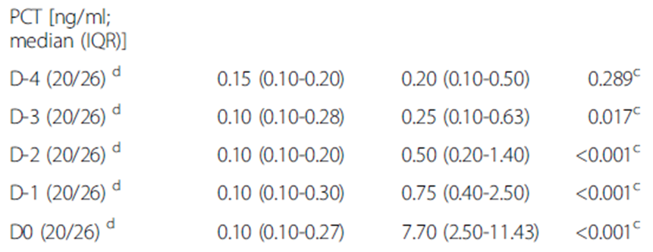
Persistent Fever in ICU: Diagnostic Approach
Intravascular Devices and Fever: Role of Procalcitonin
Prospective, observational cohort study on 102 patients (CVC >48 hrs) in Greece, between June 2008 and May 2011
Primary outcome was proven CRBSI
Daily procalcitonin measurements done
PCT level variation over time was statistically significant within patients with proven infection (p < 0.001)
BMC Infectious Diseases 2012, 12:247
Notes:
.A minimum of two peripheral blood cultures, or one culture drawn percutaneously and one drawn through the catheter, should be obtained. If both sets of cultures are positive for the same organism and the set drawn through the catheter becomes positive ≥120 mins earlier than the culture drawn peripherally, this is highly suggestive of catheter-related bloodstream infection

Slide 23
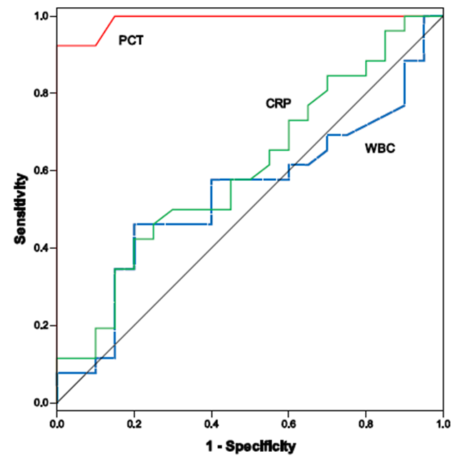
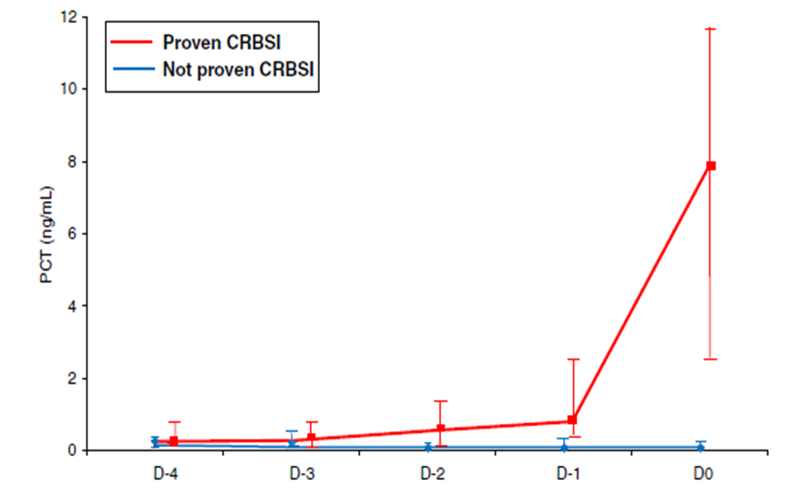

Persistent Fever in ICU: Diagnostic Approach
Intravascular Devices and Fever: Role of Procalcitonin
ROC curves of PCT, WBC, and CRP on D0 for
differentiating between patients with and without proven CRBSI in the ICU
BMC Infectious Diseases 2012, 12:247
Notes:
.A minimum of two peripheral blood cultures, or one culture drawn percutaneously and one drawn through the catheter, should be obtained. If both sets of cultures are positive for the same organism and the set drawn through the catheter becomes positive ≥120 mins earlier than the culture drawn peripherally, this is highly suggestive of catheter-related bloodstream infection

Slide 24
Persistent Fever in ICU: Diagnostic Approach
Fever Within 72 hrs of Surgery
Examine surgical wound
CXR not mandatory during initial 72 hrs unless respiratory symptoms
Urinalysis and culture not mandatory during initial 72 hrs for isolated fever
DVT, PE, superficial thrombophlebitis
Crit Care Med. 2008, 36: 1330-1349
Notes:
.A minimum of two peripheral blood cultures, or one culture drawn percutaneously and one drawn through the catheter, should be obtained. If both sets of cultures are positive for the same organism and the set drawn through the catheter becomes positive ≥120 mins earlier than the culture drawn peripherally, this is highly suggestive of catheter-related bloodstream infection

Slide 25
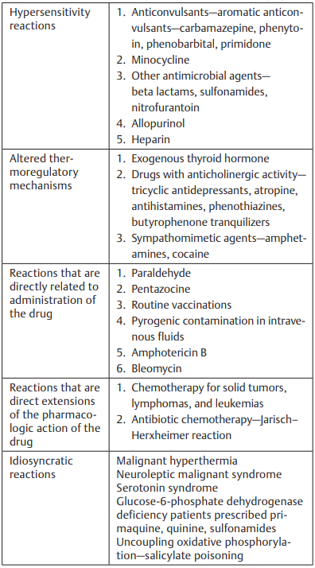
Persistent Fever in ICU: Diagnostic Approach
Non-infectious Etiologies:
More common in the neurointensive care unit than other critical care settings
50 and 80% of all patients presenting with SAH have fever within first week
Associated with increased ICP, longer ICU length of stay and overall poor outcomes
J Neuroanaesthesiol Crit Care 2019;6:275–283

Slide 26
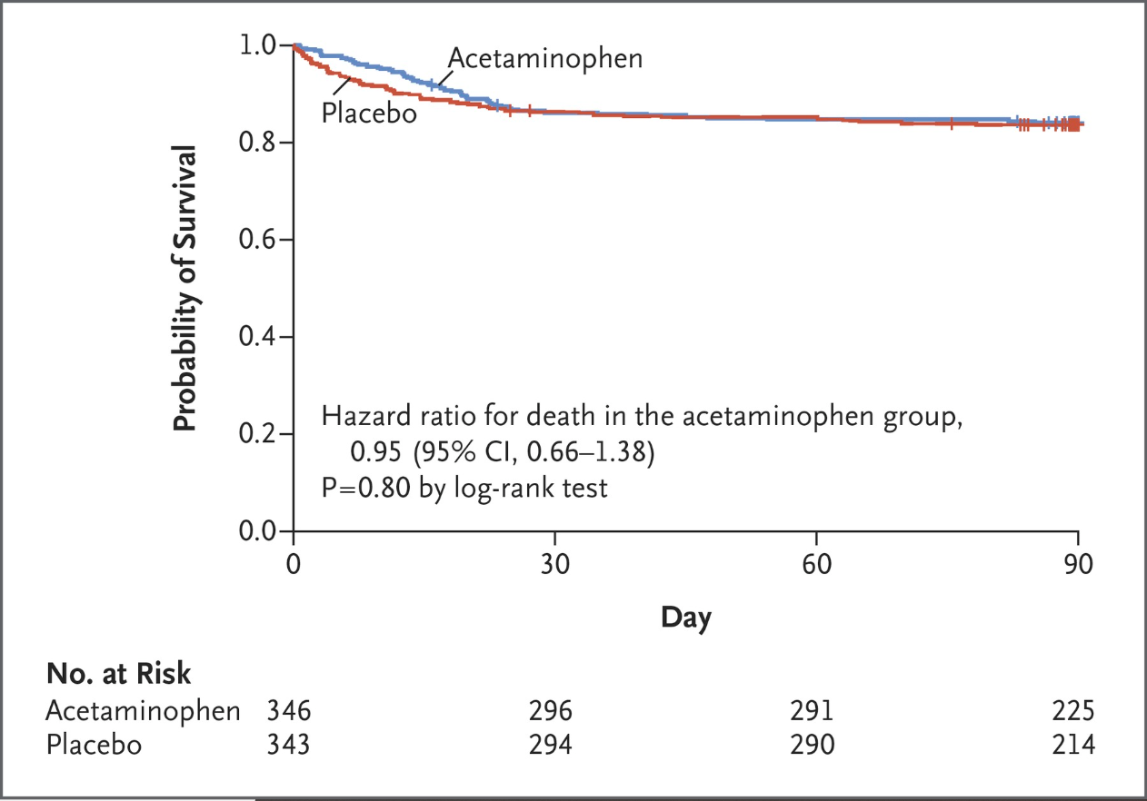
Persistent Fever in ICU: Approach to treatment
Role of Acetaminophen
Prospective, parallel-group, blinded, RCT in 2015 on fever treatment in patients with probable infection
346 were assigned to acetaminophen group and 344 in placebo
No difference in number of ICU-free days to day 28
No difference in mortality at day 28 & 90
N Engl J Med 2015; 373:2215-2224

Slide 27
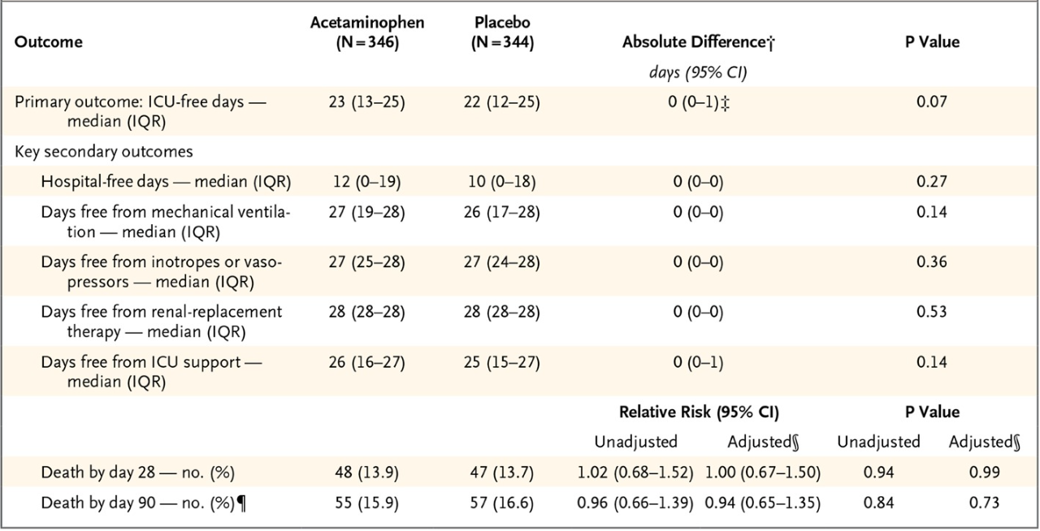
Persistent Fever in ICU: Approach to treatment
Role of Acetaminophen
N Engl J Med 2015; 373:2215-2224

Slide 28
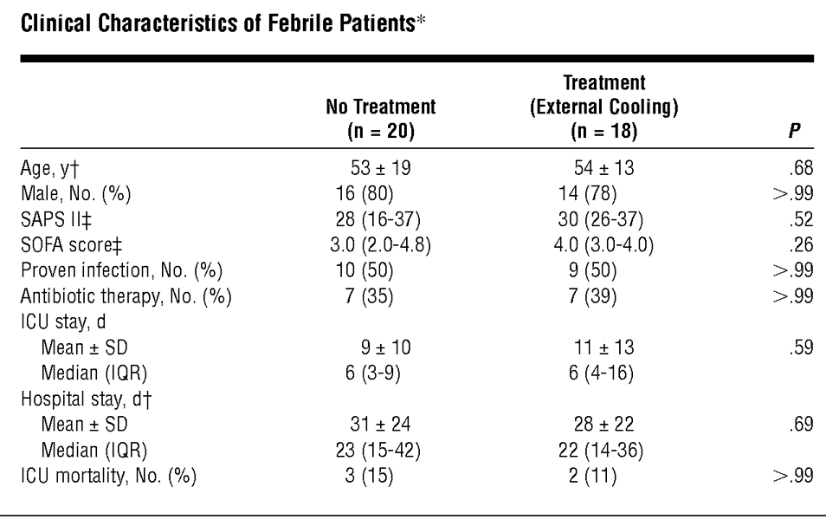
Persistent Fever in ICU: Approach to treatment
External Cooling
RCT comparing external cooling with no treatment in surgical ICU patients with fever ≥38.5°C and SIRS
18 patients received external cooling while 20 received no antipyretic treatment, excluded neurotrauma or severe hypoxemia
External cooling was achieved using cooling blankets, ice packs, or cloths
No significant differences in recurrence of fever, antibiotic therapy, ICU and hospital length of stay, or mortality
Arch Intern Med. 2001;161(1):121-123
Notes:
However, the lowering of elevated body temperature seems advisable when it is above 40.5°C, especially in patients with neurotrauma or other acute neurological diseases, as well as in patients with severe hypoxemia, malignant hyperthermia, heat shock, and related problems.

Slide 29
Persistent Fever in ICU: Approach to treatment
 | Fever | Hyperthermia
Typical examples | Infection Sterile inflammation (pancreatitis) | Exertional heat stroke Malignant hyperthermia NMS
Temp | Usually below 41 C | Often above 41 C
Clinical features | Rigor can precede temp spike | Lack of rigor, rigidity or increased tone
Effect of antipyretics | Effective in reducing temp spike | Will not work
Effect of cooling blanket | Often ineffective | Often effective and necessary
Clinical implication | Treat the underlying cause of fever | Aggressive control of body temperature is essential
Notes:
Ideally, core temperature should be measured (e.g., rectal or esophageal temperature).

Slide 30
Persistent Fever in ICU: Considerations for Empiric Therapy During Diagnostics
Initiation of broad spectrum therapy may be necessary for unstable or high-risk patients while diagnostic evaluation is ongoing
If drug-resistant pathogens are suspected, initial broad spectrum empirical antimicrobial therapy should be directed to cover the resistance pattern and prior antibiotic exposures
Including antifungal coverage in selected patients and immune suppressed host
Addressing non-infectious causes of fever with high index of suspicion
Crit Care Med. 2008, 36: 1330-1349

Slide 31
Persistent fever & Antibiotic related problems
Did Antibiotics Really Fail?
Undrained Abscess
Inadequate coverage/spectrum
Inadequate antibiotic blood/tissue levels
Retained infected devices or foreign body
Organ hypoperfusion and sub-optimal local antibiotic levels
Infection is NOT bacterial
In vitro susceptibility but inactive in vivo

Slide 32
Key Points
New fever in ICU patient should trigger careful clinical assessment rather than automatic orders for laboratory and radiologic tests
Cost-conscious approach to obtaining cultures and imaging studies should be undertaken
Focus on diagnostic stewardship and educated therapeutic decisions

Slide 33


