Slide 1
How to Research Disparities in Rural Surgery in Nebraska and Elsewhere Maureen Tierney Associate Dean and Chair Clinical Research and Public Health Creighton University School of Medicine

Slide 2
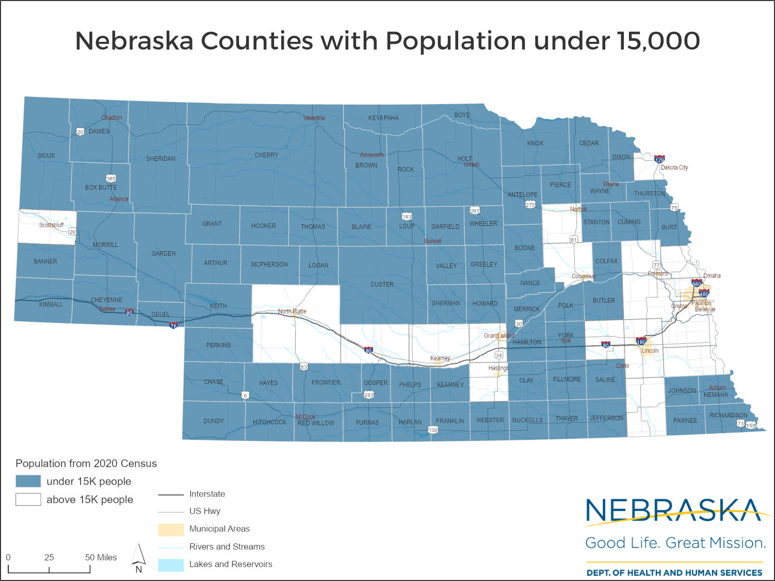
Understanding the Landscape

Slide 3
Resources on Data/Research on Rural Health Surgical Access in Nebraska
Office of Rural Health
Nebraska Rural Health Association
Rural Health Advisory Commission
Nebraska Hospital Association

Slide 4
Resources on Data/Research on Rural Health Surgical Access in Nebraska (cont.)
CHI Health Network and Health Partners
New CU residencies with a rural focus
Nebraska Association of Family Practitioners
Nebraska Association of Local Health Dept Directors
Nebraska Association of Practitioners of Infection Control

Slide 5
NE DHHS Office of Rural Health
Phone: (402) 471-2337
Medicare Rural Hospital Flexibility Program (FLEX)
Small Rural Hospital Improvement Program (SHIP)
National Health Services Corps
Federal Shortage Areas Recruitment and Retention
Nebraska NHSC State Loan Repayment Program (SLRP)
Phone: (402) 471-0180
Margaret Brockman – Administrator, Office of Rural Health

Slide 6
Critical Access Hospitals

Slide 7
Critical Access Hospitals Networks (as of 12/22/2014)
Bryan Health/Heartland Health Alliance (25)
Albion Auburn Aurora Beatrice Central City Creighton Crete David City Fairbury Falls City Henderson Holdrege Lexington McCook Neligh Oakland Osmond Pender Seward St. Paul Syracuse Valentine Wahoo Wayne York
Faith Regional Health/Northeast Network
Lynch
Good Samaritan/Central Network (15)
Ainsworth Alma Atkinson Bassett Benkelman Broken Bow Callaway Cambridge Cozad Franklin Gothenburg Imperial Minden Ord Red Cloud
CAH Link/CHI Health-St. Elizabeth (10)
Fairbury Falls City Friend Geneva Hebron O’Neill Osceola Pawnee City Superior Tecumseh
CHI Health-Alegent Creighton (5)
Blair Nebraska City Plainview Schuyler
West Point Rural NE Healthcare Network/Panhandle (8)
Alliance Bridgeport Chadron Gordon Grant Kimball Oshkosh Sidney
Banner Health System – Fort Collins, CO
Ogallala
Columbus Community Hospital
Genoa

Slide 9
Rural Health Advisory Commission
Advise the DPH on rural health situation and policy development
Meeting min publicly available
Recent meeting concerns
Loss of ARPA funds
Loosing staff
Loan repayment

Slide 10
From the 2021 NE Rural Health Advisory Commission Report
2015-2019, rural residents had higher mortality rates for
heart disease,
unintentional injury overall, and
Motor vehicle crashes.
slightly higher for colon cancer and suicide.
Between 2015 and 2019, rural compared to urban populations were more likely
to be obese, less likely to have their cholesterol checked in the past five years
Less likely and be up to date on colon and breast cancer screening,
more likely to use smokeless tobacco and engage in binge drinking,
Less likely to wear a seat belt and visit a dentist in the past year.
“Factors that have limited the availability of and access to health services in rural health areas, including the inadequate supply of health professionals, low or negative hospital financial margins, the diminishing number of EMS volunteers, the limited capacity of rural local health departments, and the lack of coordination between the health care and behavioral health systems. “

