Slide 1


Updates to management of neonatal hyperbilirubinemia: implementing a new clinical practice guideline
Brian A. Juber, MD
Neonatologist, Assistant Professor of Pediatrics
Children’s Hospital & Medical Center
University of Nebraska Medical Center
Omaha, NE

Slide 2
Objectives
The participant should be able to:
Understand the underlying physiologic processes that place newborn infants at risk for hyperbilirubinemia
Be able to recognize hyperbilirubinemia neurotoxicity risk factors
Know when to initiate phototherapy, escalate care, and perform exchange transfusion based on the updated AAP clinical practice guideline

Slide 3


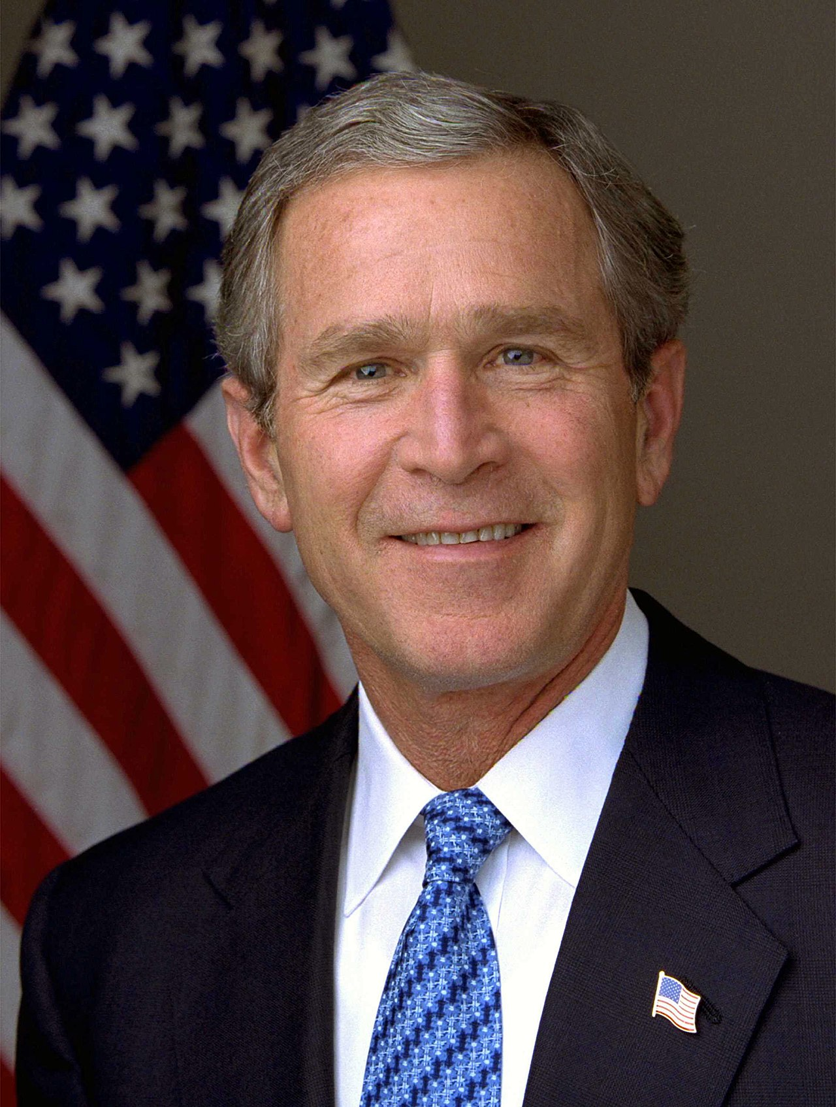

Back to 2004
Notes:
Let’s take a brief walk down memory lane back to 2004. Facebook had just launched. The Summer Olympics were in Athens, Greece. George W. Bush was President. And Pixar was pumping out classics like The Incredibles.

Slide 4
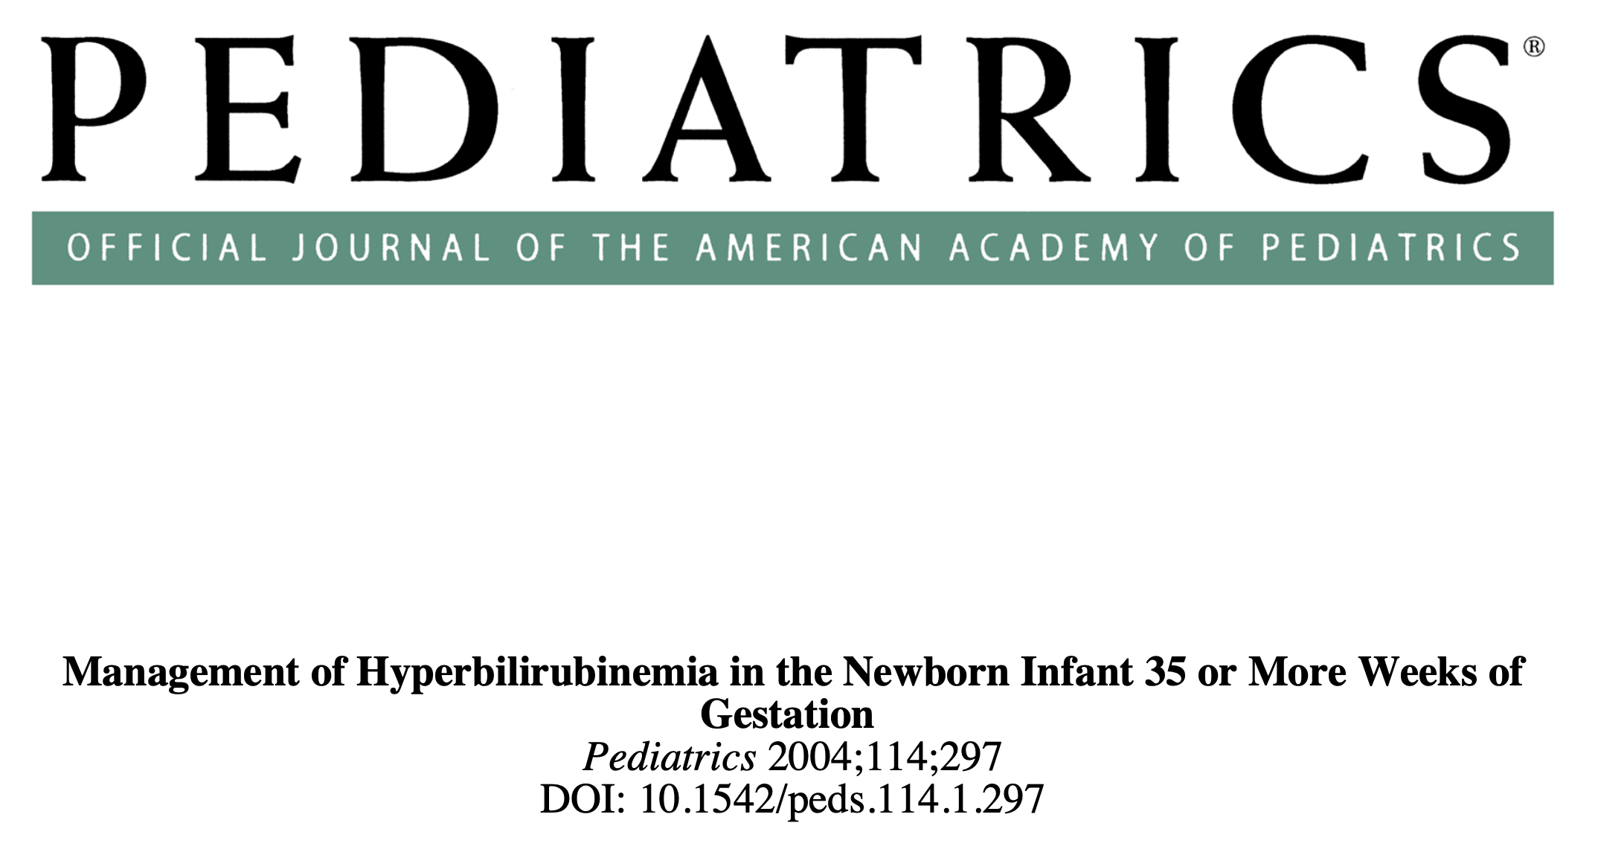
Also in 2004…
Notes:
More relevant to this talk, prior to the publication of the 2022 clinical practice guideline, 2004 was the date of the last published guidelines for the management of neonatal hyperbilirubinemia.

Slide 5
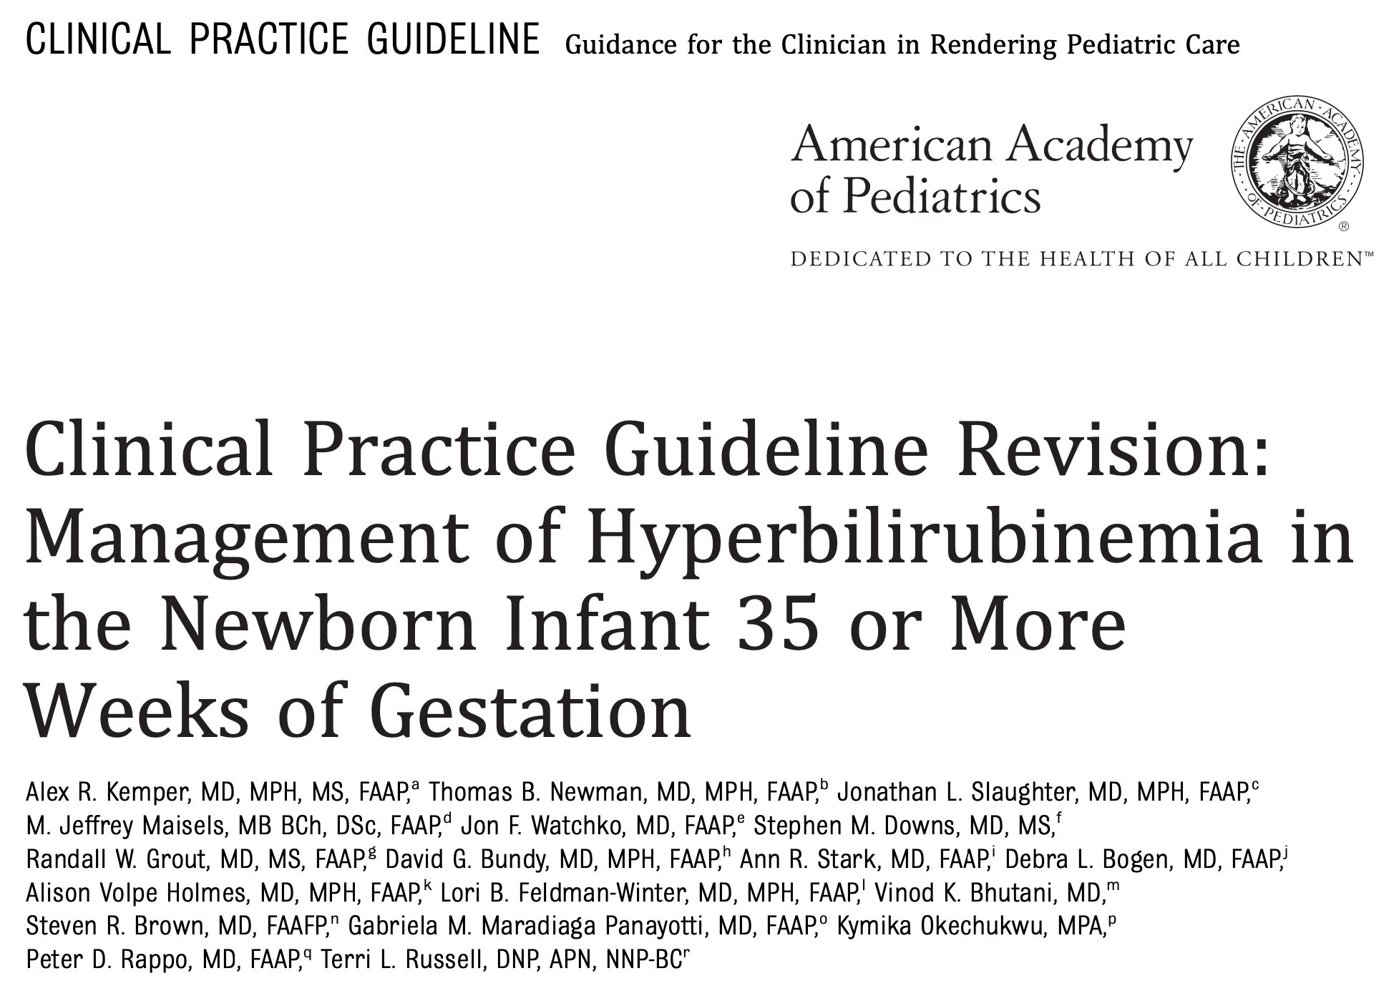
…and 18 years later
Notes:
Fast forward 18 years to August of 2022, when an updated clinical practice guideline was published. This will be the subject of the bulk of our discussion today.

Slide 6
Objectives
The participant should be able to:
Understand the underlying physiologic processes that place newborn infants at risk for hyperbilirubinemia
Be able to recognize hyperbilirubinemia neurotoxicity risk factors
Know when to initiate phototherapy, escalate care, and perform exchange transfusion based on the updated AAP clinical practice guideline
Notes:
I’ll now spend some time briefly reviewing the underlying physiologic processes that place newborn infants at risk for hyperbilirubinemia.

Slide 7
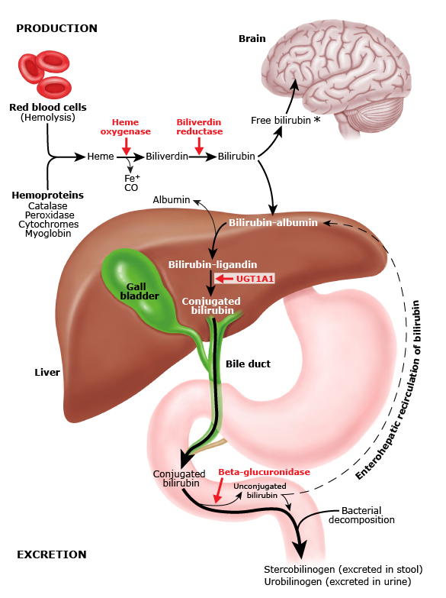
Bilirubin production, metabolism, and transport
UpToDate, 2022
Notes:
Bilirubin production starts with the breakdown of red blood cells. The vast majority of bilirubin in the body comes from breakdown of red blood cells, specifically the heme moiety of hemoglobin.
Heme is then converted to unconjugated bilirubin in a 2 step process. The first step converts heme to biliverdin and is catalyzed by the enzyme heme oxygenase. Biliverdin is then converted to bilirubin by the enzyme bilirubin reductase.
The majority of this unconjugated bilirubin is bound to albumin due to its lipophilic nature and poor solubility in plasma. Free bilirubin however is able to cross the blood brain barrier and enter into the CNS where it can exert neurotoxic effects.
In the liver, the bilirubin is conjugated. Conjugation involves glucuronidation which makes the bilirubin water soluble so that it can be excreted into the biliary system. A family of uridine diphospoglucoronosyltransferase enzymes, specifically UGT1A1, are responsible for this conversion, and this is the enzyme that is only present in very low levels at the time of birth.
Conjugated bilirubin is then excreted via the biliary system into the small intestines. It is excreted as stercobilinogen in the stool and urobilinogen in the urine with the assistance of bacterial decomposition. However a small amount of conjugated bilirubin can be de-conjugated by beta-glucoronidase enzymes in the large intestine and be re-absorbed as unconjugated bilirubin that then needs to be re-conjugated by the liver. This process is called enterohepatic circulation and is a significant contributor to breast feeding jaundice in the first week of life.
I’ve starred the major points in this process that contribute to neonatal jaundice.
First, fetal RBCs with fetal hemoglobin have a shorter lifespan than RBCs with adult hemoglobin, and all RBCs with fetal hemoglobin are turned over after birth.
Second, at the level of the liver, levels of UGT1A1 are approximately 1% of adult levels at birth, and it may take several months for this glucuronidation to increase to adult levels.
Next, infants right after birth take in very little hydration over the first several days, and often have delayed stool output. This dehydration increases rates of enterohepatic circulation.
Finally, the microbiome is less established at the time of birth so there is less bacterial decomposition of conjugated bilirubin to stercobilinogen and urobilinogen which are easily excreted in the stool and urine.

Slide 8
Benign neonatal hyperbilirubinemia
“Physiologic jaundice”
Immaturity of hepatic conjugation system
RBC (HbF) turnover after birth
Median peak TSB of 8-9 mg/dL on DOL 3-5
ALL infants should be screened for hyperbilirubinemia (with TcB or TSB) while in the nursery
Notes:
So, again, as I just discussed all infants are at risk for hyperbilirubinemia. In many cases this is a benign phenomenon that can be thought of as a fetal to neonatal transition. These cases are benign neonatal hyperbilirubinemia, formerly known as physiologic jaundice. It is primarily due to immaturity of the hepatic conjugation system, and the decreased lifespan and increased turnover of RBCs containing fetal hemoglobin also contributes. It results in a median peak TSB of 8-9 mg/dL on DOL 3-5, and resolves spontaneously as hepatic conjugation matures. Because all infants are at risk for hyperbilirubinemia, it remains a strong recommendation from the AAP that all infants should be screened for hyperbilirubinemia while in the newborn nursery with either a serum or transcutaneous bilirubin.

Slide 9
Benign neonatal hyperbilirubinemia
Breast FEEDING jaundice
First week of life
Inadequate oral intake → dehydration → increased enterohepatic circulation
Optimize feeding
Breast MILK jaundice
After first week of life
Component(s) of breast milk that de-conjugate bilirubin and increase enterohepatic circulation
Continue feeding, consider trial of formula
Notes:
Two common etiologies of benign neonatal hyperbilirubinemia are breast FEEDING jaundice and breast MILK jaundice. Breast feeding jaundice typically results in hyperbilirubinemia in the first week of life and can be thought of as a result of inadequate intake. This results in dehydration causing increased enterohepatic circulation. Hydration is the mainstay of treatment, and if at all possible this hydration should consist of enteral hydration with increased frequency of breast feeding or supplementation with formula if necessary.
Breast milk jaundice, on the other hand, typically occurs in infants who are over a week old, and the mechanism is not entirely clear. The most likely explanation is a compound in the breast milk, possibly a beta-glucuronidase or a type of fatty acid, which de-conjugates bilirubin and lead to increased reabsorption of the bilirubin from the GI tract.

Slide 10
Pathologic hyperbilirubinemia
Increased production
Decreased conjugation / clearance
Hemolytic disease
Immune mediated
RBC enzyme deficiencies
RBC structural membrane defects
Hemoglobinopathies
Extravascular blood (i.e. birth injury)
Polycythemia
Enhanced enterohepatic circulation
Delayed passage of meconium
Poor intake
Exclusive breast milk feeding
Prematurity
Hypothyroidism
Hypopituitarism
Disorders of conjugation
Crigler-Najjar syndrome
Gilbert syndrome
Enhanced enterohepatic circulation
Notes:
There are many causes of significant unconjugated neonatal hyperbilirubinemia, formerly known as “pathologic jaundice.” These can result from either increased production of bilirubin, or decreased conjugation and clearance of bilirubin. We don’t have time today to discuss these all in detail, but one major risk factor I want to highlight is immune mediated hemolytic disease, since this is a major risk factor for pathologic hyperbilirubinemia and is addressed in the new CPG from the AAP.

Slide 11
Pathologic hyperbilirubinemia – hemolysis
Increased production
Etiologies of hemolysis
Isoimimune mediated – Rh incompatibility, ABO incompatibility, minor blood group incompatibilities
Enzymatic deficiencies – G6PD deficiency, pyruvate kinase deficiency
Structural defects of RBCs – hereditary spherocytosis / elliptocytosis
Hemoglobinopathies – ⍺-thalassemia
Results in increased production of bilirubin that needs to be conjugated by an immature / non-existent hepatic system
Considered to be a neurotoxicity risk factor and thus presence lowers PT/ET thresholds
Notes:
The most common cause of hemolysis in the neonate is isoimmune mediated hemolytic disease of the newborn, meaning incompatibility between Rh types, ABO blood types, or minor blood groups between mother and infant. Enzymatic deficiencies such as G6PD and pyruvate kinase deficiency can also result in hemolysis. Structural defects in RBCs, such as hereditary spherocytosis and elliptocytosis, result in further decreased lifespan of RBCs in the neonatal circulation, resulting in increased turnover and increased heme burden. Alpha-thalassemia can also result in hemolysis due to absence of alpha-globin genes.
The end result of these hemolytic conditions is an increased production of bilirubin that needs to be conjugated by an already immature hepatic system. Hemolysis is considered to confer such as substantial risk factor for significant hyperbilirubinemia that it is considered a neurotoxicity risk factor and thus its presence results in lower thresholds to initiate phototherapy or exchange transfusion for treatment of hyperbilirubinemia.

Slide 12
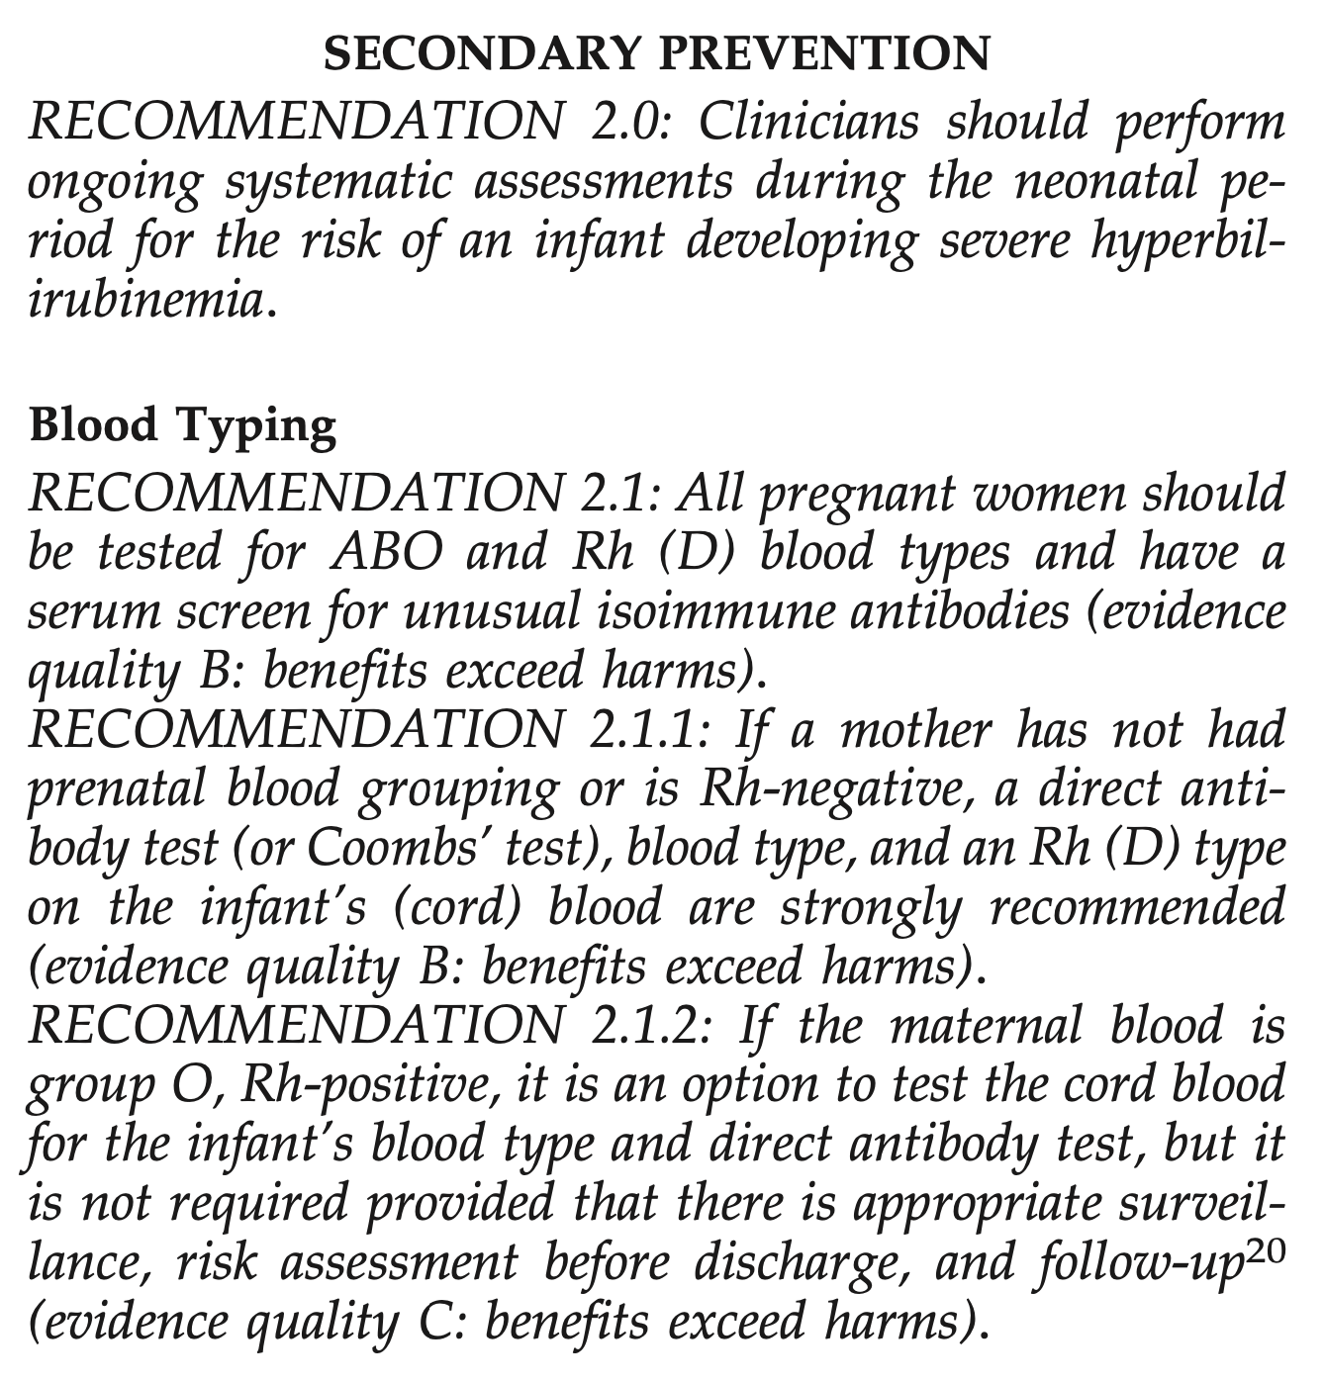
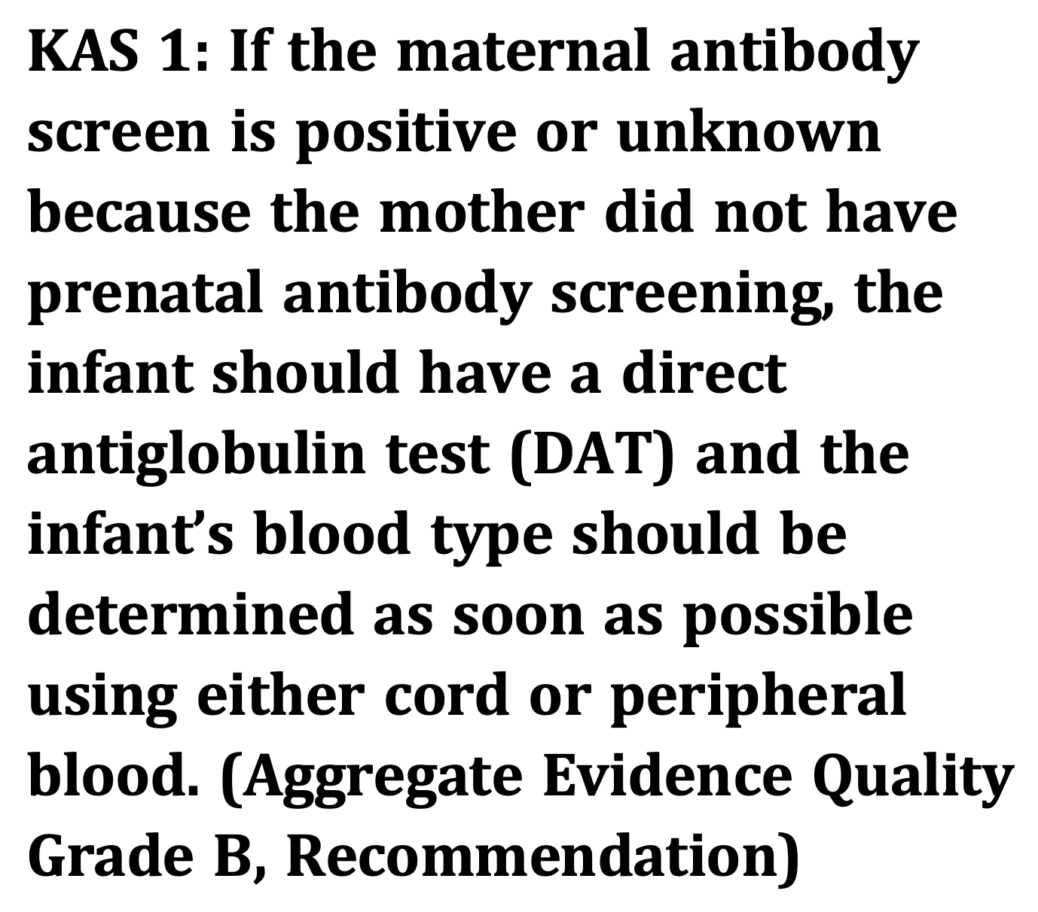
Screening for isoimmune hemolysis
2004
2022
Notes:
Both the 2004 and 2022 recommendations from the AAP recommend screening for isoimmune hemolysis, and the recommendations in both cases are similar. The first key action statement in the 2022 CPG states that “If the maternal antibody screen is positive or unknown because the mother did not have prenatal antibody screening, the infant should have a DAT and the infant’s blood type should be determined as soon as possible using either cord or peripheral blood.”

Slide 13
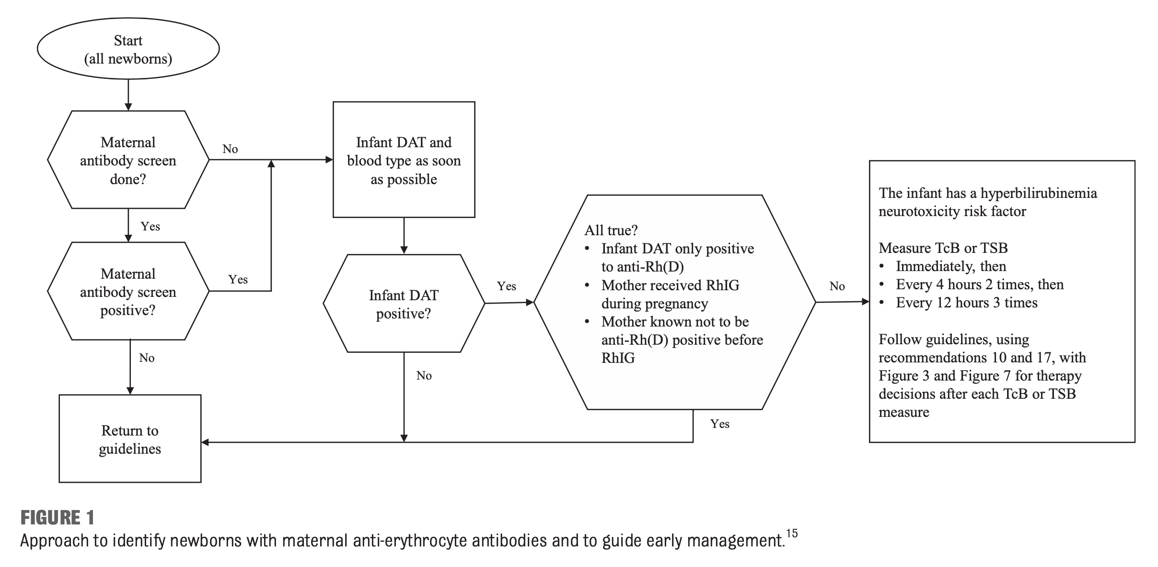
Screening for isoimmune hemolysis
Pediatrics, 2022
Notes:
Hemolysis is such a noteworthy risk factor for hyperbilirubinemia that the AAP is now recommending that ALL infants be screened for the possibility of hemolytic disease while in the newborn nursery. If a maternal antibody screen was done and it was negative, no further action is needed. If a maternal antibody screen was either not done or it was positive, the infant should have a DAT and blood type done as soon as possible. If the infant’s DAT is negative, no further action is needed. If the infant’s DAT is positive and it is likely due to maternal RhoGAM exposure, then no further action is needed. However if the infant’s DAT is positive and any of the 3 factors in the hexagonal box is NOT true, then the infant is considered to have a neurotoxicity risk factor and transcutaneous or serum bilirubin levels need to be trended closely.

Slide 14
Objectives
The participant should be able to:
Understand the underlying physiologic processes that place newborn infants at risk for hyperbilirubinemia
Be able to recognize hyperbilirubinemia neurotoxicity risk factors
Know when to initiate phototherapy, escalate care, and perform exchange transfusion based on the updated AAP clinical practice guideline
Notes:
I’ll now move on to discussing the importance of being able to recognize hyperbilirubinemia neurotoxicity risk factors.

Slide 15
Bilirubin-induced neurologic dysfunction (BIND)
Acute bilirubin encephalopathy (ABE)
Initial phase – Lethargy, hypotonia, poor suck
Advanced stages – Hypertonia (retrocollis, opisthotonos), fever, high-pitched cry, inability to feed, apnea
Warrants immediate escalation of care and exchange transfusion – even if TSB is below ET threshold
Notes:
Everyone here is aware that bilirubin can at very high concentrations exert neurotoxic effects on the central nervous system. Free unconjugated bilirubin is able to cross the blood brain barrier and can cause bilirubin induced neurologic dysfunction. In the acute phase this results in acute bilirubin encephalopathy. The initial phase is characterized by lethargy, hypotonia, and poor suck. In advanced stages, hypertonia develops, specifically retrocollis and opisthotonos. The infant may also be febrile, have a high pitched cry, have worsening ability to feed, or develop apnea. If these signs are present, this warrants immediate exchange transfusion even if the TSB is not above the exchange transfusion threshold.

Slide 16
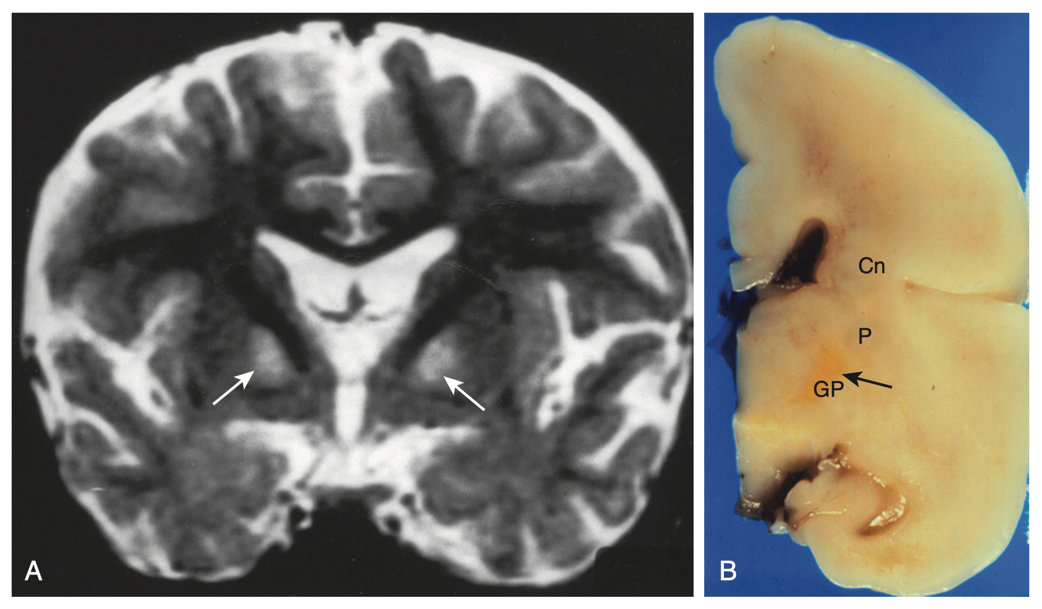
Bilirubin-induced neurologic dysfunction (BIND)
Chronic bilirubin encephalopathy (CBE, “kernicterus”)
Permanent neurologic sequelae of bilirubin neurotoxicity
Extrapyramidal movement disorder (dystonia / choreoathetosis)
Hearing loss
Upward gaze paresis
Selective deposition into globus pallidus and subthalamic nuclei
Avery’s Diseases of the Newborn, 10th Ed, 2018
Notes:
If ABE is not recognized or reversed, it can result in chronic bilirubin encephalopathy or kernicterus. This condition is characterized by permanent neurologic sequelae of bilirubin neurotoxicity. Signs include extrapyramidal movement disorders such as dystonia or choreoathetosis, hearing loss, and an upward gaze paralysis. It results from high selective deposition of bilirubin into the globus pallidus and subthalamic nuclei of the basal ganglia. The MRI demonstrates bilateral high intensity signal at the level of the basal ganglia. The postmortem brain analysis demonstrates deep orange-yellow staining of the globus pallidus with sparing of the putamen and caudate nucleus.

Slide 17
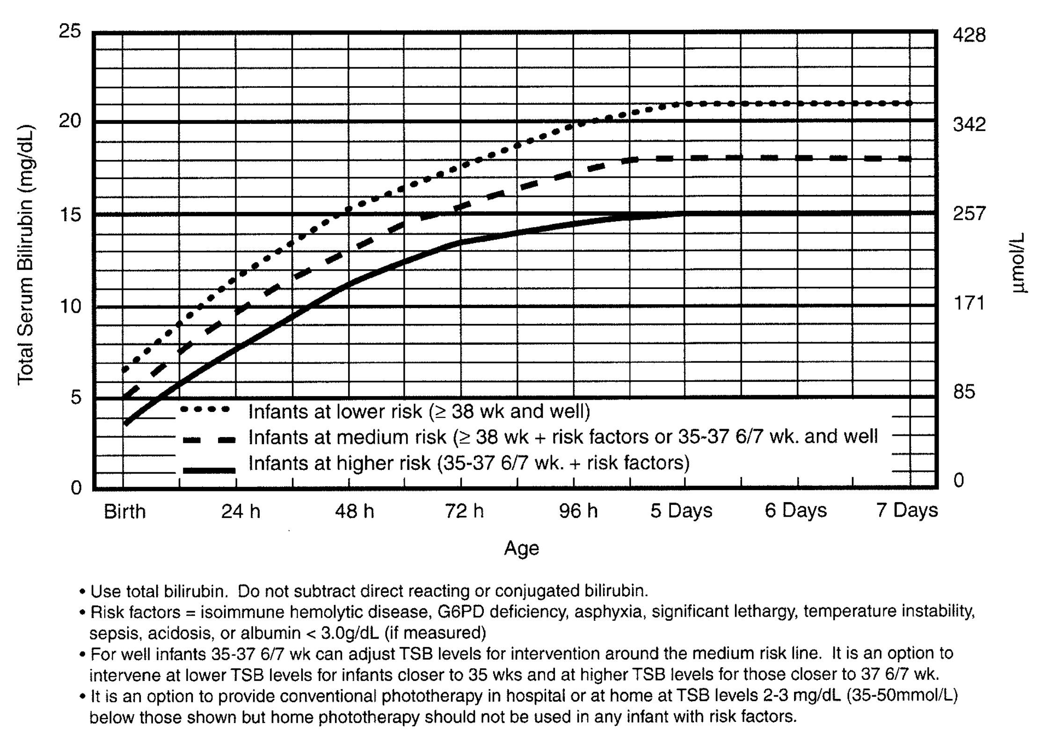
Risk factors – 2004 CPG
Pediatrics, 2004
Notes:
The term “neurotoxicity risk factor” is technically new to the 2022 CPG, but the 2004 guidelines also recognized the importance of certain conditions increasing the likelihood of neurotoxicity from high levels of bilirubin. In the 2004 CPG these risk factors were listed in the phototherapy and exchange transfusion curve figure legends as being:
Isoimmune hemolytic disease
G6PD deficiency
Asphyxia
Significant lethargy
Temperature instability
Sepsis
Acidosis
Hypoalbuminemia (serum albumin < 3.0 g/dL)

Slide 18
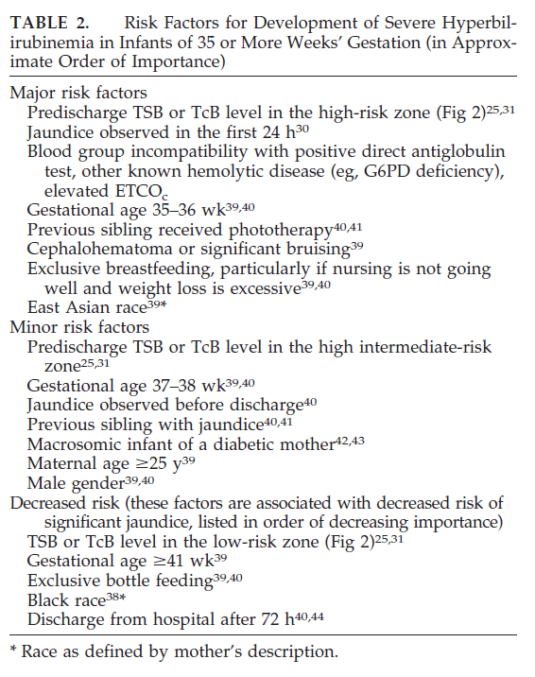
Also listed as risk factors
Risk factors for the development of severe hyperbilirubinemia but not necessarily neurotoxicity
Some overlap
Hemolytic disease
Prematurity
Pediatrics, 2004
Notes:
However the 2004 guidelines also had a long list of other risk factors, which were more generally risk factors for severe hyperbilirubinemia. Although there was some overlap between these more general risk factors and the risk factors on the previous slide (specifically, hemolytic disease and prematurity), many of the risk factors for severe hyperbilirubinemia do not in and of themselves increase the risk of neurotoxicity. To keep these two sets of risk factors separate, the 2022 CPG introduced the term “neurotoxicity risk factor.”

Slide 19
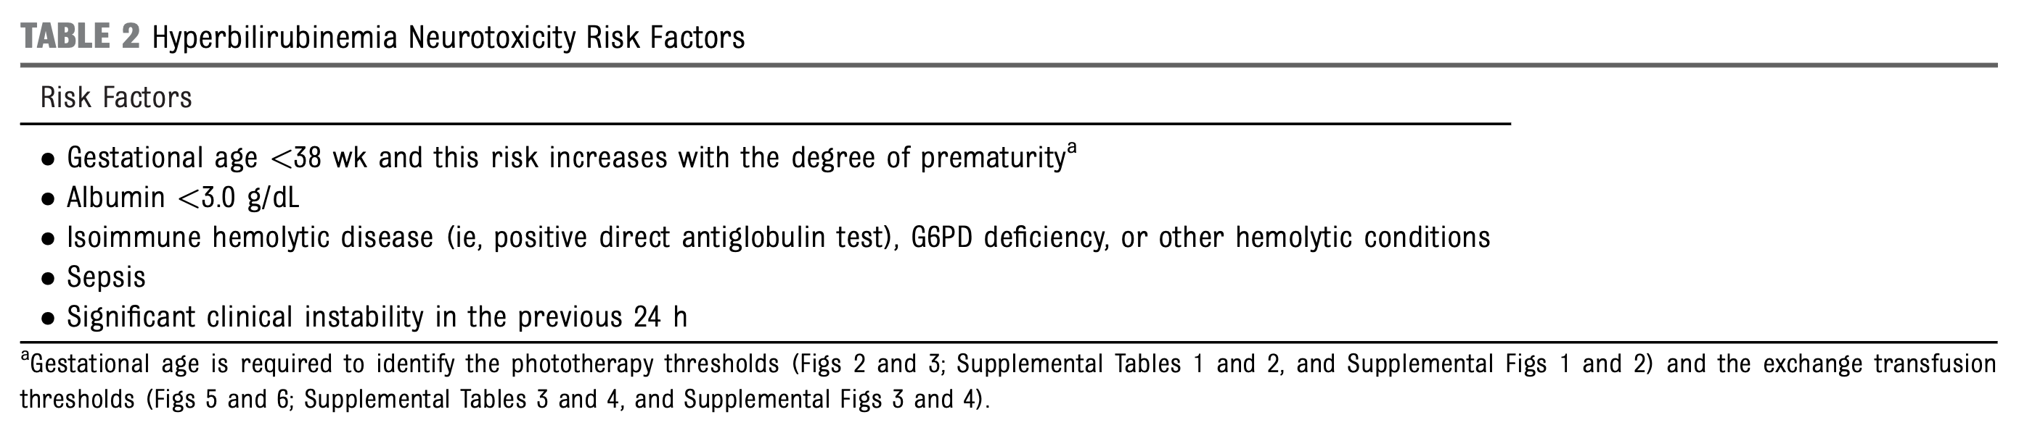
Neurotoxicity risk factors – 2022 CPG
Pediatrics, 2022
Notes:
And here they are. Hyperbilirubinemia neurotoxicity risk factors in the 2022 CPG revision are considered to be:
Gestational age <38 weeks with risk increasing with the degree of prematurity
Hypoalbuminemia with a serum albumin level of < 3.0 g/dL
Isoimmune hemolytic disease with a positive DAT, G6PD deficiency, or other hemolytic condition
Sepsis
And finally the blanket, very open to interpretation and subjective risk factor of “significant clinical instability in the previous 24 hours”

Slide 20
Key changes
2004 AAP
2022 AAP CPG
Hemolysis
Asphyxia
Significant lethargy
Temperature instability
Acidosis
Sepsis
Hypoalbuminemia (< 3.0 mg/dL)
Hemolysis
Significant clinical instability in the previous 24 hours
Sepsis
Hypoalbuminemia (< 3.0 mg/dL)
Slide adapted from AAP Project LIGHT webinar, Dr. Katie Satrom (Jan 2023)
Notes:
I adapted this slide from a presentation given by one of the AAP leaders on the new guidelines because I think it illustrates how similar but simplified the AAP has made these risk factors. Hemolysis, sepsis, and hypoalbuminemia are similar. However the new risk factor of “significant clinical instability in the previous 24 hours” takes the place of asphyxia, significant lethargy, temperature instability, and acidosis. While this does leave more open to interpretation by the individual provider, I think it simplifies things quite a bit and makes clear that even if an infant is unstable and it is from an etiology that is not specifically listed in the 2004 guidelines, they may still be at risk for neurotoxicity from hyperbilirubinemia.

Slide 21
A word about hypoalbuminemia
Unconjugated bilirubin
Lipophilic in plasma
Can cross blood brain barrier to cause bilirubin encephalopathy
Binds to albumin to increase solubility
Hypoalbuminemia (< 3.0 g/dL)
Greater proportion of serum unconjugated bilirubin is unbound
Increases risk for neurotoxicity
Not necessary to measure in all jaundiced infants
Should check as part of escalation of care
Notes:
Since hypoalbuminemia is listed as a neurotoxicity risk factor I wanted to spend just a minute or two talking about the importance of albumin in protecting from neurologic dysfunction due to hyperbilirubinemia. Recall that unconjugated bilirubin is lipophilic and thus poorly soluble in blood plasma, and because of this free albumin can cross the blood brain barrier and its neurotoxic effects can results in bilirubin encephalopathy. Unconjugated bilirubin can bind to albumin to increase its solubility.
When hypoalbuminemia is present, specifically an albumin level of less than 3 g/dL, there is a greater proportion of serum unconjugated bilirubin that is unbound and free to cross into the CNS to exert its neurotoxic effects, thereby increasing the risk for neurotoxicity. However there is insufficient evidence to recommend measuring albumin in all jaundiced infants, but an albumin should be checked as a part of escalation of care, which I’ll talk about in detail toward the end of the talk.

Slide 22
Bilirubin to albumin (B:A) ratio
Milligrams bilirubin per gram albumin
Can be used in conjunction with TSB to determine need for ET
Consider ET if B:A ratio is:
≥8.0 if GA ≥38 weeks and no NT risk factors
≥7.2 if GA ≥38 weeks and at least one NT risk factor
≥7.2 if GA 35-37 weeks and no NT risk factors
≥6.8 if GA 35-37 weeks and at least one NT risk factor
Notes:
The bilirubin to albumin ratio as milligrams of bilirubin per gram of albumin of can also be utilized to stratify risk. It should be used in conjunction with the total serum bilirubin to determine need for an exchange transfusion.
In general as the B:A ratio increases, there is progressive increased risk for neurotoxicity. However the presence or absence of risk factors as well as gestational age should be taken into account as well. For instance exchange transfusion should be considered at a B:A ratio of 7.2 in both full term infants with a neurotoxicity risk factor as well as late preterm infants with no risk factors. The threshold is the lowest for late preterm infants with a risk factor, and the threshold is highest for term infants with no risk factors.

Slide 23
Objectives
The participant should be able to:
Understand the underlying physiologic processes that place newborn infants at risk for hyperbilirubinemia
Be able to recognize hyperbilirubinemia neurotoxicity risk factors
Know when to initiate phototherapy, escalate care, and perform exchange transfusion based on the updated AAP clinical practice guideline
Notes:
Next I’ll move on to discussing knowing when to initiate phototherapy and exchange transfusion based on the new clinical practice guideline.

Slide 24
Why is this changing?
Ebbsen et al, 2012; Denmark, 2000-2007 (N=502,766 infants ≥35 weeks)
224 infants with TSB ≥26.3 mg/dL
3 cases of kernicterus – peak TSBs 38.1, 42.9, 57.1 due to ABO incompatibility (2) and G6PD deficiency
Kaiser Permanente Northern CA, 1995-2011 (N=525,409 infants ≥35 weeks)
47 infants with TSB ≥30 mg/dL
3 cases of kernicterus – peak TSBs 48.5, 49.1, 28.4 due to G6PD deficiency (2) and in utero volvulus with DIC (1)
Incidence of kernicterus: 6 / 1,028,175 = 0.0006%
Notes:
So why is this changing? Since the publication of guidelines in 2004, there have been 2 large population based studies looking at very large numbers of infants. The first study was out of Denmark and was published in 2012. It was a study of over half a million babies. 224 of those infants had a TSB over 26.3 mg/dL and only 3 of those infants went on to develop kerniceterus, with peak TSBs of 38-57, all of whom had a significant hemolytic condition – specifically ABO incompatibility or G6PD deficiency.
The other study was out of Kaiser Permanente in California. It also was a study of over half a million babies and this cohort there were 47 infants with TSB greater than 30 mg/dL. Only 3 infants went on to develop kernicterus with TSBs of 28 to 48, 2 of those were due to hemolysis due to ABO incompatibility and 1 infant was critically ill with intra-abdominal pathology.
Together these studies cover over a million infants and with only 6 cases of kernicterus, the incidence is 0.0006%. So incredibly rare.

Slide 25
Why is this changing?
Possible association between phototherapy and later development of seizures
Maimburg et al, 2006 →aHR 1.98, 95% CI 1.40-2.78 for MALES, no association for females
Newman et al, 2018 → aHR 1.22, 95% CI 1.05-1.42, higher for MALES
Notes:
There has also been some emerging evidence that phototherapy is not an entirely benign therapy. Two studies published in 2006 and 2018 have showed a possible association between phototherapy and later development of seizures. The 2006 publication showed an association for males only, and the 2018 publication showed that there was an association for both sexes, but was higher for males.

Slide 26
Why is this changing?
Conclusions
Interim evidence suggests that bilirubin neurotoxicity does not occur until TSB levels well above 2004 ET threshold
Evidence for possible harm
Concern for overtreatment
Justified raising the PT thresholds by a narrow range
Notes:
So in conclusion these studies showed that since 2004 there is emerging evidence to suggest that bilirubin neurotoxicity does not occur until TSB levels are well above the 2004 exchange transfusion thresholds, and there is emerging evidence for possible harm from phototherapy, both of which raised concerns for overtreatment. This justified raising the phototherapy thresholds by a narrow range.

Slide 27
Methodology – phototherapy curves
No neurotoxicity risk factors
40 weeks → 2022 PT threshold increased by 2 mg/dL above 2004 “low risk” threshold
35 weeks → 2022 PT threshold increased by 1 mg/dL above 2004 “medium risk” threshold
36-39 weeks → 2022 PT thresholds spaced evenly between thresholds for 35 and 40 weeks
Notes:
I’ll briefly go over the methodology that was used in making the new phototherapy and exchange transfusion threshold curves. For the curves for phototherapy and no neurotoxicity risk factors, each GA between 35-40 weeks has its own curve. For infants born at 40 weeks, the new phototherapy threshold was increased by 2 mg/dL over the 2004 low risk threshold, and for infants born at 35 weeks, the new phototherapy threshold was increased by 1 mg/dL over the 2004 medium risk threshold. For 36, 37, 38, and 39 week curves, the phototherapy thresholds were spaced evenly between the thresholds between 35 and 40 weeks.

Slide 28
Methodology – phototherapy curves
At least 1 neurotoxicity risk factor other than GA
≥38 weeks → 2022 PT threshold increased by 1 mg/dL above 2004 “medium risk” threshold
35 weeks → 2022 PT threshold increased by 1 mg/dL above 2004 “high risk” threshold
36-37 weeks → 2022 PT thresholds spaced evenly between thresholds for 35 and ≥38 weeks
Notes:
For infants with neurotoxicity risk factors, infants 38 weeks and above are grouped together, and infants born at 35, 36, and 37 weeks each have their own curves. For infants born at or above 38 weeks, the new phototherapy threshold was increased by 1 mg/dL above the 2004 medium risk threshold. For infants born at 35 weeks, the new phototherapy threshold was increased by 1 mg/dL above the 2004 high risk threshold. For infants born at 36 and 37 weeks, the phototherapy thresholds were spaced evenly between the thresholds between the other two curves.

Slide 29
Methodology – exchange transfusion curves
Difference calculated between ET and PT thresholds based on 2004 guidelines for each group
Difference added to new PT threshold in the current guideline
Notes:
For the new exchange transfusion threshold curves, the difference between the exchange transfusion and phototherapy thresholds was calculated based on the 2004 guidelines, and the difference was added to the new 2022 phototherapy threshold to get the new threshold for exchange transfusion.

Slide 30
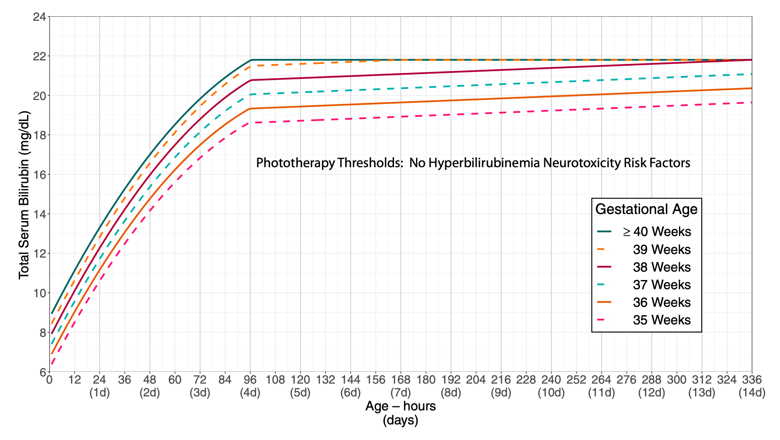
What’s new – phototherapy
Criteria for phototherapy for infants with NO neurotoxicity risk factors other than gestational age
Pediatrics, 2022
Notes:
This is the figure to use when determining criteria for phototherapy for infants with NO neurotoxicity risk factors other than gestational age. As you can see each gestational age between 35 and 40 weeks has its own threshold for phototherapy, and similar to the 2004 guidelines this threshold increases hourly until about 96 hours of life and then plateaus from there. Gestational age as a neurotoxicity risk factor is built into the graph since infants at lower gestational ages have a lower phototherapy threshold, so if gestational age is their only risk factor, you use the graphs that states no risk factors other than gestational age.

Slide 31
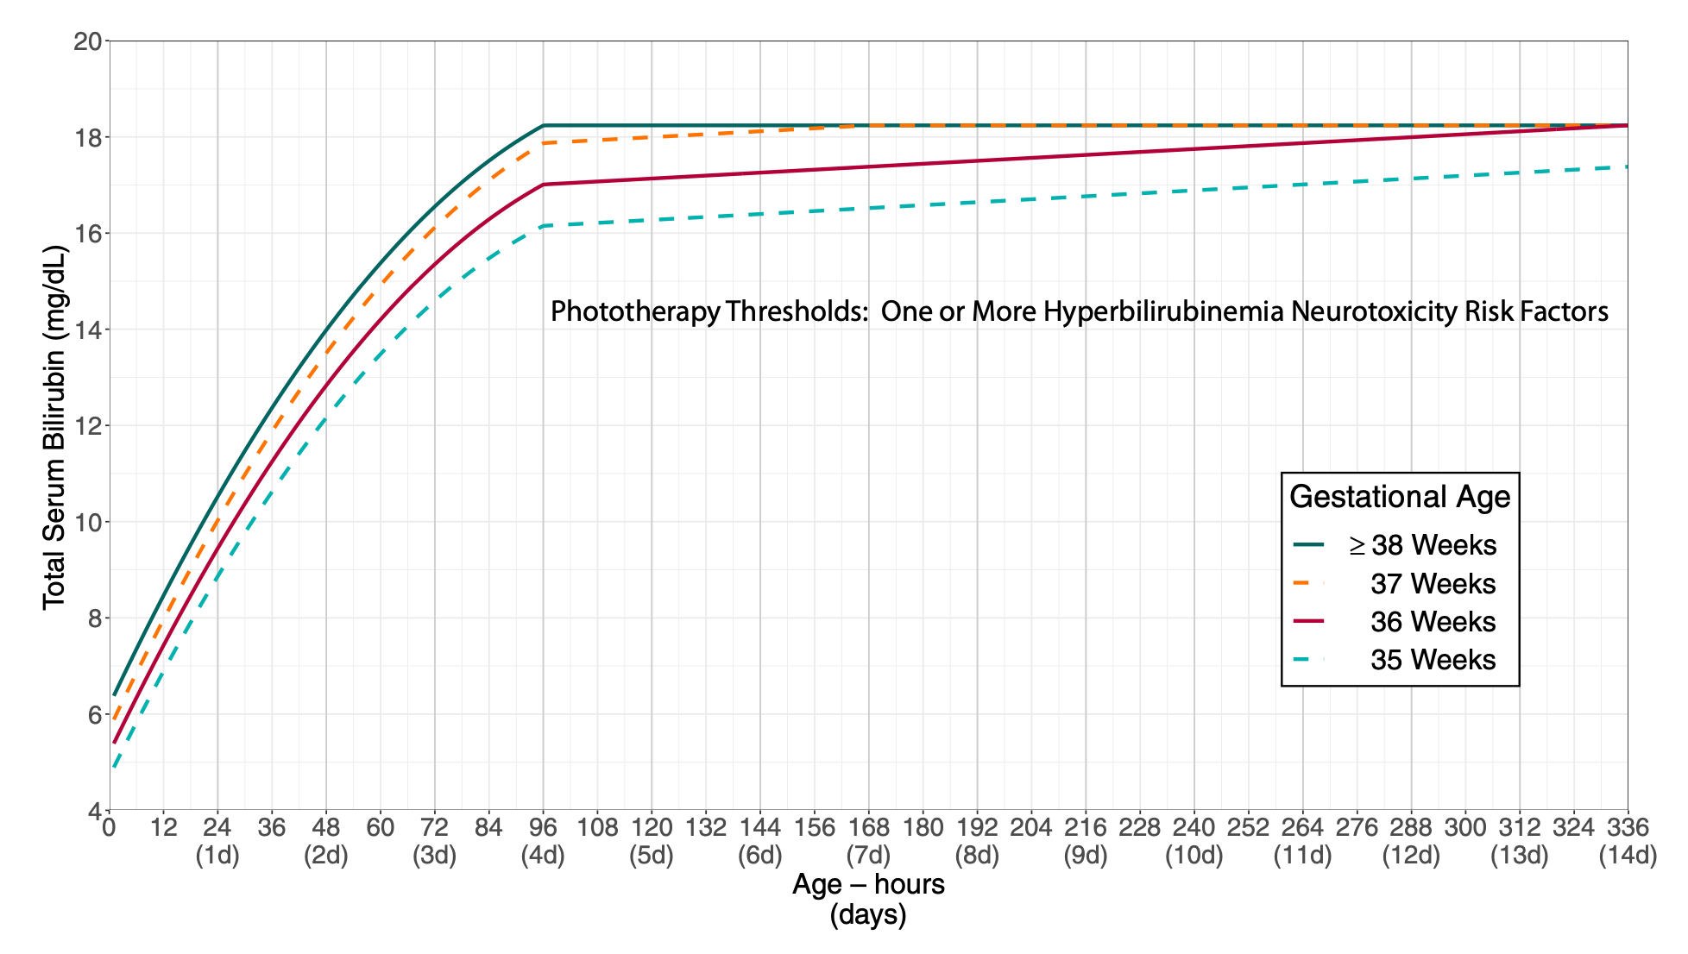
What’s new – phototherapy
Criteria for phototherapy for infants WITH neurotoxicity risk factors other than gestational age
Pediatrics, 2022
Notes:
This is the curve for criteria for phototherapy for infants with at least one other neurotoxicity risk factor other than gestational age. The infants born 38 weeks and above are grouped together, and infants born at 35-37 weeks have their own individual curve. In general the threshold for phototherapy is about 2-4 points lower for each gestational age in the setting of other neurotoxicity risk factors.

Slide 32
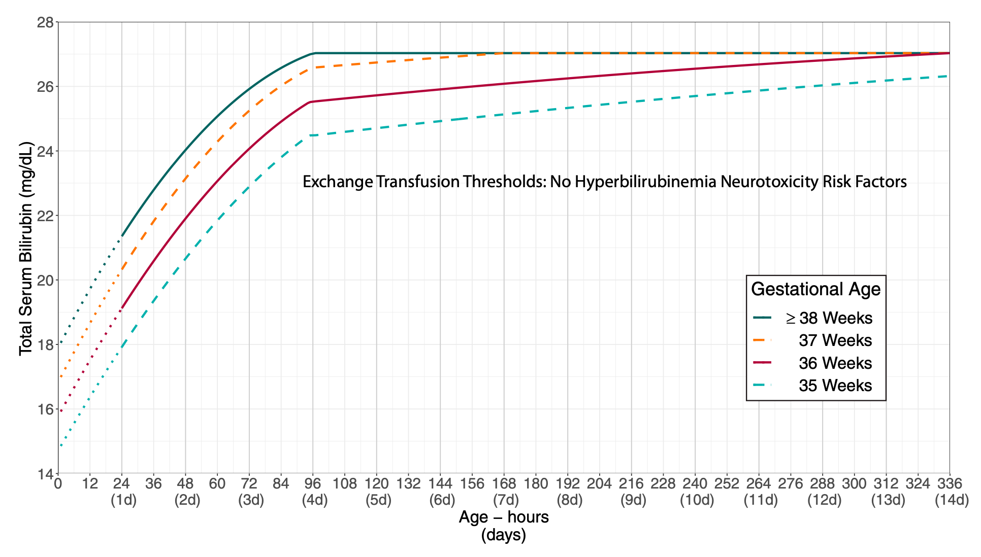
What’s new – exchange transfusion
Criteria for exchange transfusion for infants with NO neurotoxicity risk factors other than gestational age
Pediatrics, 2022
Notes:
There are 2 other similar graphs for exchange transfusion. This first graph outlines criteria for exchange transfusion for infants with no other neurotoxicity risk factors other than gestational age. Again, infants born at 38 weeks and above are grouped together and infants born at 35-37 weeks have their own individual curves.

Slide 33
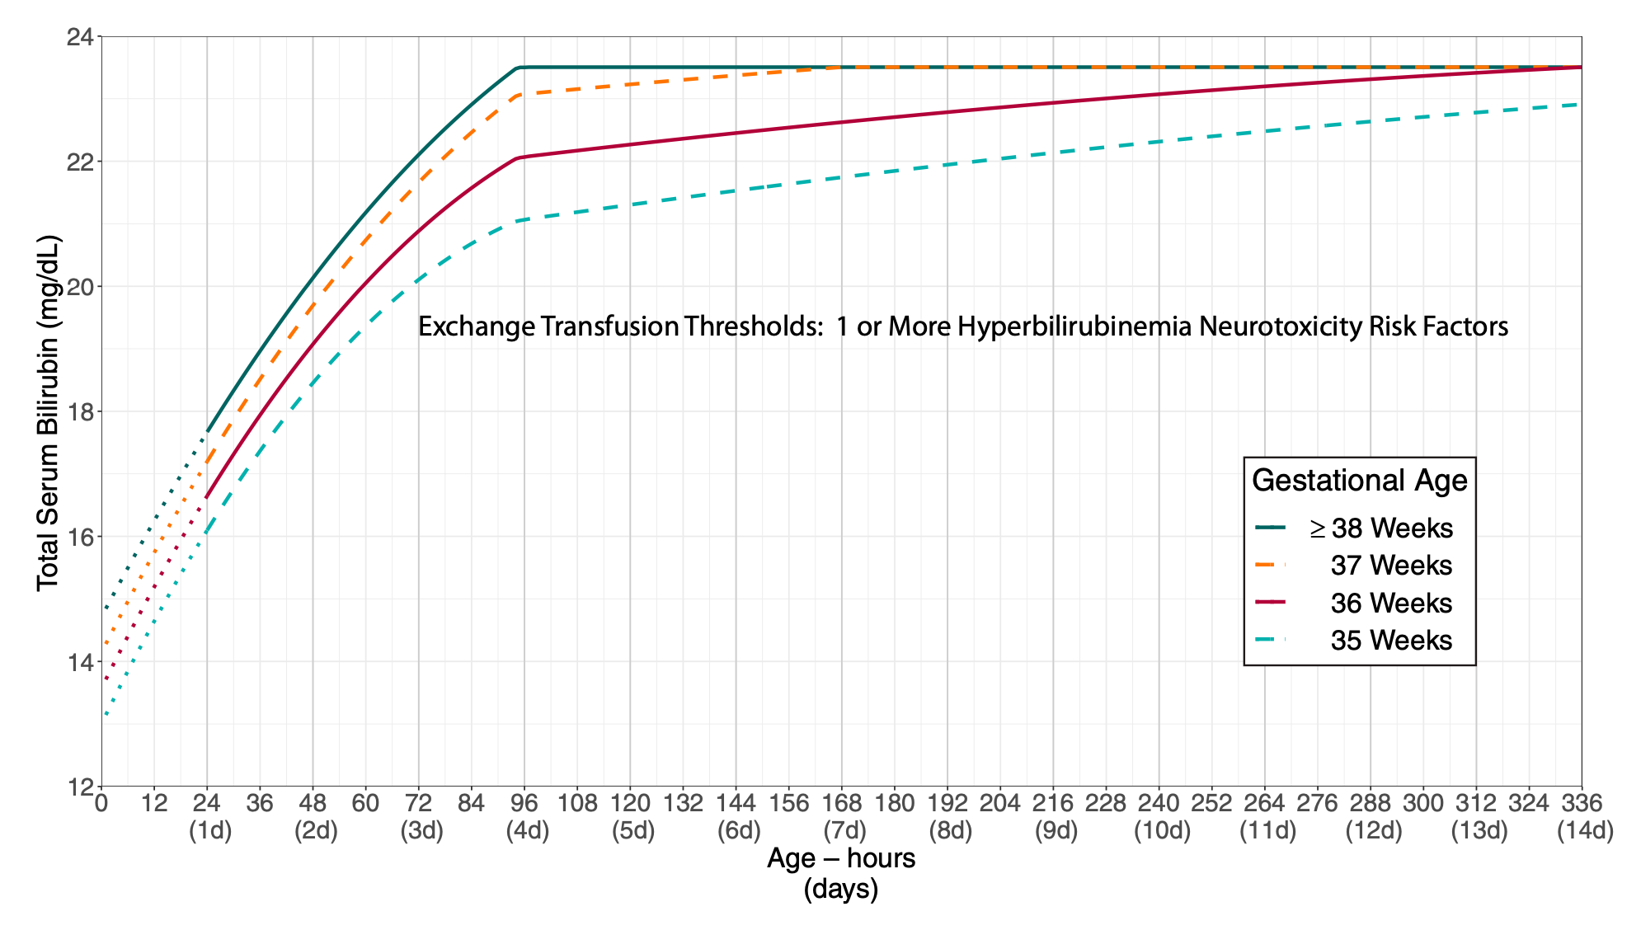
What’s new – exchange transfusion
Criteria for exchange transfusion for infants WITH neurotoxicity risk factors other than gestational age
Pediatrics, 2022
Notes:
Finally here’s the graph for criteria for exchange transfusion for infants with at least one other neurotoxicity risk factor other than gestational age. Again there is about a 3 to 4 point lower difference in criteria for exchange transfusion in infants with additional neurotoxicity risk factors, since bilirubin neurotoxicity may occur at lower TSBs in the setting of these risk factors.
You’ll also notice that in the exchange transfusion graphs, there are dotted lines for the first 24 hours for each gestational age curve. This reflects the rarity of performing an exchange transfusion in the first 24 hours of life, with little evidence to guide determination of exchange transfusion threshold. So the curves were extrapolated downward for the first 24 hours of life.

Slide 34
Escalation of care
Intensive care needed with elevated or rapidly increasing TSB
Goal is to avoid exchange transfusion and prevent CBE
Threshold is TSB within 2 mg/dL of the exchange transfusion threshold
As always – include any direct-reacting bilirubin and use TSB as the definitive test to guide management
Optimal location for management – NICU capable of performing ET if necessary
Notes:
“Escalation of care” is a new term that is included in the 2022 clinical practice guideline. It refers to intensive care that is needed with elevated or rapidly increasing bilirubin levels, with the goal of avoiding exchange transfusion and bilirubin encephalopathy. An infant meets criteria for escalation of care when their total serum bilirubin is within 2 mg/dL of the exchange transfusion threshold. As always, the total serum bilirubin should be the test to guide clinical management – so be sure to include any direct-reacting bilirubin in the bilirubin level that is being used to determine whether phototherapy, escalation of care, or exchange transfusion is necessary. The optimal location for care of an infant requiring escalation of care is in a neonatal ICU, specifically a neonatal ICU capable of performing an exchange transfusion should this become necessary.

Slide 35
Escalation of care
If infant is not at a location appropriate for ET, arrange transfer
Continue intensive PT
Continue PO and IV hydration
Labs
Complete blood count
Serum electrolytes
Serum albumin
Coombs test (DAT)
Frequent reassessment of TSB
Consider IVIG (0.5-1 g/kg) over 2 hours IF isoimmune hemolytic disease present
Unclear effectiveness
Frequent neurologic assessments
Notes:
So what to do in the event you’re taking care of an infant whose TSB is within 2 mg/dL of the exchange transfusion threshold? First and foremost, if the infant is not at a location appropriate for an exchange transfusion, prompt transfer for a higher level of care should be arranged, while at the same time continuing intensive phototherapy in addition to optimizing PO hydration and starting IV fluids. Labs that should be obtained are a CBC, serum electrolytes, a serum albumin, a DAT, and frequent reassessment of the total serum bilirubin. You can also consider IVIG if isoimmune hemolytic disease is present. Frequent neurologic assessments should also be done to evaluate for signs of developing bilirubin encephalopathy.

Slide 36
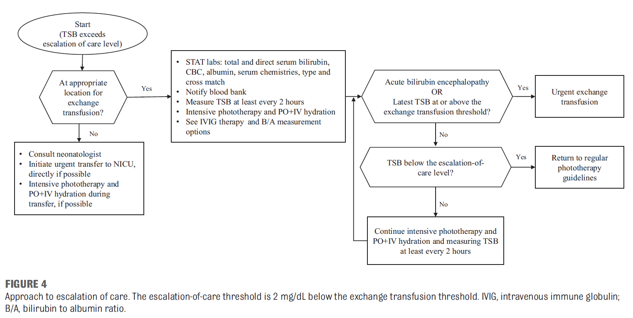
Escalation of care
Pediatrics, 2022
Notes:
The new clinical practice guideline includes a really nice flowchart for escalation of care.

Slide 37
Timing of follow up after discharge
Previous guidelines for follow up (2004 CPG, 2009 revision) – did not take into account GA, NT risk factors, excluded DAT+ infants
Use difference between TSB and PT threshold to determine timing of follow up
New process incorporates GA, NT risk factors into follow up decision making process
Notes:
Finally, I just wanted to say a brief word about timing of follow up after discharge, as this has also been modified with the 2022 clinical practice guideline. The previous guideline did not take into account gestational age or the presence of neurotoxicity risk factors, and it excluded DAT positive infants. The new guidelines take all these conditions into account since you use the difference between the TSB or TcB at the time of discharge and the phototherapy threshold, and we’ve seen how gestational age and the presence or absence of neurotoxicity risk factors are all factored into the phototherapy threshold.

Slide 38
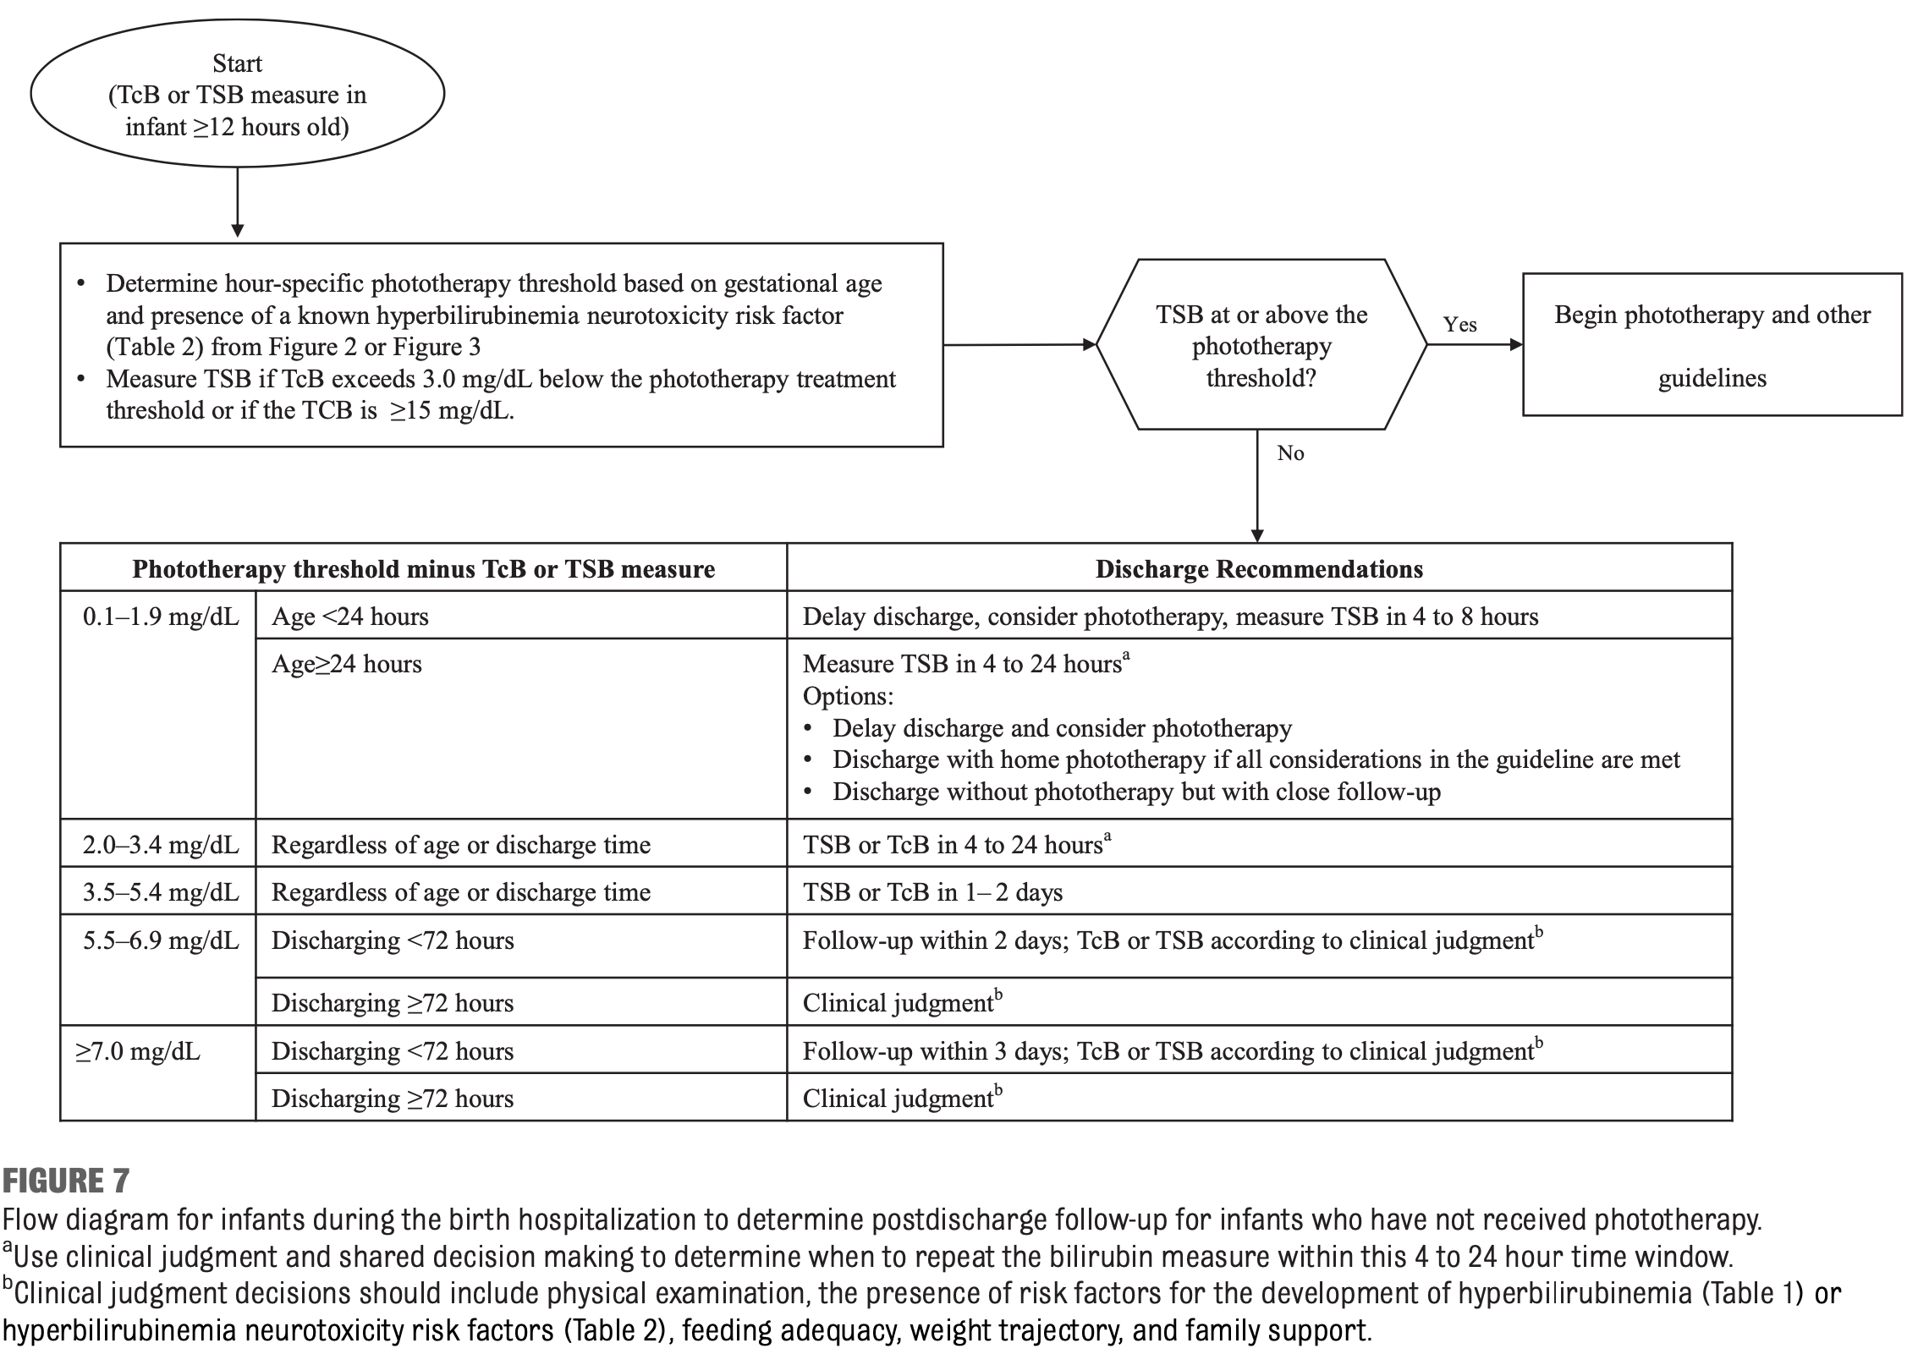
Timing of follow up after discharge
Pediatrics, 2022
Notes:
This flowchart is from the new clinical practice guideline and goes through timing of follow up for an infant being discharged with an elevated TSB or TcB.

Slide 39
Clinical case reviews

Slide 40
Case 1
You are rounding in the newborn nursery at your hospital and are examining a 6 hour old male infant born overnight at 37 weeks born by SVD. He is not jaundiced. Reviewing his mother’s chart, you note that his mother was late to prenatal care and does not have a blood type or antibody screen done. What is the most appropriate course of action?
No interventions are needed since the infant is not jaundiced
Check a CBC and TSB and repeat exam in the morning
Check blood type and DAT on the infant as soon as possible to determine risk for isoimmune hemolysis

Slide 41
Case 1
You are rounding in the newborn nursery at your hospital and are examining a 6 hour old male infant born overnight at 37 weeks born by SVD. He is not jaundiced. Reviewing his mother’s chart, you note that his mother was late to prenatal care and does not have a blood type or antibody screen done. What is the most appropriate course of action?
No interventions are needed since the infant is not jaundiced
Check a CBC and TSB and repeat exam in the morning
Check blood type and DAT on the infant as soon as possible to determine risk for isoimmune hemolysis

Slide 42
Case 1
The infant’s DAT is positive and his blood type is B positive. You discuss the mother’s history with her obstetrician and confirm that the mother did not receive Rhogam during the pregnancy and that labs drawn during labor confirmed that the mother’s blood type is O negative. Which of the following options are true?
The infant is at risk for significant hyperbilirubinemia
The infant has a neurotoxicity risk factor
The infant should have TSB’s trended in the newborn nursery
Screening for jaundice with a TcB daily is sufficient
A and D only
A, B, and C

Slide 43
Case 1
The infant’s DAT is positive and his blood type is B positive. You discuss the mother’s history with her obstetrician and confirm that the mother did not receive Rhogam during the pregnancy and that labs drawn during labor confirmed that the mother’s blood type is O negative. Which of the following options are true?
The infant is at risk for significant hyperbilirubinemia
The infant has a neurotoxicity risk factor
The infant should have TSB’s trended in the newborn nursery
Screening for jaundice with a TcB daily is sufficient
A and D only
A, B, and C

Slide 44
Screening for isoimmune hemolysis
Pediatrics, 2022

Slide 45
Case 1
You trend TSB’s in the newborn nursery and at 60 hours of life, the infant’s TSB is 12 mg/dL with a rate of rise of 0.18 mg/dL/hour. Mother is being discharged from the postpartum unit. What is the most appropriate course of action?
Delay discharge and consider PT in the nursery
Discharge infant with follow up and TSB check the next day
Discharge infant and schedule follow up with TSB check in 2-3 days
Discharge infant with scheduled follow up, but no need to recheck TSB since TSB at time of discharge is <PT threshold

Slide 46
Case 1
You trend TSB’s in the newborn nursery and at 60 hours of life, the infant’s TSB is 12 mg/dL with a rate of rise of 0.18 mg/dL/hour. Mother is being discharged from the postpartum unit. What is the most appropriate course of action?
Delay discharge and consider PT in the nursery
Discharge infant with follow up and TSB check the next day
Discharge infant and schedule follow up with TSB check in 2-3 days
Discharge infant with scheduled follow up, but no need to recheck TSB since TSB at time of discharge is <PT threshold

Slide 47
Timing of discharge for jaundiced infant
Step 1: Determine if there are neurotoxicity risk factors (in this case, YES)
Step 2: Determine PT threshold based TSB and age in hours (in this case, threshold is 15 mg/dL)
Step 3: Calculate difference between PT threshold and TSB (in this case, 3 mg/dL)

Slide 48
Timing of discharge for jaundiced infant
Step 4: Consult AAP clinical practice guideline

Slide 49
Case 2
You are seeing a 4 day (96 hour) old female infant who was born at 36 weeks due to maternal pre-eclampsia and gestational diabetes. Vacuum extraction was required with a resulting cephalohematoma. The infant was discharged from the nursery at 2 days (48 hours) of life, with a screening TcB of 14 mg/dL at the time of discharge. Maternal serologies were negative and mom is AB positive blood type, with a negative antibody screen. There are two other older siblings who required inpatient hospitalization for phototherapy. On exam, the infant is quite jaundiced but otherwise clinically well. She is exclusively breast feeding, and mom is worried her milk supply has not come in yet. Yesterday the baby only made 2 wet diapers. Which of the following are risk factors for significant hyperbilirubinemia?
Gestational age of 36 weeks
Infant of a diabetic mother
History of siblings requiring phototherapy
Maternal AB positive blood type
Female sex
Vacuum extraction with cephalohematoma
Exclusive breast feeding with suboptimal intake
Screening TcB at 48 hours of life

Slide 50
Case 2
You are seeing a 4 day (96 hour) old female infant who was born at 36 weeks due to maternal pre-eclampsia and gestational diabetes. Vacuum extraction was required with a resulting cephalohematoma. The infant was discharged from the nursery at 2 days (48 hours) of life, with a screening TcB of 14 mg/dL at the time of discharge. Maternal serologies were negative and mom is AB positive blood type, with a negative antibody screen. There are two other older siblings who required inpatient hospitalization for phototherapy. On exam, the infant is quite jaundiced but otherwise clinically well. She is exclusively breast feeding, and mom is worried her milk supply has not come in yet. Yesterday the baby only made 2 wet diapers. Which of the following are risk factors for significant hyperbilirubinemia?
Gestational age of 36 weeks
Infant of a diabetic mother
History of siblings requiring phototherapy
Maternal AB positive blood type
Female sex
Vacuum extraction with cephalohematoma
Exclusive breast feeding with suboptimal intake
Screening TcB at 48 hours of life

Slide 51
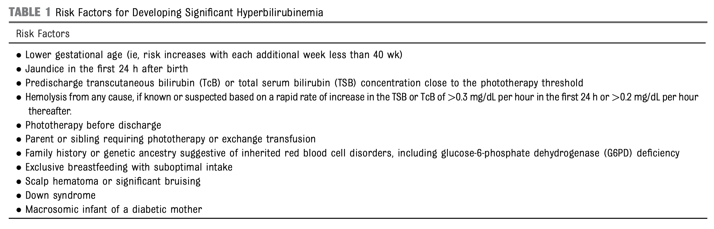
Risk factors for significant hyperbilirubinemia
Pediatrics, 2022

Slide 52
What about her discharge TcB?
First step is to determine if there are neurotoxicity risk factors (in this case, NO)
Determine PT threshold based on TcB and age in hours (in this case, threshold at time of discharge was approx. 15)

Slide 53
Case 2
You appropriately check a TSB on the female infant and it is 21 mg/dL. What is the most appropriate course of action?
Recommend formula supplementation while maternal milk supply is low and recheck TSB in 24 hours
Prescribe home phototherapy
Admit the patient to the hospital for intensive phototherapy
Admit the patient, start phototherapy, administer IVIG and IV fluids
Request transport to Children’s for exchange transfusion

Slide 54
Case 2
You appropriately check a TSB on the female infant and it is 21 mg/dL. What is the most appropriate course of action?
Recommend formula supplementation while maternal milk supply is low and recheck TSB in 24 hours
Prescribe home phototherapy
Admit the patient to the hospital for intensive phototherapy
Admit the patient, start phototherapy, administer IVIG and IV fluids
Request transport to Children’s for exchange transfusion

Slide 55
Case 2
Use PT/ET thresholds for NO neurotoxicity risk factors
Infant DOES qualify for PT so choice A is incorrect
TSB is NOT within 2 mg/dL of ET threshold (25.5 mg/dL) so escalation of care (choice D) is not correct
TSB is NOT at/above ET threshold so choice E is not correct
PTT: 19 mg/dL
ETT: 25.5 mg/dL

Slide 56
A brief word about home phototherapy
Infant must meet ALL criteria
Gestational age 38 weeks or greater
>48 hours old
Clinically well with adequate feeding
No known neurotoxicity risk factors
No previous phototherapy
TSB no more than 1 mg/dL above PT threshold
LED-based home PT device available without delay
TSB can be measured daily

Slide 57
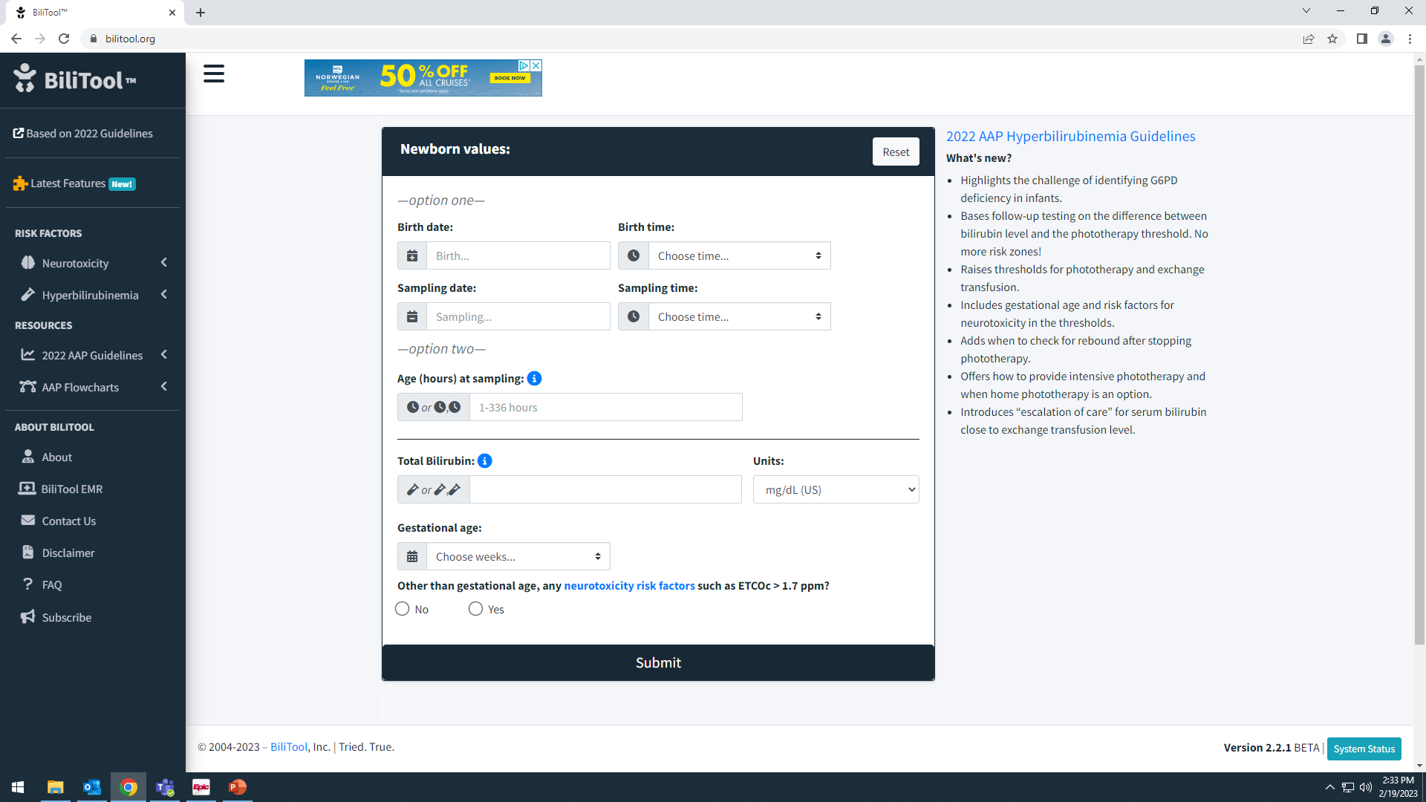
BiliTool 2.0 (http://www.bilitool.org)
bilitool.org, 2023

Slide 58
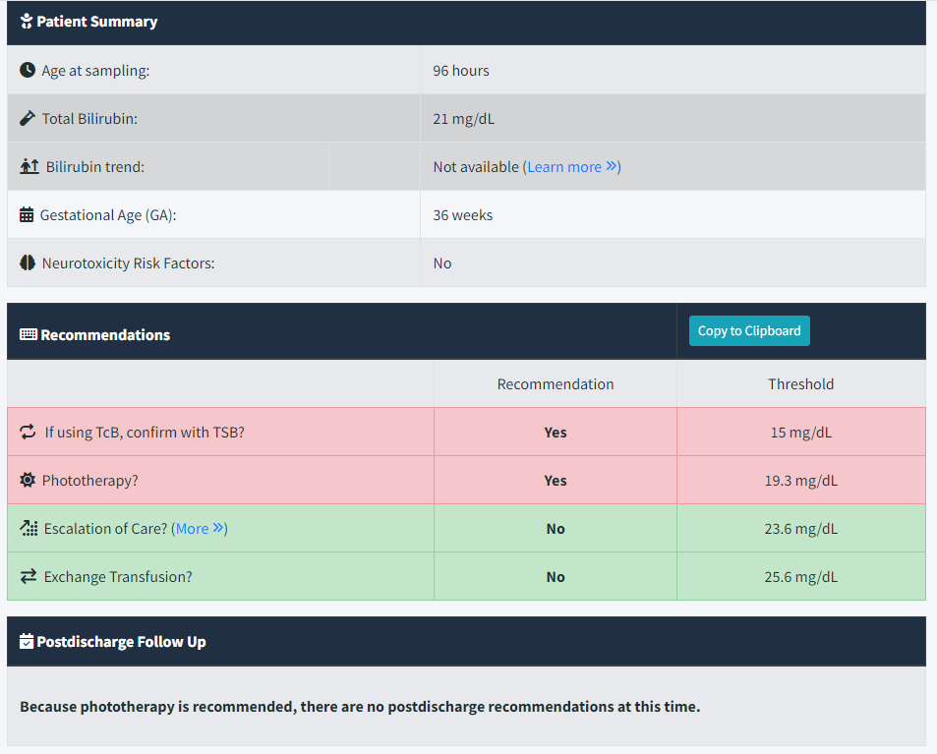
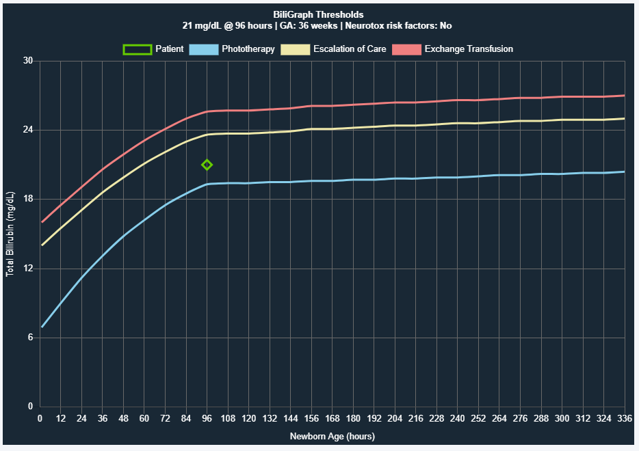
BiliTool 2.0 (http://www.bilitool.org)
From Case 2:
bilitool.org, 2023

Slide 59
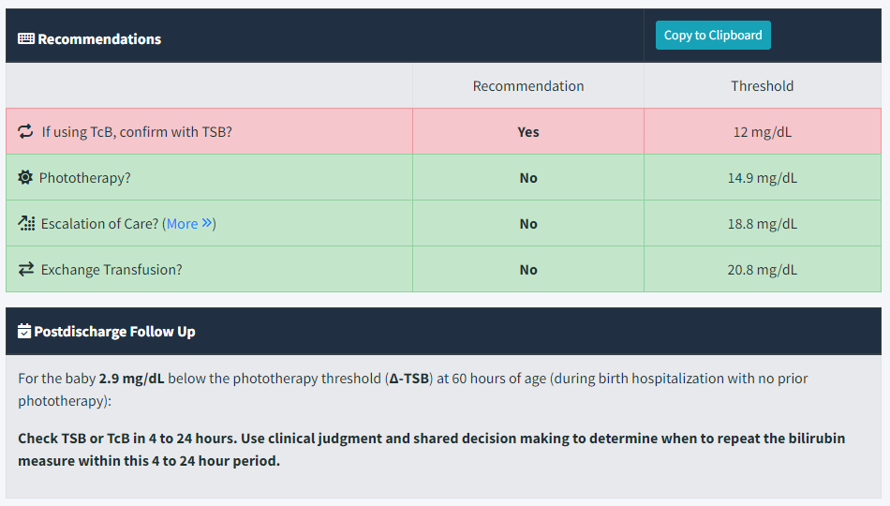
BiliTool 2.0 (http://www.bilitool.org)
From Case 1 – post-discharge follow-up
bilitool.org, 2023

Slide 60

Take home points
First and foremost – please start to use the 2022 guidelines if you are not yet doing so!
Information needed to determine PT and ET thresholds – GA, age in hours, and +/- neurotoxicity risk factors
Recognition of neurotoxicity risk factors is extremely important as this guides which threshold curve to use to determine need for PT or ET
Avoid sub-threshold phototherapy as it is not a completely benign therapy
Avoid IV fluid use unless escalation of care is needed or infant is obviously dehydrated – focus on optimizing enteral intake
If infant meets escalation of care threshold (TSB within 2 mg/dL of ET threshold) and you are not located in a place capable of ET, call Children’s neonatologist to discuss transfer

