Slide 1
Hyperbaric Oxygen as an adjunct in Treatment for Refractory Osteomyelitis
Luris c De Calero, MD
Advanced wound care center chi health

Slide 2
OSTEOMYELITIS
Infection of bone or bone marrow caused by pyogenic bacteria or mycobacteria.

Slide 3
Chronic Osteomyelitis
Clinical Signs
Laboratory evaluation
-Chronic wound overlying surgical hardware
-Chronic wound overlying traumatic injury or fracture
-Exposed bone
-Persistent sinus tract
Tissue necrosis overlying bone
Elevated CRP
Elevated Sed rate
Leukocytosis

Slide 4
Initial Treatment for Osteomyelitis
Surgical debridement
Removal of sequestrate and resection of infected bone and soft tissue to improve the healing potential of the remaining healthy tissue.
Culture directed antibiotics.
Most common causing bacteria: Staphylococcus aureus

Slide 5
Treatment for Chronic Refractory Osteomyelitis
Surgical debridement
Culture directed Antibiotics
Hyperbaric Oxygen Therapy
Intelligent debridement of bone biofilm and necrotic tissue
Bone culture preferred
As an adjuvant to bone debridement and appropriate antibiotics.
Studies show that addition of HBOT to routine surgical and antibiotic management is safe and improves the rate of infection resolution
Notes:
To date, no randomized clinical trials examining the effects of HBO₂ therapy on refractory osteomyelitis exist. However, the substantial majority of available animal data, human case series and non-randomized prospective trials suggest that the addition of Hyperbaric Oxygen (HBO₂) therapy to routine surgical and antibiotic management in previously refractory osteomyelitis is safe and improves the ultimate rate of infection resolution

Slide 6

HISTORY OF HYPERBARIC OXYGEN THERAPY
Notes:
In the medical world compressed air was used for may diseases and for performing surgery. This is the c sanitorium. Dr Cunningham treated a mr timkin for uremia and mr timkin buithe steel ball hospital, the lagest hyperbaric chamber ever contructed in Cleveland oio, accommodated a smoking room, plush carpeting, six stories high, dining rooms with white tablecloths, ndividual roms. Due to lack of scientific evidence for his ationale his was forced to close down in 1930, broken up fr scrap metal in WW2.

Slide 7
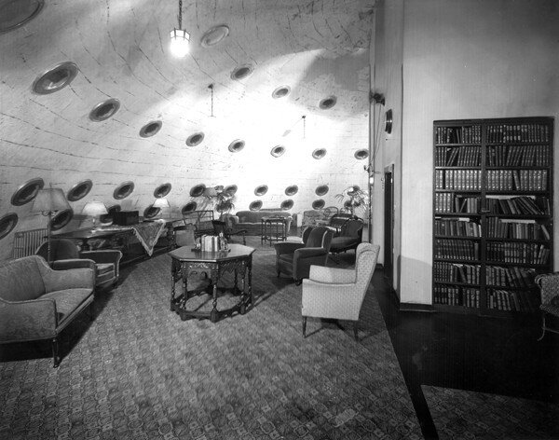

Notes:
This unusual sphere was both an early hyperbaric hospital and a 900 ton monument to the dangers of unscientific medicine. Was pressurized to 60 PSI that promised to cure a broad range of maladies including diabetes, pernicious anemia and cancer

Slide 8
Hyperbaric Oxygen Therapy
Exposure to pure concentrations of O2 in an augmented atmospheric pressure.
Consist in breathing 100 percent oxygen at 2 to 3 times the atmospheric pressure at sea level that results in arterial oxygen tension in excess of 2000 mmHg and oxygen tension in tissue of almost 400 mmHg., in a chamber similar to an MRI chamber
The therapy is delivered once daily, five days/week, 90-120 minutes, using 2.0-2.4 atmospheres absolute (ATA) pressure for 20-40 sessions

Slide 9
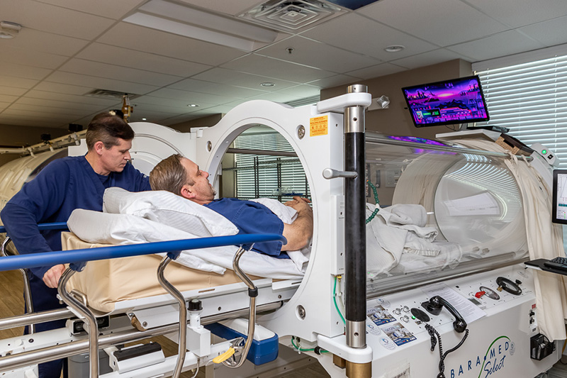

Slide 10

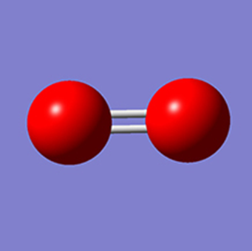
The air we breath Composition
Nitrogen: 78.08%
You inhale sextillion
molecules with each
breath
Oxygen: 20.95%

Slide 11
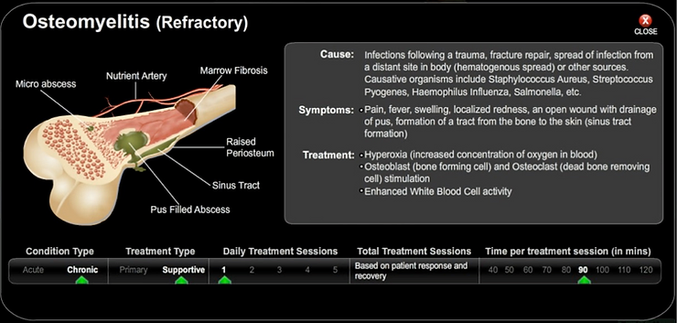

Slide 12
MECHANISMS OF ACTION OF HBO IN OSTEOMYELITIS
RAISES THE TISSUE OXYGEN TENSION
ENHANCES LEUKOCYTE PHAGOCYTIC MECHANISMS IN BONES AND WOUNDS WITH LOW OXYGEN TENSION
OPTIMAL OXYGEN TENSION ENHANCES OSTEOGENESIS AND NEOVASCULARIZATION

Slide 13
Mechanisms of action
ENHANCES OSTEOCLASTIC ACTIVITY TO REMOVE BONY DEBRIS
Exert a direct suppressive effect on anaerobic infections
Helps to augment the transport of some antibiotics across bacterial cell walls
Notes:
Aminoglycoside transport across the bacterial cell wall is both oxygen-dependent and impaired in a hypoxic environment. More specifically, active transport of antibiotics (e.g. gentamicin, tobramycin, amikacin) across bacterial cell walls does not occur if tissue oxygen tensions are below 20 to 30 mmHg.⁽¹²⁾ Therefore, HBO₂ exposures can enhance the transport and augment the efficacy of antibiotic action.⁽¹²⁻¹⁴⁾ This synergistic effect has also been shown for the cephalosporin class of antibiotics, where the combination of cefazolin and HBO₂ therapy produced a 100-fold greater reduction in bacterial counts than either antibiotics or HBO₂ therapy alone.

Slide 14
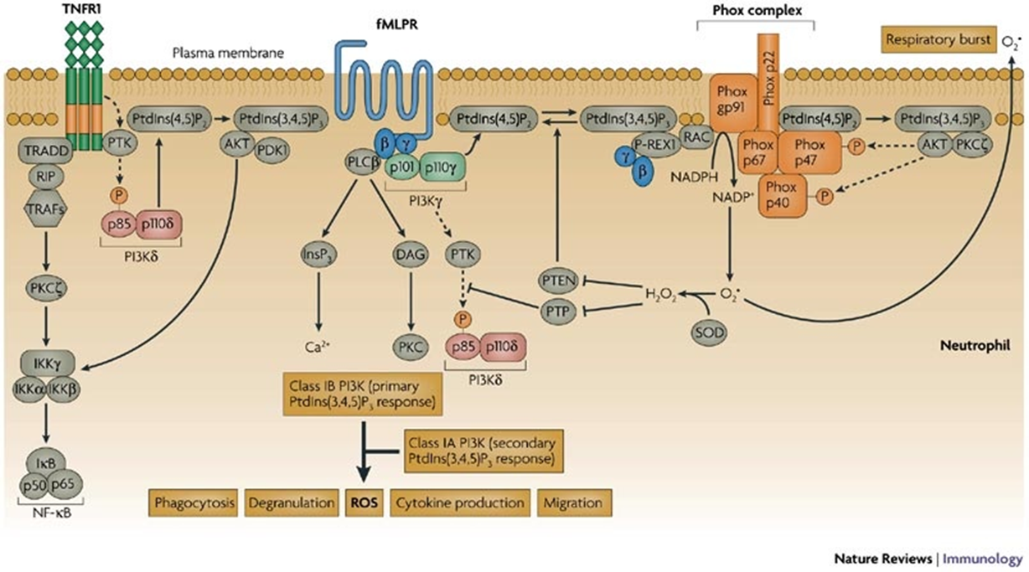
Enhanced Leukocyte Activity Oxygen is an antibiotic
Notes:
Oxygen through production of reactive oxygen species is essential to resist infection.
All kinds of leukocytes use oxygen and change it to ROS All wound cell types , phagocytic and non phagocytic neutrophils macrophages, fibroblasts, endothelial cells, however polymrphoneuclear leukocytes seem to provide most of the action,these professional cells kill almost all wound pathogens by engulfing them and exposing them to ROS
ROS act in conjunction with several redox systems and play cetral roles in coordinating cell signaling for a variety of growth factors, cytokines and hormones
In the wound area leukocytes are primed for greater activaion by exposure to complement, antibody opsonized bacteria, when they ingest dbris bacteria they become fully activated,
An enzyme complex NADPH oxidase or phox is assembled form preexisting componenets in the cell. It then begins a rapid increase in the cells consumption of molecular oxygen as much as fifty fold during which almost all consumed oxgen is converted to superoxide and then to other ROS This is alled the oxidative or respiratory burst.
The rough equation the sum of several for the oxidative burst is . This reaction proceeds at a rate proportional to local concentration of oxygen. When xygen tension is low the cells loose their power to kill bacteria
Tissue hypoxia is probably the most signifcant background for vulnerability to wound infection
ROS for phagocytosis as well as cytokine and growth factors and cell migration needed for repair of tissue
Oxygen as an antibiotic is title of paper by dr Hun and Knighton, shows that

Slide 15
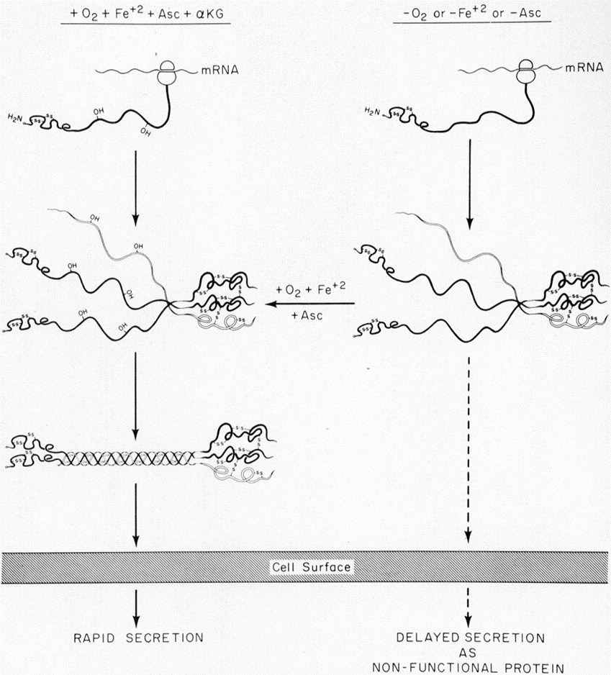
Oxygen and collagen synthesis
Notes:
Central to ound healing is granulation tissue matrix to support new blood vessel growth .
The cell is fibroblast

Slide 16
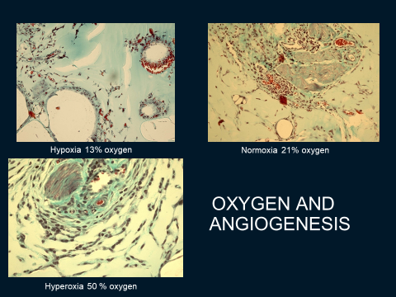

Slide 17
Outocome of HBOT for Chronic Osteomyelitis
A Systematic Review of the Literature
96 references.
460 patients with chronic osteomyelitis met the inclusion criteria
All 460 patients received antibiotics and surgical debridement
Staph aureus : 60% of patients
Adjuvant HBOT was effective in 80% of the 20 cohort and 95% of the case studies.
Overall 308 (73.5%) of 419 pts had successful outcome and no reported relapse

