Slide 1
Steatotic liver disease
Sandeep Mukherjee,MD
CHI Health Creighton University
Division of Gastroenterology

Slide 2
Disclosures
Section editor: Dynamed Plus

Slide 3
Objectives
Updated definitions for steatotic liver disease
Why is MASLD important?
Epidemiology
Etiology and risk factors
Natural history
Pathophysiology
Diagnosis-invasive vs non-invasive
Treatment-current and future
Summary

Slide 4
Revised classification of Steatotic liver disease
STEATOTIC LIVER
DISEASE
MASLD
MASH
Met-ALD
Metabolic dysfunction associated steatotic liver disease (hepatic steatosis + >1 cardiometabolic risk factor)
Metabolic dysfunction associated steatohepatitis
Metabolic associated alcoholic liver disease (MASLD + >210 g alcohol (M) or 140g (F) per week

Slide 5
Why is MASLD important?
Most common cause of elevated liver tests in United States (20-30% of population have MASLD)
Risk factors: obesity, metabolic syndrome
Advanced fibrosis (MASH) can occur in patients with risk factors with NORMAL liver tests
1 in 5 (20%) MASLD patients have MASH
1 in 25 MASH (4%) patients progress to advanced fibrosis/cirrhosis
MASH is one of the leading indications for liver transplantation in the United States
Lean patients can also develop steatotic liver disease
Remember: MASH with advanced fibrosis associated with increased mortality (non-liver and liver related)

Slide 6
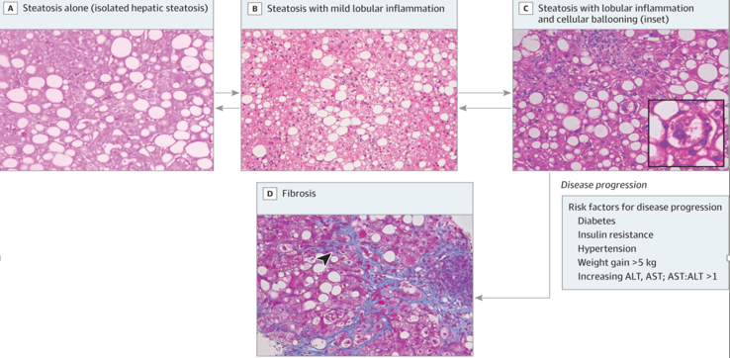
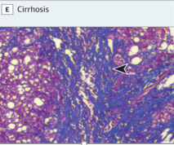
Pathology of MASLD and MASH
Rinella ME.Nonalcoholic Fatty Liver Disease A Systematic Review. JAMA. 2015;313:2263-2273

Slide 7


Slide 8
Epidemiology
Prevalence of obesity increasing in developed (29 to 37%) and developing countries (8-13%) from 1980-2013
Paralleled by increasing prevalence of NAFLD –influenced by screening test
e.g. 30% by MRI in Dallas Heart study 2004; 46%
by ultrasound 2011
Prevalence of MASH more challenging as biopsy historically required …
USA: 12% prevalence in middle aged patients, 56-69% if diabetes present and advanced fibrosis in 37-50%
Bazick J et al. Clinical model for NASH and advanced fibrosis in adult patients with diabetes and NAFLD/ Diabetes Care 2015;38:1347-55

Slide 9
Epidemiology
Prevalence of both MASLD and MASH underestimated in the United States
Up to 100 million adults may have MASLD and up to 25 million with MASH
Approximately 750,000 have stage 2 or higher fibrosis (scale from 0-4; 4 is cirrhosis)
Rinella ME.Nonalcoholic Fatty Liver Disease A Systematic Review. JAMA. 2015;313:2263-2273

Slide 10
ETIOLOGY AND RISK FACTORS

Slide 11
Etiology and risk factors
Most common: obesity and insulin resistance
Can MAFLD/MASH occur in patients with a normal BMI?
Younger patients, not obese, elevated liver tests and fatty liver on imaging……. think outside the box
Ye Q, et al. Global prevalence, incidence, and outcomes of non-obese or lean non-alcoholic fatty liver disease: a systematic review and meta-analysis. Lancet Gastro Hepatology 2020: 5:739-52

Slide 12
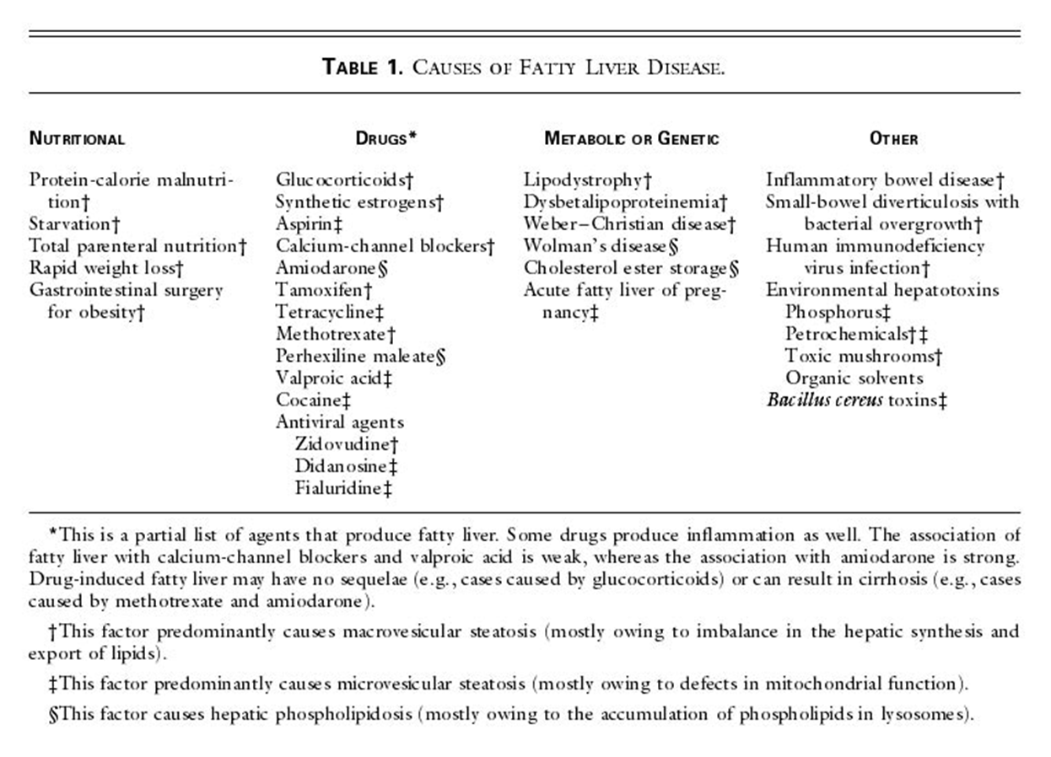
Angulo P. Non alcoholic fatty liver disease. NEJM 2002;346:1221-31

Slide 13


Slide 14
Natural history
Good news and bad news…
Good news-vast majority of MASLD patients progress slowly or not at all
70-75% with MASLD have isolated steatosis +/- inflammation
Steatosis only: zero to minimal progression
Steatosis +/- inflammation: some will progress but much longer than biopsy proven MASH

Slide 15
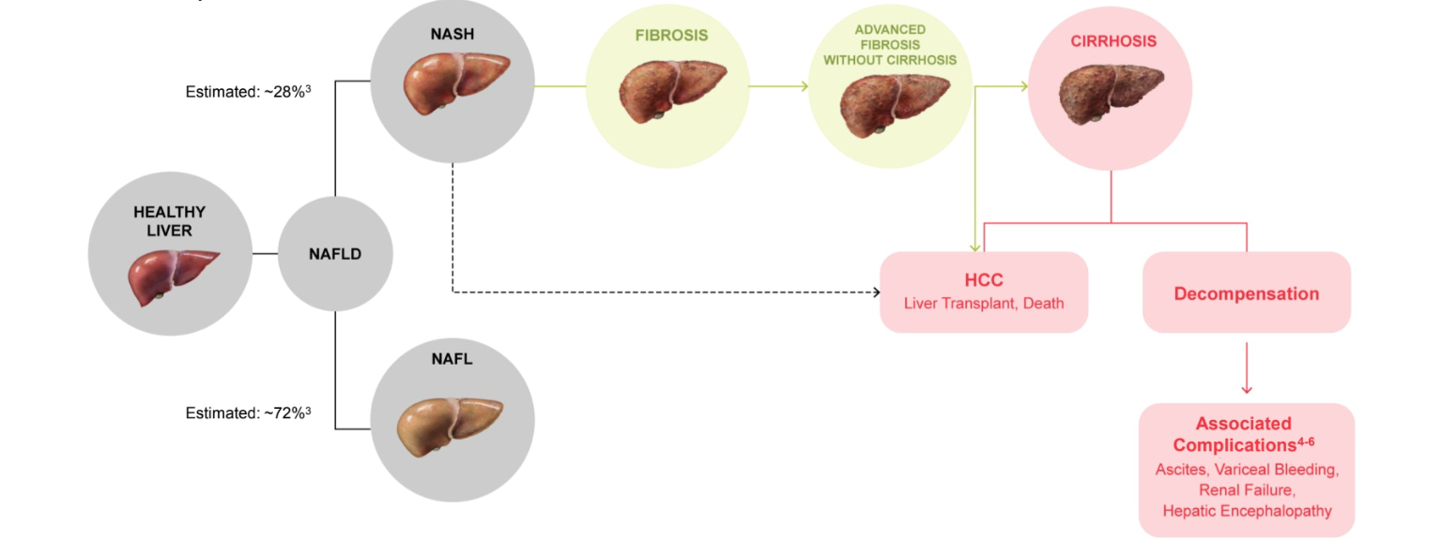
Natural history

Slide 16
Natural history
MASH patient with fibrosis at baseline: different prognosis
Fibrosis progresses by 1 stage every 7 years but may be an under-estimate
33 year follow-up study from Sweden; fibrosis was a strong predictor of
(1) overall mortality
(2) cardiovascular disease
(3) infectious disease
(4) cirrhosis
(5) hepatoma
One of the most common indications for liver transplantation in US
Ekstedt M, et al. Fibrosis stage is the strongest predictor for disease specific mortality in NAFLD after up to 33 years of follow up. Hepatology 2015;61:1547-54
Wong RJ, et al. NASH is the second leading etiology of liver disease among adults awaiting liver transplantation in the US. Gastroenterology 2015;149:278-81

Slide 17
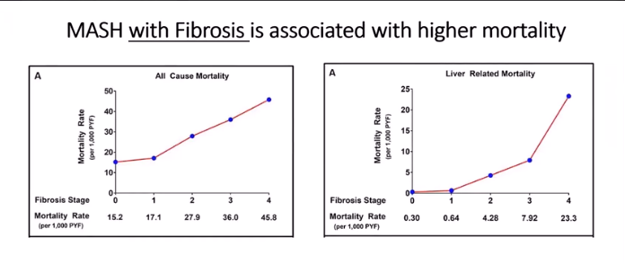
Advanced fibrosis and mortality
Dulai et al .Increased risk of mortality by fibrosis stage in nonalcoholic fatty liver disease. Hepatology 2017;65: 1557-65

Slide 18
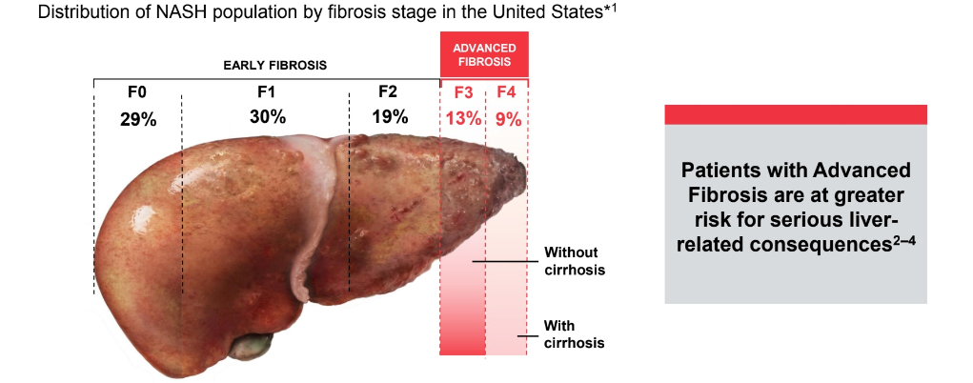
Advanced fibrosis from MASH-smaller subset but higher risk for complications from liver disease
Sanyal AJ, et al. NEJM 2021;385:1559-69

Slide 19
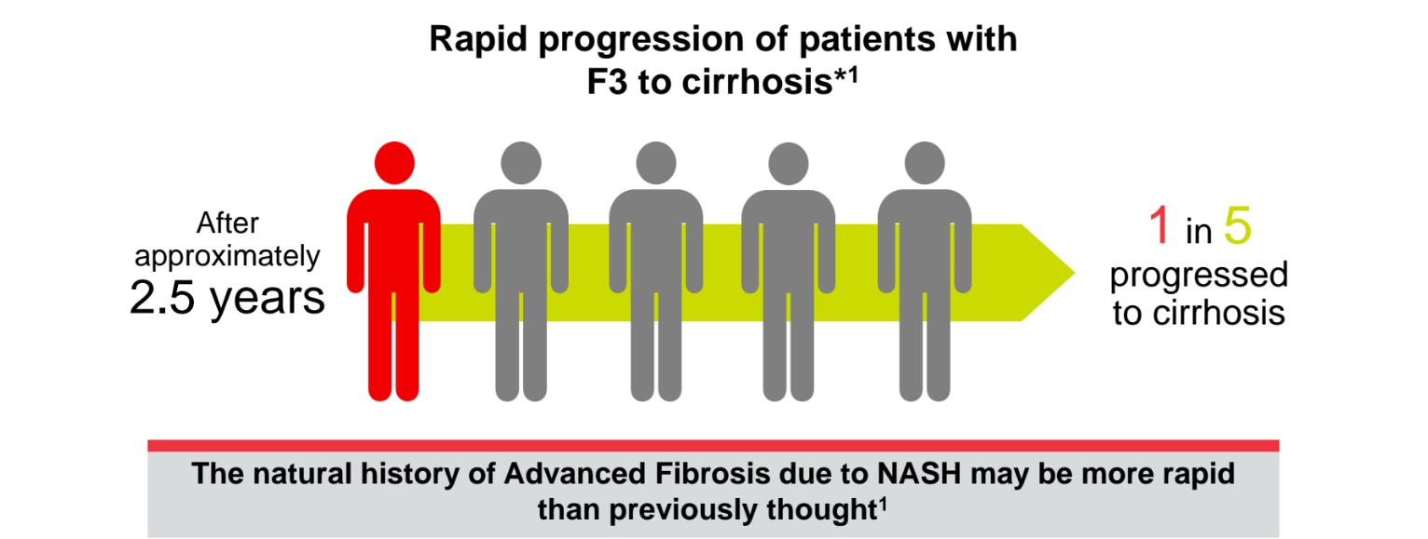
Natural history
Sanyal AJ, et al. Hepatology 2019;70:1913-27

Slide 20
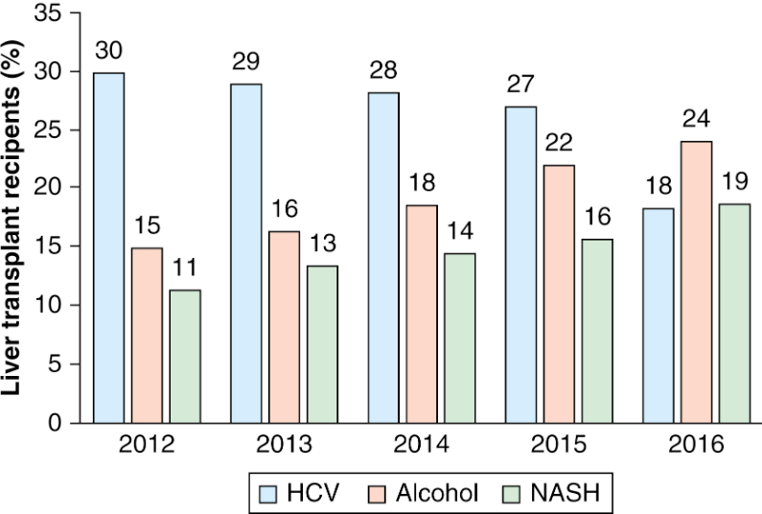
Leading indications for liver transplantation in the United States 2012-2016
Cholankeril G, et al. Alcoholic liver disease replaces hepatitis C virus infection as the leading indication for liver transplantation in the United States. Clin Gastroenterol Hepatol 2018;16:1356-8

Slide 21
PATHOPHYSIOLOGY

Slide 22
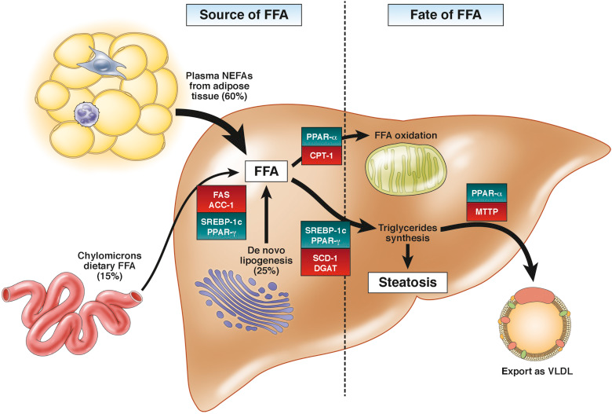
Pathophysiology of NASH
At the adipocyte level, metabolic dysregulation due to impaired insulin postreceptor signaling leads to excess lipolysis of triglycerides (TGs) and NEFA release into the circulation. Albumin-bound NEFAs are delivered to the liver. Hepatocyte NEFA uptake is mediated by fatty acid transport proteins, cluster of differentiation 36 (CD36), caveolins, and to a lesser extent passive diffusion. De novo lipogenesis (DNL) from glucose and fructose occurs in the hepatocytes and is increased in subjects with NAFLD.9Unlike glucose, entry of fructose metabolites into the DNL pathway is not regulated by glycolysis.Fructose also induces the carbohydrate response element binding protein independent of insulin and promotes hepatic steatosis. The predominant fate of NEFAs in the liver is to either undergo mitochondrial beta-oxidation or be esterified to form TGs. Partitioning of NEFAs into other lipid classes, such as phospholipids and ceramides, is also increased by enhanced NEFA influx into the liver. TG synthess, a relatively inert storage form, appears to be an adaptive mechanism to protect the liver from toxic lipids. TGs can be exported as VLDLs or stored as lipid droplets. Lipolysis of these droplets releases NEFA back into the hepatic pool, and the regulation of this step is important in the pathogenesis of NASH.

Slide 23
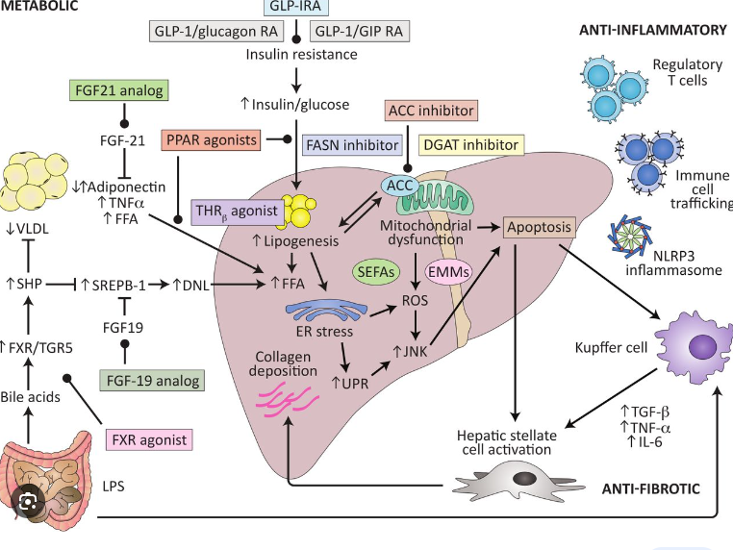
Pathophysiology of NASH
Konerman MA et al. Pharmacotherapy for NASH: current and emerging. J Hepatol 2018;68:362–75.

Slide 24
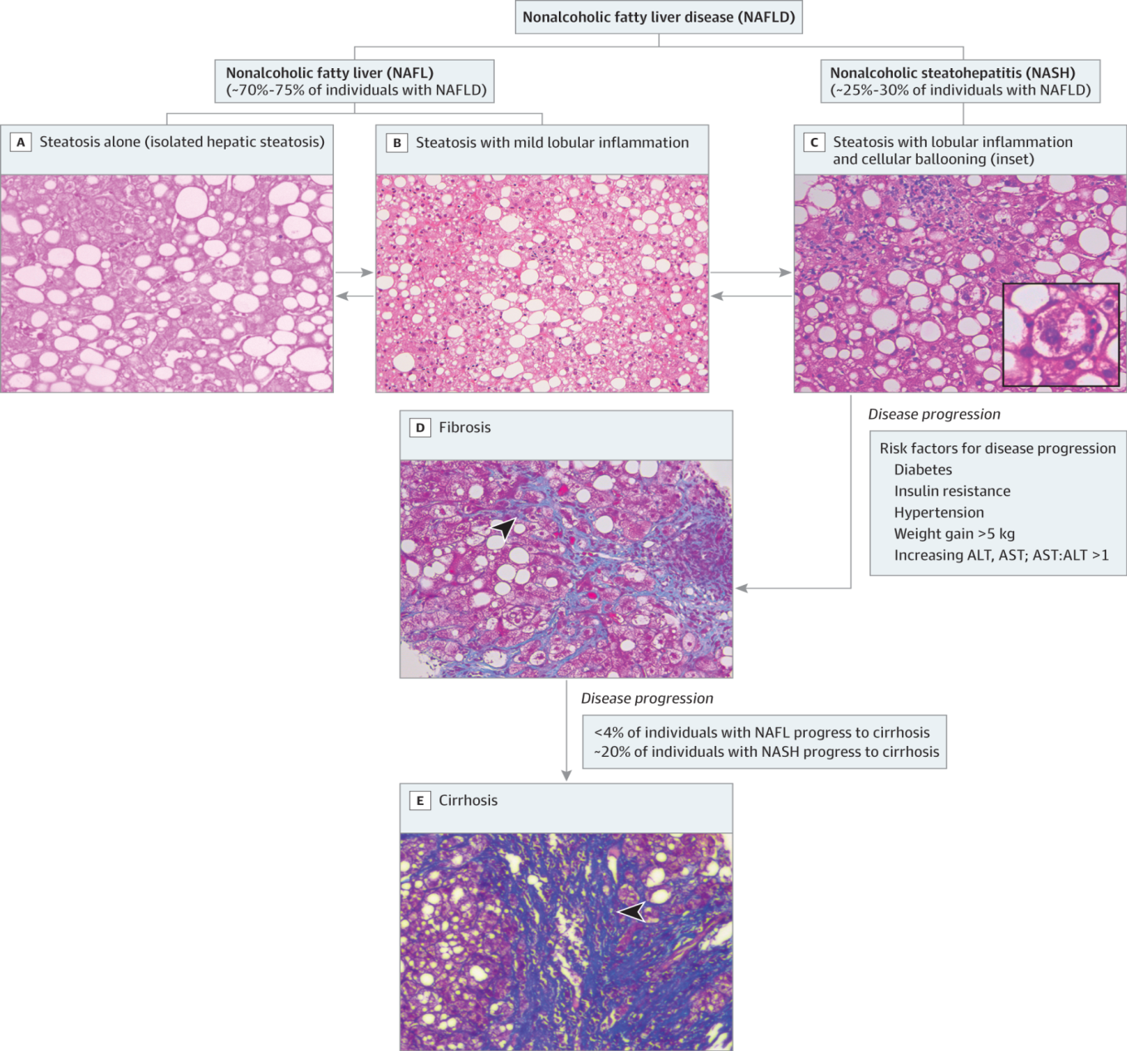
Pathology of NASH and disease progression
Rinella ME.Nonalcoholic Fatty Liver Disease A Systematic Review. JAMA. 2015;313:2263-2273

Slide 25
Nonalcoholic fatty liver disease Activity Score (NAS)
LIVER HISTOLOGY
Steatosis | 0-3
Lobular inflammation | 0-3
Ballooning | 0-2
NAS score | 0-8 [NASH >5?]
Brunt R, et al. Hepatology 2011;53:810-20

Slide 26
DIAGNOSIS

Slide 27
Diagnosis of MASH
Non-invasive
Invasive (liver biopsy)
Serum markers
Imaging modalities utilizing shear wave technology
US, CT,MRI
Low risk but not inconsequential
Inconvenience for patient with morbidity
EASL Clinical Practice Guidelines on non-invasive tests for evaluation of liver disease severity and prognosis. J Hepatol 2021;75:659-89

Slide 28
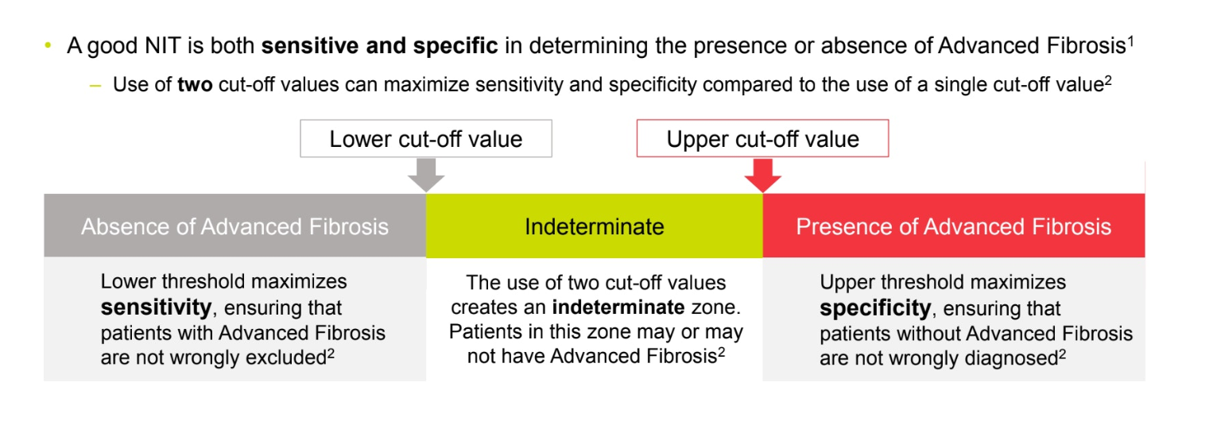
Features of good non-invasive tests
Anstee QM, et al. Hepatology 2019;70:1521-30.

Slide 29
Serum markers
1. APRI >0.87 (AST,Plt)
2. FIB-4 (Age, AST, ALT, plt ) >2.67
3. NAFLD Fibrosis score > 0.67 (Age, BMI, impaired fasting Glc or diabetes, AST, ALT ratio, plt, albumin)
4. BARD score (BMI, impaired fasting glucose or diabetes, AST,ALT )
5. AST/ALT ratio
http:gihep.com /http:mdcalc.com

Slide 30
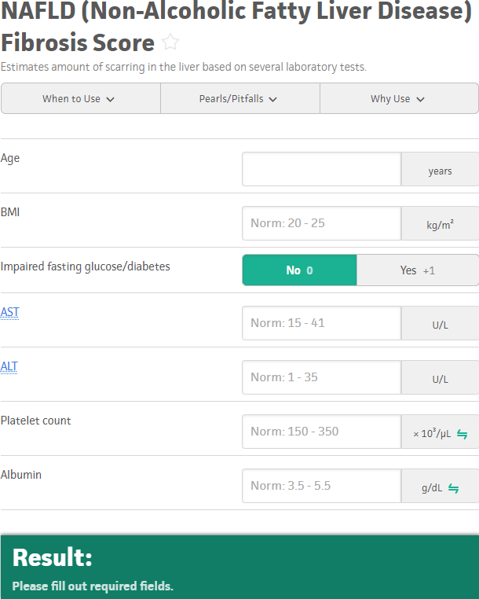
NAFLD Fibrosis Score

Slide 31
Imaging modalities
1. Vibration controlled transient elastography
(VCTE/Fibroscan) FDA approved
2. Magnetic resonance imaging
(a)Magnetic resonance elastography (MRE)
(b)MRI based Liver MultiScan

Slide 32
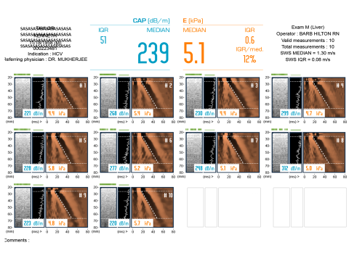
Vibration controlled transient elastography
CAP score:
dB/m Steatosis grade %age of fatty liver
238-260 S1 11-33
260-290 S2 34-66
>290 S3 >67
Reference Ranges:
Disease F0 - F1 F2 F3 F4
HBV < 6.0 > 6.0 > 9.0 > 12.0
HCV < 7.0 > 7.0 > 9.5 > 12.0
Co-HCV/HIV < 7.0 < 10.0 > 11.0 > 14.0
Cholestatic < 7.0 > 7.5 > 10.0 > 17.0
NAFLD/NASH < 7.0 < 10.0 > 10.0 > 14.0
Alcohol <7.0 <11.0 <19 >19

Slide 33
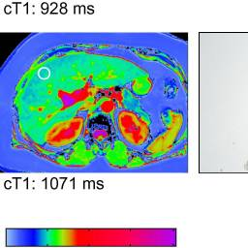
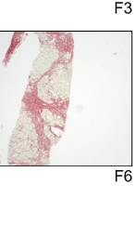
MRI based Liver MultiScan
Measures iron and fat with a novel method for calculating inflammation and fibrosis using corrected T1 technique
Quantitates iron content, fat and fibrosis
Banerjee R, et al. Multiparametric magnetic resonance for the noninvasive diagnosis of liver disease. J Hepatol 2014;60:69-77

Slide 34
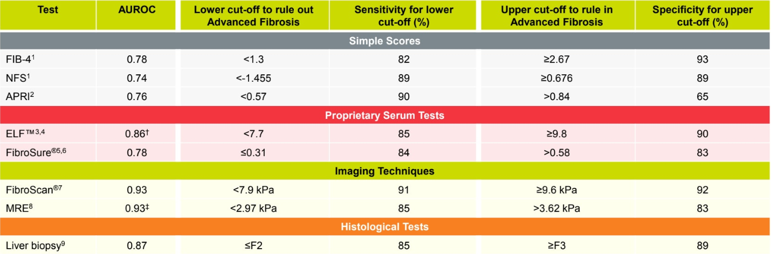
Tests used to assess fibrosis in patients with MASH

Slide 35
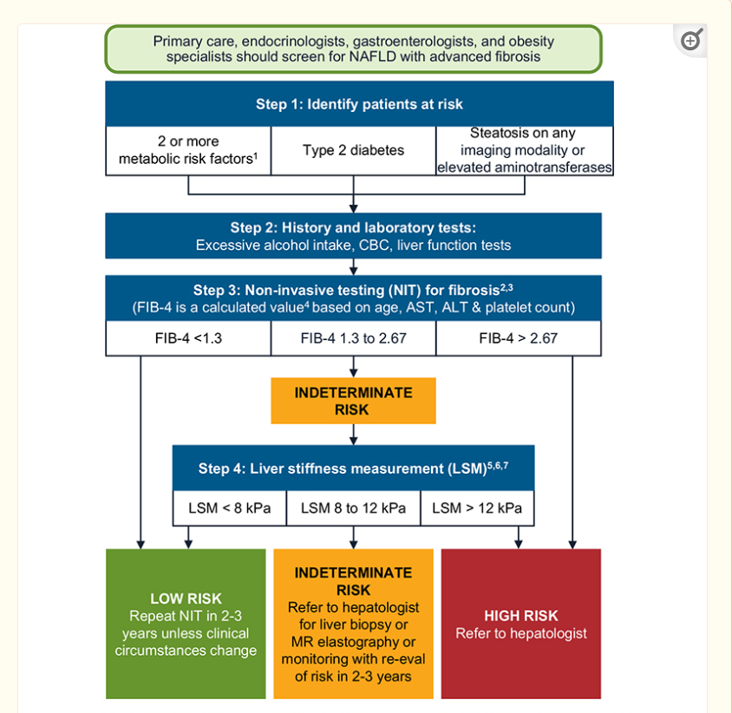
MASLD/MASH Clinical Pathway
Kanwal F, et al. Clinical pathway for risk stratification and management of patients with NAFLD. Gastroenterology 2021;165:1657-69

Slide 36
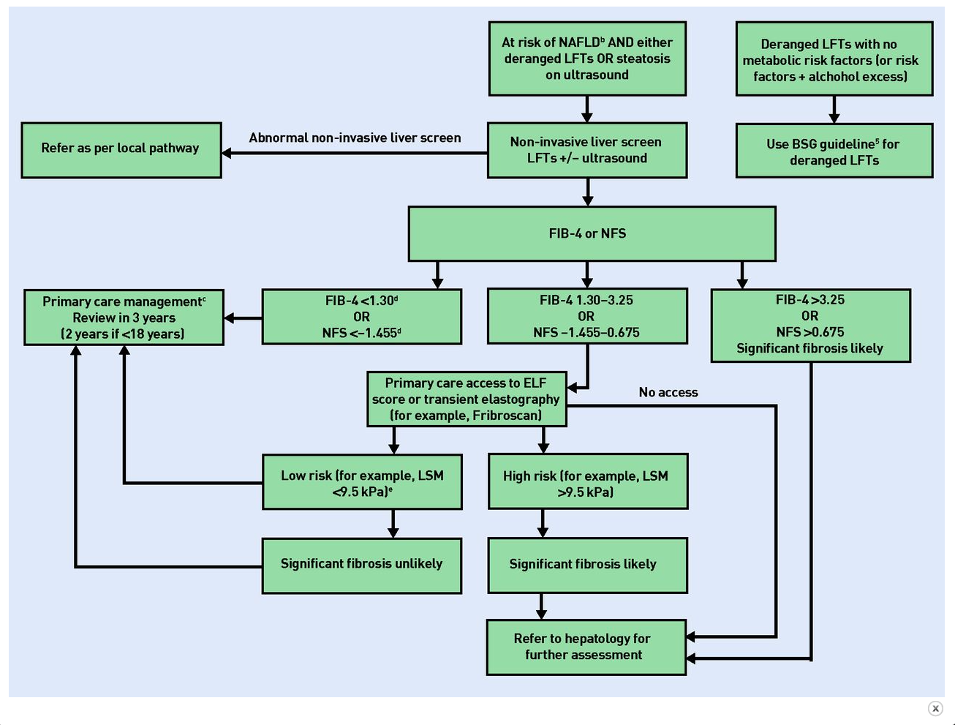
Primary Care MASLD/MASH Clinical Pathway in United Kingdom
Theodoreson M, et al.Non alcoholic fatty liver disease: leading the fight in primary care. BJGP 2022;72:499-501

Slide 37
TREATMENT

Slide 38
Treatment of MASH -directed at pathophysiology
Konerman MA et al. Pharmacotherapy for NASH: current and emerging. J Hepatol 2018;68:362–75.

Slide 39
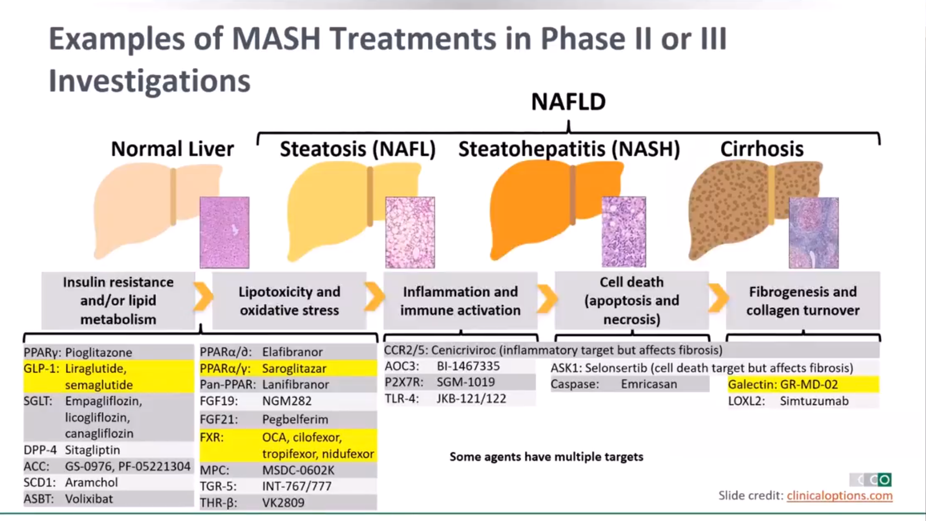
MASH Clinical trials –phase I and II

Slide 40
Treatment-current and future
Risk factor reduction (obesity, insulin resistance)
Weight loss effective in improving NASH
3% wt.loss: steatosis ↓ (35-100%)
5% wt.loss: inflammation, ballooning ↓(41-1005)
7% wt.loss: resolution of NASH (64-90%)
≥10% or wt.loss: fibrosis ↓(45%)
Vilar Gomez E, et al. Weight loss through lifestyle modification significantly reduces features of nonalcoholic steatohepatitis
Gastroenterology 2015;149;367-78

Slide 41
Current Treatment
However…..
No specific diet produces benefit in absence of weight loss; role of Mediterranean diet
Recommend net negative of 500 kcal per day with limiting fructose and increase in physical activity
Most patients unable to achieve or maintain weight loss-refer to bariatric program
Dudekula A, et al. Weight loss in NAFLD patients in an ambulatory care setting is largely unsuccessful but correlates to the frequency of clinic visit. PLoS One 2014;9:e111808

Slide 42
Current Treatment
Morbidly obese individuals with MASH-bariatric surgery may be appropriate (not specifically for MASH alone)
Diabetics with MASH-Pioglitazone, GLP-1,SGLT2 inhibitors
Pioglitazone and Vitamin E-studied in PIVENS trial but limitations
No FDA approved medications for MASH
Sanyal AJ, et al. Pioglitazone, vitamin E or placebo for NASH. NEJM 2010;363:1675-85

Slide 43
The Future
Exciting time for NAFLD
Multiple compounds in various stages of development (>20)
>1 medication may be required (complex pathophysiology, MASH with/without cirrhosis)

Slide 44
Teaching points
MASLD is a public health problem (adults and children)
2nd most common cause of liver transplantation in the United States
Awareness of role of non-invasive tests in MASLD
MASH patients with fibrosis at highest risk for disease progression
Refer patients with MASH to specialty clinics and clinical trials
AASLD Practice Guidance on the clinical assessment and management of nonalcoholic fatty liver disease. Hepatology 2023;77:1797-35

