Slide 1



Douglas County Vaccine Updates
Molly Elston, MSN, MSGH, RN/BSN - DCHD supervisor, clinical operations
Avery Wallace, MPH - DCHD epidemiologist

Slide 2
Overview
•COVID-19 Vaccinations
•COVID-19 Vaccination Timeline
•Douglas County COVID-19 vaccination rates
•Challenges and successes
•Mpox Vaccinations
•Routine Immunizations
•Effect of COVID-19 on routine immunizations
•Douglas County routine immunization rates
•Challenges and successes

Slide 3
COVID-19 Vaccination Timeline
Dec. 2020: Pfizer BioNTech monovalent primary series (16+) and Moderna monovalent primary series (18+) vaccines receive EUA and ACIP recommendation for 16+ y.o.
Feb. 2021: Janssen monovalent primary vaccine receives EUA and ACIP recommendation for 18+
Apr. 2021: All adults now eligible nationwide for COVID-19 vaccines (tiers/eligibility based on occupation/risk removed)
May 2021: Pfizer BioNTech monovalent primary series authorized for adolescents (ages 12- 15 y.o.)
Aug. 2021: ACIP recommends 3rd additional dose of mRNA primary series vaccine for immunocompromised individuals /// Full FDA approval for Pfizer BioNTech 16+ (COMIRNATY)
Sept. 2021: Monovalent Booster authorized for those 65+ and high risk (12+) and for all Janssen primary series recipients
Oct. 2021: “Mixing and Matching” of monovalent boosters permitted
Nov. 2021: Pfizer BioNTech monovalent primary series pediatric vaccine for children aged 5 to 11 years old // Monovalent Booster shot recommendation expanded to everyone >18 years old who received Pfizer or Moderna vaccine
Dec. 2021: Monovalent Boosters expanded to 16/17 y.o. for Pfizer BioNTech// Clear preference for mRNA over Janssen vaccine stated by CDC
Jan. 2022: Full FDA approval of Moderna 18+ (SPIKEVAX) /// Boosters expanded to 12–15-year-olds for Pfizer BioNTech
Mar. 2022: Additional (2nd) monovalent booster dose authorized for 50+ or certain high-risk groups
October 2021: Monovalent booster dose authorized for 5-11 y.o.
June 2022: Primary series monovalent vaccinations authorized for children <5 y.o.
September 2022: Bivalent booster dose authorized for people 12+ y.o.
October 2022: Bivalent booster dose authorized for children 5-11 y.o.
December 2022: Bivalent booster doses for some <6 y.o.
March 2023: Monovalent products removed from the market. No primary series doses for individuals 6+ y.o. without immunocompromise. Additional bivalent vaccine for 65+ and immunocompromised
May 2023: Janssen no longer available in the USA

Slide 4
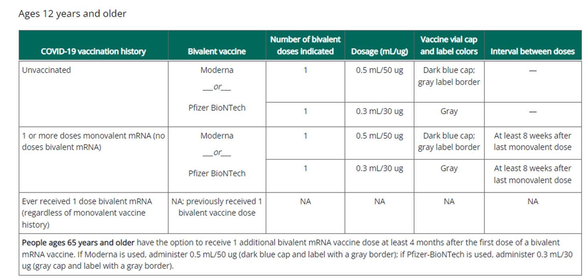
Recent COVID-19 Updates
April 2023/May 2023:
No more monovalent
6+ y.o.: 1 bivalent dose to be up-to-date
Extra bivalent dose for 65+ and immunocompromised
Special schedules for children <6 y.o. and immunocompromised
mRNA EUAs combined into 1 EUA per brand
No changes to Novavax (the only non-mRNA option)
Janssen no longer on market (expired)
Direct ordering from NESIIS still available
Interim Clinical Considerations

Slide 5
Vaccine Hesitancy
DCHD to conduct a study on vaccine hesitancy in collaboration with Professional Research Consultants (PRC)
Nature study (Stamm, et al., 2023) on how to combat vaccine fatigue
Different groups respond differently to specific motivators
Tailor vaccine messages to each subgroup and their needs
Community Spirit motivates Unvaccinated
Incentives for those vaccinated once or Twice
Low costs and new formulas for 3+ Vaccinated
Continue efforts to foster institutional trust

Slide 6
What’s next for Covid-19 vaccines?
Currently, COVID-19 vaccines free to all
Commercialization: Fall 2023
Any new products (i.e. updated fall vaccine) will go straight to commercial
Covid-19 is an ACIP-recommended vaccine = VFC covered
Bridge Access Program for COVID-19 Vaccines and Treatments = for uninsured adults through 2024
Most americans should continue to pay nothing out of pocket after commercialization
NESIIS entry will not be required for private COVID-19 vaccines after commercialization
Future of COVID-19 vaccines?
June 15, 2023: VRBPAC meeting to discuss strain(s) to be included for COVID-19 2023-2024 vaccination campaign
Likely annual covid-19 vaccines with similar cadence to influenza vaccines
Project Next Gen = development of the next generation of COVID-19 vaccines
Notes:
Bridge Access Program: https://www.hhs.gov/about/news/2023/04/18/fact-sheet-hhs-announces-hhs-bridge-access-program-covid-19-vaccines-treatments-maintain-access-covid-19-care-uninsured.html

Slide 7
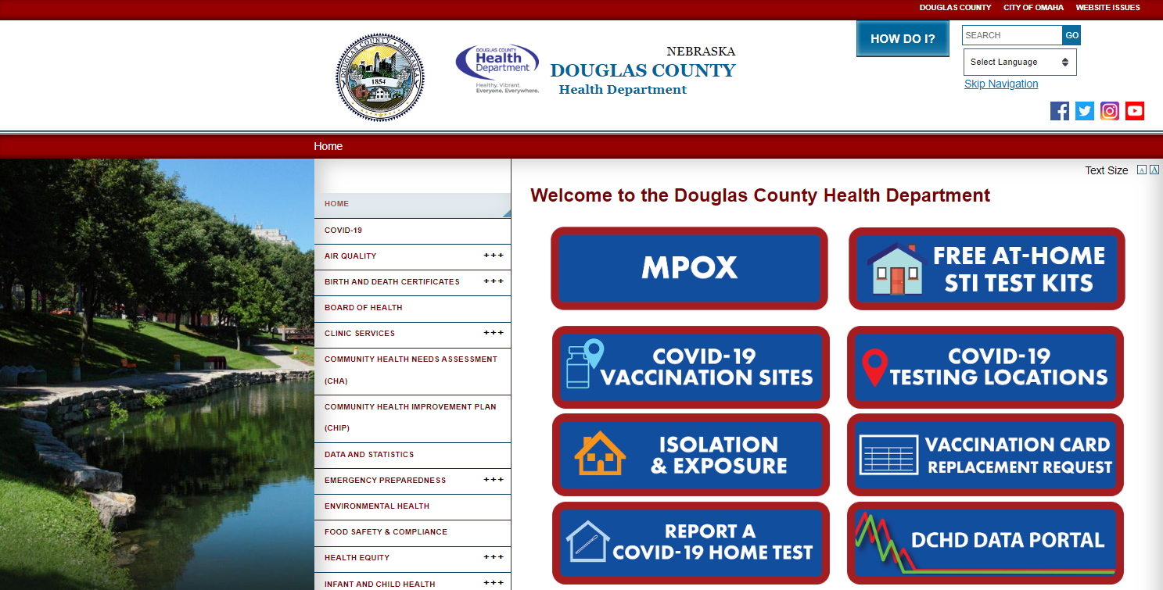
DCHD Data Portal

Slide 8
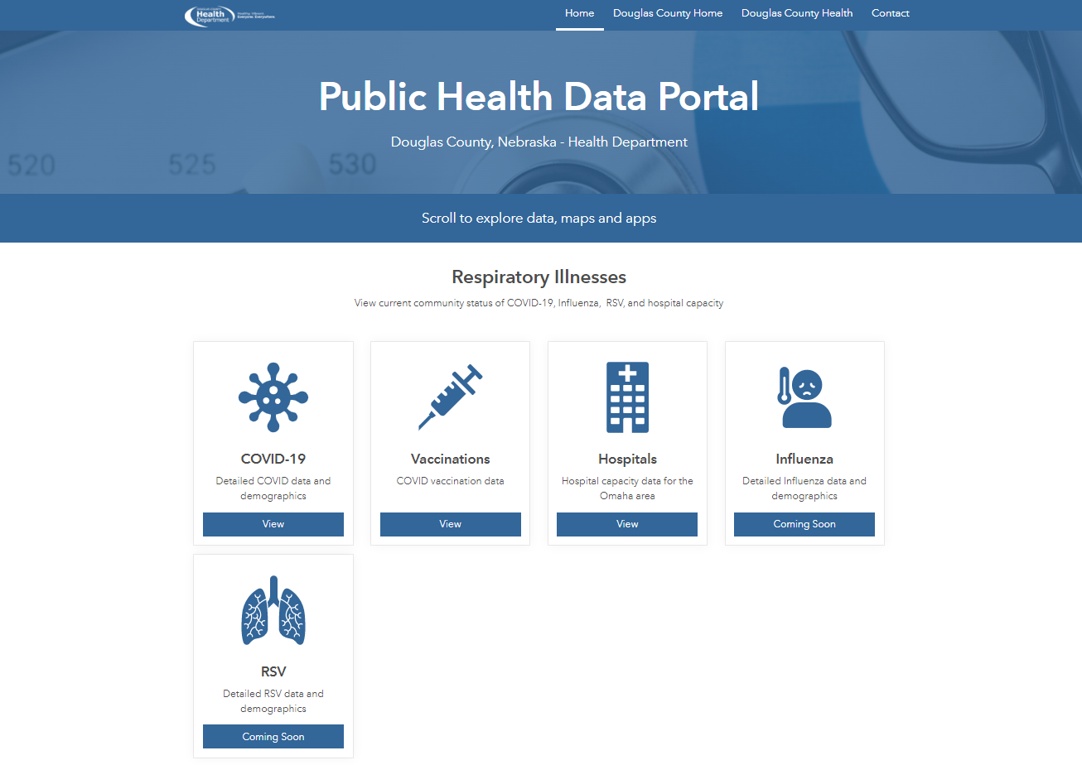
DCHD Data Portal
Notes:
Would be happy to take feedback from community members and providers on what you’d like to see and what would be most useful in terms of vaccination data displayed on this portal.

Slide 9
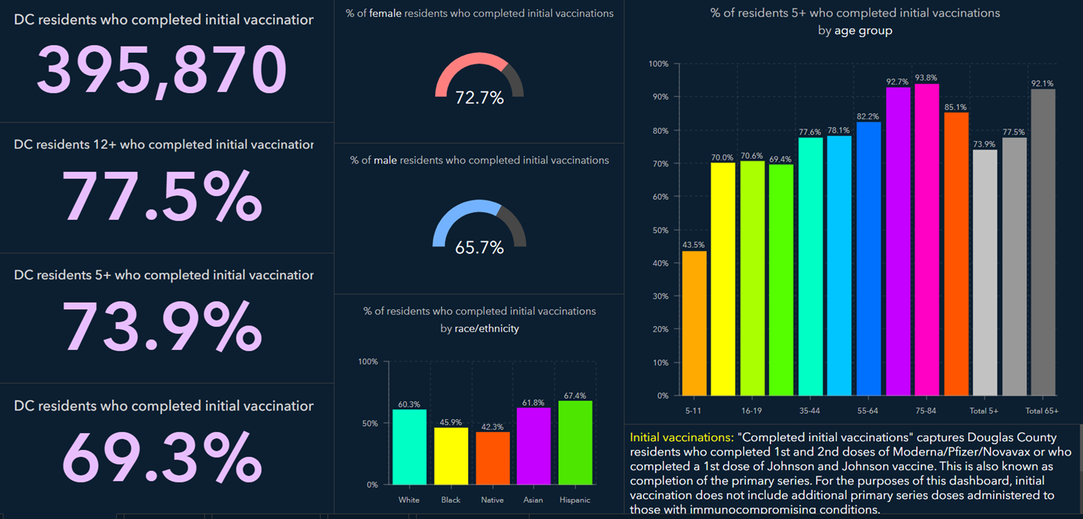
Covid19 Vaccine Dashboard
https://www.douglascountyhealthportal.com/
Notes:
Dashboard is currently under revision. Completed Initial Vaccinations = Completed Primary Series Vaccination

Slide 10
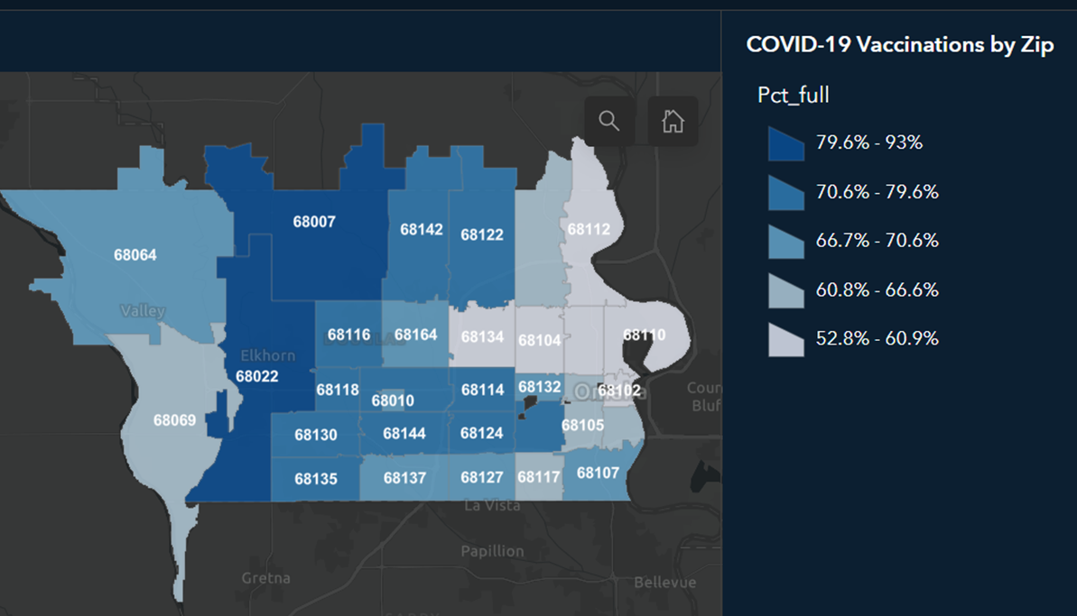
Covid19 Primary Series by Zip Code

Slide 11
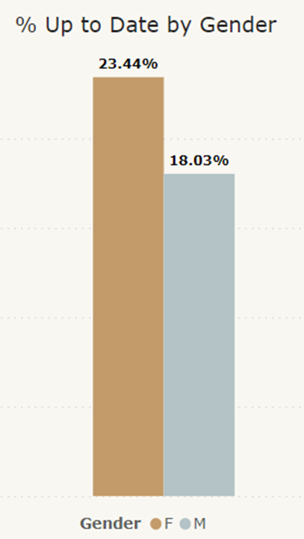
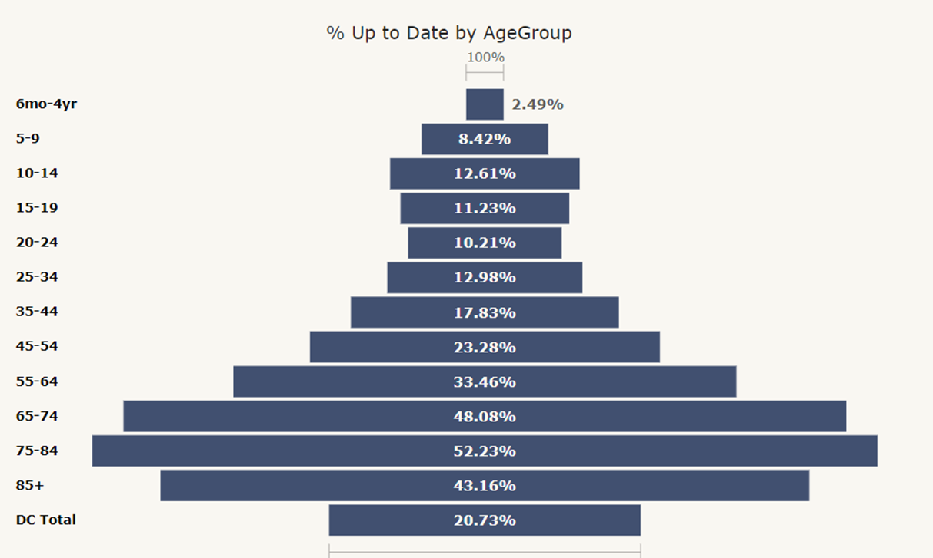
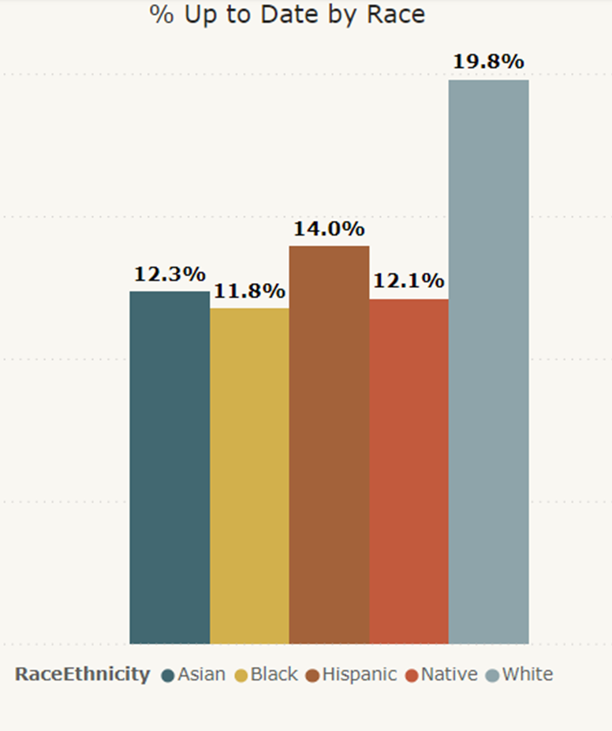
Current State of Covid-19 Vaccines in Douglas County*
*Preliminary calculations subject to change, Race/Ethnicity data for Vaccines not as complete as county population data, % will be updated on website.

Slide 12
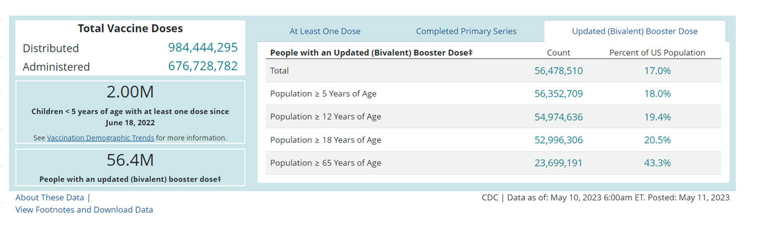
How do we compare to national data?
Notes:
DC rates are slightly ahead of national averages. 20.73% in DC received an updated bivalent booster compared to 17% nationally.

Slide 13
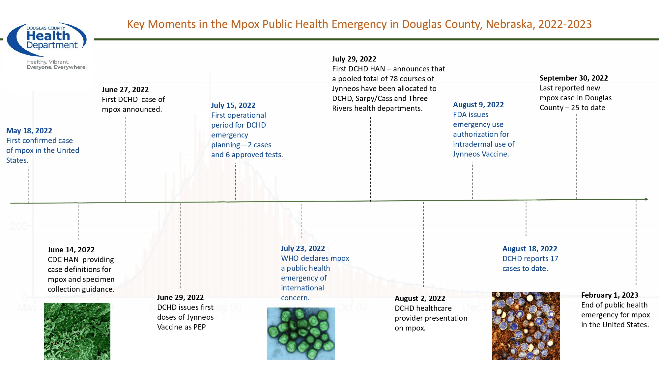
Mpox Vaccines
Notes:
-most jurisdictions in the United States may be at risk of resurgence or new mpox outbreaks without continued efforts to vaccinate people at risk, based on new modeling analyses. (>35% chance of a resurgent outbreak of mpox)
-therefore vaccination is very important. DCHD and other counties are working with an ad agency that specializes in marketing to LGBTIA+ communities through social media, dating apps and other sites. We will run an ad campaign to try to increase vaccination rates in Douglas County and the state. We will also be hosting targeted events to try to increase opportunities for eligible individuals to be vaccinated.
-To date, DCHD clinics have administered 1,826 doses of mpox vaccine. Several other facilities including CHI, Nebraska Medicine, OW, and Charles Drew have also administered mpox doses to clients.
-34% of at-risk nebraskans have had at least 1 dose of mpox vaccine
-29% of at-risk nebraskans have completed 2 doses of mpox vaccine
-Goal is to be at 35% or greater coverage in order to keep cases low

Slide 14
Routine Immunizations in DC
Notes:
Data is requested from NESIIS on # of doses administered. We will work on getting individual, deidentified patient records at a county-level from NESIIS so that we can generate data on % up-to-date in the county to allow us to directly compare to CDC national coverage rates coverage rates. This will be part of our efforts in order to create a user-friendly dashboard where we can provide regular updates on immunization coverage in douglas county

Slide 15
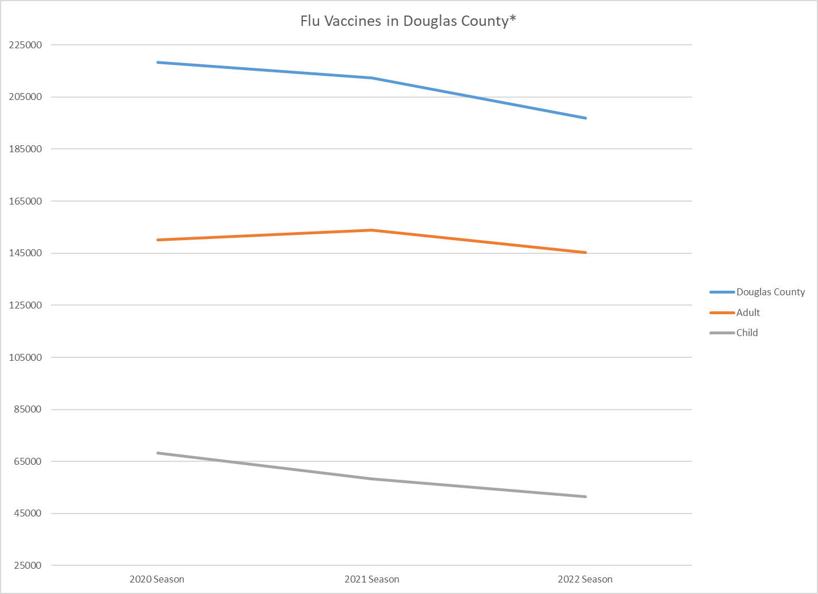
*August thru April, limited dataset
Notes:
Data source: NESIIS
2022 season (August 1 2022 to April 1 2023 data) about 33.6% of DC Population, 31.4% of Children, 34.5% of Adults

Slide 16
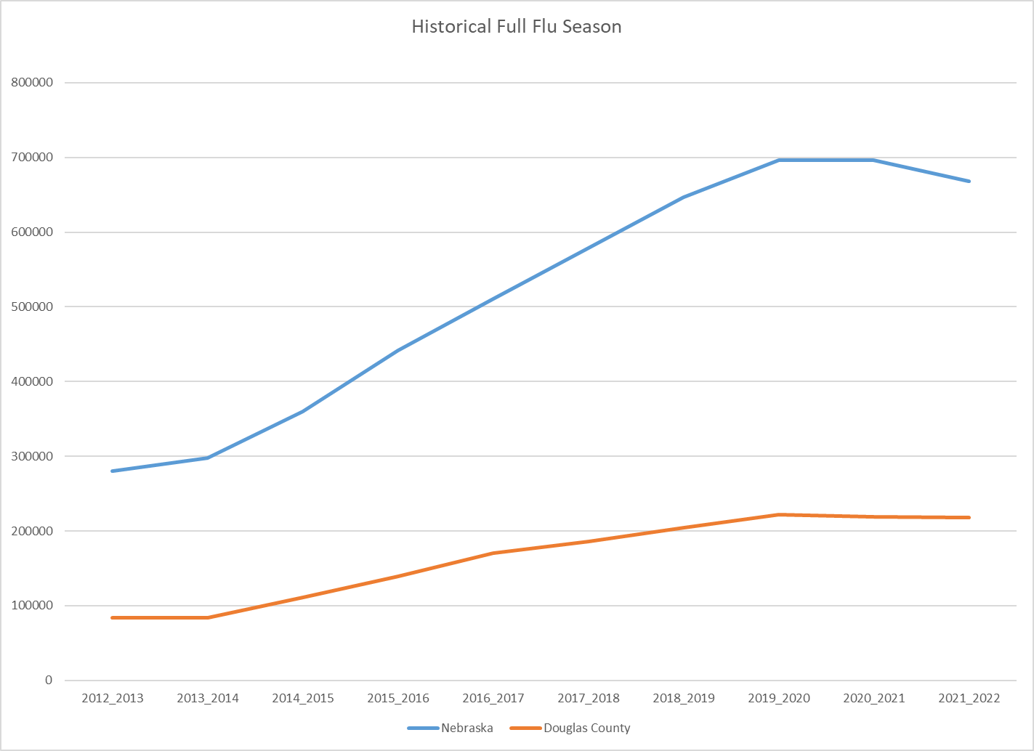
Notes:
Data Source NESIIS.

Slide 17
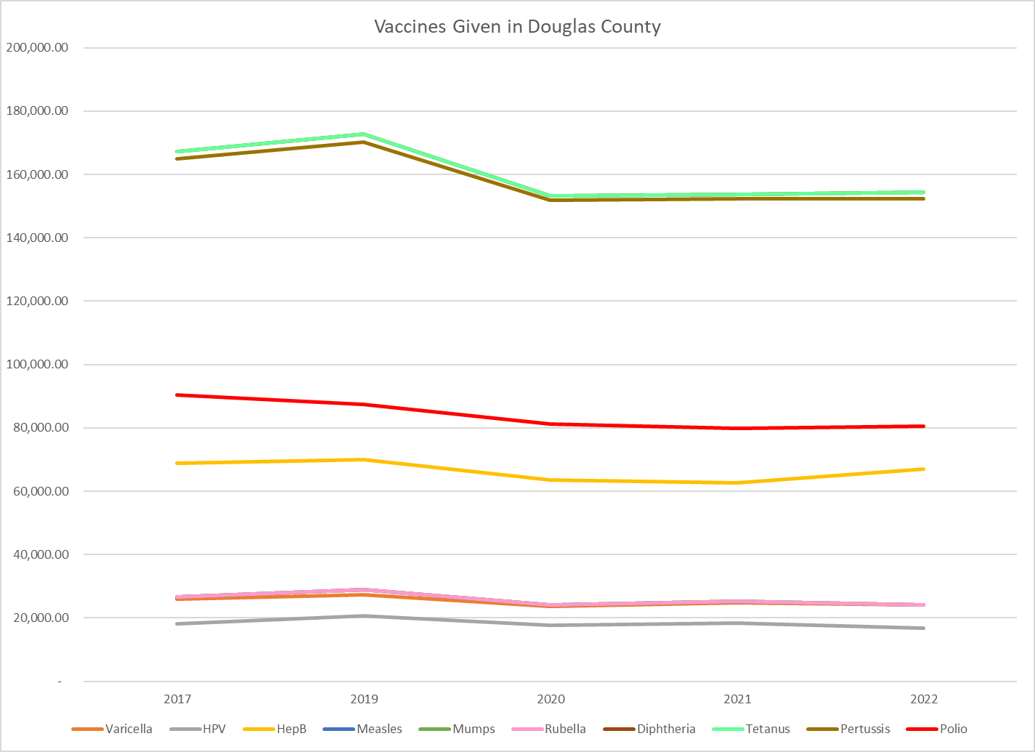
Notes:
Data source: NESIIS

Slide 18
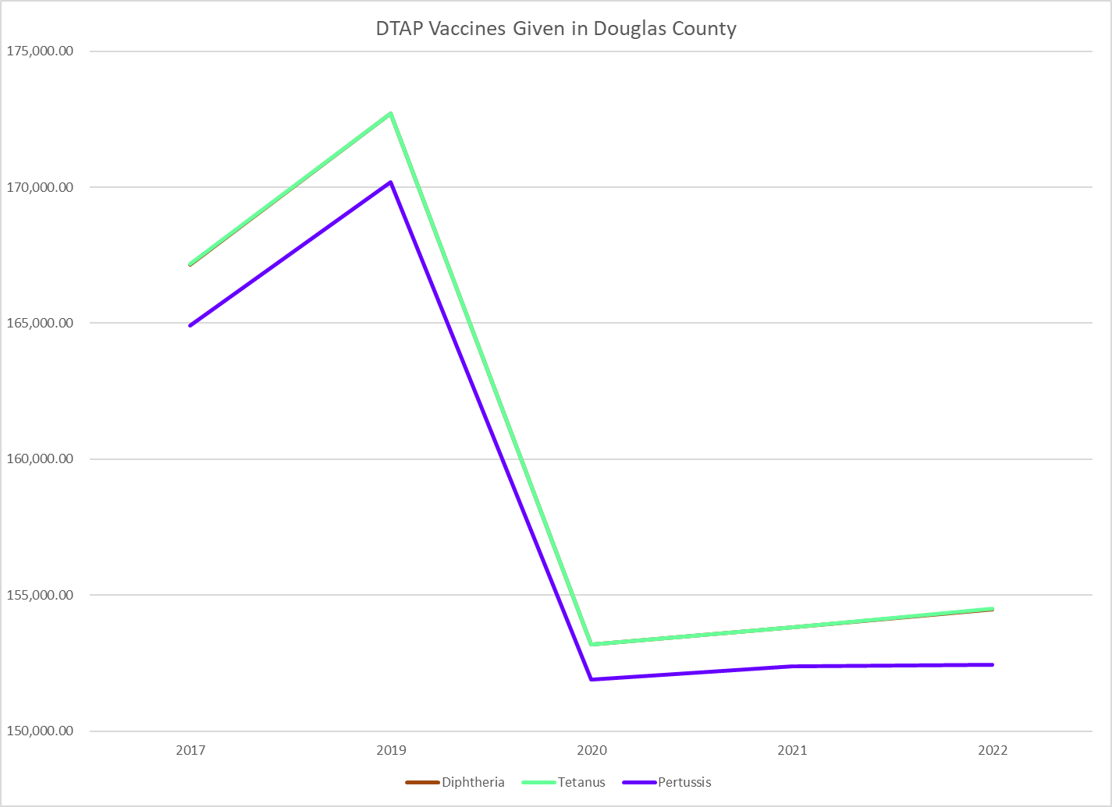
Notes:
Data Source: NESIIS

Slide 19
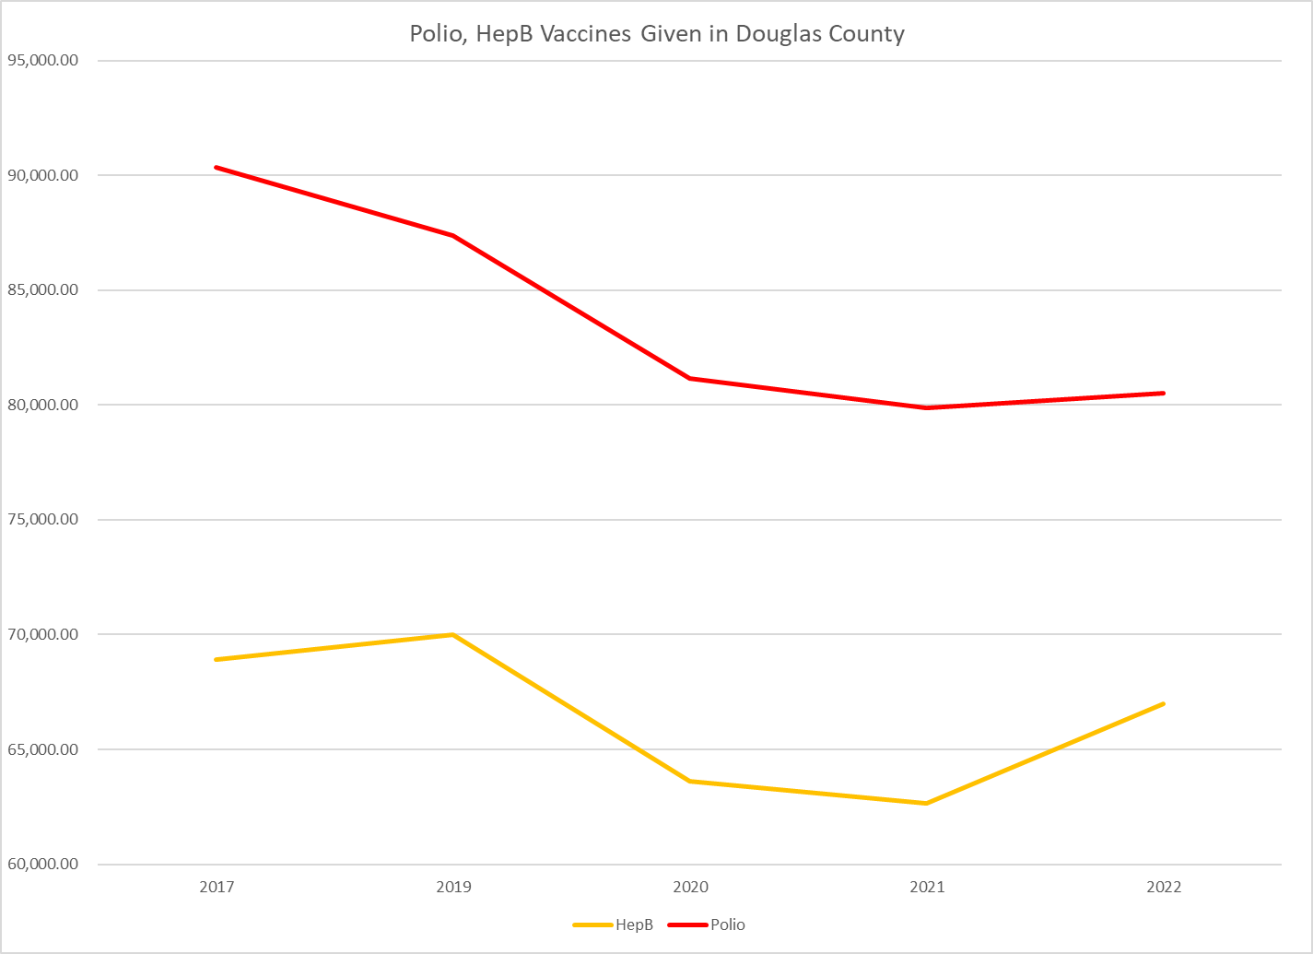
Notes:
Data source: NESIIS

Slide 20
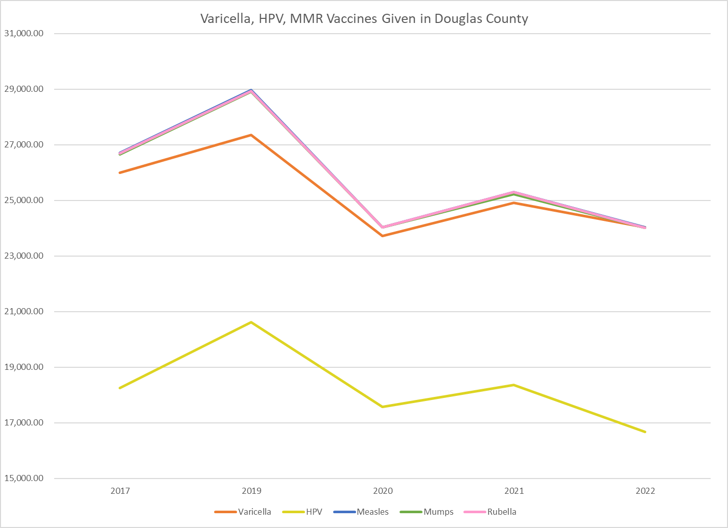
Notes:
Data source: NESIIS
Our under 18 population is about 163,500

Slide 21
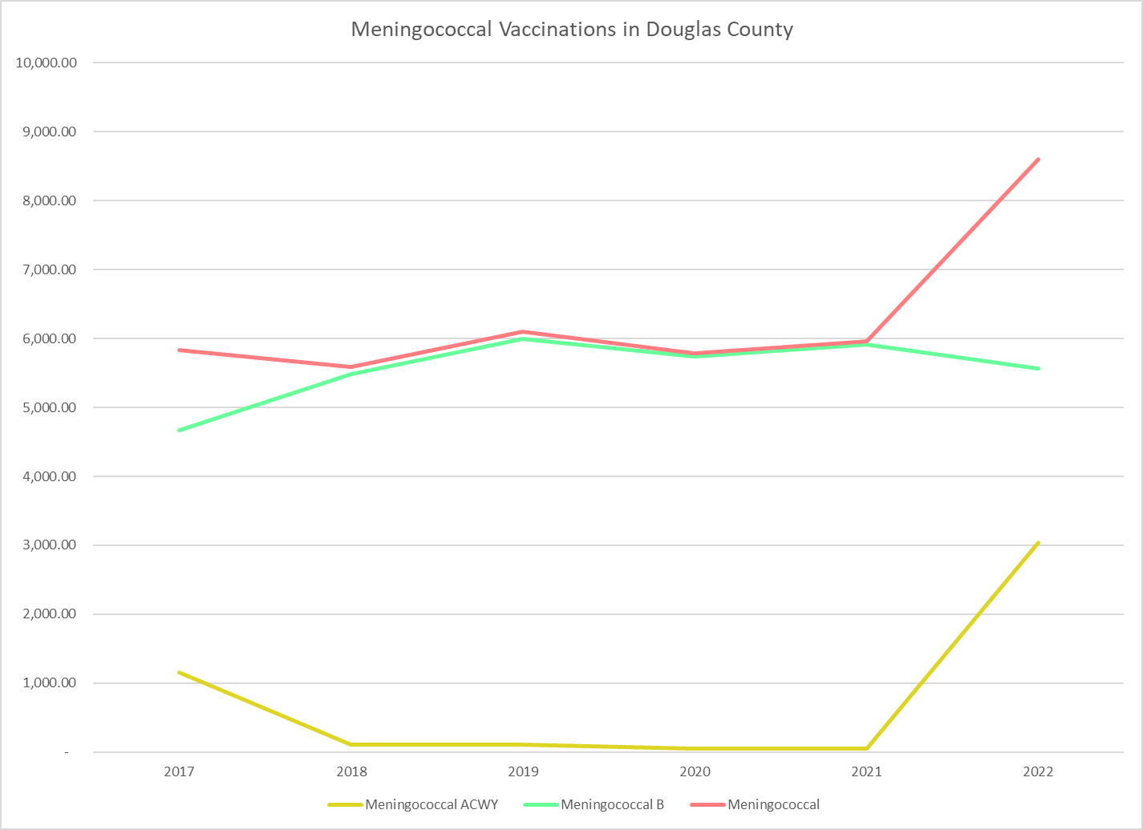
Notes:
Data source: NESIIS

Slide 22
Vaccine Pandemic Recovery
Douglas County
Vaccine | 2019 to 2022 | 2021 to 2022 | Vaccine | 2019 to 2022 | 2021 to 2022
Varicella | -12.13% | -3.54% | Rubella | -16.99% | -5.07%
HPV | -19.16% | -9.18% | Diphtheria | -10.55% | 0.43%
HepB | -4.28% | 6.94% | Tetanus | -10.54% | 0.45%
Measles | -17.03% | -5.01% | Pertussis | -10.44% | 0.04%
Mumps | -16.99% | -4.86% | Polio | -7.89% | 0.80%
Flu | -3.9% | -9.61% | Flu is based on Flu seasons 2018-2019, 2021-2022, and 2022-2023
Notes:
Data Source: NESIIS

Slide 23
Routine immunization trends nationally
CDC study of kindergartner vaccine coverage (MMWR January 2023)
During the 2020–21 school year, national coverage with state-required vaccines among kindergarten students declined from 95% to approximately 94%.
During the 2021–22 school year, coverage decreased again to approximately 93% for all state-required vaccines.
National Immunization Survey–Child identified no decline overall in routine vaccination coverage associated with the COVID-19 pandemic among children born during 2018–2019, although declines were observed among children living below the federal poverty level and in rural areas

Slide 24
Challenges with Routine Immunizations
-VFA
-Funding availability does not meet current demand
-Currently 4 VFA providers in DC

Slide 25
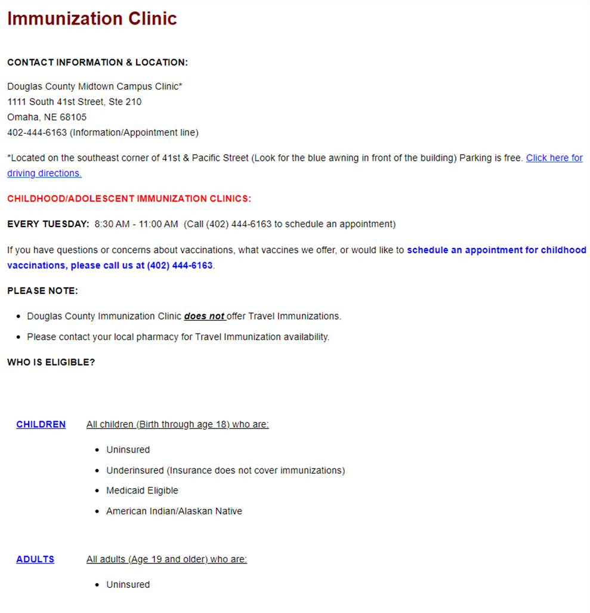
Current Routine Vaccination Efforts at DCHD
Routine Childhood/Adolescent VFC clinic at DCHD on Tuesday AMs
Providing information and appointment planning at health fairs and community events
VFA vaccines available
Collaboration with CBOs, healthcare systems, ITF, FQHCs, etc. on strategies to increase vaccination rate
Notes:
Plug for ITF.

Slide 26



Thank you.
www.douglascountyhealth.com

