Slide 1
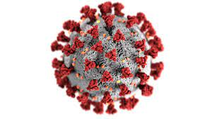
COVID -19:
Reactive arthritis vs Viral arthritis
Corrine Giggee, PA-C,
CHI Rheumatology
September 22, 2023

Slide 2


Ugh… Not again!
Notes:
i can’t. I can’t even. I thought COVID was done with. or at least I am done with COVID. But it is not going anywhere

Slide 3
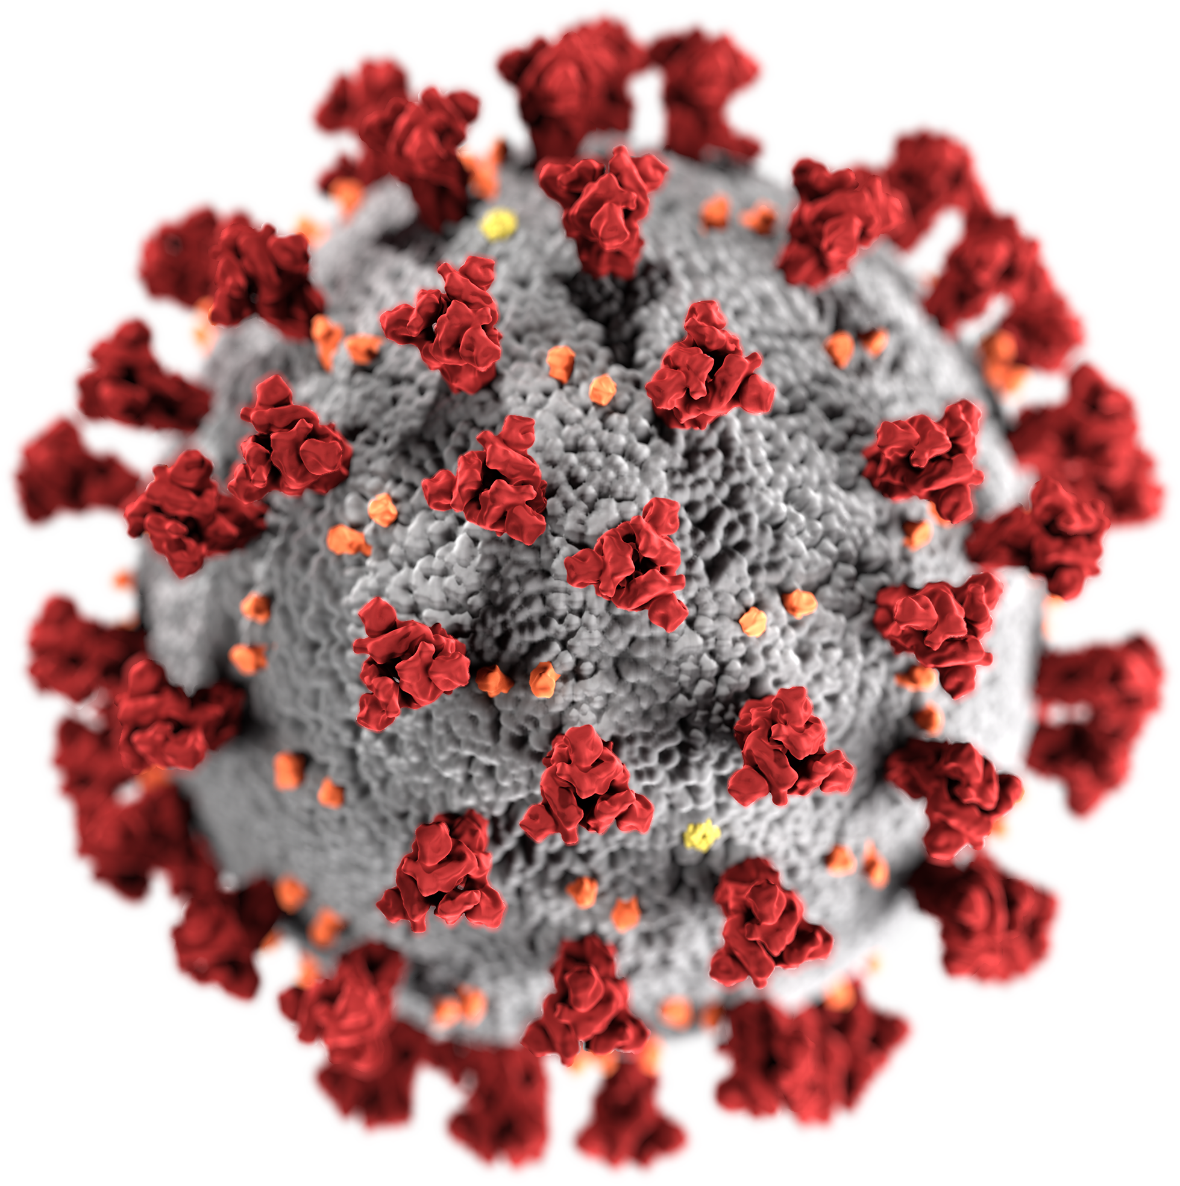
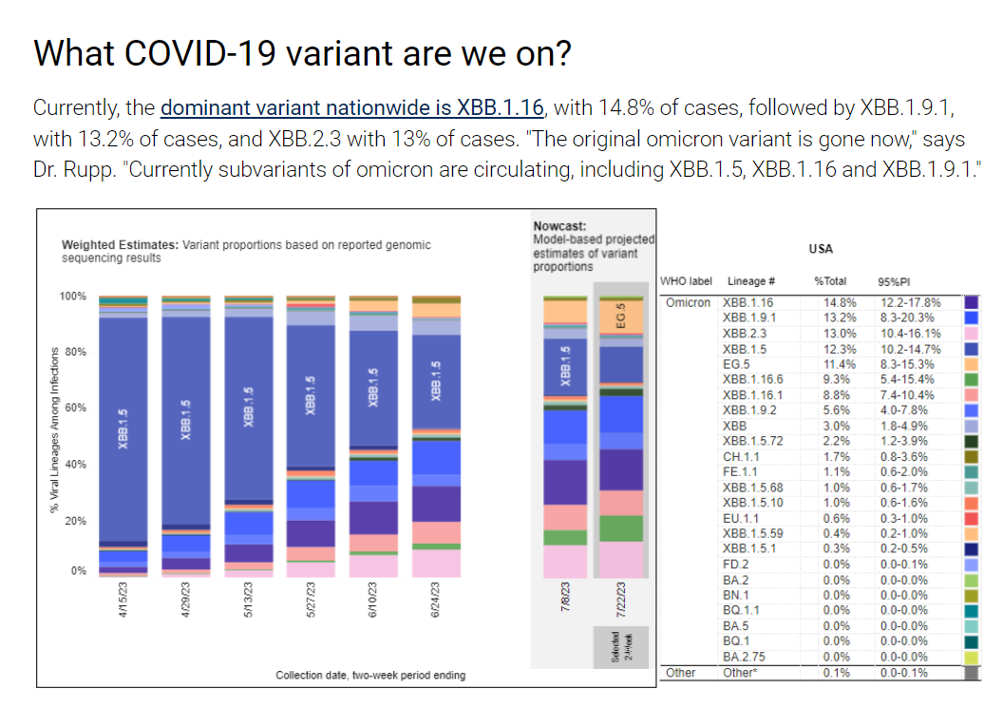
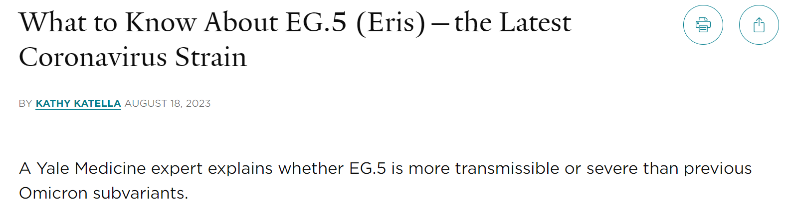
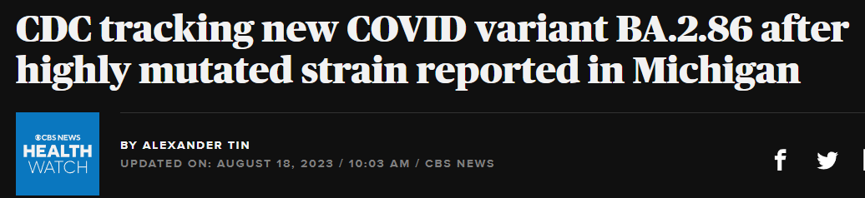
COVID not going away
Notes:
The Pandemic may be over, but COVID is not gone. the COVID molecule continues to mutate and we have different variants.
In July, UNMC came out with a tracking bar graph for the different strains. At that time, XBB.1.9.1 was the dominant variant.
Then on August 18th, Yale was warning us about EG.5 (Eris)
And CDC was taking to CBS News about the BA.2.86 strain.

Slide 4
So, let’s accept that COVID is here to stay. For now.
Notes:
So, COVID is here today stay. So let’s talk about how COVID affects our joints.

Slide 5

Does COVID cause joint pain?
Notes:
Hum.. ok let’s google it. (CLICK)

Slide 6
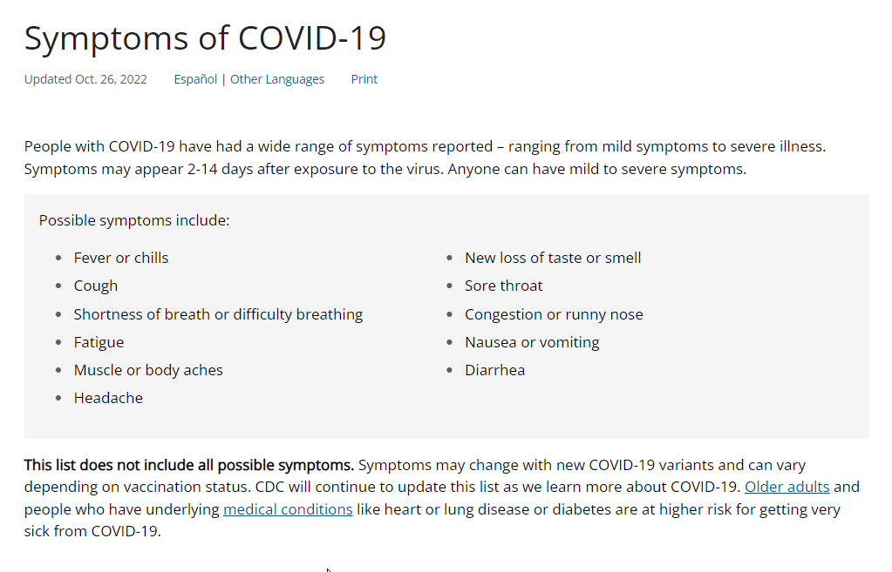
Does COVID cause joint pain?
Notes:
This the the top result on Google for covid 19 symptoms (which is the CDC website). (READ)
However (CLICK) this is not an exhaustive list. As anyone who has been living on Earth the last 3 years knows, COVID is a slippery little bugger and can cause a whole host of symptoms. And it sometimes seems that we can blame everything on COVID.

Slide 7

Does COVID cause joint pain?
COVID-19 can exaggerate arthritic joint pain
Notes:
Typically, in a coronavirus infection, the pain is in muscles rather than in joints. According to the WHO, muscle pain was reported by 14.8 percent of patients. Muscle aches may be caused by the effects of inflammatory molecules as part of the immune response to the virus.
But if you have an arthritic joint in your arm or leg, the virus may exaggerate the symptoms. For some, the joint pain during a COVID-19 infection can be severe.

Slide 8
COVID and joints
While the coronavirus can cause permanent damage to vital organs, such as the lungs and kidneys, it is not known to cause any permanent damage to bones and joints. It is, however, too early in the pandemic to know all of the long-term consequences.
2020

Slide 9
Can COVID Cause Arthritis?
ar·thri·tis
/ärˈTHrīdəs/
noun
painful inflammation and stiffness of the joints.
Notes:
So, Does COVID cause arthritis? well, Let’s look at the definition of Arthritis:

Slide 10
Viral
arthritis
Reactive arthritis
vs
Notes:
Ok, today we will be focusing on Viral vs Reactive arthritis:

Slide 11
Viral arthritis
Reactive arthritis
vs
Viral Trigger
asymmetric / symmetric polyarticular disease
joint symptoms tend to arise suddenly, often during the acute phase of the infection.
+/- rash
Usually Bacterial Trigger
Often combined with GU and Ocular symptoms
Likes big joints / asymmetric
Usually develop after initial infection resolves
Notes:
Reactive arthritis is typically secondary to a bacterial illness. Most commmonly a GI bug or an STD

Slide 12
Viral Arthritis

Slide 13
Viral Arthritis
Viral infections are a known cause of acute arthralgia and arthritis, Can occur during or after infection by various pathogens, including:
Hepatitis B virus, Hepatitis C virus, parvovirus,
Epstein-Barr virus, HIV, alphavirus, and Zika virus.
COVID?
Notes:
Viral arthritis can be acute, Joints typically become painful and swollen quickly, often over a few hours or days.
Diagnosis of viral arthritis can be difficult to confirm, nonetheless it should be considered in all patients with sudden onset of polyarticular phlogosis; to date, approximately 1% of all cases of acute inflammatory arthritis have a viral origin.

Slide 14
Diagnosis of Viral Arthritis
History
Serological testing
General work up
Synovial Fluid Analysis
Notes:
History is the biggest help for diagnosing. Look for a history of infection/rash/vaccination around the time of acute onset of symptoms
If know exposure or risk factors for, look at Serological testing for standard viral agents:
Hepatitis B
Hepatitis C
EBV
Parvovirus
If viral involvement is unknown, the diagnostic protocol may include the following:
Complete blood count
Urinalysis
Erythrocyte sedimentation rate
C-reactive protein
Liver function tests
Muscle enzymes
Rheumatoid factor tests
Anti-citrullinated peptide antibodies tests
Antinuclear antibodies tests
Arthrocentesis
Synovial fluid analysis
White blood cell count and differential
Crystal search
Gram stain
Routine culture

Slide 15
Management of Viral Arthritis
Antiviral therapy (?)
Analgesics / NSAIDS
Time
Notes:
Only a small subset of the viruses linked to arthritis have specific antiviral therapies that are currently available, including hepatitis B, hepatitis C, and HIV.
Primary treatment includes symptom relief, including analgesics, nonsteroidal anti-inflammatory drugs (NSAIDs) (at similar dosages to other arthritic conditions), and in more severe cases, physical and occupational therapy. Glucocorticoids provide limited benefits for viral arthritis and are generally not recommended.

Slide 16
Reactive Arthritis

Slide 17
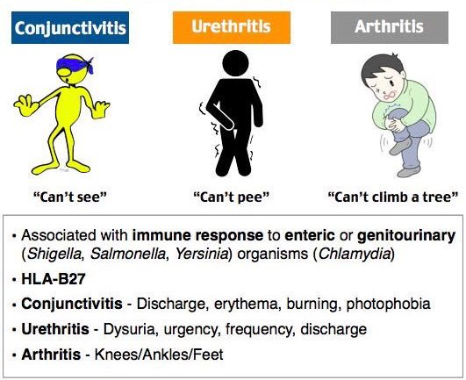
Reactive Arthritis
Notes:
Triggered by a bacterial infection in the digestive or urinary tract or the genitals,
Arthritis symptoms typically do not set in until after you have recovered from the infection.
Inflammation of the joints, eyes, and urinary tract are hallmarks of reactive arthritis, but not everyone gets all three, or they might not occur at the same time.
The knee and ankle joints are frequently affected, and many people experience pain in the sacroiliac joints in the lower back as well.
Reactive arthritis is a form of spondyloarthritis, a group of arthritis conditions that typically involve the sacroiliac joints in the lower back, and entheses (places where tendons or ligaments attach to bones). Foot pain in people with reactive arthritis is usually due to inflammation of entheses.

Slide 18
Diagnosis of Reactive Arthritis
History
HLA B27
Culture
Joint fluid (synovial fluid) test.
Notes:
History of exposure to the offending bacteria, or risky behavior for exposure
This blood test looks for the presence of HLA-B27, a genetic risk factor for reactive arthritis.
Urine or stool culture may show evidence of the bacteria (NOT the joint)
Joint fluid (synovial fluid) test. This test is to assess the level of inflammation in the joint, and to rule out other causes for the pain, such as a joint infection or other condition, such as gout. Draw fluid from a joint using a needle and syringe, and will send it to a lab for analysis.

Slide 19
Treating Reactive Arthritis
NSAIDs
Steroids
Rheumatoid arthritis drugs
Notes:
What is the best treatment for reactive arthritis?
Prescription nonsteroidal anti-inflammatory drugs (NSAIDs), such as indomethacin (Indocin), can relieve the inflammation and pain of reactive arthritis.
Steroids. A steroid injection into affected joints can reduce inflammation and allow you to return to your usual activity level.
A steroid injection into affected joints can reduce inflammation and allow you to return to your usual activity level. Steroid eye drops may be used for eye symptoms, and steroid creams might be used for skin rashes.
Limited evidence suggests that medications such as sulfasalazine, methotrexate or etanercept can relieve pain and stiffness for some people with reactive arthritis.
Reactive Arthritis can burn itself out, but some patients need to be on long term therapy. 15-30% of patients with ReA can develop long-term arthritis or other joint abnormalities.

Slide 20
What about Long COVID and Joints:

Slide 21
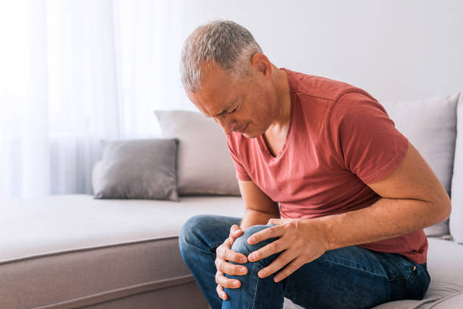
Case Study:
53 y/o previously healthy male
Admitted for SOB due to COVID x12 days
Severe joint pain and fever 2 days after discharge.
Work up:
Synovial fluid: Inflammatory, no infection
Blood work: Negative HLA B27, CCP, RF
Treatment:
NSAIDs + Steroids
Notes:
A previously healthy 53-year-old man was hospitalized for 12 days due to COVID-19 with shortness of breath. A few days after discharge from hospital, the patient developed fever and severe pain in several joints in the lower extremities. The pain was so severe that the patient was unable to stand on his feet.
WHAT DO YOU WANT TO DO:
Synovial fluid from the right-side knee contained a high number of polynuclear cells and a few mononuclear cells. Microscopy, culture and PCR tests for bacterial infection were all negative. Furthermore, the patient tested negative for rheumatoid factor, anti-cyclic citrullinated peptide and human leukocyte antigen (HLA)-B27.
WHAT IS YOUR DIAGNOSIS:
Post Viral./reactive arthritis. Post covid arthritis?
TREATMENT
The condition improved markedly after a few days’ treatment with non-steroid anti-inflammatory drugs and prednisolone.

Slide 22
What About Long COVID?
Long COVID has been found to last 60-90 days causing serious joint pain and discomfort for those affected.
Recent imaging and studies have shown that the coronavirus may cause the body to attack itself.
Mild side effects including joint pain are also possible following vaccinations
Diagnosis of exclusion
Notes:
Long COVID is defined as a long-term sequel of a SARS-CoV-2 infection, presenting as continuous or relapsing and remitting symptoms several weeks after microbiological recovery, as evidenced by negative SARS-CoV-2 PCR. In most patients, there is also evidence of radiological and biochemical recovery. Hence, long COVID represents a time lag between microbiological and clinical recovery. Some patients with long COVID may still present with haematological/biochemical and imaging abnormalities
Recent imaging and studies have shown that the coronavirus may cause the body to attack itself. This may cause long-term, severe flare-ups of issues such as rheumatoid arthritis and autoimmune myositis. While many patients with COVID-related musculoskeletal issues recover, others experience serious, lasting problems.
Needs to exclude other causes of symptoms. Respiratory infections can cause an onset of new rheumatoid arthritis and a flare-up of an existing RA
Some studies put arthralgias as the most common symptom of long COVID. A review of research indicates an estimated one in five patients with long COVID suffers from arthralgia

Slide 23
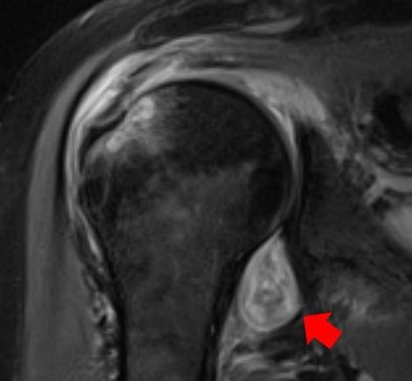
COVID attacking the MSK system
MRI IMAGE OF A PATIENT'S SHOULDER.
Notes:
The study is a retrospective review of data from patients who presented to Northwestern Memorial Hospital between May 2020 and December 2020.
"Many patients with COVID-related musculoskeletal disorders recover, but for some individuals, their symptoms become serious, are deeply concerning to the patient or impact their quality of life, which leads them to seek medical attention and imaging," said Deshmukh, an assistant professor of musculoskeletal radiology at Northwestern University Feinberg School of Medicine and a Northwestern Medicine musculoskeletal radiologist. "That imaging allows us to see if COVID-related muscle and joint pain, for example, are not just body aches similar to what we see from the flu -- but something more insidious."
Imaging (CT, MRI, ultrasound) can help explain why someone might have prolonged musculoskeletal symptoms after COVID, directing them to seek the right physician for treatment, such as a rheumatologist or dermatologist.
In some cases, radiologists may even suggest a COVID diagnosis based on musculoskeletal imaging in patients who previously didn't know they contracted the virus, Deshmukh said.
THE RED ARROW POINTS TO INFLAMMATION IN THE JOINT. THE COVID VIRUS TRIGGERED RHEUMATOID ARTHRITIS IN THIS PATIENT WITH PROLONGED SHOULDER PAIN AFTER OTHER COVID SYMPTOMS RESOLVED
"We might see edema and inflammatory changes of the tissues (fluid, swelling), hematomas (collections of blood) or devitalized tissue (gangrene)," Deshmukh said. "In some patients, the nerves are injured (bright, enlarged) and in others, the problem is impaired blood flow (clots)."

Slide 24
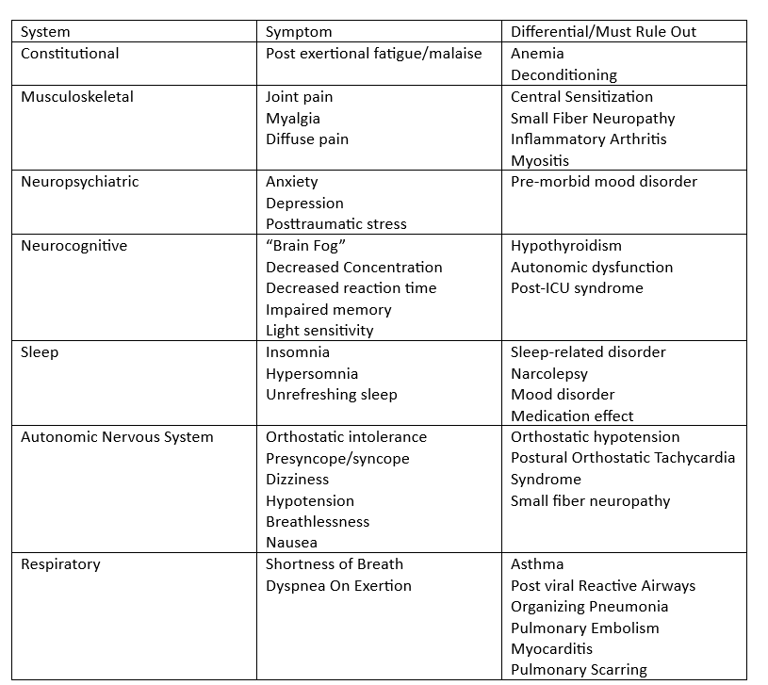
Long COVID
Within 3 months of COVID(+)
Lasting at least 2 months
Broad range of Symptoms
No diagnostic markers
No specific therapies
Treat symptomatically
Notes:
Challenges exist regarding how to classify patients with persistent symptoms following acute COVID-19. On one extreme, there is a small group with severe disease, often needing critical care and experiencing end-organ damage
Long COVID is a heterogeneous, multisystem, relapsing, and remitting illness that can affect patients regardless of the severity of their acute SARS-CoV-2 infection [2] and is unattended by end-organ pathology. Numerous groups and official bodies such as the Center for Disease Control and Prevention (CDC) and the UK National Health Service (NHS) have rendered informal definitions, which overlap in terms of stipulating that symptoms must last for a minimum of 4–12 weeks following presumed or proven COVID-19
The most common manifestations of this non-specific form of PAIS generally include fatigue and lassitude with post-exertional features, non-restorative sleep, neurocognitive complaints, signs and symptoms of dysautonomia, and viscerosomatic pain [7,9]. Collectively these features reflect a strong overlap with many other medically unexplained disorders, especially with myalgic encephalomyelitis and chronic fatigue syndrome (ME/CFS)

Slide 25
Post COVID-Vaccine Arthritis?
17 cases studies in Rheumatology journal.
Symptoms started 3-35 days after vaccination
All patients were treated with low dose steroids
All patient had severe synovitis, elevated inflammatory, COVID antibody production
All but 1 pt were weaned off of steroids in <2 months
  In the pt needing extended low dose of oral steroids, COVID antibodies remain very high >1 year after the last vaccine injection
Notes:
17 cases of previously healthy individuals in Brussels, Belgium, who developed ankle bi-arthritis shortly after vaccination with an RNA vaccine coding for the COVID 19.

Slide 26

Paxlovid Studies for Long COVID
One study at Duke University is enrolling 1700 patients to take either placebo or Paxlovid for 15 days.
SARS CoV-2 Viral Persistence Study (PASC) - Study of Long COVID-19 (PASC)
Notes:
The hypothesis is that persistent viral infection (antigenemia) and/or overactive/chronic immune response (inflammation) are underlying contributors to PASC and that antiviral and other applicable therapies may result in viral clearance or decreased inflammation and improvement in PASC symptoms.
Only a small subset of the viruses linked to arthritis have specific antiviral therapies that are currently available, including hepatitis B, hepatitis C, and HIV. Since virally mediated arthritis and arthralgias are usually self-limited, management and treatment should be guided by the severity of symptoms and the necessity of treatment, balanced with any potential risks or side effects.

Slide 27
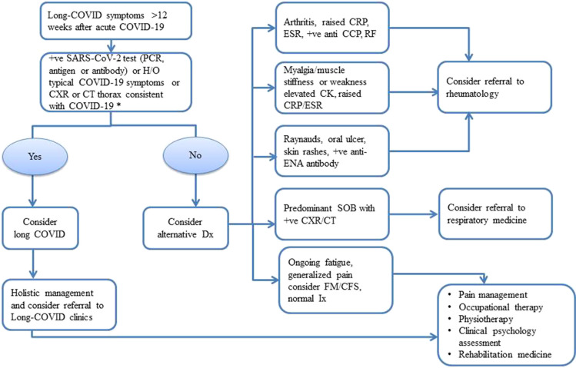
Bottom Line
COVID-19 can cause joint and muscle pain
This pain can mimic Rheumatological diseases
COVID can also worsen underlying Rheum conditions
Long COVID is difficult to diagnosis.
Notes:
Post-viral sequelae are reported following many bacterial and viral infections. COVID also can cause Musculoskeletal symptoms.
Systemic autoimmune rheumatic diseases (SARDs), including rheumatoid arthritis (RA), connective tissue disease (CTD), idiopathic inflammatory myositis (IIM) and fibromyalgia (FM) and chronic fatigue syndrome (CFS), share similar symptoms with long COVID. Patients with a history of rheumatic diseases and a previous diagnosis of COVID-19 who have developed persistent joint or muscle symptoms pose a significant challenge to clinicians. Such patients may be experiencing long COVID or a flare-up of their pre-existing rheumatic disease.
Long COVID will remain a diagnostic challenge, given the similarities it shares with SARD, including elevated inflammation markers, presence of autoantibodies and emerging evidence of organ-specific inflammatory changes on imaging

Slide 28
Bottom Line
COVID-19 can cause joint and muscle pain
This pain can mimic Rheumatological diseases
COVID can also worsen underlying Rheum conditions
Long COVID is difficult to diagnosis
Treatment should focus on Symptoms
We can look to Viral Arthritis
Ongoing research to find better treatments
We don’t know the long term impact of COVID
Notes:
Treatment should focus on symptoms. Physical therapy, Occupational Therapy, NSAIDs. It is not clear if anti-rheumatoid drugs have a place at this time. But we can look at other Viral Arthritis’ to help guide the treatment.

Slide 29
Thank you

Slide 30
References
https://www.rheumatologyadvisor.com/home/general-rheumatology/is-covid-19-associated-arthritis-a-new-disease-entity/
https://www.arthritis.org/health-wellness/about-arthritis/related-conditions/other-diseases/seeking-clues-to-long-covid
https://www.thelancet.com/journals/lanrhe/article/PIIS2665-9913(20)30348-9/fulltext?utm_source=healthu#bib2
https://www.sciencedirect.com/science/article/pii/S1521694222000535?via%3Dihub
Migliorini, F., Bell, A., Vaishya, R. et al. Reactive arthritis following COVID-19 current evidence, diagnosis, and management strategies. J Orthop Surg Res 18, 205 (2023). https://doi.org/10.1186/s13018-023-03651-6
Marc Alexandre Golstein and others, Reactive arthritis after COVID-19 vaccination: 17 cases, Rheumatology, 2023;, kead169, https://doi.org/10.1093/rheumatology/kead169
https://www.ncbi.nlm.nih.gov/pmc/articles/PMC8629735/

