Slide 1
Chronic Hepatitis C in 2023
Sandeep Mukherjee, MD
CHI Health and Creighton University Medical Center
Division of Gastroenterology

Slide 2
Disclosures
Speaker: Abbvie, Gilead, Merck
Grant support: Abbvie
Section editor for Gastroenterology and Hepatology: Dynamed Plus

Slide 3
Background
Hepatitis C-genome and life cycle
Epidemiology
Natural history and risk factors for disease progression
Extrahepatic manifestations of HCV
Screening
Evaluation
Treatment of HCV genotype 1(non-cirrhotics and cirrhotics)
‘Controversies’ in 2023
Conclusions

Slide 4
HCV genome and life cycle

Slide 5
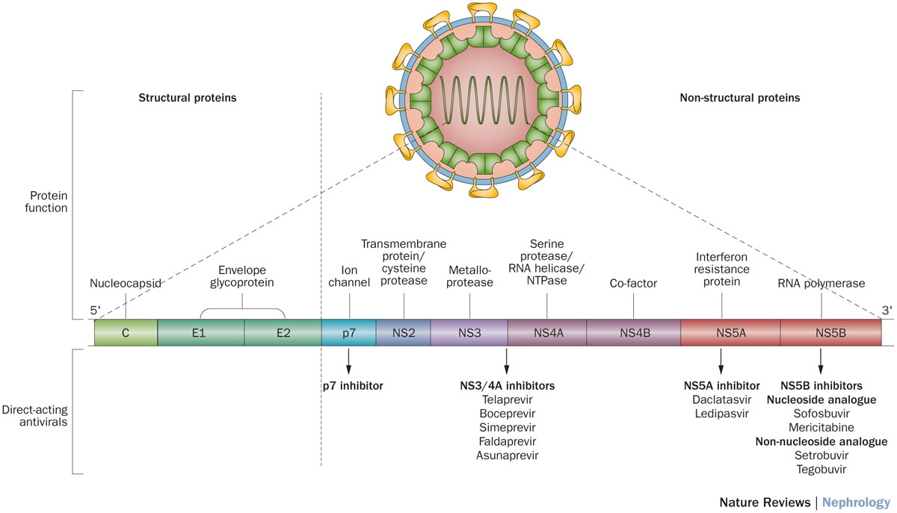
HCV Genome
Simeprevir
Paritaprevir with ritonavir
Grazoprevir
Glecaprevir
Voxilaprevir
Ledipasvir
Ombitasvir
Elbasvir
Daclatasvir
Velpatasvir
Pibrentasvir
Sofosbuvir (NUCi)
Dasabuvir (non-NUCi)

Slide 6
Life cycle of Hepatitis C
HCV
9
1
2
HCV binds to receptor
+ssRNA released after uncoating of HCV
Translation at the ribosome
Large polyprotein formed
Proteolysis produces HCV proteins
Replication within MW
-ssRNA produces many +ssRNA (polymerase)
HCV release
HCV
2
8
3
6
7
MW
5
Nucleus
4

Slide 7
Epidemiology

Slide 8
Epidemiology
2-3% of global population infected (170 million?)
USA: 3-4 million infected (prevalence 2-3%?)
70% BORN BETWEEN 1945-1965
75-79% have genotype 1 (75% G1a;25% G1b)
15% genotype 2
5-11% genotypes 3-6
Hofmeister MD et al.Estimating prevalence of HCV in the United States 2013-2016. Hepatology 2019;69:1020-31

Slide 9
Natural history and risk factors for progression

Slide 10

Natural History of HCV
HCV clearance
20% (age, gender, HIV, ETOH, IL28B)
Decompensated cirrhosis
5 yr survival 50%
Acute infection
Chronic infection
80%
Cirrhosis
16% over 20 years
Hepatoma
1-5% per years
Erman A et al. Estimation of fibrosis progression rates for chronic HCV: a systematic review and meta-analysis. in chronic HCV. BMJ OPEN 2019;9:e027491

Slide 11
Factors linked to disease progression on chronic HCV
Host factors
Coinfections
Older age at acquisition
Duration of infection
Male gender
Hepatic steatosis (G1 vs G3)
Iron overload
Organ transplant
HCV genotype 3
HBV or HIV coinfection
Schistosomiasis (Egypt)
Environmental factors
ETOH use > 50 grams/day
Marijuana use
Shida JH. Influence of cannabis use on severity of hepatitis C disease. Clin Gastroenterol Hepatol 2008

Slide 12
Extrahepatic manifestations of HCV

Slide 13
Extrahepatic manifestations of HCV
Liver disease, systemic illness or both?
Numerous extrahepatic manifestations

Slide 14
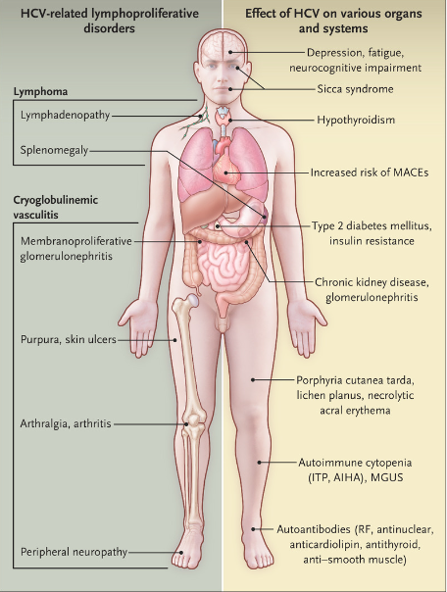
Extra-hepatic manifestations of HCV
Cacoub P, et al. Extrahepatic manifestations of HCV. NEJM 2021;384: 1038-52

Slide 15
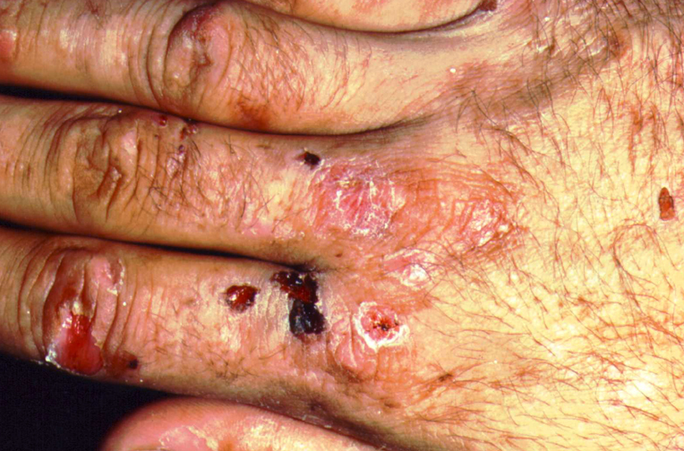
Porphyria cutanea tarda

Slide 16
Additional facts about HCV
Decompensated cirrhosis and hepatoma projected to increase (median age of HCV – related deaths = 57 years) BEFORE DAA INTRODUCED
Leading cause of liver transplants in USA BEFORE DAA INTRODUCED
SUSTAINED VIRAL RESPONSE associated with:
(a) better long-term liver related outcomes
(b) reduced all-cause mortality
Krassenberg L et al. Clinical outcomes following DAA depend on disease severity. J Hepatol 2021;74:1053-63.
van der Meer AJ, et al. Association between SVR and all-cause mortality among patients with chronic hcv and advanced hepatic fibrosis. JAMA. 2012;308:2584-93

Slide 17
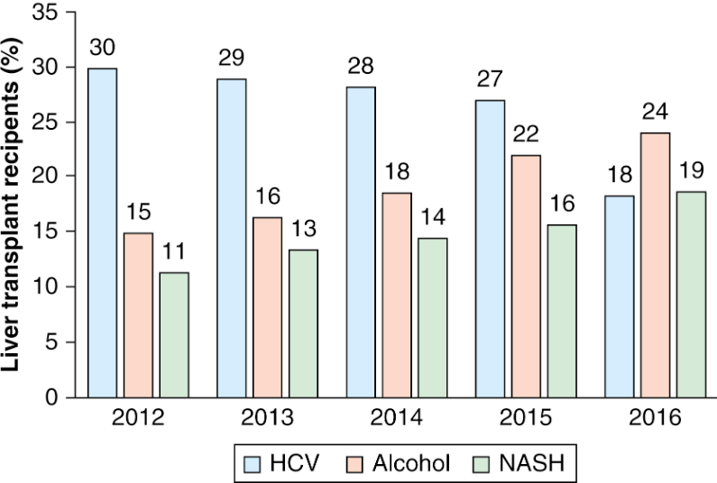
Leading indications for liver transplantation in the United States 2012-2016
Cholankeril G, et al. Alcoholic liver disease replaces hepatitis C virus infection as the leading indication for liver transplantation in the United States. Clin Gastroenterol Hepatol 2018;16:1356-8

Slide 18
Screening for HCV

Slide 19
US Preventive Services Task Force Recommendation statement on HCV screening
Importance: Hepatitis C virus (HCV) is the most common chronic blood-borne pathogen in the US and a leading cause of complications from chronic liver disease. HCV is associated with more deaths than the top 60 other reportable infectious diseases combined, including HIV. Cases of acute HCV infection have increased approximately 3.8-fold over the last decade because of increasing injection drug use and improved surveillance.
Objective: To update its 2013 recommendation, the USPSTF commissioned a review of the evidence on screening for HCV infection in adolescents and adults.
Population: This recommendation applies to all asymptomatic adults aged 18 to 79 years without known liver disease.
Evidence assessment: The USPSTF concludes with moderate certainty that screening for HCV infection in adults aged 18 to 79 years has substantial net benefit.
Recommendation: The USPSTF recommends screening for HCV infection in adults aged 18 to 79 years. (B recommendation).
JAMA 2020;323:970-75

Slide 20
Screening
3-4 million in USA have chronic HCV
1.6 million diagnosed (50%)
170-200,000 successfully treated (5-6%)

Slide 21
Evaluating patients with HCV

Slide 22
(My) evaluation of patients with chronic HCV
CBC,CMP (INR if cirrhotic)
HCV serology, viral load , genotype
HIV, HAV, HBV
Iron studies (Fe, TIBC, ferritin) -individualized
Abdominal ultrasound scan
Urine drug screen – individualized
Non-invasive tests for fibrosis

Slide 23
Non invasive assessment of hepatic fibrosis
Biomarkers
Imaging
APRI
Fibrosis-4
Fibrosure (USA)/Fibrotest
Few others
Fibroscan (> 14 kPa)
Magnetic resonance elastography
http://gihep.com/calculators/hepatology
http://www.hepatitisc.uw.edu/page/clinical-calculators

Slide 24
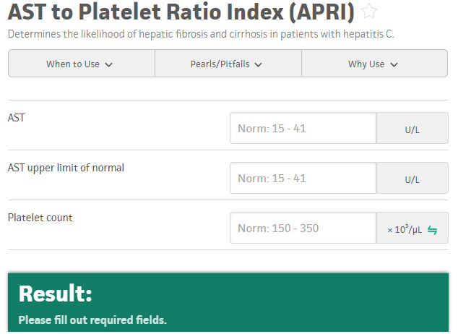

Slide 25
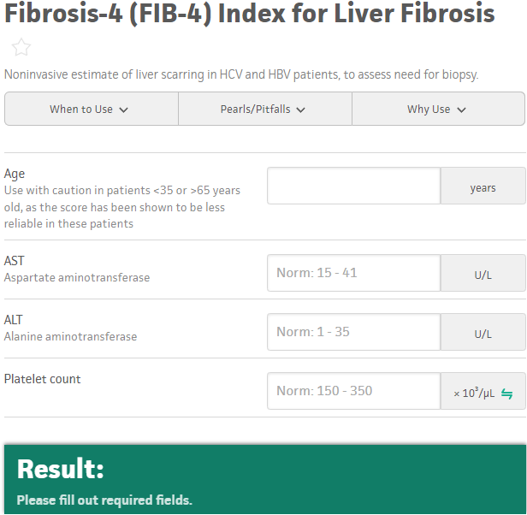

Slide 26
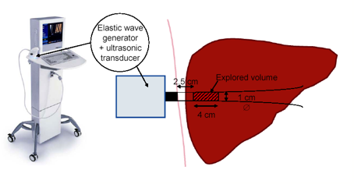

Slide 27
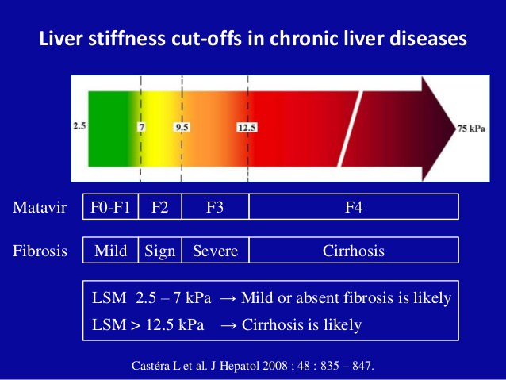

Slide 28
Treating HCV genotype 1

Slide 29
Treatment of Hepatitis C Genotype 1
Guidelines from AASLD/IDSA http:www.hcvguidelines.org
No more interferon?
Direct acting antivirals (DAA) act by inhibiting specific enzymes and proteins important in the replication of HCV
SVR >90%
Monitor for HBV reactivation during treatment in patients exposed to HBV

Slide 30
HCV Genome
Simeprevir
Paritaprevir with ritonavir
Grazoprevir
Voxilaprevir
Ledipasvir
Ombitasvir
Velpatasvir
Daclatasvir
Elbasvir
Sofosbuvir
Dasabuvir

Slide 31
When and in whom to initiate treatment
Treatment is recommended for all patients with chronic HCV infection, except those with short life expectancies that cannot be remediated by treating HCV, by transplantation, or by other directed therapy. Patients with short life expectancies owing to liver disease should be managed in consultation with an expert. Rating: Class I, Level A *
http:www.hcvguidelines.org

Slide 32
Treatment of Hepatitis C Genotype 1
Will discuss treatment in naïve HCV genotype 1a and 1b patients only
Will not discuss treatment of other genotypes or unique populations
Sofosbuvir/Velpatasvir/Voxilaprevir for treatment experienced patients

Slide 33
Treatment of HCV genotype 1
Direct Acting Antivirals (DAA) regimens recommended for HCV
Treatment differences may be influenced by:
1) Viral load
2) HCV subtype (1a or 1b)
3) Presence or absence of cirrhosis and hepatic decompensation
4) Resistance Associated Variants (RAVs)

Slide 34
Treatment of naïve HCV genotype 1a
Non-cirrhotic
Compensated cirrhosis
Ledipasvir 90 mg/sofosbuvir 400 mg qd for 8-12 wk
Velapatasvir 100mg/sofosbuvir 400mg qd for 12 wk
Elbasvir 50mg /grazoprevir 100 mg qd for 12 wk (if no RAV);16 wk with RBV if RAV
Glecaprevir 300mg/pibrentasvir 120mg for 8wk
Ledipasvir 90 mg/sofosbuvir 400 mg qd for 12 wk
Velapatasvir 100mg/sofosbuvir 400mg qd for 12 wk
Elbasvir 50mg /grazoprevir 100 mg qd for 12 wk if no RAV (if RAV present: 16 wk + RBV)
Glecaprevir 300mg/pibrentasvir 120 mg for 8 wk
http:www.hcvguidelines.org

Slide 35
Treatment of naïve HCV genotype 1b
Non-cirrhotic
Compensated cirrhosis
Ledipasvir 90 mg/sofosbuvir 400 mg qd for 8-12 wk
Velapatasvir 100mg/sofosbuvir 400mg qd for 12 wk
Elbasvir 50mg /grazoprevir 100 mg qd for 12 wk
Glecaprevir 300g/ pibrentasvir 120mg for 8 wk
Ledipasvir 90 mg/sofosbuvir 400 mg qd for 12 wk
Velapatasvir 100mg/sofosbuvir 400mg qd for 12 wk
Elbasvir 50 mg/grazoprevir 100 mg qd for 12 wk
Glecaprevir 300 mg/ pibrentasvir 120 mg for 8 wk
http:www.hcvguidelines.org

Slide 36
HCV Controversies in 2023

Slide 37
Ongoing controversies in HCV
HBV reactivation during DAA treatment
Hepatocellular carcinoma risks with DAA treatment
Treating decompensated patients
HCV + organs transplanted into HCV- patients

Slide 38
HBV Reactivation
11/2013-10/2016: 29 cases of HBV reactivation reported to FDA
2 deaths, 1 liver transplant, 6 hospitalizations and 10 DAA discontinuations
Seen in HBV sAg+ and sAg-/anti-HB core +
Chen et al. HBV reactivation in hepatitis B and C coinfected patients treated with antiviral agents: a systemic review and meta-analysis.Hepatology 2017

Slide 39
HBV reactivation
Mechanism?
Viral interference in co-infections (seen with HBV/HDV, HBV/HCV)
HCV infection induces innate immune response via IFN-stimulated genes which suppress HBV (high levels of IFN-inducible protein 10)
HCV eradication can lead to HBVr (via ↓IP-10 )
Wiegand SB, et al. Dominance of HCV is associated with lower HBV surface antigen and higher IP-10 levels in HBV/HCV coinfected patients.Clin Microbiol 2015

Slide 40
Hepatocellular carcinoma risks with DAA treatment
Case reports of increased hepatocellular carcinoma (HCC ) risk after HCV eradication in cirrhotics with DAA
No evidence on multiple studies of large databases
But…cirrhotics still need HCC surveillance after SVR (because they are cirrhotic)
Pinero F, et al.Treatment with direct acting antivirals for HCV decreases but does not eliminate the risk of hepatocellcular carcinoma. Liver Int 2019;39:1033-43

Slide 41
Treating decompensated cirrhotics
Why?
If MELD >20, severe portal hypertension…LT evaluation may be more appropriate
12 or 24 wks of treatment (12 wks-add RBV )
Follow guidelines
PROTEASE INHIBITORS(…previr) AND IFN CONTRAINDICATED
Terrault NA, et al. International Liver Transplantation Society Consensus Statement on Hepatitis C Management in Liver Transplant Candidates. Transplantation. 2017
Ekpanyagong S,et al. HCV therapy in advanced liver disease:outcomes and challenges. UEG 2019;7:642-50.

Slide 42
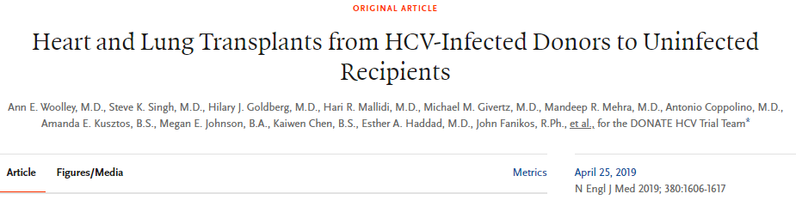
Transplanting HCV+ organs into HCV- patients
Wide geographic variation
Reported in variety of transplanted organs, not just liver
Patel P, et al. Review of heart transplantation from HCV positive donors. World J Transplant 2022;12:394-404
Bethea E, et al Cost-effectiveness of transplanting HCV-infected livers into uninfected recipients with preemptive antiviral treatment. Clin Gastroenterol Hepatol 2019;17:739-47.

Slide 43
Conclusion

Slide 44
Conclusion
Screen, diagnose and treat
Non-invasive testing for assessing fibrosis
Treat all patients unless reduced life span
Check for HIV, HBV before treatment
Reduced liver-related and all cause mortality in patients who achieve SVR
Vaccinate for HAV, HBV and if cirrhotic, also pneumococcus
Cirrhotics who achieve SVR can still develop HCC-keep screening

