Slide 1
Pediatric Go Wish Together
Meghan Potthoff PhD, APRN-NP

Slide 2
Learning Objectives
Describe barriers to difficult conversations in pediatric palliative care.
1
Identify the benefits of improving communication strategies for families in palliaitve care.
2
Discuss clinical and community settings where the Pediatric Go Wish Together conversation game could be utilized
3

Slide 3
Overview of the Literature
Communication
Pediatric Palliative Care Perspectives
Advance Care Planning in Pediatrics
Good Death/Dignified Death

Slide 4

Barriers To Difficult Conversations
What it will do/mean to the patient/family
Fear of the reaction/conversation
Possibility for intense emotion
Fear of being blamed
Fear of a message that is too optimistic
Natural instinct to want to do and say good
Notes:
Lack of Training/Education
Difficulty handling their own emotions
Most difficult to discuss when treatment options are exhausted
Busy/distracted
Other things that complicate it for pediatric

Slide 5

Purpose of Pediatric GO Wish Together
The twofold purpose of this embedded mixed method pilot study WAS to explore the use of an advance care planning conversation tool with parents caring for children suffering from a life threatening illness and to examine the parent experience of a child’s illness while caring for a child receiving pediatric palliative care.

Slide 6
Qualitative Results
SUBHEAD.

Slide 7
Research Questions
What is the parent’s overall experience and perception of the Go Wish- Pediatrics intervention?
How do parents describe their experience of utilizing Go Wish- Pediatrics as a tool to facilitate advance care planning?
What could be done to improve the Go Wish- Pediatrics intervention?
Were any values or items missing from the Go Wish- Pediatrics intervention?
Notes:
Semi Structured interview
Review of Card Game results
The structured qualitative questions (Interview Guide) for feasibility and usability
Transcription
Thematic Analysis

Slide 8
Qualitative Theme 1
Operationalizing thoughts into action
“to have the cards where you can actually physically seem them and lay them out instead of trying to see them in your head was really helpful, this made it more real for me.”
“if you just are thinking these thoughts in your head when you are talking with someone you get distracted by other things and you forget to write them down or acknowledge if it is important to you or not.”

Slide 9
Qualitative Theme 2
Empowered to join the conversation
“opened her eyes to things she wouldn’t have even thought to ask about but really wanted to talk about with someone about.”

Slide 10
Qualitative Theme 3
A lighthouse in the fog
“This fog of medical terminology and words that we were living everyday was so overwhelming that we didn’t even know what to ask, the cards gave me a focused point to organize my thoughts.”
“you look at the stats and feel doomed as a married couple, I mean you have to make these decisions that most people don’t even have to think about and you’re trying to make the decisions as a couple…..but it is so hard, you can’t even see where you are going.”

Slide 11
Mixed Methods Analysis

Slide 12
Mixed Methods Analysis
Guilt & Worry
Being a “drain”
Unresolved Sorrow & Anger
Spiritual Journey
Being Judged
Long Term Uncertainty
Future
Relationships
Emotional Resources
Support groups

Slide 13
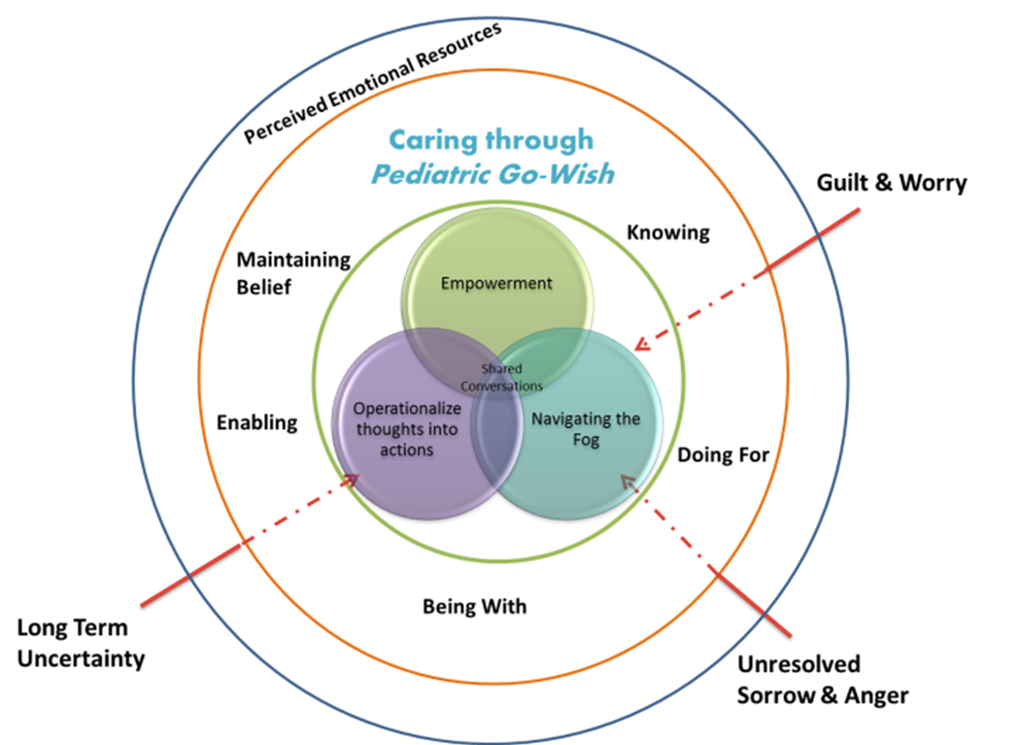
Caring Wish Conversation Framework

Slide 14
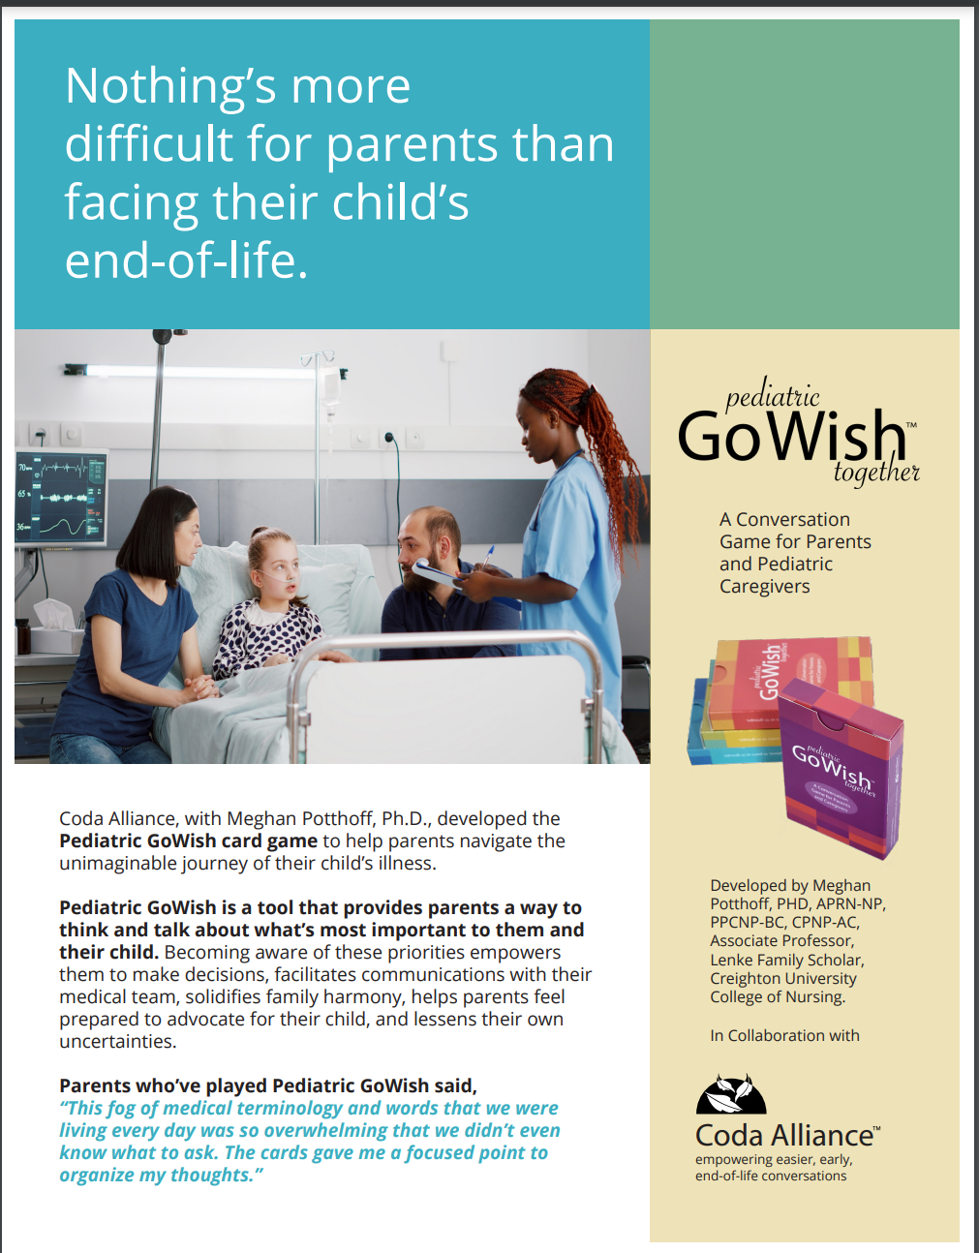

Slide 15
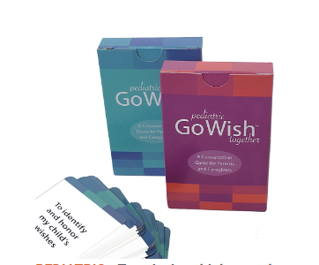
Go Wish Together
Ways it can be used:
Intake
Prior to care conferences
Prior to decision making situations
Conversation starter with healthcare team, between family members

Slide 16
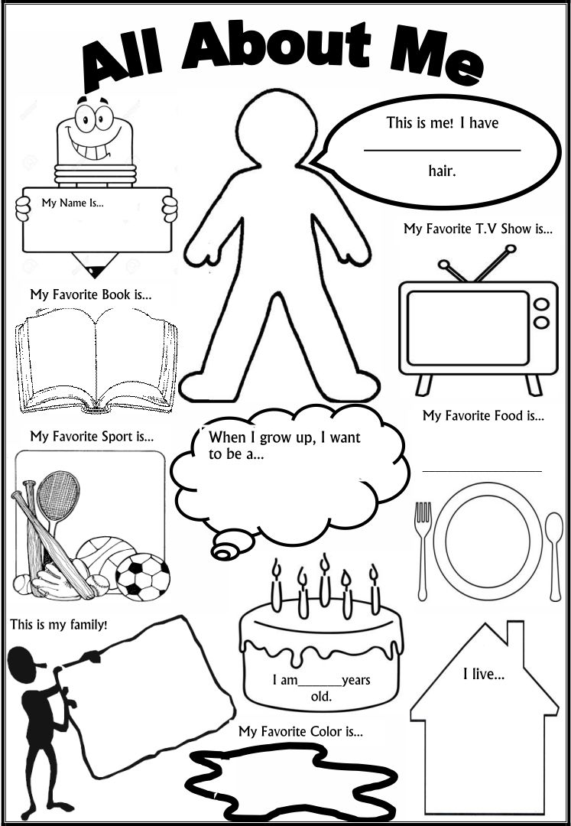

Other Tools

Slide 17
Next Steps
Role in different settings (primary, acute, community)
Adolescents
Role in development of written ACP
Hierarchy of Needs n Pediatric Palliative Care

Slide 18
Thank you!
Meghan Potthoff meghanpotthoff@creighton.edu 402-280-2660

